Slide 1
INDIFFERENCE CURVE ANALYSIS

Slide 2
OBJECTIVES
To Understand Consumer Preferences using Indifference Curve.
☞ To understand Budget Constraints.
☞ To Understand
the Conditionswhich Enable
Consumer to Maximize his Satisfaction.
☞ To Understand the Effect of Price and Income Changes on Consumer Equilibrium.
☞ To Understand Price Effect and the Methods by which Price Effect can be Decomposed.

Slide 3
OUTLINES
☞ Indifference Curves:
Definition, Shape, Assumptions and Properties.
Budget Line: Definition, Shape and Effect of Price and Income Changes
☞ Consumer Equilibrium: Conditions, Shifting of Equilibrium when price and Income changes and decomposition of price effect into income and Substitution effects.

Slide 4
DEFINITION: IC
An Indifference curve (IC) is
the locus combination
of all those of two goods
which give the same level of satisfaction to the consumer.
consumer is indifferent towards all the
Thus
combinations lying on the same indifference curve. In other words, consumer gives equal preference to all such combinations.

Slide 5

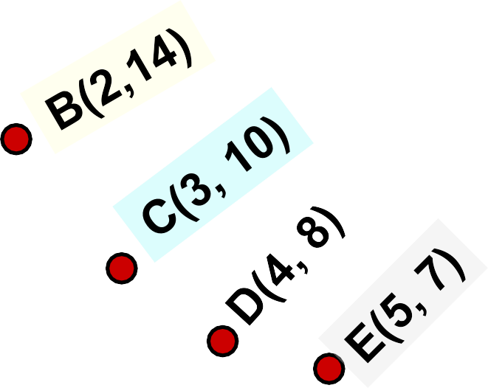
INDIFFERENCE CURVES
INDIFFERENCE SCHEDULE (Table Showing Different Combinations giving Equal Satisfaction)
Combination | Apples | Oranges
A | 1 | 22
B | 2 | 14
C | 3 | 10
D | 4 | 8
E | 5 | 7
24
22
20
18
16
14
12
10
A(1, 22)
8
6
4
2
0
Oranges
Apples
1 2 3 4 5 6

Slide 6
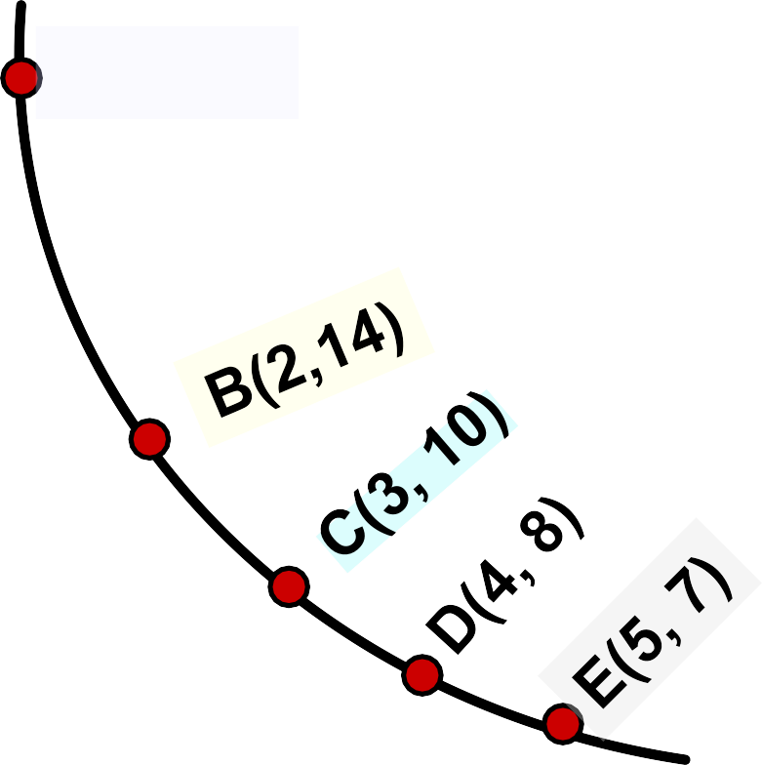
INDIFFERENCE CURVES
24
22
20
18
16
14
12
10
A(1, 22)
INDIFFERENCE SCHEDULE
Combination | Apples | Oranges
A | 1 | 22
B | 2 | 14
C | 3 | 10
D | 4 | 8
E | 5 | 7
Oranges
8
6
4
2
0
IC₁
Apples
1 2 3 4 5

Slide 7
MARGINAL RATE OF SUBSTITUTION(MRS)
The marginal rate of substitution of X for Y (MRS_{xy}) is defined as the amount of Y, the consumer is just willing to give up to get one more unit of X and maintain the same level of satisfaction.
_{MRSxy =} Decrease in the Consumption of Y
= (-) ^{∆Y}
∆X
Increase in the Consumption of X

Slide 8
DIMINISHING MARGINAL RATE OF SUBSTITUTION
Combination | Apples | Oranges | MRS
A | 1 | 22 | ---
B | 2 | 14 | 8:1
C | 3 | 10 | 4:1
D | 4 | 8 | 2:1
E | 5 | 7 | 1:1
As the consumer increases the consumption of apples, then for getting every additional unit of apples, he will give up less and less of oranges, that is, 8:1, 4:1, 2:1, 1:1 respectively This is the Law of Diminishing MRS.

Slide 9






LAW OF DIMINISHING MRS
24
22
20
18
16
14
12
10
A
MRS = -ΔO/ΔA = 8:1
MRS = 4:1
MRS is measured by the slope of the indifference curve
MRS = 2:1
8
6
4
2
0
Oranges
IC₁
Apples
1 2 3 4 5

Slide 10
ASSUMPTIONS OF IC ANALYSIS
Rational Consumer
Ordinal Utility
Non-Satiety (More is Preferred to Less)
Diminishing Marginal Rate of Substitution.
Consistency: If a consumer prefer A to B in one period then he will not prefer B to A in another period.
Transitivity: If a consumer prefer A to B and B to C, then he must prefer A to C.

Slide 11
PROPERTIES OF IC
An Indifference curve has negative slope i.e. it slope downwards from left to right.
Indifference curve is always convex to the origin. This implies that two goods are imperfect substitutes and MRS between two
goods decreases as a consumer move along an indifference curve. IC will be straight line if MRS is constant and L shaped in case of Complimentary.

Slide 12
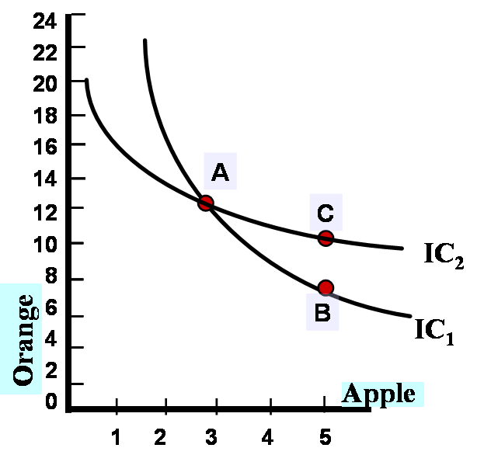
PROPERTIES OF IC
3. Two Indifference curves never intersect or become tangent to each other.
This will violet the rule of Transitivity because: on IC₁ A is equally preferred to B and on IC₂ A is equally preferred to C.
This implies B is equally preferred to C, which can not be because more is always preferred to less.

Slide 13
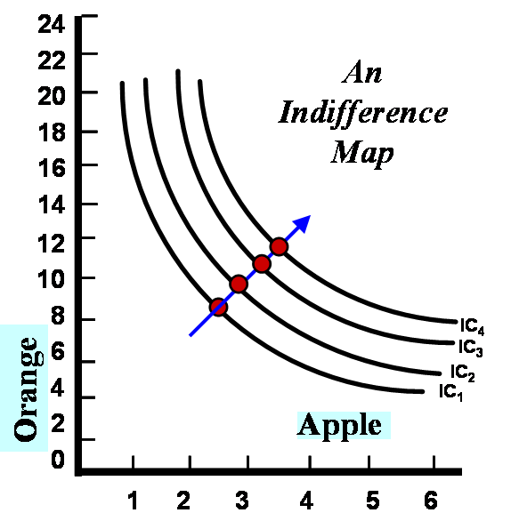

PROPERTIES OF IC
4. Higher indifference curve represents higher satisfaction.
This is because the combinations lying on higher indifference curve contain more of either one or both goods and more is always preferred to less.
More is preferred to Less

Slide 14
PROPERTIES OF IC
5. Indifference curve touches neither X-axis nor Y-axis (By Definition)
X
12
10
6. Indifference curve need not to be parallel to each other (because of Different MRS on different ICs)
A(0, 10)
8
6
4
2
0
Oranges
IC
1
Apples
1 2 3 4 5

Slide 15
BUDGET CONSTRAINTS
(What is Attainable)
Budget constraints limit an individual’s ability to consume in light of the prices they must pay for various goods and services.
Budget line or Price Line: Shows all possible combinations of two goods that the consumer can buy if he spends the whole of his given sum of money on his purchases at the given prices.

Slide 16
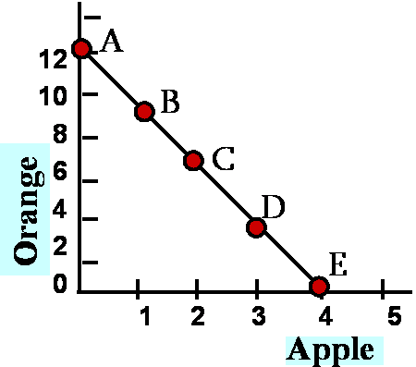

BUDGET LINE
Com binat ion | Apples (@ Rs. 6 per unit) | Oranges @ Rs. 2 Per unit | Total budget (Rs.)=6xA +2xO
A | 0 | 12 | 24
B | 1 | 9 | 24
C | 2 | 6 | 24
D | 3 | 3 | 24
E | 4 | 0 | 24
Budget line corresponding to budget of Rs. 24

Slide 17





BUDGET LINE
Slope = ΔO ranges /Δ Apples
= (-) ³ = (-) ^{Pa}
1 Po
The slope is the negative of the ratio of the prices of the two goods.The slope indicates the rate at which the two goods can be substituted without changing the amount of money spent.
141
A
2
10
8
B
6
4
2
0
C
Oranges
-3
 | +1
D
E
1 2 3 4 5
Apples

Slide 18
CONSUMER EQUILIBRIUM
Consumers choose a combination of goods that will maximize the satisfaction they can achieve, given the limited budget available to them.
The maximising combination must satisfy two conditions:
☞ It must be located on the budget line.
☞ Must give the consumer the most preferred combination of goods and services.

Slide 19

CONDITIONS OF CONSUMER EQUILIBRIUM
Condition-1:
Budget Line should be Tangent to the Indifference Curve.
16
IC₁
14
₁₂ A
10
A
8
6
4
2
0
Combination A can not be attained due to budget constraints
Budget Line
Oranges
B
Apples
1 2 3 4
5

Slide 20


CONDITIONS OF CONSUMER EQUILIBRIUM
Point B does not maximize satisfaction because there exist a point C which is attainable and yields a higher satisfaction.
IC
12
1
10
B
8
6
C
Oranges
4
2
0
Budget Line
1 2 3 4
5
Apples

Slide 21

CONDITIONS OF CONSUMER EQUILIBRIUM
Equilibrium occurs (Point C) when the consumer selects the Combination which reaches the highest attainable Indifference curve.
At Equilibrium (Point C) we would have slope of Indifference Curve
(MRSxy) equal to the
Slope of Budget Line
(Px/Py)
12 A
10
Oranges
8
6
4
2
0
C
IC₄ IC₃
IC₂ IC₁
(Attainable)
1 2 3 4 5 6
B
Apples

Slide 22

CONDITIONS OF CONSUMER EQUILIBRIUM
Condition-2: Indifference Curve must be convex to the origin.
16
Combination E can not be equilibrium point Because MRS will be increasing at E whereas it should be diminishing at the equilibrium point.
Budget Line
B
14
A
12
10
Oranges
8
6
4
2
0
IC
E
1
1 2 3 4
5
Apples

Slide 23


EFFECT OF CHANGE IN THE BUDGET/INCOME
If budget (Income) of the consumer increases to Rs. 36, then budget line will shift outward to L₂
18
16
14
12
I=36
10
If budget (Income) of the consumer reduces to Rs. 12, then budget line will shift inward to L₃
8
6
4
2
0
L₂
Oranges
L
1
(I=24)
(I=12)
L₃
1 2 3 4 5 6
Apples

Slide 24



UNDERSTANDING INCOME EFFECT
INCOME EFFECT: Effect on the consumer equilibrium caused by change in his income if relative prices remain constant.
18
16
14
12
L₂
INCOME CONSUMPTION CURVE (ICC) Curve Showing points of equilibrium at
various levels of consumer income given constant product price.
L₁
10
Oranges
8
C
6 L₃
4
2
0
B
A
Apples
1 2 3 4 5 6

Slide 25
NEGATIVE INCOME EFFECT
L₂
ICC for Inferior Goods
18
16
14
12
NEGATIVE ICC: in case of inferior goods ICC is negative showing decrease in the quantity demanded of a good with the increase in consumer income.
B
L
1
1
0
8
Oranges
6 L₃
4
2
0
A
Apples
1 2 3 4 5 6

Slide 26
SUBSTITUTION EFFECT
Substitution Effect refers to change in the amount of goods purchased due to change in their relative prices alone, while real income of the consumer remains constant.
The substitution of relatively cheaper good for a relatively expensive good is called substitution effect. There are two methods to measure substitution effect (i) Slustky’s Measure and (ii) Hicks Measure.

Slide 27



SLUSTKY MEASURE
According to Slustky Measure real income is constant if the consumer is left with an income which would enable him to buy his original combination of goods at he new price.
A
G
Oranges
N P
E
D
F
I₁
B
I₂
I
3
O M Q H
Substitution Effect
C
Apples

Slide 28



HICKS MEASURE
According to Hicks Constant real income means that consumer will remain on same indifference curve as before the change in price
A
G
N P
Oranges
F
E
D
I₂
I₁
B
M Q
C
O H
Apples
Substitution Effect

Slide 29


EFFECT OF CHANGE IN PRICE OF A GOOD
If price of Apples increases from Rs. 6 per unit to Rs. 12 per unit, then for a budget of Rs. 24, price line will shift inward to L₃
16
14
12
If price of Apples decreases from Rs. 6 per unit to Rs. 4 per unit, then for a budget of Rs. 24, price line will shift
1
0
8
6
4
2 L₃
0
Oranges
L₂
L
(P = 4)
1
a
outward to L
2
(P =12)
a
(P_{a}=6)
1 2 3 4 5 6
Apples

Slide 30
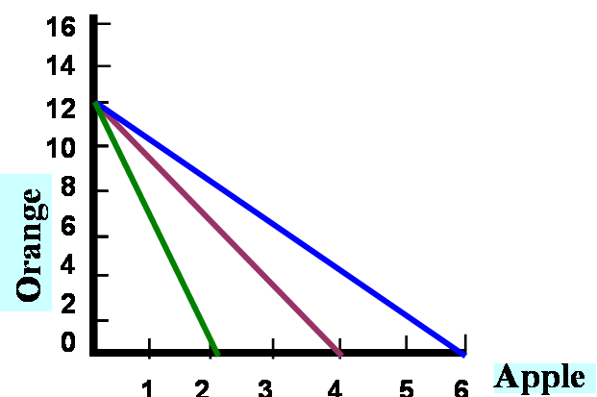



UNDERSTANDING PRICE EFFECT
PRICE EFFECT: The price effect may be defined as the change in the consumption of goods when the price of either of the two goods changes while the price of the other good and the income of the consumer remain constant.
PRICE CONSUMPTION CURVE (PCC)
C
A
B

Slide 31
DECOMPOSITION OF PRICE EFFECT
Price Effect has two components:
  the substitution effect; and
  the income effect.
There are two main methods of decomposition of the price effect into the income and substitution effect :
The Hicksian method; and
The Slutsky method

Slide 32



THE SLUSTKY’s APPROACH
Price Effect (MP) = Substitution Effect (MN)
+Income Effect (NP)
A
G
Oranges
F
E
D
I₁
B
I₂
I
3
O
M N
P
H
C
Apples
☞ Price Effect: Movement from D to E = MP
☞ Substitution Effect: Movement from D to F = MN
☞ Income Effect: Movement from F to E = NP

Slide 33



THE HICKSIAN APPROACH
Price Effect (MP) = Substitution Effect (MN)
+ Income Effect (NP)
A
G
Oranges
D
E
F
I₂
I₁
B
O M N P H C
Apples
☞ Price Effect: Movement from D to E = MP
☞ Substitution Effect: Movement from D to F = MN
☞ Income Effect: Movement from F to E = NP

Slide 34
PRICE EFFECT AND NATURE OF GOODS
Nature of Goods | Income Effect | Substitution Effect | Price Effect
Normal Goods | +ve | +ve | +ve
Inferior goods | -ve (weak) | +ve (strong) | +ve
Giffen's Goods | -ve (strong) | +ve (weak) | -ve

Slide 35
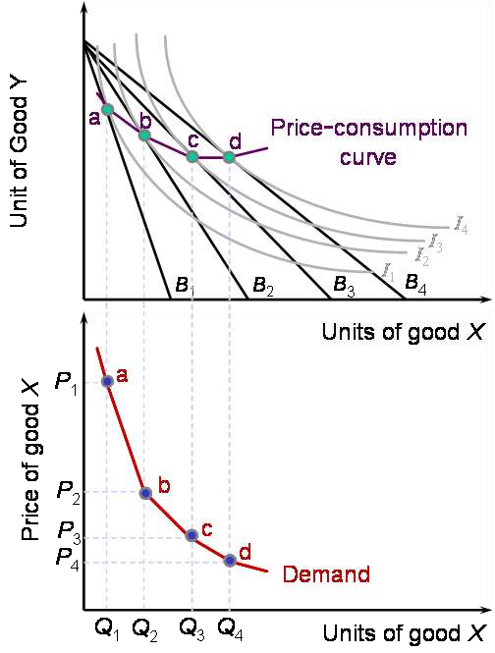
DERIVATION OF DEMAND CURVE FROM PCC

