Slide 1
Unit - 3 Price & Output Determination

Slide 2
Basic Concepts
What is Market?
Elements of Market:
Buyers & Sellers
Goods & Service
Price for a product or service at a time
Knowledge about market condition
Bargaining for a price

Slide 3
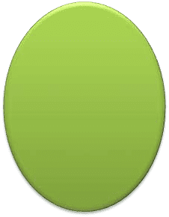
1. Types of Market
Perfect competition
Oligopoly
Market
Monopoly
Monopolistic Competition

Slide 4
2. Revenue
Revenue means income. By revenue we mean sales figure that a firm earns by selling its output.
Types of Revenues:
Revenue
Total Revenue
Average Revenue
Marginal Revenue
AR = TR/Q OR
AR = P X Q/Q
TR = P X Q
MRn = TRn – TRn-1

Slide 5
Cont.
Total Revenue refers to the amount of money which a firm realize by selling certain units of commodity.
Average Revenue is the revenue earned per unit of output.
Marginal Revenue is the change in the Total revenue resulting from the sake of an additional unit of a commodity.

Slide 6
3. Profit
Profit is the difference between income and expenditure.
Types of Profit:
Profit
Super Normal Profit
AR > AC
TR > TC
Sub Normal Profit
AR < AC
TR < TC
Normal Profit
AR = AC
TR = TC

Slide 7
Cont.
Super Normal Profit is an excess profit which is earned over and above the minimum profit.
Normal Profit is minimum profit which is earned by the firm. In this case revenue is equal to the cost.
As per accounting definition normal profit should be zero but economically the cost includes rent for land, wages to labor, interest on capital, some minimum profit to entrepreneur ; which is required to run the business.
Subnormal profit is called when the revenue is less than its cost.

Slide 8
Price determination under Perfect Competition
Perfect Competition
Large no. of sellers
Large no. of buyer
Homogeneous products
Free entry and exit
Perfect knowledge
Perfect mobility of factors of production
Seller is the price-taker

Slide 9
Cont.
While discussing price determination under Perfect
Competition Firm.
it should be clear between the Industry and
According to one of the features of Perfect Competition firm is the price taker; which means firms are not free to determine their own prices.
Prices are determined on the basis of market demand and market supply.
Economically under Perfect Competition price is determined by the intersection of market demand and market supply curve.

Slide 10
Cont.
Example:
Price | Qty Demanded | Qty Supplied
10 | 2000 | 600
11 | 1600 | 1000
12 | 1200 | 1200
13 | 1000 | 1500
14 | 800 | 1600
15 | 500 | 2000

Slide 11
Cont.
Market Demand Curve represents the summation of demand curve of all the customers.
Market Supply curve represents the summation of supply curve of all the firms of the industry.
In Perfect Competition alone demand or only supply can
not fix the price.
Both are required to fix the price.

Slide 12
Price determination under Perfect Competition for
SHORT RUN
Certain Assumptions:
Under perfect competition Price determined by the market
In short run one can make any changes in variable factors but it does not allow any change in fixed factors.
Every firm under perfect competition produces same cost curve.
Under perfect competition for short run always the demand curve and average revenue curve will be one and a same.

Slide 13
Cont.
Firm sales additional units at the same price so that average revenue curve and marginal revenue curve will be one and a same.
Avg. cost curve and Marginal cost curve as usual found
normally as “U” shaped.
In short run there are three possibilities as below to earn profit:
Super Normal Profit
Normal Profit
Sub Normal Profit
After attaining the equilibrium the firm will not increase or decrease its output.
Equilibrium = MR = MC

Slide 14
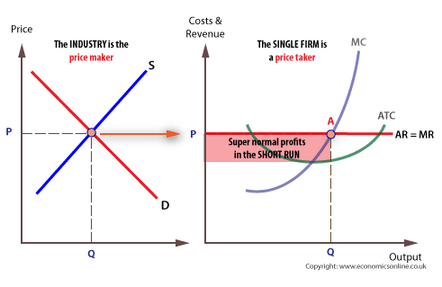

Slide 15
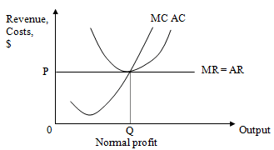

Slide 16
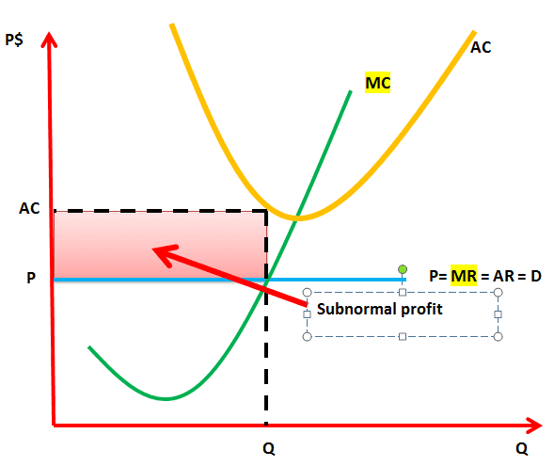

Slide 17
Price determination under Perfect Competition for
LONG RUN
Long run is that period which allows change in each and every factor.
Firm can adjust supply according to the change in demand.
The firm may change the size or scale of operation to reduce the cost.
It can be possible that some firms may leave the market.
As a result supply becomes perfectly elastic and therefore supply will change with the change in price.
In long run firm will earn only NORMAL PROFIT.

Slide 18
Cont.
Price will be fixed by the industry by intersection point of market demand and supply.
As the firm earns Normal profit so we can see in the diagram that AR = AC.

Slide 19
Cont.
Now suppose that the price is fixed at OP2 than the revenue will increase and this will give super normal profit and due to super normal profit of the existing firm other entrepreneurs will also get interested to enter in to the market.
At the same time new firms will start producing same commodities.
As a result supply will get increased while demand remains constant so price will be reduced from OP2 to OP1.
Thus firms in short run earning supernormal profit will start earning normal profit in long run.

Slide 20
Cont.
This happens only in long run because in short run neww entry is not possible.
Now suppose the price is fixed at OP3 and firms are earning subnormal profit in short run.
At the same time, some firms may leave the market because of subnormal profit.
This will resulted in supply decrease and demand remains
constant .
This situation will lead to increase in the price from OP3 to OP1.

Slide 21
Price determination under Monopoly for SHORT RUN
Only one firm producing..
No other seller can enter in to the market
Firm and Industry will be one and a same.
Monopolist is a price maker.
E.g Indian Railway

Slide 22
Cont.
Features of Monopoly :
Only one seller
Large no. of buyer
No close substitute
No new entry
Monopolist is price maker
Downward slopping demand curve

Slide 23
Cont.
Short run period allows change in variable factors only.
In Monopoly the firm will achieve its equilibrium where MR = MC
In short run there are three possibilities as below to earn profit:
Super Normal Profit
Normal Profit
Sub Normal Profit
But generally the firm will earn supernormal profit because there is no direct competition.

Slide 24
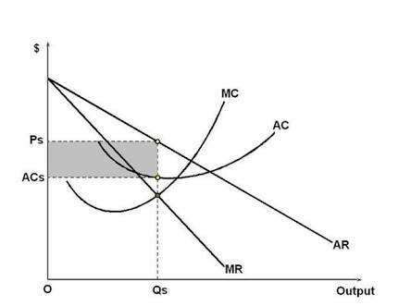
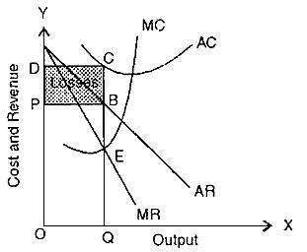

Slide 25
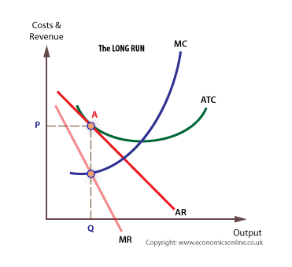

Slide 26
Cont.
A Monopolist may be earning profit or incurring losses in sort run. If he make losses he might have misjudged demand. And in short run cost conditions can not be adjusted.
In such condition he may reduce the price even below the cost and incur short run losses with the hope of earning profits in long run.
Though a Monopolist is a price maker, downward slopping demand curve indicates that the prices & output decisions are independent.
So either he can fix the price & sell the quantity demanded by consumer or he can determine the quantity to be sold & let the market decide the price.
He can't decide both simultaneously.

Slide 27
Price determination under Monopoly for
Long run is that p^{L}er^{O}iod^{N}w^{G}hich^{R}a^{U}llo^{N}ws a firm to change all
the factors of production .
In long run a firm can adjust its supply in relation to demand.
In long run too like short run a firm will achieve equilibrium where MR = MC
In short run it can be possible that AR > AC or AR < AC but in Long run AR in no case will be less than AC.
Most probably the price of AR of product will be greater than its AC.
So in long run the firm will earn supernormal profit under Monopoly.

Slide 28
Monopolistic Competition
Monopolistic competition refers to market structure where there is keen competition, but not perfect among a group of large no. of small sellers having some degree of monopoly power because of their differentiated products.
Thus M.C is a mixture of competition and a certain degree of monopoly power.
M.C is a market situation in which there is a large no. of competing monopoly, each one selling a differentiated product and very close substitute for each other.

Slide 29
Cont.
Features of Monopolistic Market:
Large no. of sellers
Large no. of buyers
Production differentiation
Free entry and exit
Price and Non-price competition [variation, advts., promotion]
The group
Two dimensional competition [price and non-price]

Slide 30
Monopolistic Competition under Short Run
Under M.C there is a large no. of sellers, each taking independent action and having some Monopoly power due to product differentiation.
Short run is that period which allows change in variable factors.
The equilibrium point can be determined where MR = MC.
In short run there are three possibilities as below to earn profit:
Super Normal Profit
Normal Profit
Sub Normal Profit

Slide 31
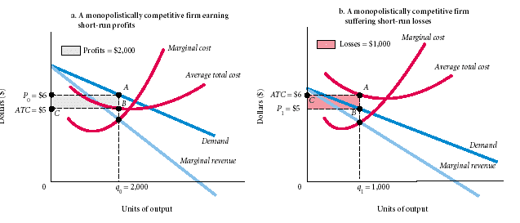
Super Normal profit and Sub-normal Profits

Slide 32
Normal profit

Slide 33
Monopolistic Competition under Long Run
Long run is that period which allows the firm to change ll the factors of production that is fixed and variable.
If the existing firms are earning super normal profit then there will be new entry in the market this will be resuled in the firm will only earn Normal profit.
Thus, total supply of the group will increase.
But compared to supply demand not increased so that the
firm will start selling at a lower price.
Same would be done by the other firms to maintain their sales.
Thus, he price will increase and super normal profit will
disappear.

Slide 35
Cont.
On the other hand the firms earning subnormal profit will exit from the market.
Thus total supply will decrease.
Demand is still the same and there is a decrees in supply and this will resulted in increase in the prices of the product.
The result will be normal profit to the existing firms.

Slide 36
Oligopoly
Oligopoly is a situation where a few large firms compete with each other and there is an element of interdependence in decision making of those firms.
Any decision the firm makes regarding product, price or promotion will affect the sales of competitors and so the result will be counter moves (reactions) from the competitors.

Slide 37
Cont.
Features:
Small no. of large sellers
Interdependence
Price Rigidity [reducing or increasing price]
Presence of monopoly element
Advertising

Slide 38
Kinked Demand Curve
The kinked demand curve was first used by Paul M Sweezy to explain price rigidity.
Here each Oligopolist will act and react to any decision taken by the firm regarding the price.
Such a situation can be seen where products of all the firms are quite similar and their prices are also the same.
If one firm is selling the products at a price less than that of its competitors, the competitors will be compelled to reduce their prices to match with the firm’s price.
On the other hand, if one firm decides to sell the products at a higher price, its competitors will not react by increasing their prices.

Slide 39
Cont.
So in the 1st situation [price reduction] the firm does not get more customers, while in the next situation [price rise] the firm loses its customers to the rivals.
Thus, the firm under oligopoly realize that it is better to stick to one price than to start a price war.
Consequently firms in oligopoly do not raise their prices due to the possibility of loosing customers. And they do not even cut the prices because of the fear of price war.
So prices in oligopoly tend to be sticky.

Slide 40
Kinked Demand Curve Diagam
PRICE
OUTPUT

Slide 41
Cont.
It can be seen from the diagram that the kinked demand curve AKB is made up of 2 segments.
The demand segment corresponding to lower price is less elastic than the demand segment corresponding to higher price.
This is because , price reduction by a firm is followed by its rivals where as price increase is not followed by the rival firms.
Thus, here in the diagram original prevailing price is OD where sales are equal to ON.
Now the firm raise the price from OD to OE, the rivals do not follow this price rise so the sales are reduced from ON to OM.

Slide 42
Cont.
Thus AK part of demand curve appears more realistic.
Likewise, when the firm lowers its price from OD to Of but as other rival firms also follow this price reduction, there is only a marginal increase in sale from ON to OP and hence the KB part of the demand curve appears less elastic
Thus, price rigidity is explained by kinked demand curve theory, the prevailing price is OD at which kink is found
(K) in the demand curve AB, the price OD will tend to remain stable or rigid at each of the firms in oligopoly will not see any gain in lowering it or raising it.

