Slide 1







PRERNA BHATI
Training and Development
Training vs. Development.
Importance of Training.
Types of Training.
Training Process Model.
Learning Principles.
Training Methods.

Slide 2















1. Training vs. Development
1. Difference Between Training
Training focuses on specific job knowledge and skill that is to be applied in the short run.
Development focuses on broad knowledge and insights that may be required for adaptation to environmental demands in the future.

Slide 3

















2. Importance of Training
Respond to technology changes affecting job requirements.
Respond to organizational restructuring.
Adapt to increased diversity of the workforce.
Support career development.
Fulfill employee need for growth.

Slide 4
























3. Types of Training
3. Types of Training
Skills Training. 5. Creativity Training.
Retraining. 6. Literacy Training.
Cross-Functional. 7. Diversity Training.
Team Training. 8. Customer Service.

Slide 5








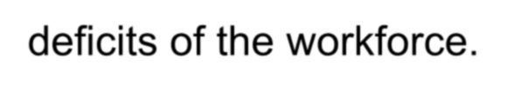
SKILLS TRAINING
Focus on job knowledge and skill for:
  Instructing new hires.
  Overcoming performance deficits of the workforce.

Slide 6



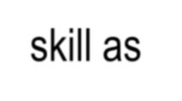






2. Retraining
Maintaining worker knowledge and skill as job requirements change due to:
Technological innovation
Organizational restructuring

Slide 7








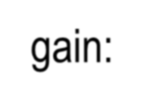

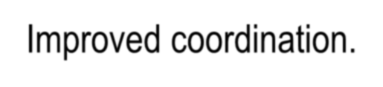
Cross-Functional Training
Training employees to perform a wider variety of tasks in order to gain:
  Flexibility in work scheduling.
  Improved coordination.

Slide 8


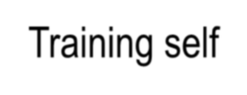





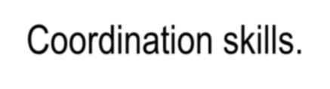

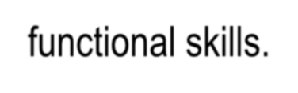
4. Team Training
Training self-directed teams with regard to:
Management skills.
Coordination skills.
Cross-functional skills.

Slide 9








5. Creativity Training
Using innovative learning techniques to enhance employee ability to spawn new ideas and new approaches.

Slide 10


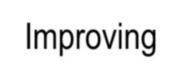
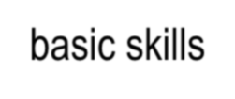





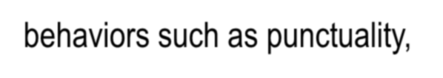
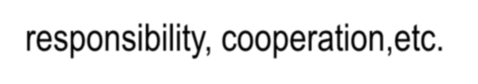
6. Literacy Training
Improving basic skills of the workforce such as mathematics, reading, writing, and effective employee behaviors such as punctuality, responsibility, cooperation,etc.

Slide 11



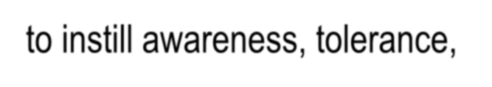
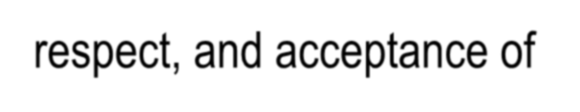
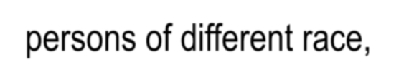


7. Diversity Training
Instituting a variety of programs to instill awareness, tolerance, respect, and acceptance of persons of different race, gender, etc. and different backgrounds.

Slide 12


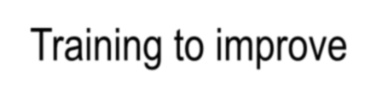


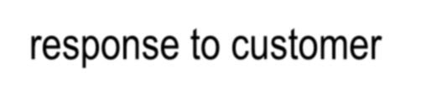

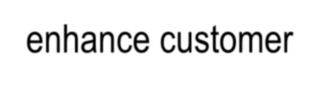
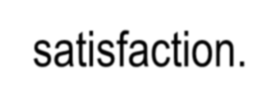
8. Customer Service Training
Training to improve communication, better response to customer needs, and ways to enhance customer satisfaction.

Slide 13



4. Training Process Model
I. Needs Assessment
II. Developing & Conducting
Training
III. Evaluating Training

Slide 14
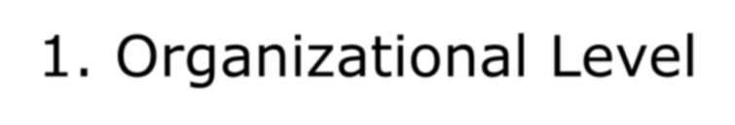







1. Organizational Level
Sales and operating plans.
  Productivity measures.
    Technology change.
      Organizational restructuring.
Change in workforce.

Slide 15
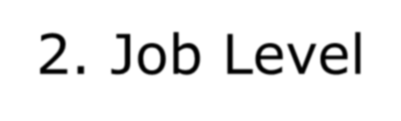

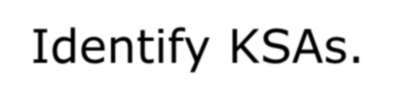


2. Job Level
Job and task analysis.
  Identify KSAs.
Review procedural and technical manuals.
Design Training Program

Slide 16
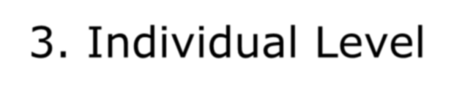







3. Individual Level
Determine who needs training and what kind.
Tests.
Prior training and experience.
Performance review.
  Career assessment.

Slide 17













Methods of training
1. Classroom Instruction
2. Video and Film
3. Computer Assisted Instruction
4. Computer Assisted Instruction with Video
5. Simulation/Vestibule
6. Off the job training

Slide 18


















1. Classroom Instruction
PROS CONS
Efficient dissemination of large volume of
Learner does not control pace or content
information.
Does not consider individual differences.
Effective in explaining
Limited practice.
Limited feedback.
Limited transfer to job.
concepts, theories, and
principles.
Provides opportunity for discussion.

Slide 19










2. Video and Film
PROS CONS
Provides realism.
Adds interest.
Does not consider individual differences.
Limited practice.
Limited feedback.
Limited transfer to job.
Allows scheduling
flexibility.
Allows exposure to hazardous events.
Allows distribution to multiple sites.

Slide 20























3. Computer Assisted Instruction
PROS CONS
Efficient instruction.  Limited in presenting
theories and principles.
Limited discussion.
Considers individual
differences.
Allows scheduling
Transfer depends on
flexibility.
particular job. (Good for
Allows active practice
computer work.)
for some tasks.
Allows learner control.
High development cost (40-60 hours per hour of
instruction at $100-$300
Provides immediate
per hour.)
feedback to tasks.

Slide 21












4. Computer Assisted Instruction
with Video
PROS
CONS
Same as basic CAI.
Same as basic CAI.
Adds realism.
Adds additional cost.
Adds interest.
$50,000-$150,000 per hour
Allows exposure to
of instruction due to:
hazardous events.
* Script writers
Production specialists
Camera crews

Slide 22


















5. Simulation/Vestibule
PROS
Provides realism.
Allows active practice.
Provides immediate feedback.
Allows exposure to hazardous events.
High transfer to job.
No job interference.
Lowers trainee stress.
CONS
Cannot cover all job aspects.
Limited number of trainees.
Can be very expensive (for example, “aircraft simulators” and “virtual reality” simulators).

Slide 23
















6. On-The-Job Training
PROS
Provides realism.
Allows active practice.
Provides immediate feedback.
High motivation.
High transfer to job.
Lowers training cost.
CONS
Disruptions to operations.
May damage equipment.
Inconsistent across departments.
Inadequate focus on underlying principles.
Lack of systematic feedback.
Transfer of improper procedures.
Trainee stress.

Slide 24





Off the job training
Case studies
Role plays
Conference method
Lectures

Slide 25










Employee
Performance Management
Performance appraisal is a formal structured system of measuring and evaluating an employees job related behavior and outcomes to discover how and why the employee is presently performing on the job and how the employee can perform more
effectively in the future so that the employee, orag. and society all benefit.

Slide 26








Why Performance Appraisal?
Appraisal provide information upon which promotion and salary decision can be made.
Appraisal provide an opportunity for a manager and his/her subordinates to sit
down and review the subordinate’s work- related behavior, and then develop a plan
for corrective action.
Appraisal provide a good opportunity to
review the person’s career plans in light of his/her exhibited strengths and weaknesses

Slide 27




Performance Management Cycle
Performance Planning (Setting Performance Targets)
Regular Review and Monitoring
Feed back
Corrective Action
Training & Development Plan
Salary/Bonus
Adjustment
Career Development
Performance Appraisal and Evaluation

Slide 28















Performance Management Cycle
Defining
Performance
1. Defining the performance standards
means making sure that you and your
Standard/ Targets
subordinate agree on his/her duties and targets that you expect
Appraising
Performance
2. Appraising performance means
comparing your subordinate’s actual performance to the standard/targets set
in step one.
Providing Feedback for Development
3. Providing feedback means discussing plans for any development that is
required.

Slide 29


















Problems in Performance Appraisal
Poor
Poor
Lack of standards
feedback to employee
measures of performance
Irrelevant or
Failure to
Negative
subjective standards
apply evaluation
communication
data
Common Performance Evaluation Problems

Slide 30





Bias in the Appraisal Process
The "halo" effect occurs when a supervisor’s
rating of a subordinates on one trait biases the
Halo
Effect
rating of that person on other traits
A tendency to rate all employees the same way, such as rating them all average
Central
Tendency

Slide 31


Bias in the Appraisal Process
The problem that occurs when a supervisory
has a tendency to rate all subordinates either
Leniency
high or low
The tendency to allow individual differences such as age, race, and sex affect the appraisal
Bias
rates these employees receives.

Slide 32

Performance Appraisal Element
Competencies: It represents soft or qualitative aspects of performance (process)
Performance Result: Hard or quantitative aspects of performance (result)
Performance appraisal elements has two main categories:

Slide 33





Performance Appraisal Element
1. Competencies Score
Overall Score
2. Performance Result Score
Will determine the employee’s career movement, and also the reward to be earned

Slide 34
Employee Career Management

