Slide 1




PRERNA BHATI
UNIT 4

Slide 2
What is compensation management
Compensation Management is designing and implementing total compensation package with a systematic approach to providing value to employees in exchange for work performance,
Compensation is a systematic approach to providing monetary value to employees in exchange for work performed.
Compensation may achieve several purposes assisting in recruitment, job performance, and job satisfaction.

Slide 3




Objectives
To recruit & retain qualified employees.
To increase or maintain morale.
To determine basic wage & salary.
To reward for job performance.

Slide 4
Its importance
Compensation is an integral part of human resource management which helps in motivating the employees and improving organizational effectiveness.
Effectiveness in terms of:
■
■
■
Attracting & Retaining Talent Motivating talent for better performance Cost effectiveness

Slide 5
Its importance
Image Building
Ensure Equity
Institutional effectiveness
Legal Compliance
Effective Compensation
Attract talent
Administratively Efficient
Motivate & Retain Staff
Reward Valued Behavior
Employee Management

Slide 6














Its importance
HIGH COMPENSATION – LOW COMMITMENT Hired Guns | HIGH COMPENSATION – HIGH COMMITMENT Professionals
LOW COMPENSATION – LOW COMMITMENT | LOW COMPENSATION – HIGH COMMITMENT
Workers as commodity | Family oriented organization

Slide 7
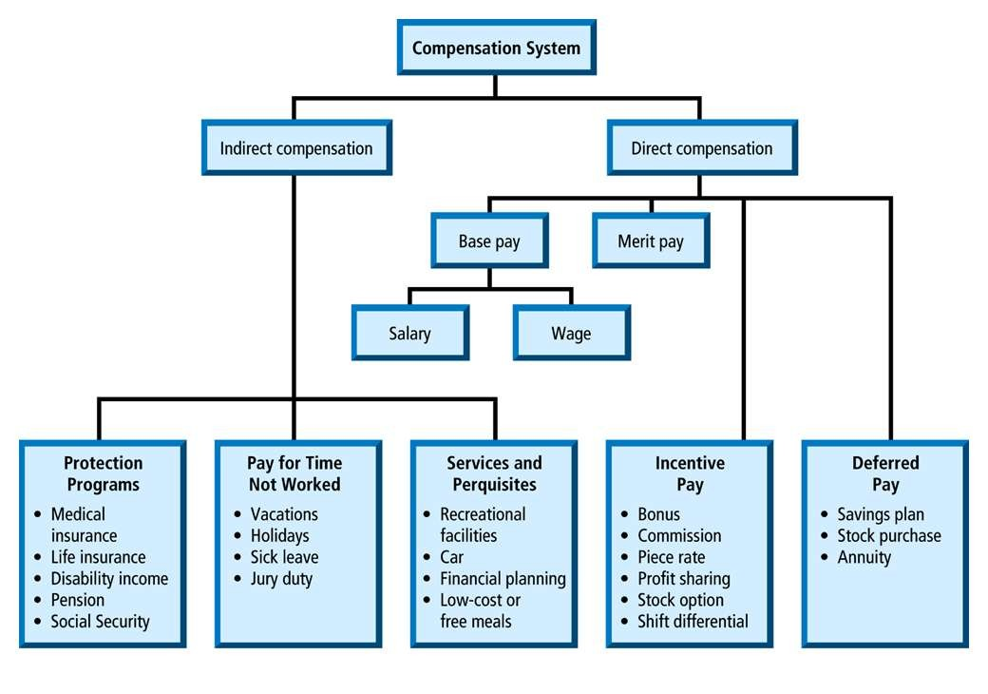
Types of Compensation

Slide 8
Types of Compensation
Direct compensation
It refers to monetary benefits offered and provided to employees in return of the services they provide to the organization. The monetary benefits include basic salary, house rent allowance, conveyance, leave travel allowance, medical reimbursements, special allowances, bonus, PF/Gratuity, etc. They are given at a regular interval at a definite time.

Slide 9
Types of Compensation
Indirect compensation
It refers to non-monetary benefits offered and provided to employees in lieu of the services provided by them to the organization. They include Paid Leave, Car / transportation, Medical Aids and assistance, Insurance (for self and family), Leave travel Assistance, Retirement Benefits, Holiday Homes.

Slide 10
Constituents of Compensation – CTC, heads
Wage and Salary:
The most important component of compensation and these are essential
irrespective of the type of organization
Administered individually
Provides employee stabile income and can plan chores of daily life, budget
Incentives:
Incentives are the additional payment to employees besides the payment of wages and salaries. Often these are linked with productivity, either in terms of higher production or cost saving or both.
Can be administered individually and for groups
Additional compensation having immediate effect and no future liability.

Slide 11
Constituents of Compensation – CTC, heads
Fringe Benefits:
Fringe benefits include such benefits which are provided to the employees either having long-term impact like provident fund, gratuity, pension; or occurrence of certain events like medical benefits, accident relief, health and life insurance; or facilitation in performance of job like uniforms, Canteens, recreation, etc.
Administered for a group mostly
Perquisites:
These are normally provided to managerial personnel either to facilitate their job performance or to retain them in the organization. Such perquisites include company car, club membership, free residential accommodation, paid holiday trips, stock options, etc.
Administered individually mostly

Slide 12
Purpose of Compensation
BUSINESS STRATEGY
PEOPLE REQUIREMENT
Compensation
Management

Slide 13
Purpose of Compensation
For Employer
Brand image (employer of choice) for attracting candidates Motivating employees for higher productivity and
performance
Retaining talent
Consistency in compensation Provoking healthy internal competition
For Employee
Work-life Balance
Recognition as tool to self esteem
Planning for better quality of life

Slide 14
Factors affecting Compensation
Mental requirements, Physical requirements, Skill requirements, Responsibility level, and
Working conditions (risk, time, hazards)

Slide 15

Organizational Affordability
Factors affecting Compensation
Man power planning Sales – salary ratio
Market Rate for Talent Economic Conditions

Slide 16
Job Evaluation Job Specification Job Description
Inputs in Compensation Structure
Time and Motion Study
Market Survey
Demand and Supply Industry wise bench marking

Slide 17
Laws governing and affecting Pay Structure
Minimum Wages Act (discuss – minimum remuneration, its heads
Income Tax Act (discuss – heads which provide tax relief )
Equal Remuneration Act
Payment of Wages Act (discuss – permissible deductions) Acts on social securities (PF, Bonus, Gratuity, Employee
Compensation)

Slide 18
Anatomy of Pay Structure
Monthly salary components
Basic Salary Dearness Allowance
House Rent Allowance Conveyance Allowance
Others (Shift Allowance, Uniform Allowance, Education
Allowance)

Slide 19
Anatomy of Pay Structure
Incentives
Time based incentive Production based incentive Task based incentive

Slide 20
Anatomy of Pay Structure
Social Security / Statutory payments Contribution towards Provident Fund Contribution towards ESI
Payment of Bonus
Payment of Gratuity (not part of wages but considered part of CTC)

Slide 21
Some interesting comparisons
The salary of top executives of public sector are miserable compared to private sector .
S B I of India chief is paid 10%of HDFC Bank Managing Director
BHEL’S chief gets about 10 to 12 lakhs per annum as against ABB ‘S MD getting nearly 40 to 50 lakhs

Slide 22
Recent trends in Compensation Management Employees’ Stock Ownership Plan
Employee Stock Ownership Plan (ESOP) is an employee benefit plan. The scheme provides employees the ownership of stocks in the company. It is one of the profit sharing plans. Employers have the benefit to use the ESOPs as a tool to fetch loans from a financial institute. It also provides for tax benefits to the employers.

Slide 23
Recent trends in Compensation Management
Advantages of ESOP
Ownership Tax-Rebate
Retirement benefits

Slide 24
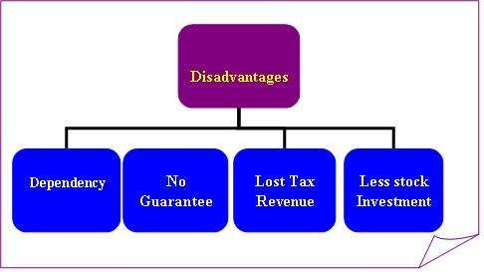
Recent trends in Compensation Management
Advantages of ESOP

Slide 25
Recent trends in Compensation Management
Long Term Compensation Plan

Slide 26
Executive Compensation
Executive compensation is an issue that all companies spend considerable time studying -- especially public companies that have to publicly disclose the compensation details for the five highest-paid employees in the company. Many public companies have been criticized by the media, by shareholders and by the government for creating compensation plans with large rewards for executives. The compensation function has to strike a balance between designing executive compensation plans that attract and retain top executives and that are acceptable to the public.

Slide 27

Recognizing and Rewarding Employees
 HR professionals design programs to successfully motivate employees to perform at their best and that recognize and reward employees for their contributions in a way that's affordable to the company. However, ultimately, it's the supervisors and managers in a company who recognize and reward employees, and compensation staff must train and educate managers on how to use rewards and recognition to make employees feel appreciated by the company and happy in their jobs.

Slide 28

External Competitiveness
 As HR professionals strive to establish competitive pay rates so an organization can attract and retain the right talent, they compare their compensation rates to the rates in published surveys to gauge their competitiveness. However, many nuances complicate the process. For example, when you're hiring the head of software development, the competition for talent might be a different set of companies than when you're hiring an administrative assistant.

Slide 29

Internal Equity
 Legal considerations are also on the mind of HR professionals who manage compensation programs. In addition to being competitive with the external market, pay must be equitable internally within the organization.
Companies generally want to reward high performers with more money and try to create pay differences between employees in the same job to recognize outstanding performance. However, HR must be mindful that it's against the law to pay employees who perform the same
work differently solely because the employee is female,
nonwhite or over 40.

