Slide 1
Mohanlal Sukhadia University Department of English
INDIAN WRITING IN ENGLISH
Fire on the Mountain
Anita Desai
Submitted by :
Riddhi Katariya
M.A. English (Semester-I)
Paper : V
Indian Writing in English
(MAE/1/CC/05)
Submitted to:
Prof. Seema Malik
Title : Anita Desai
as an Indian Blend of
Virginia Woolf and Jane Austen

Slide 2
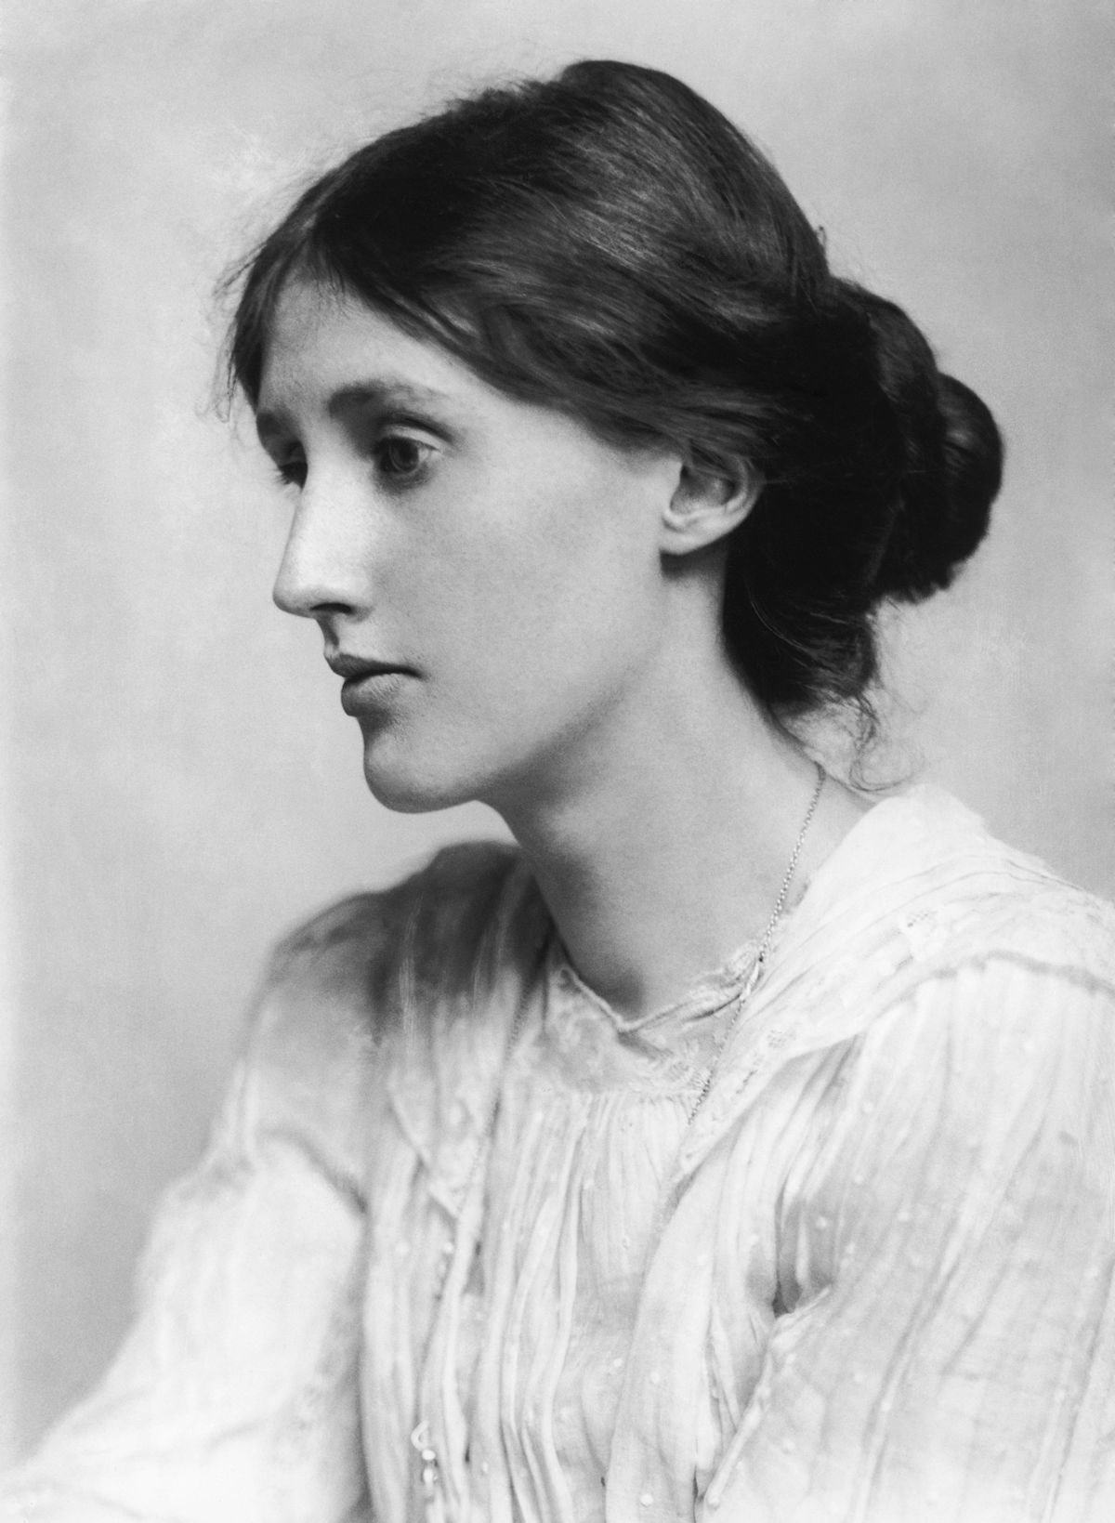
Virginia Woolf
Born: Adeline Virginia Stephen
Brought up and educated at home in London: she had free access to her father's rich library
In 1895, she had the first nervous breakdown caused by her mother's death
In 1904, she moved with her sister Vanessa, and the two brothers to a house in Bloomsbury : the house became a meeting place of a group of intellectuals called “THE BLOOMSBURY GROUP”
1882-1941

Slide 3
She began writing professionally in 1905
1912 : married Leonard Woolf
Her first novel "The Voyage Out"
was published in 1915
She is an important modernist writer
One great innovators in English language
In 1941, she committed suicide by drowning herself
She experimented with:
- Stream of consciousness : it is a narrative method that attempts "to depict the multitudinous thoughts and feelings which pass through the mind“
- Underlying psychological and emotional motives of the characters : she was a very serious and conscious artist, interested more in minds, sensation, thoughts, feelings, intuitions, than in the life of external action

Slide 4
- Breaking conventions : we can see there is a constant sense of searching for a new ways of representing the world and of thinking about people and their experiences
Fractured narrative and chronology : she presents her story from the middle, flashing backward and forward revealing the entire story
- Feminist movement : her novels and essays consists a highly ground breaking feminist critique of the exclusion of women from economic independence and education
- Interior Monologue - to convey the feelings and emotions
Themes
- Imperfect marriage - Familial ties
- Identity (of women in particular)
- Complexities of man-woman relationships
Use of time, memory and space
Death

Slide 5
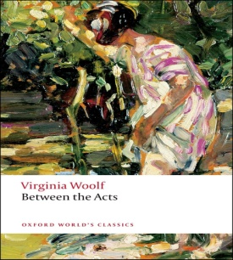
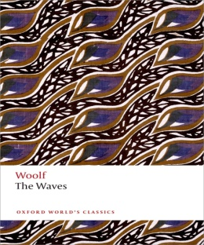
Her most famous works include :
-Mrs. Dalloway (1925) – one of the most well known novels, addresses the moral dilemma of war and its effects and provides an authentic voice of soldiers returning from World War I -To the Lighthouse (1927) – considered as a peak of the Modernism, the plot centers on Ramsay family’s anticipation of and reflection upon a visit to a lighthouse and the connected familial tensions ,the shifting perspective of each character’s consciousness is unique - the Orlando (1928) – a biography, one of her lightest novels of a young nobleman who lives for three centuries without ageing and - the Waves (1931) – presents a group of six friends akin to a prose poem

Slide 6
Jane Austen
She was a born in Steventon, Hampshire, England
Seventh of the eighth child
Apart from three years of school, she was educated at home along with her sister
At the of 12, she was writing amusing and instructive parodies and variations on 18th century literature- from Sentimental novels to serious histories
First Trilogy
In 1801, the family moved to Bath followed by Chawton
Second Trilogy
Published her work under the pen name “By a Lady”
She led a secluded life
Died at the age of 41
1775-1817

Slide 7
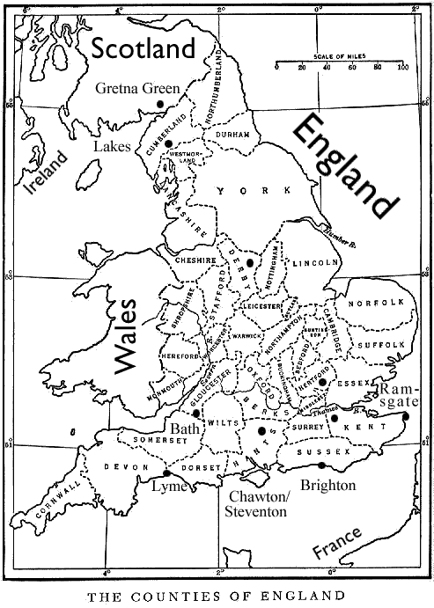
She experimented with :
- Parody and Burlesque : : her characters lack common sense which is characterized by mocking, imitation and exaggeration
- Irony and Satire : She critiques marriage market and illuminates the foibles of individual characters and her society
-Realism : focuses on everyday relationships in the most trivial incidents of everyday life
- Comedy of manners : Comedy of Manners has its roots in the 17th century. The plays are set in aristocratic society and ridicules them with dialogues. The form has mostly been used by the playwrights and the characters portrayed are the fool, jealous husband etc. The masters of this form are : William Wycherley (The Country Wife) and William Congreve (Way of the World) etc
The traces of this form can be seen in Emma
Characters and language : her characters belong to landed gentry and there is a little scenic description and they contain more of dialogues
Themes
- Education and reading
- Morality
- Religion
-Gender (the position of women, in particular)
- Class background
- Politics
- Role of colonialism

Slide 8
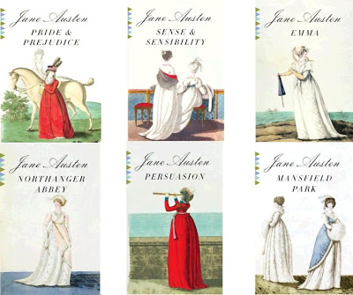
Her most famous works include : -
Sense and Sensibility (1811) – the satirical, comic work offers a vivid depiction of 19th century middle class life
Pride and Prejudice (1813) – a romantic novel follows Elizabeth Bennett and the conflict following her and her sisters quest to get married and produce a male heir
- Mansfield Park (1814) – third novel which deals with Fanny’s relationship with Edmund
Emma (1816) – is a comedy of manners depicting the lives and challenges of society women living in Georgian, Regency England, centering on Emma Woodhouse who makes matches between her friends and acquaintances for amusement
- Northanger Abbey (1818) – a satirical novel which follows a young clergyman’s daughter named Catherine Morland, who visits her wealthy neighbors to participate in a season of balls
- Persuasion (1818) - tells the story of Anne Elliot and her relationship with Captain Frederick Wentworth which ends, then picks back up again after many years

Slide 9
Anita Desai
Born: Anita Mazumdar to a (German)mother and (Bengali) father
Grew up speaking many languages
She was a student at Queen's Mary, Delhi
Earned a Bachelor of Arts from Miranda House
In 1958, she married Ashwin Desai, the director of a computer software company and author of the book Between Eternities : Ideas on Life and the Cosmos
They have four children, including Booker Prize winning novelist Kiran Desai
She is a novelist and a professor at Massachusetts Institute of Technology
She has received many prestigious awards for her novels
Sahitya Academi Award (1978)
Shortlisted, Booker Prize for fiction (1980)
British Guardian Prize (1983)
1937-

Slide 10
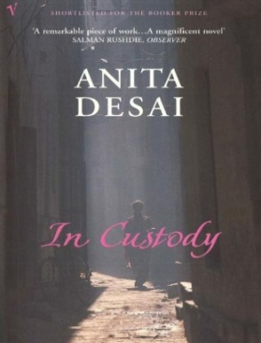
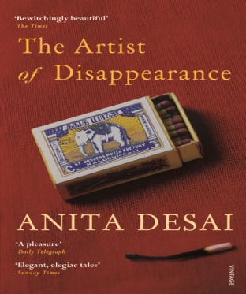
Her most famous works include : -
Cry, the Peacock (1963)
- Voices in the City (1965)
- Bye-bye Blackbird (1971)
- The Peacock Garden (19474)
- Where shall we go this summer ? (1975)
- Cat on a Houseboat (1976)
- Fire on the Mountain (1977)
- Games at the Twilight (1978)
- Clear light of the day (1980)
- The Village by the Sea (1982)
- The Custody (1984)
- Baumgartner’s Bombay (1988)
- Journey to Ithaca (1995)
- Fasting, Feasting (1999)
- Diamond Dust and Other Stories (2000)
- The Zigzag Way (2004)
- The Artist of Disappearance (2011)

Slide 11
Experimented with
- Inner realties and psyche reverberations: she explored the modern idea of Sensibility
- Contemporary issues: the hazards and complexities of man-woman relationships
- Identity: the founding and nurturing of individuality and the establishing of Individualism
Characters: mostly include neurotic females, highly sensitive but sequestered in the world of dream and imagination and alienated from their surroundings
Stream of consciousness: she tries to unfold the protagonist’s mind to her readers
Themes
Desai is considered the writer who introduced psychological novel in the tradition of Virginia Woolf in India
She is a pioneer of writing on feminist issues in India
She has covered themes such as women's oppression and quest for a fulfilling identity, family relationship and contrast, the crumbling of traditions and anti-Semitism
Mental and spiritual development
Marriage
Escapism
Isolation

Slide 12
Virginia Woolf | Jane Austen | Anita Desai
British, 20th century Modernist writer | British, 18th century Romantic writer | Indian, 20th century Modernist writer
Writing style : - Stream of consciousness - Feminist movement - Breaking conventions Interior Monologue Realist | Writing style : Comedy Wit and Satire - Realist | Writing style : -Stream of consciousness - Feminist movement - Breaking conventions Interior Monologue Realist
Themes : - Imperfect marriage - Identity (of women in particular) Complexities of man-woman relationships Use of time, memory and space - Escapism - Familial ties - Death | Themes : - Imperfect marriage - Identity (of women in particular) - Complexities of man-woman relationships | Themes : Imperfect marriage Identity (of women in particular) - Complexities of man-woman relationships - Use of time and memory - Escapism
Characters : - Neurotic females | Characters : - Landed gentry | Characters : - Neurotic females

Slide 13
Conclusion
Virginia Woolf, Jane Austen and Anita Desai are great artists in the realm of fiction. They are rooted in totally different milieus, yet their works share in common the niche, structure, themes, style and techniques. Like Jane Austen, Desai confines to the ‘two inches of ivory’ as far as the social milieu and characters are concerned and like Virginia Woolf, Anita Desai maps the inner working of the mind. The mentioned writers have their thematic nexus on the complexities of man-woman relationship and the role and status of women in the changing society which binds them together in a strong bond. Though these writers are from different centuries and countries, they share a lot in common. In the end, it can be said that Anita Desai is an Indian blend of the two British writers i.e., Virginia Woolf and Jane Austen respectively.

Slide 14
Works Cited
Dalmia, Yashodhara: 1979. “An Interview with Anita Desai” The Times of India, 29 April.
Gilbert Ryle. 1986. Jane Austen and the Moralists.
Monique Nathan, Virginia Woolf, Evergreen Books Ltd., London, 1961, p20

Slide 15
Thank You

