Slide 1
Fire on the Mountain -Anita Desai
Topic – Title Analysis
Submitted to -
Prof. Seema Malik
Submitted by -
Juhi Chawla
M.A. Semester-I
Paper Name- Indian Writing in English-I
Paper Code- MAE/1/CC/05
Department of English,
University College of Social Sciences and Humanities,
Mohanlal Sukhadia University, Udaipur

Slide 2
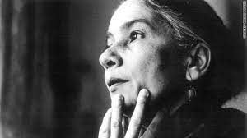
Anita Desai is the pioneer of the psychological novel in Indian English where in she portrays the conflicts of her protagonists to highlight their individuality and hunger for freedom. She is the prominent Indian author, writing in English who delineates feminist themes seriously, focusing on the conditions of women in India.

Slide 3
About the Novel :-
Fire on the mountain by Anita Desai was published in 1977.
Highly symbolic and poetic in nature.
Anita Desai makes use of sounds in her novel in a sense that one can actually hear the sounds of nature in one’s mind.
Awards won by the novel :-
Winifred Holtby Memorial Prize (1978)
Sahitya Akademi Award (1978).

Slide 4
Themes in the novel :-
Patriarchy
Memory
The nature and its destruction by humans
Perils of motherhood
Feminism
Alienation
Human connection
Reality v/s Fantasy

Slide 5
Plot Summary :-
Protagonist – Nanda Kaul
Setting – Carignano, in Kasauli
Novel is divided in 3 parts:
- Nanda Kaul at Carignano
- Raka comes to Carignano
- Ila Das leaves Carignano
but all are inter-related.

Slide 6
Relationships –
- Nanda Kaul – Raka
(great grandmother – great granddaughter)
- Nanda Kaul – Ila Das
(childhood friends)
Anita Desai presents the image of a suffering woman with her psyche and storm within.
Not only highlights the silent miseries, pain and agony of a woman but also makes the analysis of the situation thus simplifying it for the readers to reach to the root cause of the problem.

Slide 7
Nanda Kaul
- No individuality hence identity crisis.
- False portrayal of her life.
Raka
. - Free child
- Reflects Nanda’s suppressed self.
Ila Das
- Social worker / activist / independent lady

Slide 8
What ignited the fire ?
Alienation of Nanda Kaul -
“Nanda Kaul was a recluse out of vengeance for a long life of duty and obligation”(48)
The social status she received, being the wife of a dignitary, never helped her to enjoy life as all she experienced was loneliness and neglection.
Husband had an illicit relationship with another woman, Miss David.
Used as a mere object or a decorative item needed for the efficient running of ‘his’ house.
Nanda, though burning from inside, suppressed her frustration and anger by leading a mechanical life devoid of emotions.

Slide 9
Throughout the novel, Nanda mentions the house she lived in ealier as ‘Vice Chancellor’s house’ / implies that Nanda had never felt any belongingness to that house.
Moved to Kasauli / wanted to be alone and forgotten.
“be a charred tree trunk in the forest.”(41)
Nanda Kaul’s retreat to the mountains of Kasauli is not ‘withdrawal’ but can be termed as ‘forced’ seclusion.
“She did not live here alone by choice-she lived here alone because that was what she was forced to do, reduced to doing.”(145)

Slide 10
Alienation of Raka -
“If Nanda Kaul was a recluse out of vengeance for a long life of duty and obligation, her great grand-daughter was a recluse by nature, by instinct. She had not arrived at this condition by a long route of rejection and sacrifice- she was born to it, simply.”(48)
Traumatic experience of witnessing the chaotic life of her mother makes her develop a reclusive behaviour.
Refuses to get close to any human being.
Throughout the novel, “secrecy” and Raka go hand in hand.

Slide 11
The only thing she wanted was “to be left alone and pursue her own secret life amongst the rocks and pines of Kasauli”.(52)
A house is supposed to be a place of security and succor, but for Raka, it was a madhouse of abuse, fear, and impotence.
Having lived in a broken home, she loses trust in belongingness, like Nanda.

Slide 12
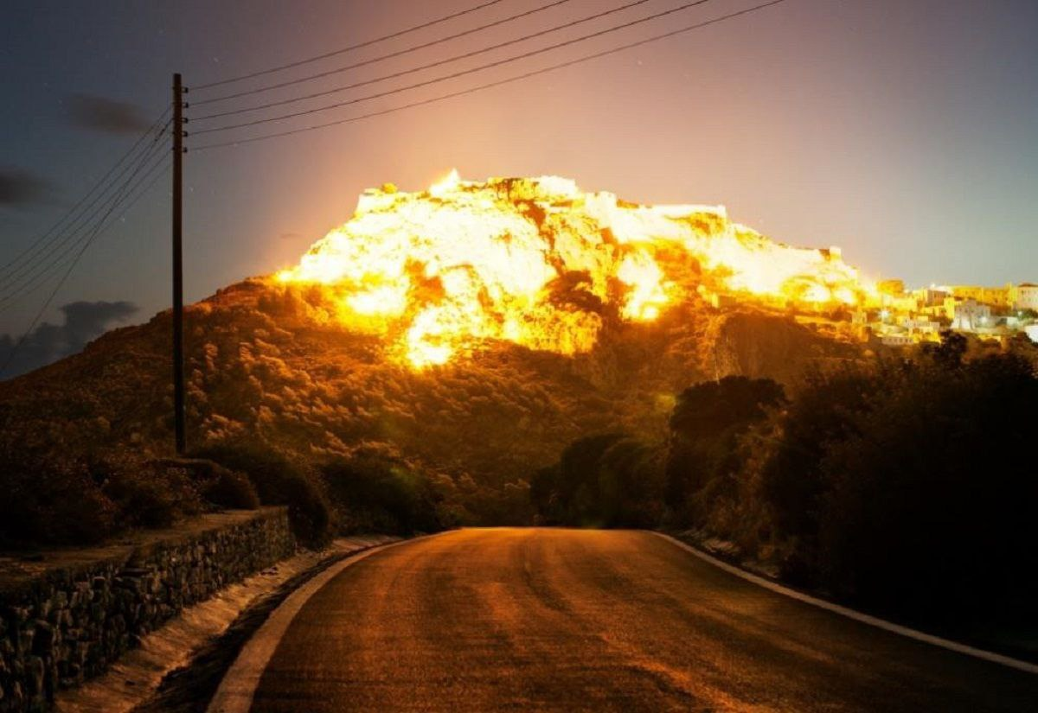
Title Analysis :-
Fire traditionally symbolizes destruction and purification, both of which Raka seeks in setting fire to the mountain.
The burnt house on the hill is symbolic of Raka and what has happened to her, which is why it draws her in so inexorably.
This house being burnt shows Raka’s devastated psyche but also the fact that fire can destroy and purify.

Slide 13
Sets fire on the mountain in the hope that it will burn away the traumas and terrors of the patriarchal world in which Raka and Nanda Kaul live, exorcise the demons of Raka’s past, and cleanse the world.
“Look, Nani, I have set the forest on fire. Look, Nani – look – the forest is on fire.”(145)
The fire also was the externalisation of suppressed fire in Nanda.

Slide 14
The fire that has been lying suppressed under the heavy responsibilities ascribed upon her.
Outcome of this suppressed fire for Nanda was that it ended up swallowing her as the anchor of her fantasy, which she was clinging to, was now fallen.

Slide 15
Works Cited :-
Primary source-
Desai, Anita. Fire on the Mountain. London: Penguin Book, 1977.
Secondary Source-
Dar, Ab. Majeed “Isolation in Wilderness: A Protest against Social Norms in Anita Desai’s Fire on the Mountain”, Islamic University, Awantipora Kashmir (J&K), 2015

Slide 16
Thank You.

