Slide 1
Indian Writing in English
(MAE/1/CC/05)
Relationship between
Raka and Nanda Kaul
Submitted by – Vipul Vaghela
Department of English
M.A. English Semester – I
University College of Social Sciences and Humanities
Mohan Lal Sukhadia University, Udaipur
Submitted to – Prof. Seema Malik

Slide 2
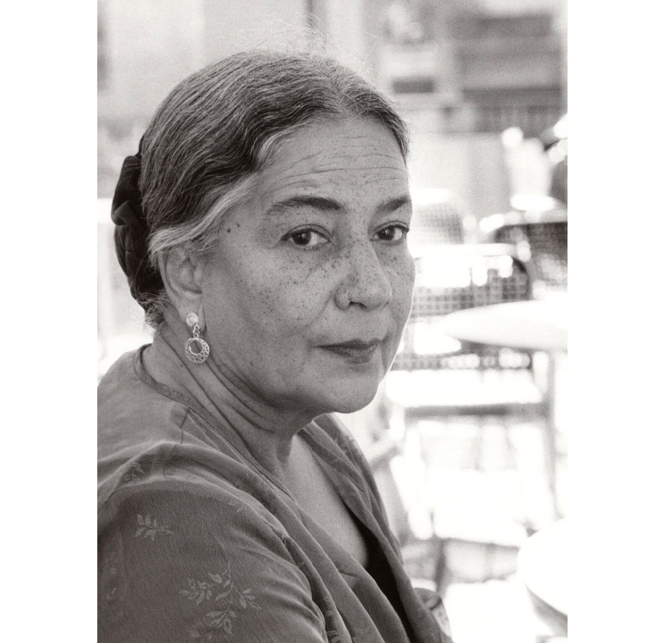
Anita Desai
Her maiden name is Anita Mazumdar.
Born on June 24,1937, Mussoorie ,Uttarakhand, India.
She is an Indian novelist and an author of children’s books.
She received Sahitya Akademi Award in 1978 for Fire on the Mountain, shortlisted for Booker Prize (three times), British Guardian Prize for The Village by the Sea in 1983.
Works - Clear Light of Day(1980), In Custody (1984), The Zigzag(2004), The Artist of Disappearance(2011).

Slide 3
Characters:
Nanda Kaul – A recluse and an intelligent woman, widow of a university Vice-Chancellor, who does not like to express her feelings
Raka – Nanda’s great-granddaughter, daughter of Rakesh and Tara
Ila das – She is a friend of Nanda Kaul from her childhood, and was a social worker
Ram Lal- Cook at Carignano, who is old and has developed a bond with Raka
Nanda Kaul’s husband – A Vice-Chancellor of University in Punjab
Asha – One of Nanda Kaul’s daughter
Tara – Nanda Kaul’s granddaughter, Asha’s daughter, and Raka’s mother
Rakesh – Tara’s husband and Raka’s father, a cruel and an evil person
Miss David – A Mathematics teacher with whom Nanda Kaul’s husband had a long affair

Slide 4

An Introduction:
The novel is written in three parts and each part introduces a woman character : Nanda Kaul, Raka and Ila Das
All the three women characters undergo a conflict within their own self because of the environment in which they live it makes them start a relationship with solitude

Slide 5
Narrative Style:
It is a neatly organized novel with accurate unifying links between paragraphs
Language is one of the main elements of her narrative style which lets us feel every little detail
Use of ‘internal narration’ to delve deeper into her character’s consciousness
The outer world and the character’s inner state is interwoven in her narration, mainly with the use of symbols e.g.- Fire, Burnt House, Eagle
Her unique use of imagery gives a poetic picture to the novel
The structure of the novel is such that it regularly alternates from present to past in a zigzag pattern
Role of nature : Nature becomes one of the important characters apart from the three women

Slide 6
Character of Nanda Kaul: Part 1
The novel mainly deals with loneliness and isolation as well as the resultant anguish and agony in the deserted life of an old widow.
Part 1, narrates the story of Nanda Kaul who lives in Carignano, a desolate and haunted house in Kasauli, away from the world
Her isolation is threatened by the letter from Asha, her daughter announcing the arrival of Raka, the grand-daughter of Asha and Nanda Kaul’s great grand-daughter
Her fierce desire to live alone is the result of her busy but, empty life as the wife of an ex Vice Chancellor of Punjab University
“Whatever else came or happened would be an unwelcomed intrusion and distraction.” (3)

Slide 7
Her husband did not love her as a wife and treated her as some decorative and useful instrument needed for the efficient running of his household
“Mr. Kaul had wanted her always in silk, at the head of the long rosewood table in the dining –room, entertaining his guest.” (20 )
Nanda wants to be alone and doesn't want Raka to come to Carignano that’s why she cuts the call and its seems like there is a total lack of joy in her voice
“Her voice dropped lower and lower as she dropped words like small, cold pebbles into the mouthpiece” (23)
The inner reality of her life is revealed to us when we learned that her relationship with her husband was an unhappy one “Discharge me”, she groaned, “I have discharged all my duties. Discharge” (33)
  She sends Ram Lal to taxi stand to meet Raka. She knows she should be the one to go
  “She sent Ram Lal instead. She knew she ought to go.” (36)

Slide 8
  She cannot picture a child in Carignano, just as she cannot picture roses or fountain in her sparse garden
  She is frustrated because she will have to see the child to bed, make her eat, entertain, to play with her
  “It seemed to much to her that she should now have to Raka, discover her as an individual and, worse, as a relation, a dependant.” (38)
Her husband’s extra marital affair with Miss David had been a source of agony throughout her life
The painful memory of the days when her husband went to visit Miss David’s home haunts her
“Nor had her husband loved and cherished her and kept her like a queen- he had only done enough to keep her quiet while he carried on a lifelong affair with Miss David, the mathematics mistress. Whom he had not married because she was a Christian but who he had loved, all his life “

Slide 9
Character of Raka: Part 2
In order to make Nanda Kaul confront the reality, Anita Desai invited Raka to her life.
She never makes demand and seems to have no need of anything
One day on the way back home, she lands up in the club building
Nanda compares Raka with an insect on the other hand Raka compare Nanda with pine tree and rock
“She look like one of those dark crickets that leap up in the fright but do not sing, or a mosquito, minute and fine, on thin, precarious leg” (43) “old lady who murmured at her as another pine tree, the grey sari a rock – all components of the bareness and stillness of the Carignano garden” (44)

Slide 10
Nanda Kaul doesn’t know where Raka is going and she makes it clear that Raka is not a part of her life
“Raka was a perceptive child was clear to Raka – that she was not part of Nanda Kaul’s life”(51)
She is not a normal child and shuns all tenderness viciously
She as a child loves privacy and seclusion and does not care for Nanda Kaul “She ignored her so calmly, so totally that it made Nanda Kaul breathless.” (52)
For very first time Nanda and Raka together go for a walk down the hillside and Raka feels like a chained dog
“I think I’ll come with you today” (60)
Both were laughing on langurs
“Raka and Nanda Kaul went downhill, laughing, at a quicker pace – refreshed.” (65)
  Nanda sees how Raka always talks to Ram Lal and he always entertains Raka by his stories
  “Ram Lal could arouse Raka’s interest and hold it as Nanda Kaul could not.” (84)

Slide 11
  Raka does not remember Nanda when Ram Lal is with her. She did not call Nanda to come and see the animal
  “She had not even called to her Nani to come and see the langurs.” (87)
  Nanda tries to entertain Raka by telling the story of her great–great-grandfather
  “It comes all the way from Tibet, you know. My father brought it.” (90)
  Nanda also tells about Tara so that she can trust her easily
  “Rainy days are lily days! Rainy days are lily days” (96)
  Raka is not interested in Nanda’s story and does not know why she is doing this. Thus the two pull apart once again
  “She could not understand this new talkativeness of her great-grandmother’s who had preferred, till lately, not to talk to her at all, nor had wanted to be talked to. Now she was unable to stop.” (106)
  Nanda is worried about Raka because she is not back for tea.
  “she had seen the room empty, the bed flat and untouched“(110)

Slide 12
The relationship between Nanda Kaul and Raka :
Nanda Kaul | Raka
She was a recluse out of vengeance for a long-life of duty and obligation | Raka isn’t a born recluse but a victim of a broken home
Nanda is a victim of emotional deprivation (by husband and children) | Raka is also a victim of emotional deprivation (by parent)
Nanda Kaul is isolated from Raka and the society | Raka is isolated from Nanda Kaul and the society
She is representative of elder generation | She representative of young generation
She is an introvert and doesn’t want to exhibit her feeling towards anyone and anything around her | She is caring towards animals but is also an introvert
Nanda Kaul has abandoned her past life to stay on the mountain | Raka is bound to live in Carignano

Slide 13
Conclusion:
In the end, Nanda’s mask starts falling off as she wishes to penetrate to Raka’s secret world. Till now, she remained aloof from Raka as she was afraid to enter a child’s world which might betray her. She believed that every attachment offers a “preface to a new betray and all socialization as fake”
Nanda too realizes how she has been trapped in a conflict between fantasy and reality. This shows Nanda’s inner self that craves for affection, attention and some love
Raka, on the other hand, is a loner by “choice”, comfortably avoids Nanda and pays no great interest in the fantasies that are fake and unreal
The novel ends with Raka setting fire to the mountain. Anita Desai makes Raka a strong figure as she never tried to pretend and she holds a complete control of herself by being close to reality and nature

Slide 14
Works Cited:
  Secondary Source :-
1. Desai, Anita. Fire on the Mountain. London: Penguin Book, 1977.

Slide 15
Thank you.

