Slide 1
Internal Reconstruction

Slide 2
Dr. Asha Sharma
Assistant Professor
Department of Accountancy and Statistics
University College of Commerce & Management Studies
Mohanlal Sukhadia University, Udaipur

Slide 3
Alteration of share capital
According to Section 94 of the Companies Act , a limited company can, if authorised by its articles of association, alter the capital clause of its memorandum of association in any of the following ways:
Increase its share capital by issue of new shares. Accounting entries are the same.
Consolidate all or part of its existing shares of smaller amounts into shares of larger of larger amounts.
E.g. Rs. 5,00,000 share capital divided into 50,000 shares of Rs. 10 each, consolidated into 5,000 shares of Rs. 100 each.

Slide 4
Share Capital A/c Dr. (Rs. 10) 5,00,000 To Share Capital A/c (Rs. 100) 5,00,000
(Being consolidation of 50,000 equity shares of Rs. 10 each into 5,000 shares of Rs. 100 each fully paid)
3. Sub- divide its shares of higher denomination into shares of smaller denomination. In case of partly paid up shares , the proportion between the paid up and unpaid amount on the shares continues to be the same after sub-division as before.
Share Capital A/c Dr. (Rs. 100) 5,00,000 To Share Capital A/c (Rs. 10) 5,00,000
Being consolidation of 50,000 equity shares of Rs. 100 each into 5,000 shares of Rs. 10 each fully paid)

Slide 5
4. Convert all or any of its fully paid up shares into stock or reconvert that stock into fully paid up shares.
(Being conversion of 50,000 equity shares of Rs. 10 each fully paid into Rs. 5,00,000 equity stock )
Reverse entry will be passed for conversion of equity stock into fully paid equity shares.
5. Cancel those shares which have not been taken up i.e., decrease its unissued capital without resulting in the reduction of paid up capital. It does not require any journal entry because it does not affect paid up capital in any way.
Equity Share Capital A/c Dr. 5,00,000 To Equity Stock A/c 5,00,000

Slide 6
Internal Reconstruction or capital reduction
Internal Reconstruction means the reduction of capital to cancel any paid up share capital which is lost or unrepresented by available assets. This is generally resorted to write off the past accumulated losses of the company.
Reduction of capital is unlawful except when sanctioned by the court. The issued share capital of a company represents the security on which the creditors rely. The uncalled capital acts as a future security for the company’s creditors. Therefore any reduction of capital reduces the security of the creditors.

Slide 7
However, in genuine cases, a company is permitted to reduce its share capital by Section 100 in any of the following ways:
By extinguishing or reducing the liability on any of its shares in respect of share capital not paid up.
E.g. capital of a company consists of 2,00,000 equity shares of Rs. 10 each on which Rs. 8 has been paid, now being reduced to a fully paid share of Rs. 8.
(Being 2,00,000 equity shares of Rs. 10 each, Rs. 8 per share paid up converted into 2,00,000 equity shares of Rs. 8 each fully paid up.
Share Capital A/c Dr. (Rs. 10) 16,00,000 To Share Capital A/c (Rs. 8) 16,00,000

Slide 8
2. By paying off any paid up capital which is in excess of the needs of the company out of accumulated profits.
(i)
(Being the amount to be repaid to shareholders on reduction of paid up capital)
(ii)
(Being the amount paid off)
(iii)
(Being transfer on repayment of share capital)
Share Capital A/c Dr. 1,60,000 To Shareholders A/c 1,60,000
Shareholders A/c 1,60,000 To Bank A/c 1,60,000
Profit &Loss A/c Dr. 1,60,0000 To General Reserve A/c 1,60,000

Slide 9
The court consults creditors for 1st and 2nd type of capital reduction. If some creditors are unwilling to give their consent to such capital reductions the company will have to settle their claims before getting sanction from the court.

Slide 10
3. Where any paid up share capital is being reduced without reducing the liability on the shares.
E.g. A share of Rs. 10 on which Rs. 8 has been paid up is being reduced to a share of Rs. 10, Rs. 6 paid up.
Share Capital A/c Dr. 2 To Capital Reduction A/c 2
The court ordinarily gives sanction for 3rd type of capital reduction without consulting the creditors because creditor’s interest is in no way affected by such reduction.

Slide 11
4. Where any paid up share capital is being reduced , reducing the liability on the shares.
E.g. a share of Rs. 10 on which Rs. 8 has been paid up is being reduced to fully paid share of Rs. 6.
5. By any other method approved by the court.
.
Share Capital A/c Dr. (Rs. 10 ) 8 To Share Capital A/c (Rs. 6) 6 To Capital Reduction A/c 2

Slide 12
Accounting entries on internal recontruction
1. When the face value of the shares is changed or the rate of dividend on preference shares is changed, it is treated as change in the category of the share capital.
If the face value of the shares or the rate of dividend on preference shares is not changed on reduction of share capital, it does not result in the change of the category of the share capital.
(Old) Share Capital A/c Dr. To (New) Share Capital A/c To Capital Reduction(or Reconstruction ) A/c
Share Capital A/c Dr. To Capital Reduction A/c

Slide 13
2. If any sacrifice has been made by creditors and debentureholders:
3. If the value of any asset is appreciated:
4. When any contingent liability (say Sales tax) arises and is to be paid immediately:
Creditors A/c Dr. Debentures A/c Dr. To Capital Reduction A/c
Respective Asset A/c Dr. To Capital Reduction A/c
Capital Reduction A/c Dr. To Liability (Sales Tax) Payable A/c
Liability (Sales Tax) Payable A/c To Bank A/c

Slide 14
5. When amount of capital reduction is utilised for writing off fictitious assets, past losses and excess value of other assets:
Capital Reduction A/c Dr. To Profit &Loss A/c To Goodwill A/c To Preliminary Expenses A/c To Discount on Shares or Debentures A/c To Patents or Trade Marks A/c To Plant and Machinery A/c To Other Assets A/c To Capital Reserve A/c ( Balance Amount)

Slide 15
The amount to be written off cannot exceed the amount credited to Capital Reduction Account..
If any reserve appears on the liabilities side of the Balance Sheet, the same may be utilised in writing off the accumulated losses and assets.
The amount written off or appreciated in respect of fixed assets under a scheme of reconstruction must be shown for five years in the balance Sheet.
The words ‘And Reduced’ should be added to the name of the company if directed by the court for such period as the court deems fit.

Slide 16
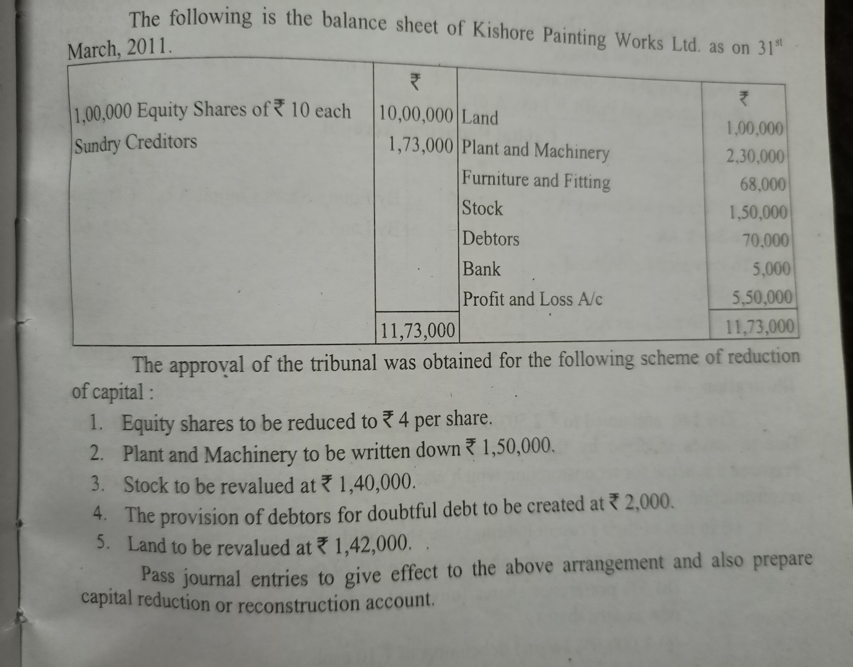

Slide 17
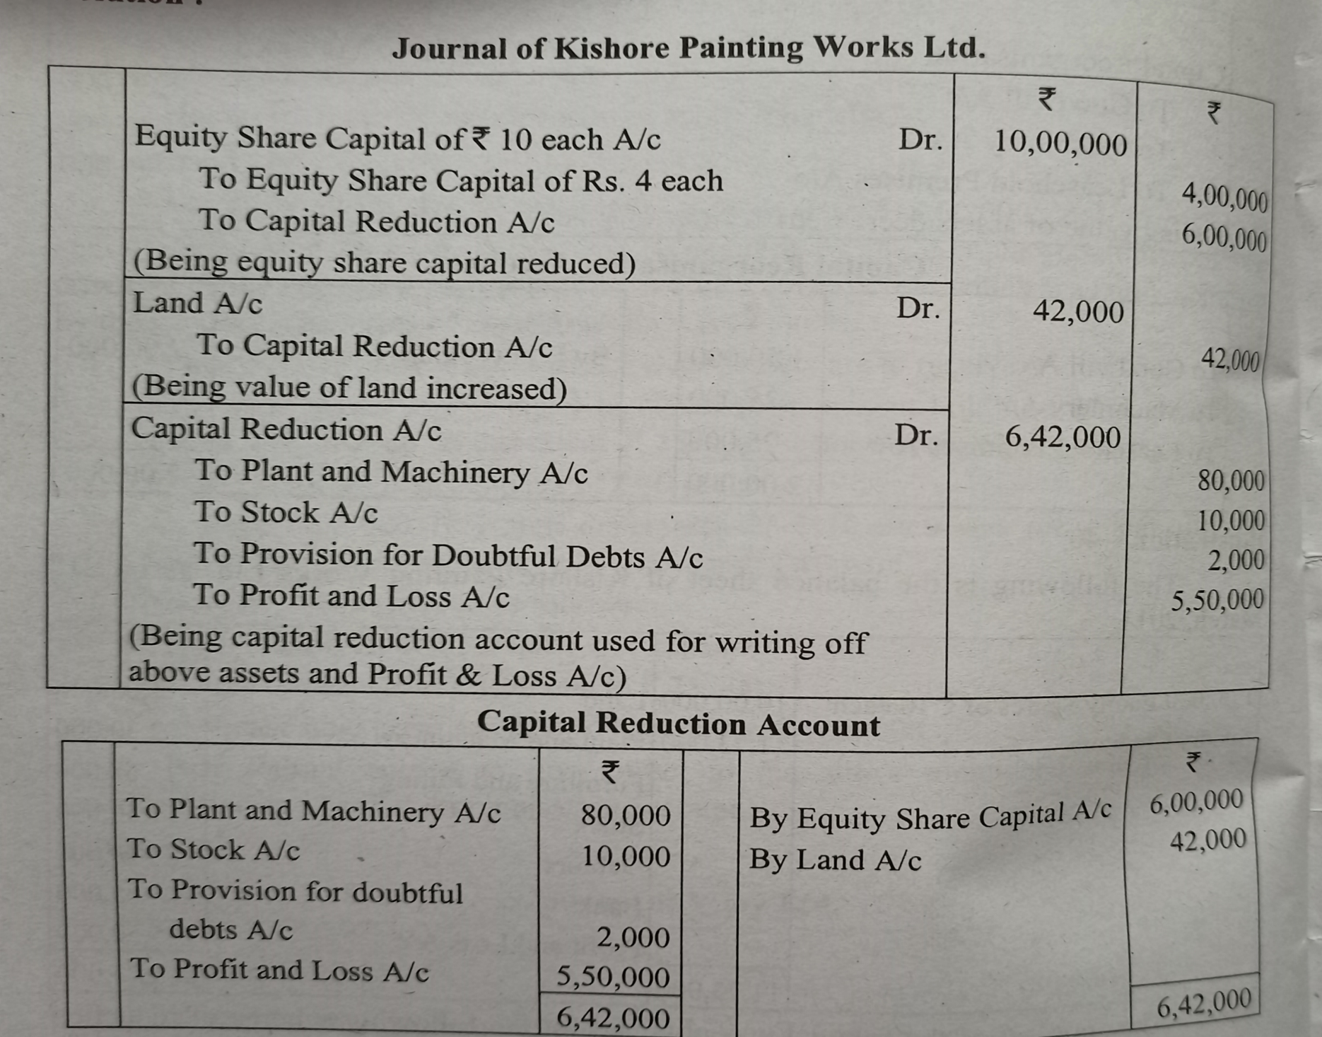

Slide 18
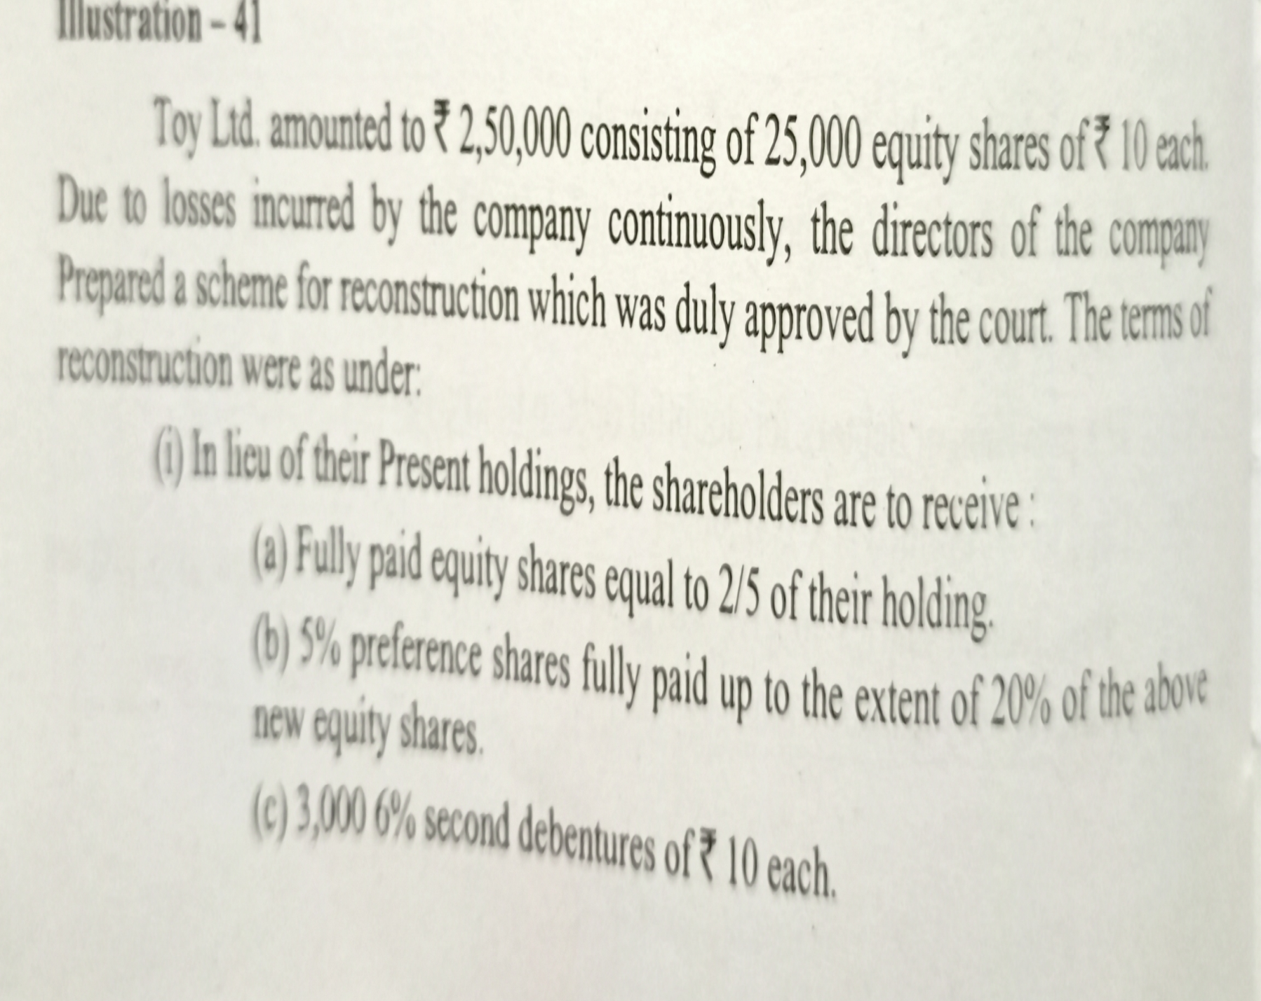

Slide 19
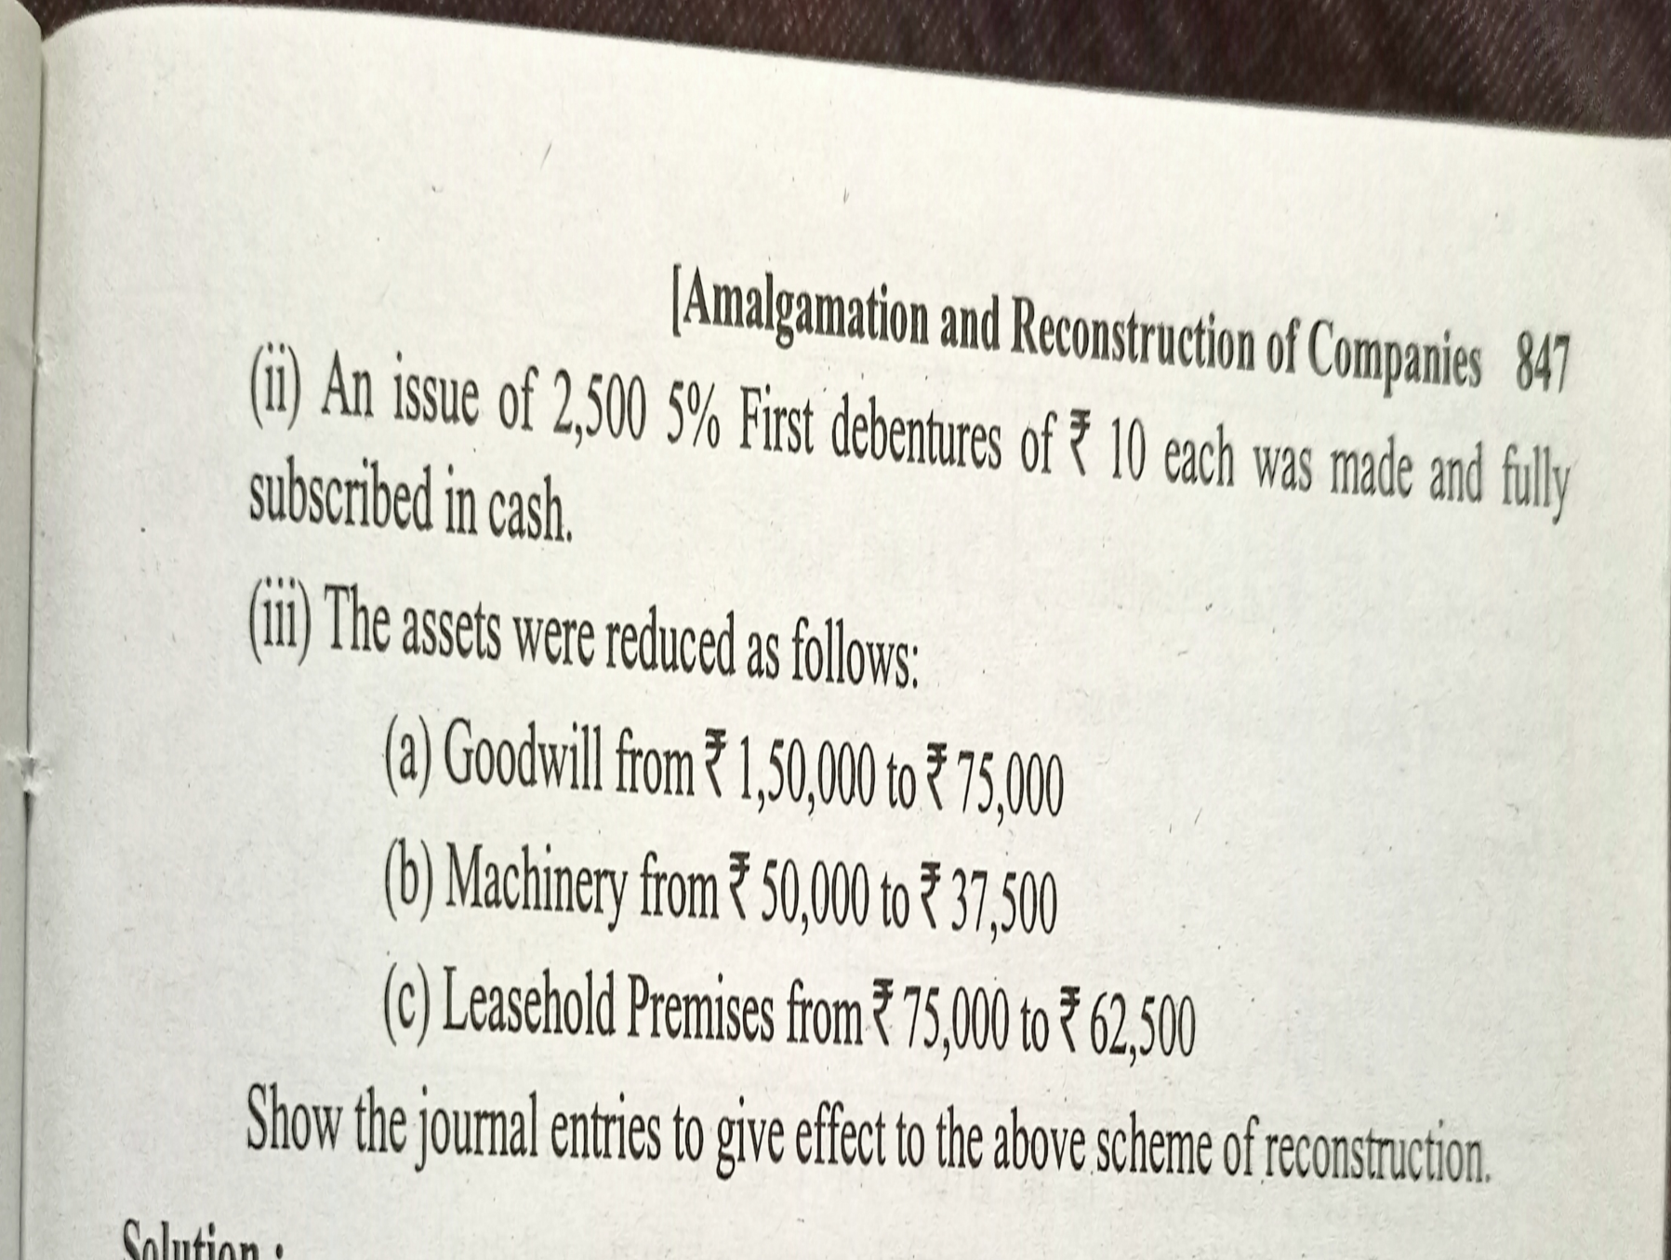

Slide 20
