Slide 1
Women Novelists in Indian English Fiction
Submitted to –
Prof. Seema Malik
Submitted by-
Suysha Agarwal
MA Semester – I
Department of English
University College of Social Sciences and Humanities
Mohanlal Sukhadia University, Udaipur
Paper – V
Indian Writing in English-I

Slide 2
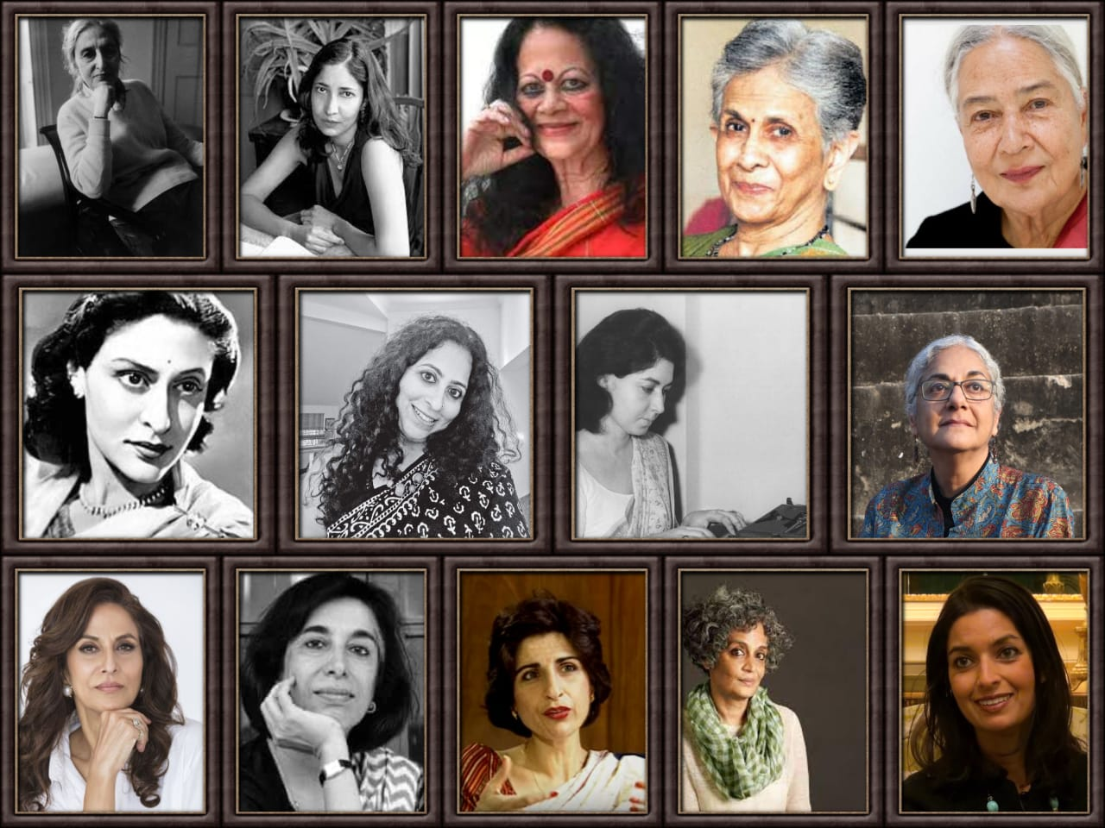
“Women are natural storytellers even when they don't write or publish.”(Iyengar 435)
Toru Dutt
Bianca or The Young Spanish Maiden
Raj Lakshmi Debi
The Hindu Wife or The Enchanted Fruit
Krupabai Satthianadhan Kamala
A Story of Hindu Life and
Saguna: A Story of Native Christian Life
Shevantibai M.Nikambe’sRatanbai
A Sketch of a Bombay High Caste Hindu Young Wife

Slide 3
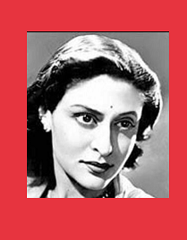
Kamala Markandaya
1
Born - January1, 1924
2
Pseudonym of Kamala Purnaiya
3
American Library Association Notable Book in 1955 for Nectar in a Sieve
4
“Most Americans’ perception of India came through Kamala Markandaya; she helped forge the image of India for American readers in schools and book clubs.”(Larson 21)

Slide 4
Thematic Concerns
Some Inner Fury
East vs. West
Resistance, Rebellion and Death
Plight of rural woman
Western values - Modern and Materialistic
Indian values - Traditional and Spiritual
Nectar in a Sieve

Slide 5
East vs. West
Indian values
“... We could be together all the time. We shall be soon. But you have to go away. I’ll come back- I’ll always come back to you!” (Some Inner Fury 199)
“A woman they say, always remembers her wedding night…but for me there are other nights…when I went to my husband matured in mind as well as in the body.” (Nectar in Sieve 66)
Resistance, Rebellion and Death
Plight of rural woman
Resistance - “My husband and I have parted company.”(Some Inner Fury 70)
Rebellion - “Everybody is interested in freedom…only, we do not all agree on the means to the end, as I think you know too.” (Some Inner Fury 126)
Death - “…I could not believe she was dead. The feeling would not come, then I looked at her and she had always been beautiful and she was beautiful.” (Some Inner Fury 239)
“I do not blame him. He is justified, for a man needs a children.” (Nectar in Sieve 13)

Slide 6
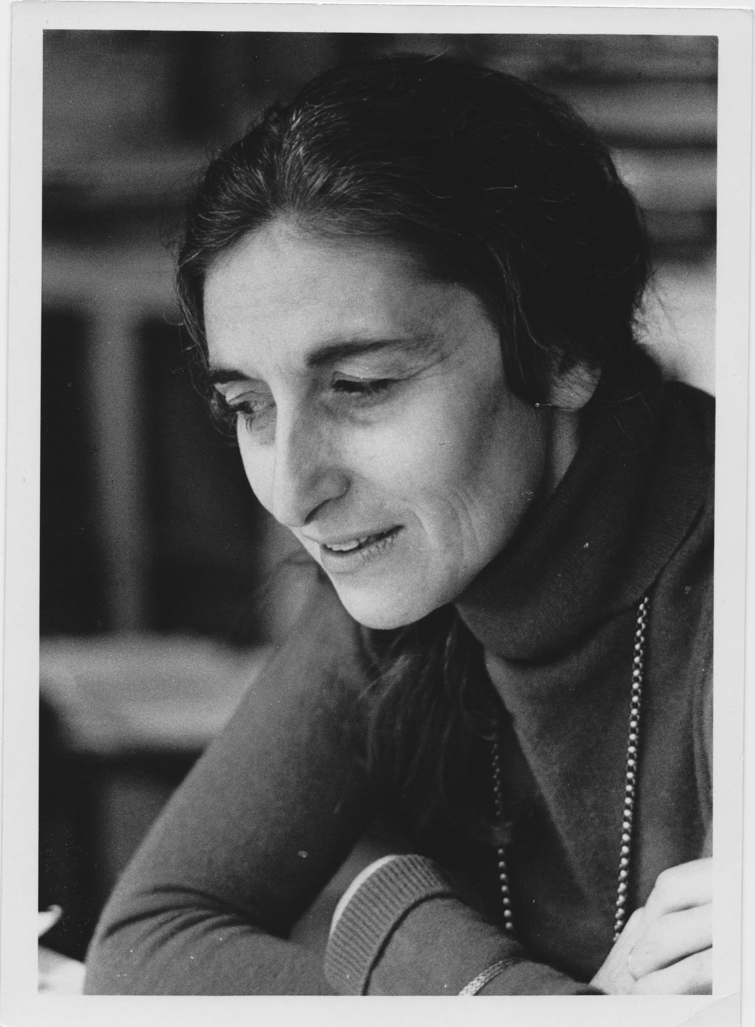
Ruth Prawer Jhabvala
1
Born - May 7, 1927
2
1975 Booker Prize : Heat and Dust
3
Till date the only person to win both a Booker Prize and an Oscar.

Slide 7
Thematic Concerns
Olivia
“She had, at last come to the right place." (Heat and Dust 19)
“I don’t know India. It’s true I don’t, but what’s that got to do with it? People can still be friends, can’t they, even if it is India.” (Heat and Dust 103)
“It’s part of their religion, isn’t? I thought one wasn’t supposed to meddle with that….And quite apart from religion, it is their culture and who are we to interfere with anyone’s culture, especially an ancient one like theirs.”(Heat and Dust 58)
“There are many ways of loving India, many things to love her for-the scenery, the history, the poetry, the music and indeed the physical beauty of the men and women.” (Heat and Dust 170)
Heat and Dust
Multicultural Perspectives
Major Minnies

Slide 8
Doughlas
“Wretched inhabitants of this wretched country.” (Heat and Dust 148)
Anne
“I have never known such a sense of communion. Lying like this under the open sky there is a feeling of being immersed in space-though not in empty space, for there are all these people sleeping all around me, the whole town and I am part of it. How different from my often very lonely room in London with only my own walls to look at and my books to read.” (Heat and Dust 52)
“Town is used to accepting and merging all sorts of different elements-for instance, the grand old tombs of Mohammedan royalty on the one hand and the little grey suttee stones on the other. There are also the town’s cripples, idiots and resident beggars.” (Heat and Dust 78-79)

Slide 9
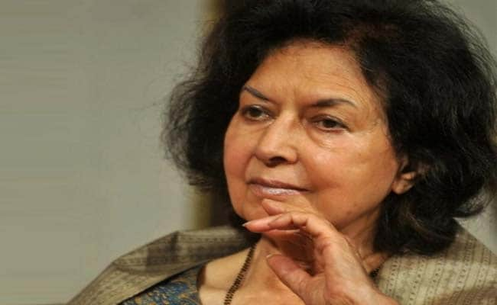
Nayantara Sahgal
Born - May 10, 1927
1
Member of the Nehru-Gandhi family
2
Returned her Sahitya Akademi Award 1986 for Rich Like Us
3
“It is very difficult to separate [politics] from real life in India as the reality of life is so political here where women are roasted alive on their husbands' funeral pyre[s] and are burnt to death for dowry.“ (Sahgal 8)
4

Slide 10
Thematic Concerns
Freedom – human, natural and personal
Victimization of women in patriarchal society
Mistaken Identity
Rich Like Us
Man-Woman relationship
Nationalistic viewpoint

Slide 11
Nationalistic viewpoint
Man – woman relationship
“I knelt too, facing Mecca, and prayed in imitation of Razia, yet as naturally as if I have been doing it since birth.” (Mistaken Identity 55)
"[T]inkers, tailors and tradesmen .. . rich men, poor men, beggar men .. . all sorts and classes of Hindus and Muslims erased their differences and came together in response to Gandhi's call for civil disobedience.” (Rich Like Us 115-116)
Victimization of woman
Freedom
"Early one morning she left the family mansion...she walked out to star in the most sensational scandal of the generation. Society has not forgiven this liaison between an illiterate Ranee and her communist lover, and the shameless public exhibition they make of it." (Mistaken Identity 238)
"I was a civil servant until I was thrown out, soon after the emergency began." (Rich Like Us 232)
I “t was always Sita who had to pray to be swallowed by the earth, and always a woman who had to climb her husband’s pyre and be burned alive.” (Rich Like Us 67)

Slide 12
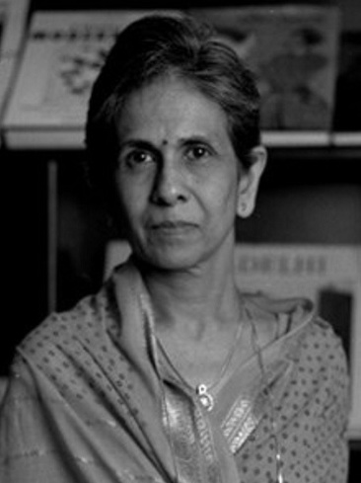
Shashi Deshpande
Born - August 19, 1938
1
Awarded Padma Shri in 2009
2
Returned her Sahitya Akademi Award 1990 for That Long Silence
3
4
Traditional Values – Harmony and Co-existence
Modernity – Independent Individual Identity

Slide 13
Thematic Concerns
That Long Silence
Long silence
Quest for identity
Plight of modern educated middle class woman
Gender discrimination
The Dark Holds No Terror

Slide 14
Long silence
Quest for identity
“The woman who had once lived here , [was] Mohan’s wife, Rahul and Rati’s mother. Not myself.” (That Long Silence 69)
“I remember now that he had assumed I would accompany him, had taken for granted my acquiescence in his plans. So had I.”(That Long Silence 11)
“ Will have to erase the silence between us, but the actual drama is postponed to the future.” (That Long Silence 192)
Plight of modern educated middle class woman
Gender discrimination
“He had been the young man and I his bride. Now I was the lady doctor and he was my husband.” (The Dark Holds no Terror 180)
“For me, things now began to hurt…. A frayed saree I could not replace, a movie I could not see, an outing I could not join in. I knew now that without money life became petty and dreary. The thought of going on this way became unbearable.” (The Dark Holds no Terror 92)
“He’s different. He’s a boy.” (The Dark Holds no Terror 45)
“But of my birth, my mother had said to me once...... it rained heavily the day you were born. It was terrible. And somehow, it seemed to me that it was my birth that was terrible for her, not the rains.” (The Dark Holds no Terror 169)
“…Daughter? I don’t have any daughter. I had son and he died. Now, I am childless.” (The Dark Holds no Terror 196)

Slide 15
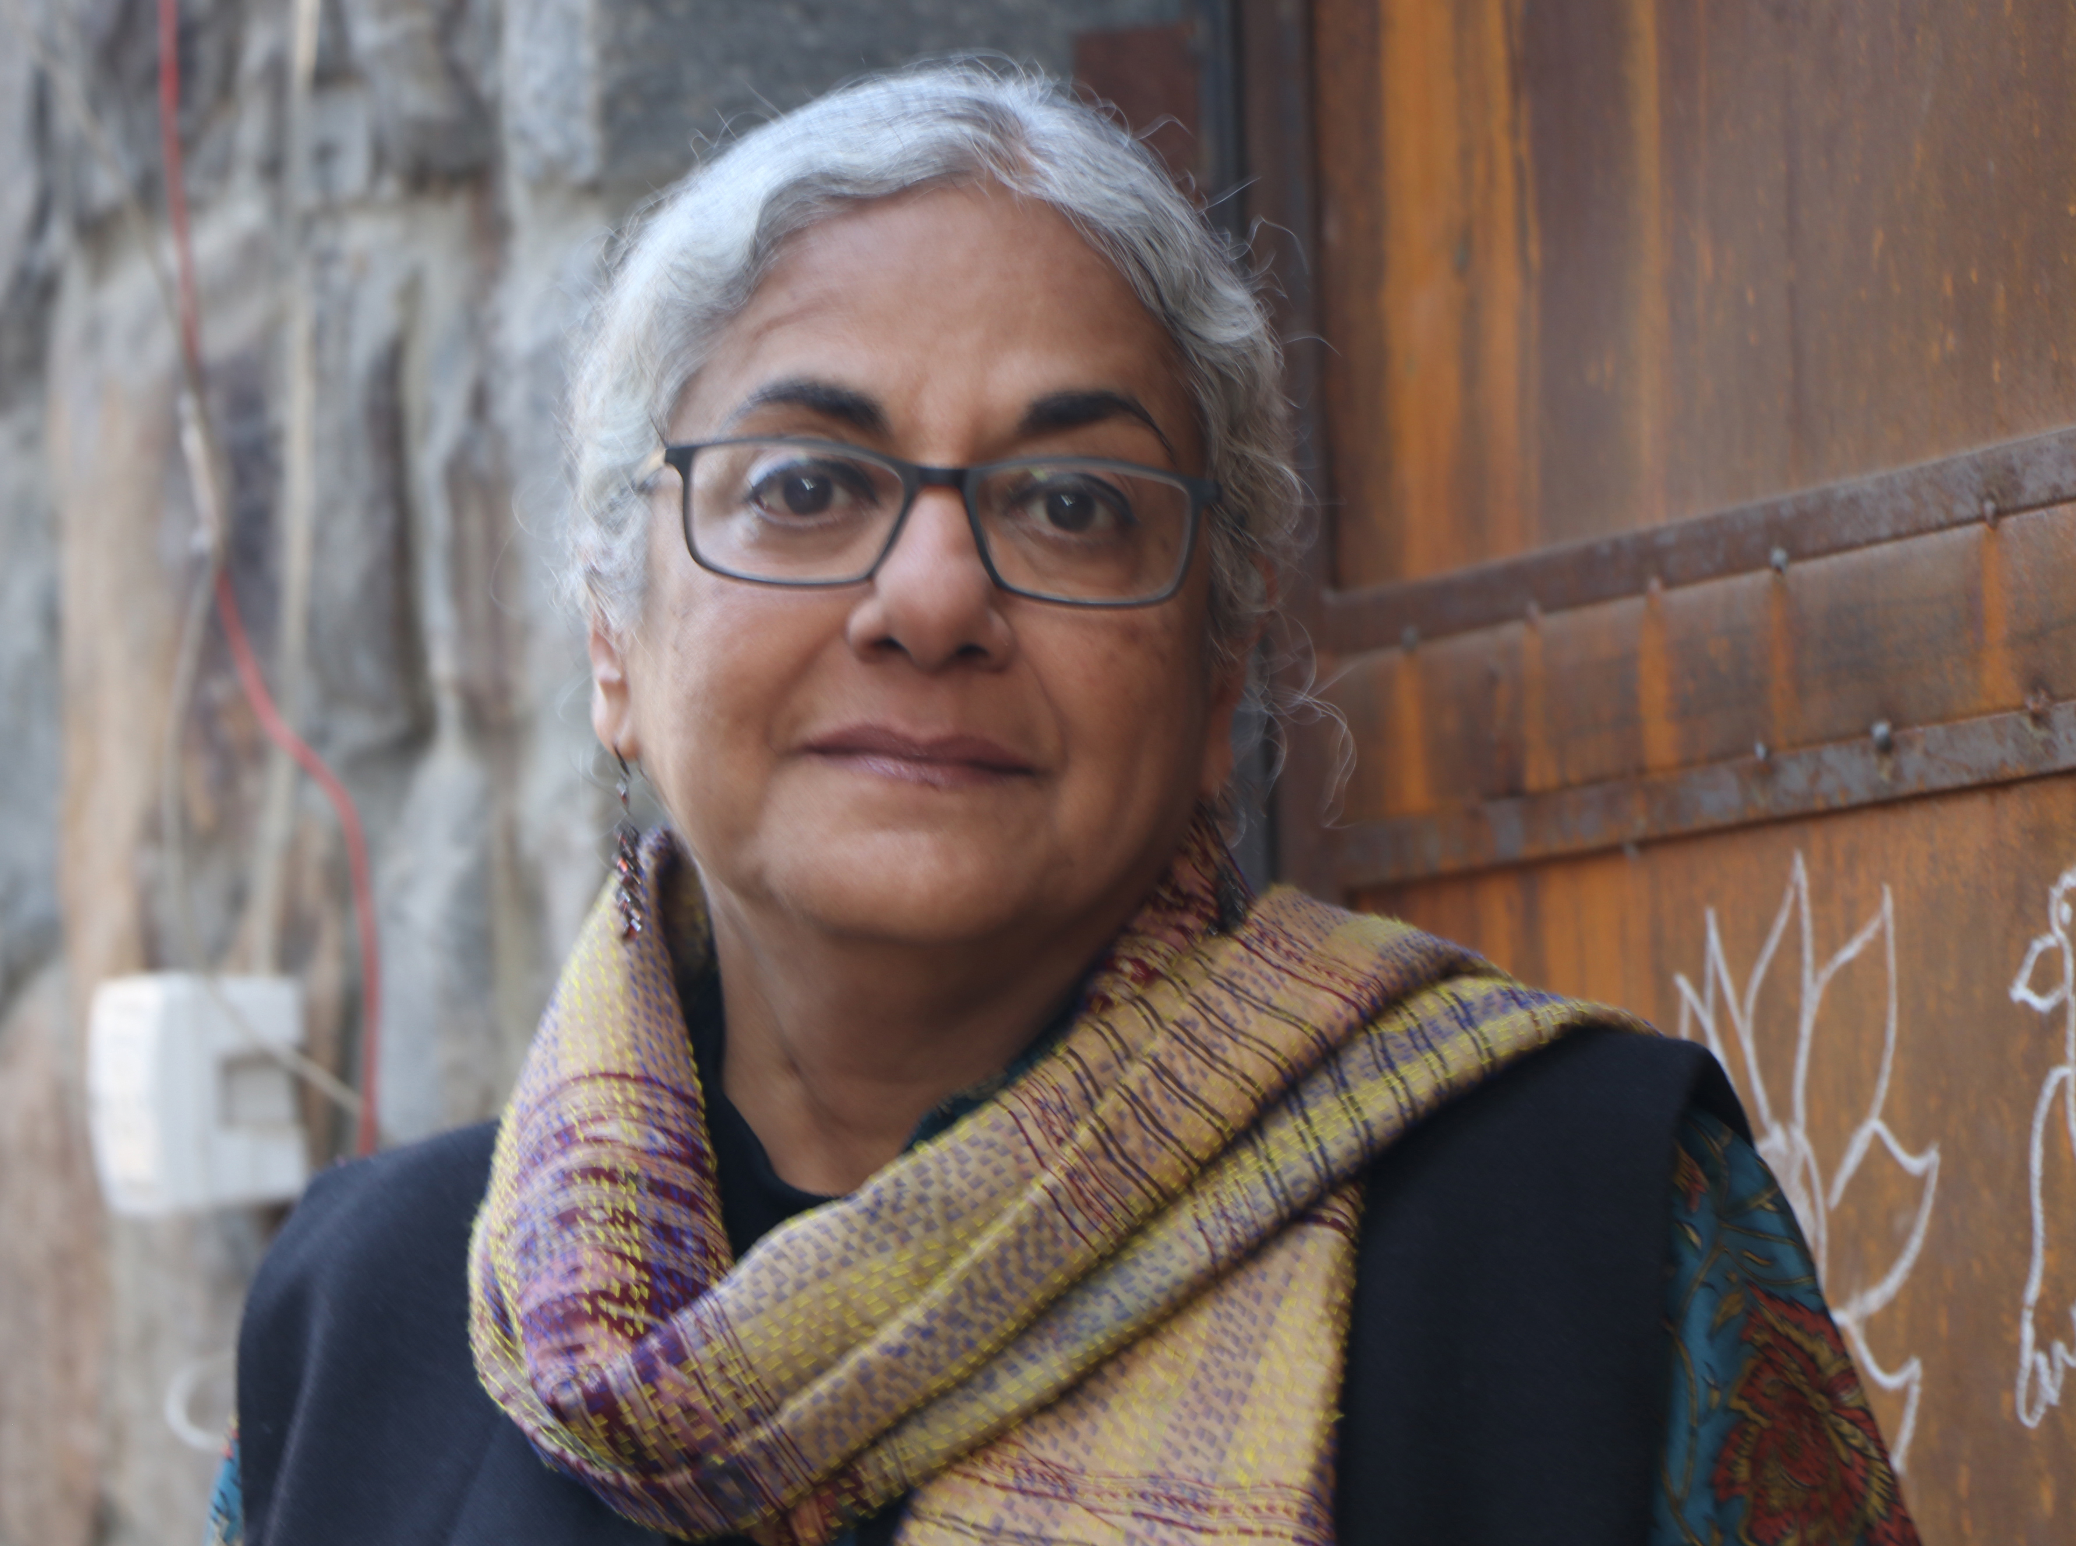
Githa Hariharan
Born in 1954
1
2
Won the Commonwealth Writers’ Prize for best first novel in the Eurasian region in 1993 (The Thousands Faces of Night)
Explores Indian Mythology
3

Slide 16
Thematic Concerns
1
2
3
Myth
vs.
Reality
Repressed status of women in the society
Recreation of Women’s Identity
The Thousands Faces of Night

Slide 17
Myth vs. Reality
Reality
“Yes, I am a wife and a daughter-in-law.” (The Thousand Faces of Night 30)
Nala and Damyanti
“A woman gets her heart’s desire by great cunning.” (The Thousand Faces of Night 20)
Gandhari
“The lesson brought me five steps close to adulthood. I saw for the first time that my parents too were afflicted by a kind of blindness. In their blinkered world they would always be, one leading the other, one hand always in the grasp of another.” (The Thousand Faces of Night 29)
Amba
“I lived a secret life of my own; I became a woman Warriors, a heroine, I was Devi. I rode a tiger and cut of the evil magical demons heads.” (The Thousand Faces of Night 41)
Ganga
“To be a goodmother, to be a mother at all . . . you have to renew your wifely vows everyday.” (The Thousand Faces of Night 88)
Recreation of Women’s identity
Devi – the mother goddess

Slide 18
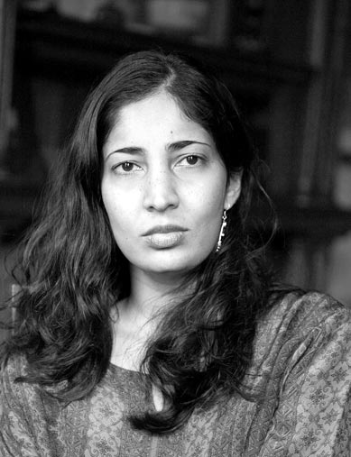
Kiran Desai
1
Born - September 3, 1971
2
Man Booker Prize 2006
(The Inheritance of Loss)
Experiments with irony and humour
3

Slide 19
Thematic Concerns
Alienation
Conflicts of culture, globalization,economic inequality,etc.
Freedome from mundane life
The Inheritance of Loss
Hullabaloo in the Guava Orchard

Slide 20
Alienation
Escapism
Jemubhai Patel
“For entire days nobody spoke to him at all, his throat jammed with words unuttered, his heart and mind turned into blunt aching things, and elderly ladies, even the hapless--blue haired, spotted, faces like collapsing pumpkins-- …. The young and beautiful were no kinder; girls held their noses and giggled, “Phew, he stinks of curry!” (The Inheritance of Loss 39).
“A foreigner in his own country.” (The Inheritance of Loss 29)
Nimmi
“He did not like his wife’s face, searched for his hatred, found beauty, dismissed it…. An Indian girl could never be as beautiful as an English one.” (The Inheritance of Loss 168)
Sai
“She had no idea how to properly make tea this way, the Indian way. She only knew the English way.”(The Inheritance of Loss 7)
Biju
“She had hoped for men from the poorer parts of Europe--Bulgarians perhaps, or Zechoslovakians. At least they might have something in common with them like religion or skin colour….” (The Inheritance of Loss 48)
“I want my freedom.” (Hullabaloo in the Guava Orchard 47)
“The Baba has subdued the beast.” (Hullabaloo in the Guava Orchard 108)
“The ape community obtained news of Sampath and organised a visit.” (Hullabaloo in the Guava Orchard 89 )
“Sampath’s hide out has now turned into a place of worship for devotees who pay visits, offer prayers and receive blessings ofthe famous Baba in his tree top hermitage.” (Hullabaloo in the Guava Orchard 92)
“This scene filled his whole mind and he wondered if he could ever get enough of it. This was the way of the riches and this was the king’s life . . . . he thought ….. yes he was at the right place at last.” (Hullabaloo in the Guava Orchard 51)

Slide 21
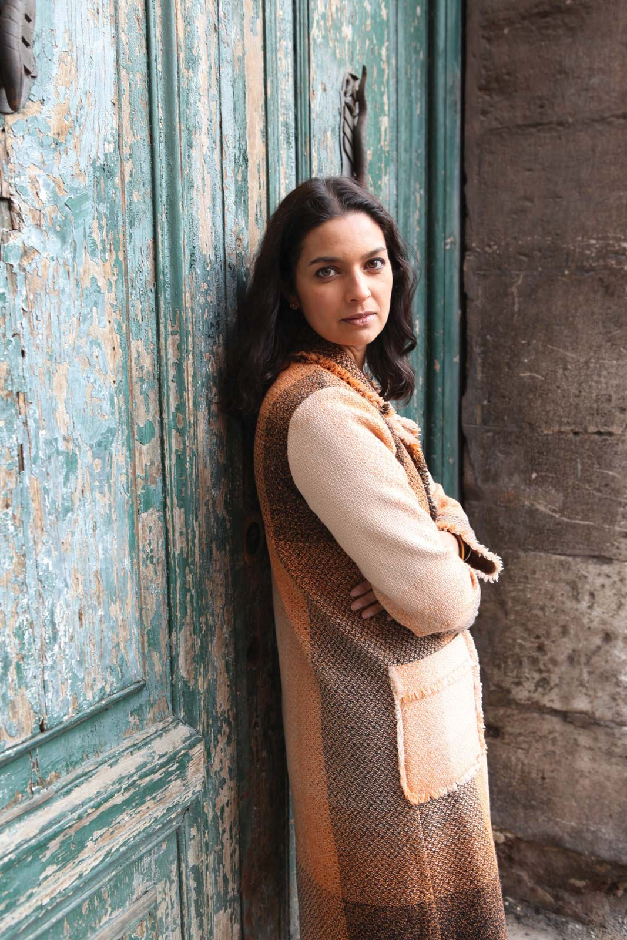
Jhumpa Lahiri
1
Born - July 11, 1967
Pseudonym of Nilanjana Sudeshna
2
Pulitzer Prize for Fiction for her debut "Interpreter of Maladies"
3

Slide 22
Thematic Concerns
Cultural Alienation
Sufferings of
first and second generations emmigrants
Question of Identity
I
II
III
The Namesake

Slide 23
First generation
Cultural alienation
“She stands there watching until the rear car disappears into the tunnel, until she and Gogol are the only people remaining on the platform. She pushes the stroller back down Massachusetts Avenue, weeping freely, knowing that she can’t possibly afford to go back and buy it all again.” (The Namesake 42)
“Who had forsaken everything to come to this country, to make a better life, only to die here?” (The Namesake 180)
“…feels lonely suddenly, horribly, permanently alone, and briefly, turned away from the mirror she sobs for her husband. She feels overwhelmed by the thought of the move she is about to take, to the city that was once home and is now in own way foreign.” (The Namesake 278)
“I am saying I don’t want to raise Gogol alone in this country. It’s not right. I want to go back.” (The Namesake 33)
Question of Identity
“He is afraid to be Nikhil, someone he doesn't know. Who doesn't know him.” (The Namesake 57)
“American-born confused Deshi, Gogol is a symbol for the confusion that immigrants experience under the conditions of displacement.” (The Namesake 118)
Second generation
“At times…, and another bottle of wine is opened, and Gogol raises his glass to be filled yet again, he is conscious of the fact that his immersion in Maxine's family is a betrayal of his own.” (The Namesake 141)

Slide 24
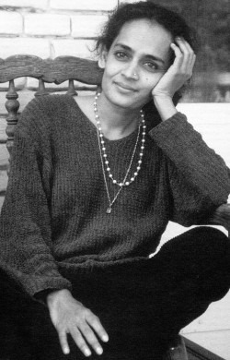
Arundhati Roy
Born - November 24, 1961
1
2
First Indian Women to win
Man Booker Prize for The God of Small Things (1997)
3
"Fiction is truth. I think fiction is the truest thing there ever was.“

Slide 25
Thematic Concerns
Plight of woman
Class Division
Small Things
1
3
2
The God of Small Things

Slide 26
Plight of woman
Small things
Education for girls is an “unnecessary expense.”(The God of Small Things 66)
“She thought that anything, anyone at all would be better than returning to Ayemenem.”(The God of Small Things 68)
“To everything that she had fled from only a few years ago. Except that now she had two young children. And no more dreams.” (The God of Small Things 70)
“Even later, on the thirteen nights that followed this one, instinctively they stuck to the Small Things. The Big Things ever lurked inside. They knew that there was nowhere for them to go. They had nothing. No future. So they stuck to the small things.” (The God of Small Things 220)
Class division
“Where they really lived. Where the Love Laws lay down who should be loved. And how. And how much.” (The God of Small Things 182)
”It was a time when the unthinkable became thinkable and the impossible really happened.” (The God of Small Things 16)

Slide 27
Shobha De
Born - January 7, 1948
1
2
Referred as ‘Jackie Collins of India’
3
Brings out secret lives and survival of the high class
4
Every name of the novel starts with letter ‘S’

Slide 28
Thematic Concerns
Socialite Evenings
Absurdities of modern world
Image of new woman

Slide 29
Image of new woman
Absurdities of modern world
“Men like dogs could be conditioned through reward and punishment.”(Socialite Evenings 87)
“No calls on Sundays, no calls at home, letters to be destroyed immediately after reading... no presents.” (Socialite Evenings 171)
“Like most women in her circle, she (Anjali) had started dabbling in fashion designing and advertising.” (Socialite Evenings 10)
“We were reduced to being marginal people. Everything that mattered to us was trivialized . .......... roof over our head and four square meals a day.” (Socialite Evenings 69)
“He was just an average Indian husband-unexciting, uninspiring, untutored... He wasn’t looking for any stimulation either intellectually or emotionally.” (Socialite Evenings 90)

Slide 30
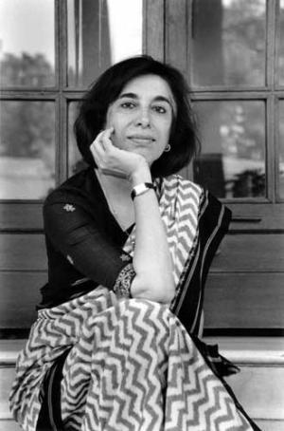
Manju Kapur
Born - January 7, 1948
1
2
Awarded Commonwealth Writers’ Prize 1999 for Difficult Daughters
3
Examines roles of womanhood – a mother, a daughter, a friend, a wife

Slide 31
Thematic Concerns
Marriage
Modernity over Tradition
Mother-Daughter Relationship
Difficult Daughters

Slide 32
Marriage
Mother – Daughter relationship
“The one thing I had wanted was not to be like my mother.”(Difficult Daughters 1)
“I grew up struggling to be the model daughter... My mother tightened her reins on me… Now live in it, Mama, and leave me be. Do not haunt me anymore.” (Difficult Daughters 279-280)
“It is the duty of every girl to get married.” (Difficult Daughters15)
“He does not even know you, has never tried to know you. For him, you are a woman that his family has arranged he should marry. For such men the individual is unimportant. It is the institution they are concerned with. If not you, then someone else.” (Difficult Daughters 56-57)
Modernity over tradition
“Would independence remove the inequalities between two wives.” (Difficult Daughters 232)
“A metaphor to explore the possibilities for modem women in education and economic independence who experience humiliation and disillusionment.” (Difficult Daughters 18)

Slide 33
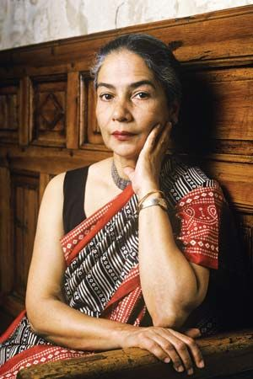
Anita Desai
1
Born - June 24, 1937
Padma Bhushan 2014
2
Emphasis from outer to inner reality
3

Slide 34
Protagonists
The one who fails to adjust with harsh realities of life.
Eg- Maya, Monisha and Nanda Kaul
The one who compromise with their surroundings for survival
Eg- Sara, Bim, Sarla and Lotte

Slide 35
Conclusion
“Through this medium of expressing themselves in writing, women have investigated and published those aspects of their lives as sexual beings that have not previously been acknowledged by society. Despite late 21stcentury, women are still very far from attaining the required level of Socio-cultural, educational and economic advantages usually enjoyed by men. “(Sree 39)

Slide 36
Works Cited
Iyengar, Srinivas. Indian Writing in English. Sterling Publishers 1993
Prasad, Amar Nath . New Lights on Indian Women Novelists in English. Sarup & Sons, 2005
Markandaya, Kamala. Nectar in the Sieve. . Jaico, 1965
Markandaya, Kamala. Some Inner Fury. Jaico, 1971
Jhabvala, Ruth Prawer. Heat and Dust. New York: Simon and Schuster, Inc., 1975
Sehgal, Nayantara. Mistaken Identity. Arnold Heinemann, 1988
Sehgal, Nayantara. Rich Like Us. Arnold Heinemann, 1985
Deshpande, Shashi. The Dark Holds No Terror. Vikas Publishing House(P) Ltd.,1980
Deshpande, Shashi. That Long Silence. Penguin, 1988
Hariharan, Githa. The Thousand Faces of Night. Penguin, 1992
Desai, Kiran. The Inheritance of Loss. Penguin, 2006
Desai, Kiran. Hullabaloo in the Guava Orchard .Faber and Faber. London. 1998
Lahiri, Jhumpa. The Namesake. Harper Collins, 2003
Roy, Arundhati. The God of Small Things. Flamingo, 1997
De, Shobha. Socialite Evenings. India, Penguin, New Delhi, 1989
Kapur, Manju. Difficult Daughters. New Delhi: Penguin India, 1998

Slide 37
THANK YOU

