Slide 1

MATERIAL RESOURCE PLANNING (MRP)
ENTERPRISE RESOURCE PLANNING (ERP)

Slide 2
MRP I ?

Slide 3
Meaning
It is basically a system which controls system of inventory so that up-to-date records of the status of a large number of items in inventory can be kept.

Slide 4
Aims
□ Determine for final products what should be produced and at what time.
□ Calculate the required production
□ Determine the requirements for material Bill of Materials (BOM).
□ Calculate inventories, work-in-progress, batch sizes and manufacturing and packaging lead times.
□ control inventory by ordering bought-in components

Slide 5
OBJECTIVES
□ It determines the quality and timing of finished goods demanded.
□ It determines time phased requirements of the demand for materials,
□ It computes the inventories, work-in-progress batch sizes and manufacturing and packing lead times.
□ It controls inventory by ordering components and materials in relation to orders received rather than ordering them from stock level point of view.

Slide 6
Benefits
□ Significantly decreased inventory levels and corresponding decreases in inventory carrying costs.
□ Fewer stock shortage,.
□ Increased effectiveness of production supervisors and less production chaos.
□ Better customer service
□ Greater responsiveness to change
□ Closer coordination of the marketing, engineering, and finance activities

Slide 7
MRP II ?

Slide 8
meaning
MRP II utilizes software applications for coordinating manufacturing processes, from product planning, parts purchasing, inventory control to product distribution. MRP II is a method for the effective planning of all the resources of a manufacturing company.

Slide 9
It also addresses business planning, sales and operations planning, demand management, production planning, master scheduling, material requirement planning, capacity requirement planning,

Slide 10

MRP-II and its interfaces

Slide 11
Essential Elements of MRP II
□ The essential elements of MRP II system are as follows:
□ Demand Forecast –
□ Production Planning –
□ Resource Planning -

Slide 12
□ Rough-cut Capacity Planning –
□ Master Production Schedule –
□ Bills of Material –
□ Materials Requirement Planning

Slide 13
□ Detailed Material and Capacity Plans –
□ Shop and Purchase Order Release - which activate production and purchasing.
□ Shop-floor Control –
□ Purchase and Inventory Control -

Slide 14
NEED OF IMPLEMENTING MRP
REALTIME INVENTORY STATUS AVAILABLE
MEETING DELIVERY SCHEDULE
IMPROVED PERFORMANCE

Slide 15
MRP Inputs
MRP Processing
MRP Outputs
Changes Order releases
Planned-order schedules
Master
schedule
Primary reports
Exception reports
Bill of
materials
Planning reports
Performance- control reports
MRP computer programs
Secondary reports
Inventory records
Inventory
transaction

Slide 16
ADVANTAGES
INVENTORY
PRODUCTION
SALES
ENGINEERING
FINANCE
SCHEDULING

Slide 17
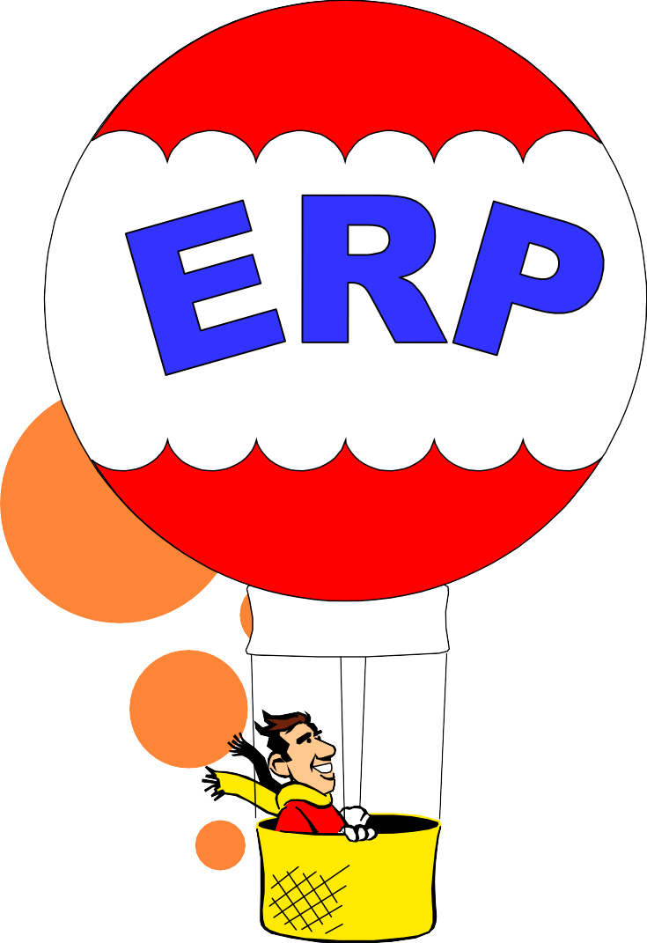
Enterprise Resource Planning Systems

Slide 18
ERP ?

Slide 19
meaning
ERP means the techniques and concepts for integrated management of business as a whole from the view point of the effective use of management resources to improve the efficiency of enterprise management. ERP provides integrated business software modules to support functional units of an enterprise. It has a process oriented approach in the sense that it focuses on core processes like order fulfillment, materials procurement, balance sheet preparation etc. and attempts to integrate various functions of an enterprise involved the execution of these processes.

Slide 20
ERP systems provide integration across multiple locations and functional areas. ERP systems permit organizational standardization across different locations. ERP system brings with time-tested and successful business practices that will help the organization to become more competitive. ERP also facilitates communication and collaboration with outside organizations like suppliers, customers, logistic agents, insurance companies, market enquiries, service outlets, warehouses, retail and wholesale outlets etc.

Slide 21
NEED FOR IMPLEMENTING ERP
FOR PROPER RESOURCE UTILIZATION
TO REDUCE LEAD-TIME
FOR DECISION MAKING
TO INCREASES CUSTOMER SATISFACTION
TO PROVIDE BETTER PROCUREMENT PROCESS

Slide 22
Benefits from ERP
Lowering the cost of products and services purchased
- Significant paper and postage cost reductions
- Improve the productivity of process and personnel
- Inventory reduction
- Lead time reduction
- Reduced stock obsolescence
- Faster product/service lookup and ordering saving time and money
- Automated ordering and payment, lowering payment processing and paper costs

Slide 23
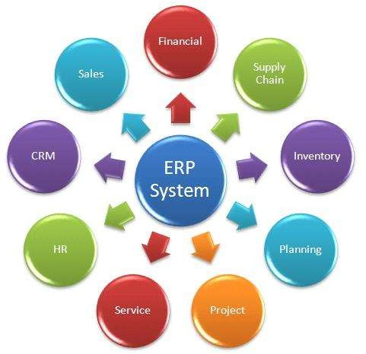
COMPONENTS OF ERP

Slide 24
STEPS IN IMPLEMENTING ERP

Slide 25
Draw a detailed plan
Identify the
Select the
need
software
Organisation
Evaluate the
is ready?
old process
Ass ess the
Start
costs of
organising
installing

