Slide 1
Natural and Acquired Immunity
Dr. Namita Ashish Singh

Slide 2
Immunity
Immunity is body's ability to resist or eliminate potentially harmful foreign materials or abnormal cells

Slide 3
History
Emil von Behring and Kitasato (1890)
Serum from vaccinated animals was protective (diptheria)
Metchinkoff (1880)
Cell based Immunity
Since 1901 there have been 19 Nobel Prizes for immunology-related research.
Both serum and cells contribute to immunity
Notes:
Emil von Behring -German
Kitasato –Japanese
Metchinkoff –Russian
Merrill Chase - American

Slide 4
Where and how do we defend against disease pathogens?
Immunity is
The ability to resist infection and disease
Many body cells and tissues are involved in the implementation of immunity (Not just lymphocytes and other immune cells)
Innate (Nonspecific) Defenses (we are born with this capability)
Respond immediately to many different harmful agents
Do not require a previous exposure to a foreign substance
Adaptive (Specific) Defenses (these components develop with time)
Lymphocytes (B, T): Are major players in the immune response but other cells and participants in the innate system work cooperatively
Identifies, attacks, and reinforces immunity to a specific pathogen
These 2 categories of immune mechanisms work together
Notes:
B & T lymphocytes have very specific receptors, recognize only very specific types of foreign components

Slide 5
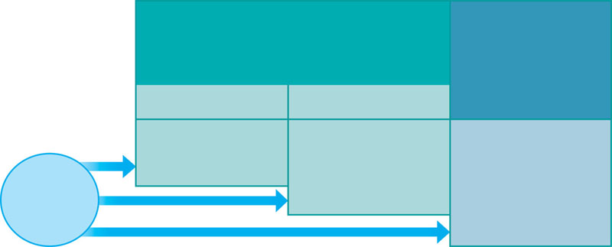
A typical immune response
INNATE IMMUNITY
Rapid responses to a
broad range of microbes
ACQUIRED IMMUNITY
Slower responses to
specific microbes
External defenses
Internal defenses
Skin
Phagocytic cells
Humoral response
(antibodies)
Mucous membranes
Antimicrobial proteins
Secretions
Inflammatory response
Invading
microbes
(pathogens)
Natural killer cells
Cell-mediated response
(cytotoxic
lymphocytes)
Complement

Slide 6
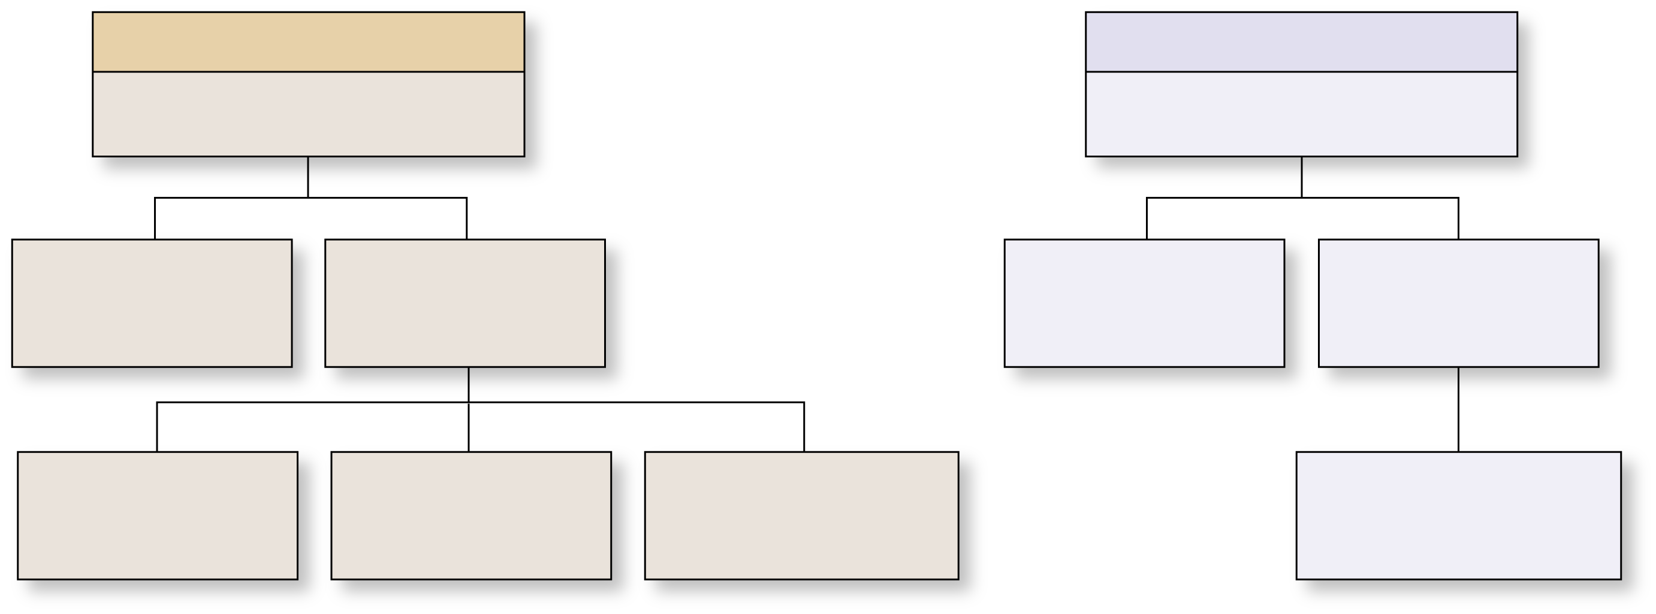
Overview of the Immune System
Copyright © The McGraw-Hill Companies, Inc. Permission required for reproduction or display.
Immune System
Innate immunity
Adaptive immunity
Immediate response to wide
array of substances
Delayed response to
specific antigen
Skin and mucosal
Membranes & barriers
(prevent entry)
Nonspecific
internal defenses
T-lymphocytes
(cell-mediated
immunity)
B-lymphocytes
(humoral immunity)
Cells
(e.g., macrophages,
NK cells)
Chemicals
(e.g., interferon,
complement)
Physiologic responses
(e.g., inflammation,
fever)
Plasma cells
(synthesize and
release antibodies)

Slide 7
Innate - Nonspecific Defenses: 7 categories
1st line of defense
Physical barriers: Skin and mucosal barriers - keep hazardous materials outside the body
2nd line of defense
Phagocytes: neutrophils and macrophages: engulf pathogens and cell debris
Immunological Surveillance: natural killer cells (NK cells) destroy abnormal cells.
Interferons: Chemical messengers that coordinate the defenses against viral infections. Antiviral proteins do not kill viruses but block replication in cell
Complement: Complement action of antibodies to destroy pathogens
Inflammation: Triggers a complex inflammatory response limiting the spread of infection
Fever: A high body temperature which increases body metabolism, accelerates defenses and accelerates body defenses
Notes:
Rapid response
Physical barrier in lungs, digestive system, urinary system
Phagocyte- endocytose material, mix with lysosomal solution & kill

Slide 8
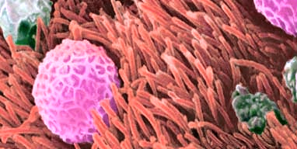
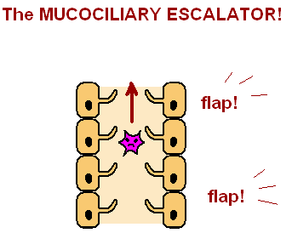
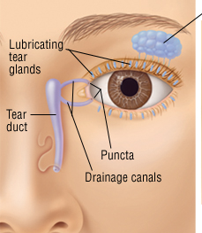
Anatomical Barriers - Mechanical Factors
Skin
Mucociliary escalator
Flushing action of
saliva, tears, urine

Slide 9
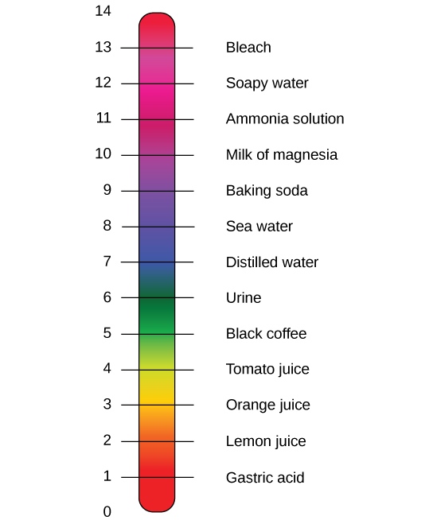
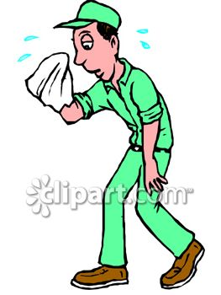
Anatomical Barriers – Chemical factors
Lysozyme in tears /saliva
Antimicrobial
Peptides in sweat
HCl in stomach
Notes:
Sweat – AMP – dermcidin

Slide 10
Anatomical Barriers – Biological factors
Normal flora – microbes in many parts of the body
Normal flora – > 1000 species of bacteria
Normal flora – competes with pathogens
for nutrients and space

Slide 11
Innate immunity vs Adaptive Immunity
Innate Immunity
(first line of defense)
Adaptive Immunity
(second line of defense)
No time lag
A lag period
Not antigen specific
Antigen specific
No memory
Development
of memory
Notes:
Analogy – IIT campus is the human body. The compound wall is the first line of defense or equivalent of innate immunity. It does not allow entry into the campus. Barbed wire fence may hurt intruders, if any. NO LAG, Not speific for any intruder (pathogen). It has no memory (It does not remember the intruder).
Let’s say an intruder manages to get into the campus. Then the second line of defense (let’s say security personnel) - get into action. They identify the intruder and pin him down and get him out. (Lag to mobilize resources, they just target a specific intruder (pathogen) and they remember the intruder and become better equipped if they encounter the same intruder again (Memory).

Slide 12
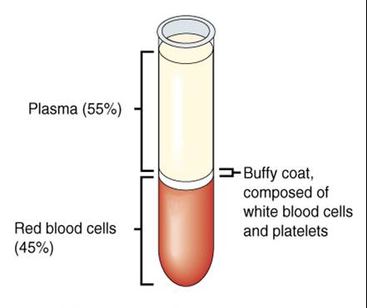
Internal defenses Innate immune system: components of Blood
Complement proteins
Coagulation proteins
Extracellular
Cytokines
WBCs

Slide 13
White blood cells (WBCs)
Macrophages
B-lymphocytes
T-lymphocytes
Natural killer(NK) cells
Mast cells

Slide 14
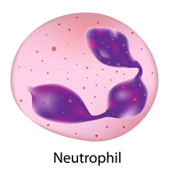
Neutrophils in innate immune response
Most abundant WBCs (~50-60%)
Efficient phagocytes
Most important cells of the innate immune system
Phagocytosis
Phago = to eat
Cyte = cell
WBCs (eg. Neutrophils) – find, eat and digest microbes !

Slide 15
How do neutrophils find microbes ?
https://youtu.be/I_xh-bkiv_c
https://www.youtube.com/watch?v=ZUUfdP87Ssg

Slide 16
How do phagocytes invade the area of infection or injury?
- Inflammatory factors – released by mast cells, etc.
- Vasodilation – capillaries become permeable
- Margination – WBCs slow down & align on the vessel wall
Diapedesis – blood cells leave vessels & enter the CT
Chemotaxis – blood cells follow a chemical gradient (move toward the source ie., bacteria)
Notes:
Mast cells release inflammatory factors that cause vasodilation (more permeable)
Margination: WBCs stick to the edge of blood vessel
Mast cells release CAM (Chemical Adhesion Molecule), allows diapedesis
Chemotaxis: WBC move up gradient toward bacteria
**know order of this process

Slide 17
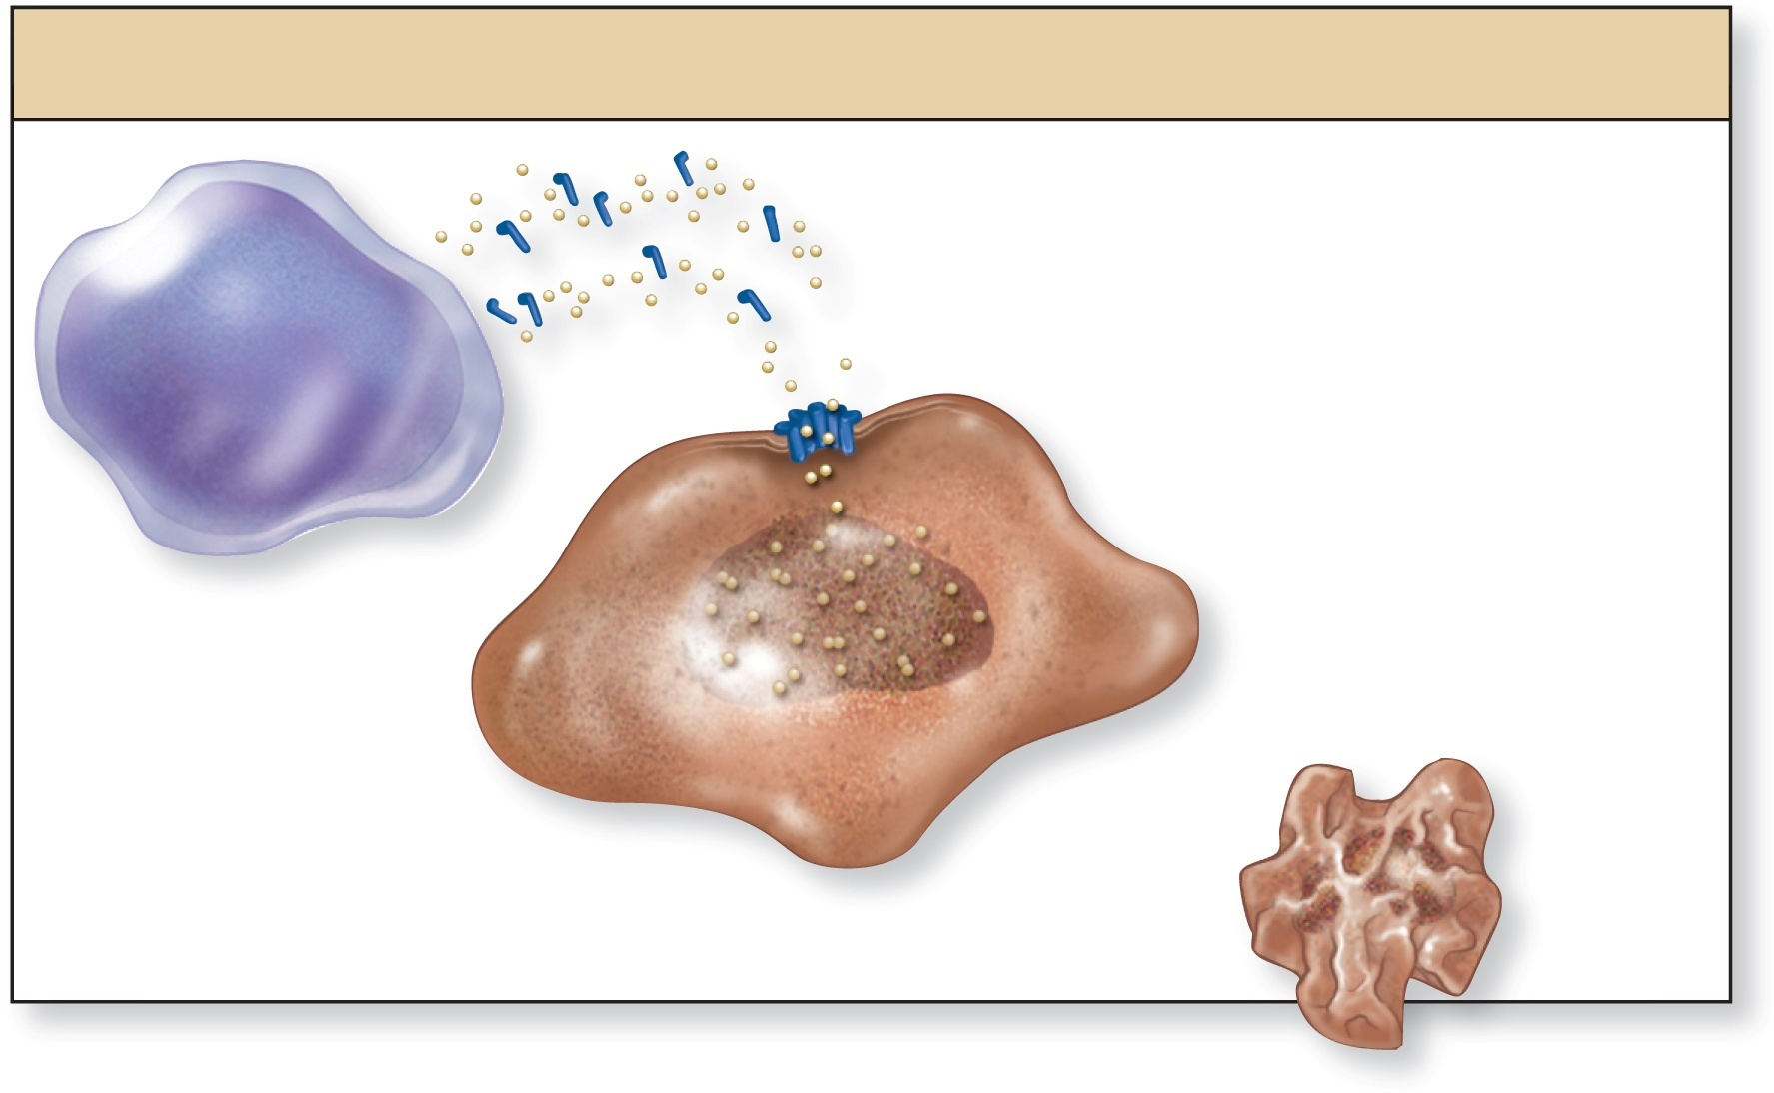
Immunological surveillance: NK cells
Copyright © The McGraw-Hill Companies, Inc. Permission required for reproduction or display.
NK cell: Apoptosis-initiating cells
Perforin and
granzyme
Perforin forms a
transmembrane pore
Granzymes enter
pore, causing
apoptosis of cell
NK cell
Unhealthy or
unwanted cell
Apoptosis
Recognizes unhealthy cell (usually expressing abnormal proteins or viral proteins – uses perforins (make a hole in the membrane) and granzymes (initiate apoptosis – programmed cell death via gene expression
Notes:
2 ways to kill a cell: lyze it (damages cells in surrounding area) or apoptosis (kills cell but does not release lyzosomal components so other cells are not damaged)
Less selective than lymphocytes respond to a variety of abnormal cell antigens; any cell with abnormal Ags will be attacked; highly versatile; attack bacteria in solution, viruses, and cancer cells. Respond quickly and has Fc receptors so will recognize an antibody attached to antigens expressed on the surface of an infected cell.

Slide 18
Interferons – signaling molecule (cytokine) released by viral-infected cells
Binds receptors of neighboring cells:
promotes macrophage function and apoptosis of infected cell
triggers synthesis of enzymes destroying viral RNA or DNA
triggers synthesis of enzymes that inhibit synthesis of viral proteins
Notes:
Cytokine- general term describing signaling molecules
Cause macrophages to phagocytose
Activate NK cells (apoptosis of injured cell)
Make enzymes that inhibit viral replication

Slide 19
Complement Proteins (#C1-C12))
~11 antimicrobial proteins in plasma – ‘complements’ functions of antibodies They have a number of functions (below) to defend against pathogens
Copyright © The McGraw-Hill Companies, Inc. Permission required for reproduction or display.
Opsonization
Inflammation
Cytolysis
Elimination of
immune complexes
Complement
Complement
Antigen
C
Mast cell
Basophil
Neutrophil
Macrophage
MAC
protein
Antibody
C
Complement
Pathogen
Pathogen
Erythrocyte
Inflammation
Macrophage
Complement (C) cross-links
immune (antigen-antibody)
complexes to erythrocyte and
transports to liver and spleen.
Complement (C) binds to
pathogen; acts as opsonin
Complement activates and attracts various cells of
innate immunity.
Complement proteins create
MAC to lyse cell.
Opsonin – coats pathogen to make appear different and thus recognizable by macrophages
Inflammation - Activates mast cells, basophils, neutrophils, and macrophages to increase inflammatory response -
Cytolysis – causes cell lysis (Big MAC attack)
Eliminates Antigen-Antibody complexes on RBCs killed in spleen
Notes:
Mast cells release a host of chemicals that increase blood flow, blood vessel permeability, attract and activate phagocytes and increase temperature
Made in liver
**Opsonization- complement protein/antibodies will stick on pathogen to make it look different
Complement Proteins activate WBCs, help inflammation
Multiple Complement proteins cause a cell to lyze

Slide 20
Innate Immunity: Inflammation
Redness - increased blood flow
Heat - increased blood flow and increased metabolic activity
Swelling - increase in fluid loss – capillaries to interstitial space, capillaries become more permeable due to histamine and other chemicals
Pain - stimulation of pain receptors from compression from interstitial fluid; chemical irritation by kinins, prostaglandins, microbe substances
Loss of function - (may occur in severe cases)
Acute inflammatory response
a local, nonspecific response -- typically lasts 8-10 days
sometimes persists in process of chronic inflammation
Notes:
Products of Inflammation Necrosis Local tissue destruction in area of injury Pus Mixture of debris and necrotic tissue Abscess Pus accumulated in an enclosed space
Swelling- fluid out of damaged blood vessels
Local response- red finger prints
Systemic event- whole body reacts

Slide 21
Innate Immunity: Inflammation
Immediate, local, nonspecific response
Major effector of innate immunity that helps eliminate infectious agents
1st step: chemicals like histamine, leukotirenes, prostaglandins and chemotactic factors released
2nd step: response in blood vessels = vasodilation and increased capillary permeability
3rd step: leukocytes (WBCs) recruited via margination and diapedesis. Also cells undertake chemotaxis and migrate toward (up the gradient) of chemical agents (bacterial secretions)
Neutrophils, eosinophils, macrophages clean up the area

Slide 22
Innate Immunity: Fever
Fever
Abnormal elevation of body temperature -- at least 1°C from normal (37°C)
May accompany inflammatory response
Due to excess fluid loss so requires increased fluid intake to prevent dehydration
Events of fever
Results from
release of pyrogens such as interleukin 1, interferons
toxins from infectious agents, drug reactions toxins, brain tumors
Pyrogens released and circulate through the body
target hypothalamus and cause release of prostaglandin E₂
raises temperature set point of hypothalamus
Notes:
Pyrogens increase temperature of body

Slide 23
Innate Immunity: Fever
Benefits of fever
Inhibits reproduction of bacteria and viruses
Promotes interferon activity
Increases activity of adaptive immunity
Accelerates tissue repair
Increases CAMs on endothelium of capillaries in lymph nodes
additional immune cells migrating out of blood
Recommended to leave a low fever untreated
Risks of a high fever significant above 100 degrees F
High fevers potentially dangerous above 103⁰ in children
Changes in metabolic pathways and denaturation of proteins
Possible seizures, irreversible brain damage at greater than 106⁰, death above 109⁰
Notes:
Promotes inflammation so that body (WBC) repairs itself, cleans system (this is good)
High fever- can damage cells, hypothalamus controls this

Slide 24
How do neutrophils eat and digest microbes ?
Granules
Notes:
Two additional roles: Antigen presentation – (role in adaptive immunity)
Triggers an inflammatory repsonse

Slide 25
Monocytes
Monocytes (~5% of WBCs)
Migrate into the tissues and become Macrophages
Macrophages
Big eaters”
Phagocytosis of microbes in tissue
(neutrophils are present only in blood)
Antigen presentation
Lung Bone
Liver Brain intestine

Slide 26
Natural killer cells
Not B-lymphocytes / T-lymphocytes
Important part of the innate immune system
Kill virus /bacteria infected cells (Intracellular pathogens)
Kills cancer cells
Notes:
are defined as large granular lymphocytes (LGL)

Slide 27
NK cells differentiate choose cells to kill ?
Uninfected cell / Normal cell
Microbe infected cell / cancer cell
Some cell surface proteins are missing

Slide 28
Toll-like receptors (TLRs)
Transmembrane proteins
Present on macrophages / few other cells
Conserved across vertebrates
Important part of innate immune system

Slide 29
TLRs – What do they do ?
They look out for microbes (or their components)
They bind to the microbes (or their components)
They trigger a cascade of events to kill or protect against pathogens
THEY ARE INNATE IMMUNE SENSORS

Slide 30
What happens when a TLR bind to a microbe ?
Secretion of Cytokines / Interferon
Enhanced immune response
Inflammation
Phagocytosis of infected cell
TLR binding to microbe
Apoptosis of infected cell
Killing of infected cell

Slide 31
Summary: innate response – internal defenses – Cellular (WBCs)
Come into play when the external defenses are breached
Neutrophils
Monocytes /macrophages
NK cells
TLRs

Slide 32
Innate immune system: components of Blood
Complement proteins
Coagulation proteins
Cytokines
WBCs

Slide 33
Cytokines
Small proteins – secreted by cells of the immune system
Affect the behaviour of other cells
signalling molecules
Key players in innate and acquired immunity

Slide 34
Which cells release cytokines ?
Cells of the immune system:
Neutrophils – when they encounter a pathogen
Macrophages – when they encounter a pathogen
TLRs – bind to microbe / components of a microbe
NK cells – on encountering a microbe infected cell /tumour cell
Lymphocytes – when they are activated

