Slide 1
UNIT III
UNIT COSTING

Slide 2
Meaning
Unit or Output costing is used in those industries or organisations where standard products are produced from a common process and all the units produced are more or less similar to each other.
This method is also known as “Single Costing Method”.

Slide 3
Definition of Unit or Output Costing
“Unit Costing method is a Method of costing applied to ascertain the cost per unit or production where standard and identical products are manufactured.
Walter W.Bigg.

Slide 4
Charachterstics of Unit Production
Production should be uniform or Homogeneous
Identical products
The cost unit should be physical /natural
Per Unit cost should be determined ,for eg.Per ton, per metre etc.

Slide 5
Objectives of Unit /Output Costing
To know the totsl cost of production
To classify cost under related categories such as prime cost, works cost etc.
To determine the effect of each element of cost
To compare cost during two or more periods
To determine proposed setting price to earn desired profit
To Determine tender price on the basis of Cost Data and Fututre prospects.

Slide 6
Cost Sheet
Cost Sheet is a statement of cost showing the total cost of production and profit or loss from a particular product or service.
A Cost Sheet shows the cost in a systematic manner and element wise.
A typical format of the Cost Sheet is given -

Slide 7
Cost Sheet
Cost sheet is a statement which is used to determine the total cost of goods produced in a specific Period and in which total cost,per unit cost and cost incurred at various stages from manufacturing a products to the stage of making it saleable are shown.

Slide 8
Definition of Cost sheet
“Cost Sheets are prepared for the use of management and consequently they must include all the essential details which may assist the manager in judging the efficiency of Production.”

Slide 9
Facts about Cost sheet
Total Quantity of production
Total cost of total quantity produced
Per unit cost of total quantity produced
Various components of cost at various stages of Production i.e. Prime cost,factory cost
Direct and Indirect cost of production
Comparative cost of two products and its analysis
Proportion of each individual cost to total cost expressed in percentage.

Slide 10
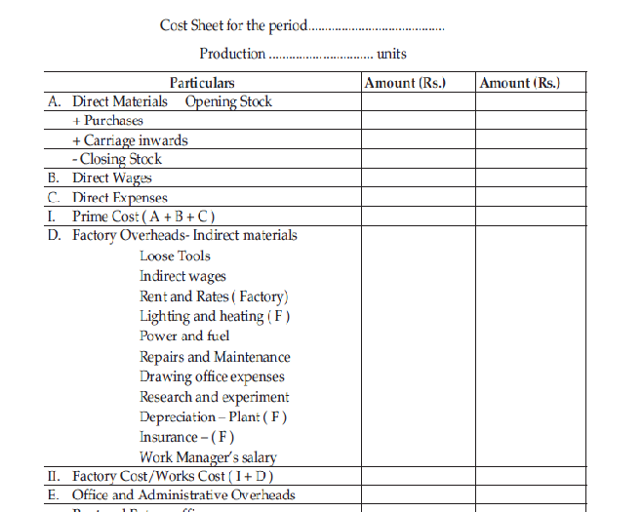

Slide 11
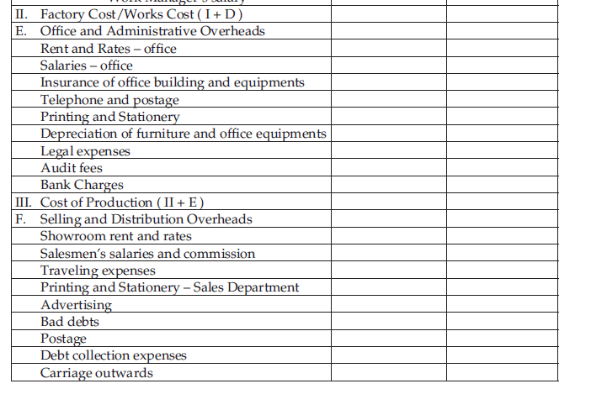

Slide 13
Cont…
Particulars | Total Cost (Rs.) | CostPerUnit(Rs.)
Opening stock of Direct Raw Material ---- Add: Purchases during the Year ---- Add : Incidental Expenses(Carriage , Freight,Octroi , Custom Duty) ---- Less: Closing Stock of Direct Raw Material ----- Less: Defective Materials Returned Less: Residue used in other products Cost of direct raw material consumed Direct Wages/Labour Charges or Productive Wages Direct Expenses /Chargeable Expenses
(A) Prime Cost | ------- | ------
Add: Work Overhead /Factory Overhead Factory Oncost/Un Productive Labour Indirect Wages/Unproductive Labour (Fuel,Power,coal,Light & water,Factory Insurance,Rent of factory,Dep. On Factory Building/machine Repairs on factory Building /machine | ------- | ------
2.)Cost Sheet with Profit

Slide 14
cont…
Particulars | Total Cost (Rs.) | CostPerUnit(Rs.)
Add: Opening Stock of work in progress Less: Closing Stock of Work in Progress Add: Additional Overburden on Rectification Less: Sale of Scrap/Defective etc.
Factory /Works Cost | ------- | ------
Add:Office and administrative Overheads/Office exp Legal Expenses,Office Expenses,Office salaries,office Lighting,Adm. Expenses,Printing and stationery,fees of Directors,telephone &Telegrams,Managing Director’s Salary(office),Dep.on Office building/furniture,Repairs to office building/Furniture | ------- | ------
Office Cost or cost of Producion | ------ | ------
Add: opening stock of Finished Goods Less: Closing Stock of Finished Goods
Cost of Goods Sold | ------ | ------
Cost Sheet with Profit

Slide 15
cont…
Cost Sheet with Profit
Particulars | Total Cost (Rs.) | CostPerUnit(Rs.)
Add: Selling & Distribution Overheads: Advertisement Discount Travelling Expenses Salesman Commission Dep.On Delivery Vans Packing and Distribution Charges Bad Debts Upkeep of Delivery Vans Warehouse Rent,etc.
Cost of Sales | ------- | ------
Profit( certain % on total cost or sales) | ------- | ------
Selling Price | ------- | --------

Slide 16
DIRECT MATERIAL
+
DIRECT LABOUR
+
DIRECT EXPENSES
=
PRIME COST

Slide 17
Prime cost + Factory Overheads*
=
FACTORY COST
* Factory Overheads
includes factory rent, oil & water, electric power, depreciation, etc.

Slide 18
Factory Cost + Administrative overheads*
=
COST OF PRODUCTION
*Administrative overheads
includes office rent, depreciation for office, manager salary, stationery, etc.

Slide 19
Cost of Production + Selling Overheads*
=
COST OF SALES
*Selling Overheads
includes salesman salary, advertising, free samples, delivery charges, etc.

Slide 20
Cost of Sales + Profit Margin
=
SALES

Slide 21
Sales = Direct Materials + Direct Labour + Direct
Expense + Factory overheads + Administrative overheads+ selling overheads + profit margin

Slide 22
COST SHEET
Particulars | Rupees
Direct Materials | ………………….
+Direct Labour | ………………….
+Direct Expenses | ………………….
= Prime Cost | ………………….
+ Factory overheads | ………………….
=Factory Cost | ………………….
+Administrative overheads | ………………….
=Cost of Production | ………………….
+Selling overheads | ………………….
=Cost of Sales | ………………….
+Profit margin | ………………….
=Sales | ………………….

