Slide 1
Portfolio Management
Prof Anil K kothari

Slide 2
The capital asset pricing model was developed by the financial economist (and later, Nobel laureate in economics) William Sharpe, set out in his 1970 book Portfolio Theory and Capital Markets. His model starts with the idea that individual investment contains two types of risk:
Systematic Risk vs. Unsystematic Risk
Systematic Risk – These are market risks—that is, general perils of investing—that cannot be diversified away.
Interest rates, recessions, and wars are examples of systematic risks.
Unsystematic Risk – Also known as "specific risk," this risk relates to individual stocks. In more technical terms, it represents the
component of a stock's return that is not correlated with general market moves.
Modern portfolio theory shows that specific risk can be removed or at least mitigated through diversification of a portfolio. The trouble is that diversification still does not solve the problem of systematic risk; even a portfolio holding all the shares in the stock market can't eliminate that risk. Therefore, when calculating a deserved return, systematic risk is what most plagues investors.

Slide 3
The capital asset pricing model (CAPM) is the equation that describes the relationship between the expected return of a given security and systematic risk as measured by its beta coefficient. Besides risk the model considers the effect of risk-free interest rates and expected market return.
Assumptions
Basic assumptions of the CAPM model are as follows.
Markets are ideal—no transaction fees, taxes, inflation, or short selling restrictions.
All investors are averse to risk.
Markets are highly efficient. All investors have equal access to all available information.
All investors can borrow and lend unlimited amounts under a risk-free rate.
Beta coefficient is the only measure of risk.
All assets are absolutely liquid and infinitely divided.
The amount of available assets is fixed during a given period of time.
Markets are in equilibrium. All investors are price takers, not price makers.
Return of all available assets is subject to normal distribution function.

Slide 4
The Capital Asset Pricing Model (CAPM) measures the risk of a security in relation to the portfolio. It considers the required rate of return of a security in the light of its contribution to total portfolio risk. The CAPM holds that only undiversifiable risk is relevant to the determination of expected return on any asset.
Even though the CAPM is competent to examine the risk and return of any capital asset such as individual security, an investment project or a portfolio asset

Slide 5
Assumptions of Capital Asset Pricing Model
The CAPM is based on the following assumptions.
1. Risk-averse investors
The investors are basically risk averse and diversification is necessary to reduce their risks.
2. Maximising the utility of terminal wealth
An investor aims at maximizing the utility of his wealth rather than the wealth or return. The term ‘Utility’ describes the differences in individual preferences. Each increment of wealth is enjoyed less than the last as each increment is less important in satisfying the basic needs of the individual. Thus, the diminishing marginal utility is most applicable to wealth.
There are also other forms of utility functions. Some investors showing a preference for larger risks are those who have increasing marginal utility for wealth. In such cases, each increase in wealth prompts the individual to acquire more wealth. For a risk-neutral investor, each increment in wealth is equally attractive. In other words, each increment would have the same utility for him.

Slide 6
3. Choice on the basis of risk and return:
Investors make investment decisions on the basis of risk and return. Risk and return are measured by the variance and the mean of the portfolio returns. CAPM assumes that the rational investors put away their diversifiable risk, namely, unsystematic risk. But only the systematic risk remains which varies with the Beta of the security.
Some investors use the beta only to measure the risk while other investors use both beta and variance of returns as the sources of reward. As individuals have varying perceptions towards risk and reward, CAPM gives a series of efficient frontlines.
4. Similar expectations of risk and return
All investors have similar expectations of risk and return. In other words, all investors’ estimates of risk and return are the same. When the expectations of the investors differ, the estimates of mean and variance lead to different forecasts.
As a result, there will be innumerable efficient frontiers and the efficient portfolio of each will be different from that of the others. Varying preferences also imply that the price of an asset will be different for different investors.
5. Identical time horizon
The CAPM is based on the assumption that all investors have identical time horizon. The core of this assumption is that investors buy all the assets in their portfolios at one point of time and sell them at some undefined but common point in future. This assumption further implies that investors form portfolios to achieve wealth at a single common terminal rate.

Slide 7
6. Free access to all available information
One of the important assumptions of the CAPM is that investors have free access to all the available information at no cost. Supposing some investors alone are able to have access to special information which is not readily available to all, then the markets would not be regarded efficient. In other words, if the available information has not reached all, it will be difficult to draw a common efficient frontier line.
7. There is risk-free asset and there is no restriction on borrowing and lending at the risk free rate
This is a very important assumption of the CAPM. The risk free asset is essential to simplify the complex pairwise covariance of Markowitz’s theory. The risk free asset makes the curved efficient frontier of MPT to the linear efficient frontier of the CAPM simple.
As a result, the investors will not concentrate on the characteristics of individual assets. By adding a portion of risk-free assets to the portfolio and borrowing the additional funds needed at a risk free rate, the risk is either decreased or increased.
8. There are no taxes and transaction costs
According to Roll, there must be either a risk free asset or a portfolio of short sold securities. Then only the capital Market Line (CML) will be straight. When there are no risk free assets, the investor could not create a proxy risk free asset. As a result, the capital market line would not be linear and the direct linear relationship between risk and return would not exist.
9. Total availability of assets is fixed and assets are marketable and divisible
This assumption holds the view that the total asset quantity is fixed and all assets are marketable.

Slide 8
Formula
The CAPM model allows you to assess the expected return of a given security using the following formula:
E(R_{i}) = R_{F} + β_{i} × (E(R_{M}) - R_{F})
where E(R_{i}) is an expected return of a security, R_{F} is a risk-free rate, β_{i} is the beta coefficient of a security, and E(R_{M}) is an expected
Market risk premium (RP_{M}) can be calculated as follows.
RP_{M}) = E(R_{M}) - R_{F}
The risk premium of a given security (RP_{i}) can be assessed as follows:RP_{i}) = β_{i} × (E(R_{M}) - R_{F})
Example
Let’s assume an investor is thinking of buying one of three stocks: Stock A with a beta of 0.85, Stock B with a beta of 1.25, and Stock C with a beta of 1.65. If the risk-free rate is 4.50% and the expected market return is 12.35%, the expected return of each security can be assessed under CAPM.
E(R_{A}) = 4.50 + 0.85 × (12.35 - 4.50) = 11.17%
E(R_{B}) = 4.50 + 0.85 × (12.35 - 4.50) = 14.31%
E(R_{C}) = 4.50 + 0.85 × (12.35 - 4.50) = 17.45%
Thus, a relationship exists between risk and the expected return of a security. So, the higher the beta, the higher the expected return and vice versa.

Slide 9
CAPM's starting point is the risk-free rate–typically a 10-year government bond yield. A premium is added, one that equity investors demand as compensation for the extra risk they accrue. This equity market premium consists of the expected return from the market as a whole less the risk-free rate of return. The equity risk premium is multiplied by a coefficient that Sharpe called "beta."
Beta's Role in CAPM
According to CAPM, beta is the only relevant measure of a stock's risk. It measures a stock's relative volatility–that is, it shows how much the price of a particular stock jumps up and down compared with how much the entire stock market jumps up and down. If a share price moves exactly in line with the market, then the stock's beta is 1. A stock with a beta of 1.5 would rise by 15% if the market rose by 10% and fall by 15% if the market fell by 10%.
Beta, compared with the equity risk premium, shows the amount of compensation equity investors need for taking on additional risk. If the stock's beta is 2.0, the risk-free rate is 3%, and the market rate of return is 7%, the market's excess return is 4% (7% - 3%). Accordingly, the stock's excess return is 8% (2 x 4%, multiplying market return by the beta), and the stock's total required return is 11% (8% + 3%, the stock's excess return plus the risk-free rate).
What the beta calculation shows is that a riskier investment should earn a premium over the risk-free rate. The amount over the risk-free rate is calculated by the equity market premium multiplied by its beta. In other words, it is possible, by knowing the individual parts of the CAPM, to gauge whether or not the current price of a stock is consistent with its likely return.

Slide 10
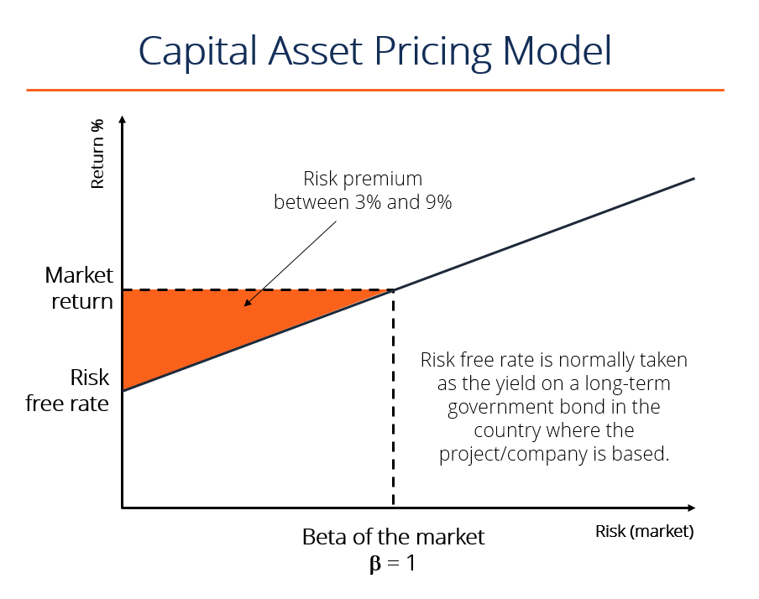

Slide 11
Portfolio diversification
CAPM deals with the risks and returns on financial securities and defines them precisely, if arbitrarily. The rate of return an investor receives from buying a common stock and holding it for a given period of time is equal to the cash dividends received plus the capital gain (or minus the capital loss) during the holding period divided by the purchase price of the security.
Although investors may expect a particular return when they buy a particular stock, they may be disappointed or pleasantly surprised, because fluctuations in stock prices result in fluctuating returns. Therefore common stocks are considered risky securities. (In contrast, because the returns on some securities, such as Treasury bills, do not differ from their expected returns, they are considered riskless securities.) Financial theory defines risk as the possibility that actual returns will deviate from expected returns, and the degree of potential fluctuation determines the degree of risk.
An underpinning of CAPM is the observation that risky stocks can be combined so that the combination (the portfolio) is less risky than any of its components. Although such diversification is a familiar notion, it may be worthwhile to review the manner in which diversification reduces risk.

Slide 12
The security market line
The culmination of the sequence of conceptual building blocks is CAPM’s risk/expected return relationship. This fundamental result follows from the proposition that only systematic risk, measured by beta (β), matters. Securities are priced such that:
R_{s} = R_{f} + risk premium
R_{s} = R_{f} + β_{s} (R_{m} – R_{f})
Where: R_{s} = the stock’s expected return (and the company’s cost of equity capital).
R_{f} = the risk-free rate.
R_{m} = the expected return on the stock market as a whole.
β _{s} = the stock’s beta.
This risk/expected return relationship is called the security market line (SML). I have illustrated it graphically in Exhibit III. As I indicated before, the expected return on a security generally equals the risk-free rate plus a risk premium. In CAPM the risk premium is measured as beta times the expected return on the market minus the risk-free rate. The risk premium of a security is a function of the risk premium on the market, R_{m} – R_{f}, and varies directly with the level of beta. (No measure of unsystematic risk appears in the risk premium, of course, for in the world of CAPM diversification has eliminated it.)
Security Market Line Slope
The slope of the security market line represents the market risk premium, i.e. the excess return over the market return. The market risk premium compensates for the additional systematic risk associated with the security. Therefore, the higher the risk, the higher the market risk premium for the security, and the higher the expected overall return for the security.

Slide 13
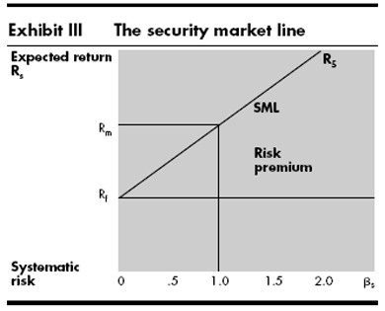
In the freely competitive financial markets described by CAPM, no security can sell for long at prices low enough to yield more than its appropriate return on the SML. The security would then be very attractive compared with other securities of similar risk, and investors would bid its price up until its expected return fell to the appropriate position on the SML. Conversely, investors would sell off any stock selling at a price high enough to put its expected return below its appropriate position. The resulting reduction in price would continue until the stock’s expected return rose to the level justified by its systematic risk.

Slide 14
Capital Market Line is a theoretical concept that represents all the portfolios that optimally combine the risk-free rate of return and the market portfolio of risky assets. Security Market Line measures the risk through beta, which helps to find the security’s risk contribution to the portfolio.
The differences between the capital market line and the security market line:
Capital market line:
CML shows the tradeoff between expected return and total risk.
CML considers both systematic and unsystematic risk.
CML is the graphical presentation of the equilibrium relationship between expected return and total risk for efficiency diversified portfolios.
The slope of the CML shows the market price of risk for efficient portfolios.
The CML is a line that is used to show the rates of return, which depends on risk-free rates of return and levels of risk for a specific portfolio.
Slope of the CML = (R_{m} – R_{f}) / σ_{m}

Slide 15
Security market line:
SML shows the tradeoff between the required rate of return and systematic risk.
SML considers only systematic risk.
SML is the graphical presentation of CAPM.
The slope of the SML shows the differences between the required rate of return on the market index and the risk-free rate.
SML is a graphical representation of the market’s risk and returns at a given time.
The slope of the SML = (R_{m} – R_{f}).
Most importantly, SML is used to determine whether more assets/investments can be added to the existing market portfolio. The risk running individually in these diverse market portfolios tells the investor about his undervalued and overvalued investments and thus this system of calculation is known as systematic risk.

Slide 16
Determining the Expected Rate of Return for a Risky Asset
Assume: RFR = 6% (0.06)
R_{M} = 12% (0.12)
Implied market risk premium = 6% (0.06)
E(R_{A}) = 0.06 + 0.70 (0.12-0.06) = 0.102 = 10.2%
E(R_{B}) = 0.06 + 1.00 (0.12-0.06) = 0.120 = 12.0%
E(R_{C}) = 0.06 + 1.15 (0.12-0.06) = 0.129 = 12.9%
E(R_{D}) = 0.06 + 1.40 (0.12-0.06) = 0.144 = 14.4%
E(R_{E}) = 0.06 + -0.30 (0.12-0.06) = 0.042 = 4.2%

Slide 17
Price, Dividend, and Rate of Return Estimates

Slide 18
Comparison of Required Rate of Return to Estimated Rate of Return

Slide 19
Parameters of Comparison | CML | SML
Full form | Capital Market Line | Security Market Line
Definition | CML determines your average rate of success or loss in the market share. | SML determines the market risk you are running with your investment.
Portfolios | Defines functioning portfolios. | Defines both functioning and non-functioning portfolios.
Functioning | More efficient. | Less efficient.
Agenda | To describe only market portfolios and risk-free investments. | To describe overall security factors.

Slide 20
The APT is a more flexible and complex alternative to the Capital Asset Pricing Model (CAPM). The theory provides investors and analysts with the opportunity to customize their research. However, it is more difficult to apply, as it takes a considerable amount of time to determine all the various factors that may influence the price of an asset.
Assumptions in the Arbitrage Pricing Theory
The Arbitrage Pricing Theory operates with a pricing model that factors in many sources of risk and uncertainty. Unlike the Capital Asset Pricing Model (CAPM), which only takes into account the single factor of the risk level of the overall market, the APT model looks at several macroeconomic factors that, according to the theory, determine the risk and return of the specific asset.
These factors provide risk premiums for investors to consider because the factors carry systematic risk that cannot be eliminated by diversifying.
The APT suggests that investors will diversify their portfolios, but that they will also choose their own individual profile of risk and returns based on the premiums and sensitivity of the macroeconomic risk factors. Risk-taking investors will exploit the differences in expected and real returns on the asset by using arbitrage.

Slide 21
Arbitrage in the APT
The APT suggests that the returns on assets follow a linear pattern. An investor can leverage deviations in returns from the linear pattern using the arbitrage strategy. Arbitrage is the practice of the simultaneous purchase and sale of an asset on different exchanges, taking advantage of slight pricing discrepancies to lock in a risk-free profit for the trade.
Mathematical Model of the APT
The Arbitrage Pricing Theory can be expressed as a mathematical model:
Where:
ER(x) – Expected return on asset
Rf – Riskless rate of return
β_{n} (Beta) – The asset’s price sensitivity to factor
RP_{n} – The risk premium associated with factor
Historical returns on securities are analyzed with linear regression analysis against the macroeconomic factor to estimate beta coefficients for the arbitrage pricing theory formula

Slide 23
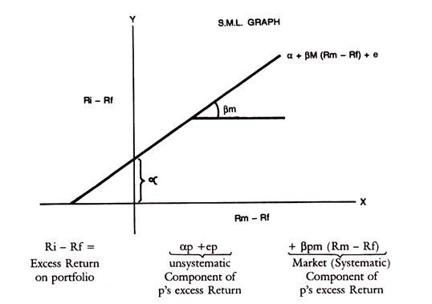
If thus the market index is used as a surrogate for other individual securities in the portfolio, the relation of any individual security with the Market index can be represented in a Regression line or characteristic line. This is drawn below, with the excess return on the security on the y-axis and excess return on the Market Portfolio on the x-axis.
The equation of the characteristic line is Ri – Rf = a + βim (Rm – Rf) + ei
Ri is the holding period return on security i
Rf is the riskless rate of interest
Alpha is the vertical intercept on y-axis representing the return on the security when only unsystematic risk is considered and systematic risk is measured by Beta. c_{i} is the residual component, not captured by the above variables.

