Slide 1
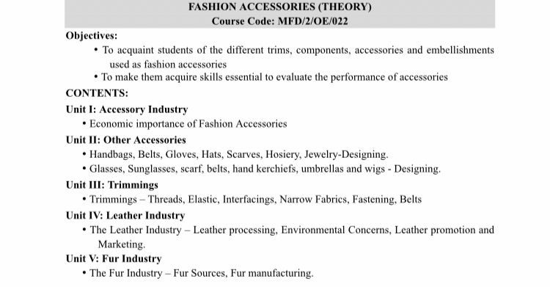

Slide 2
Unit I
Psychological and Sociological Influences of Clothing

Slide 3
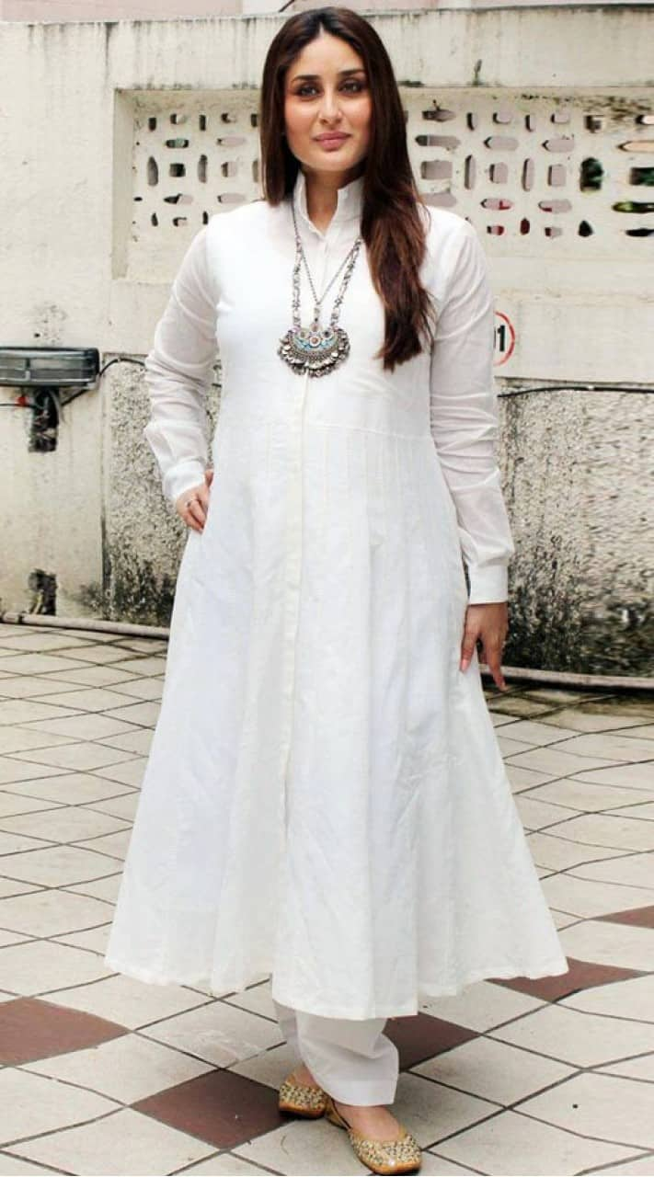
“Dressing is a way of Life.” –Yves Saint Laurent
Today Dressing well has become an essential factor on professional fronts, much like necessities.
A well dressed up individual brings about a certain aura and confidence.
Clothing is the primary instruments when creating a positive first impression.
A good dresser focusses on details in others as well as themselves.

Slide 4
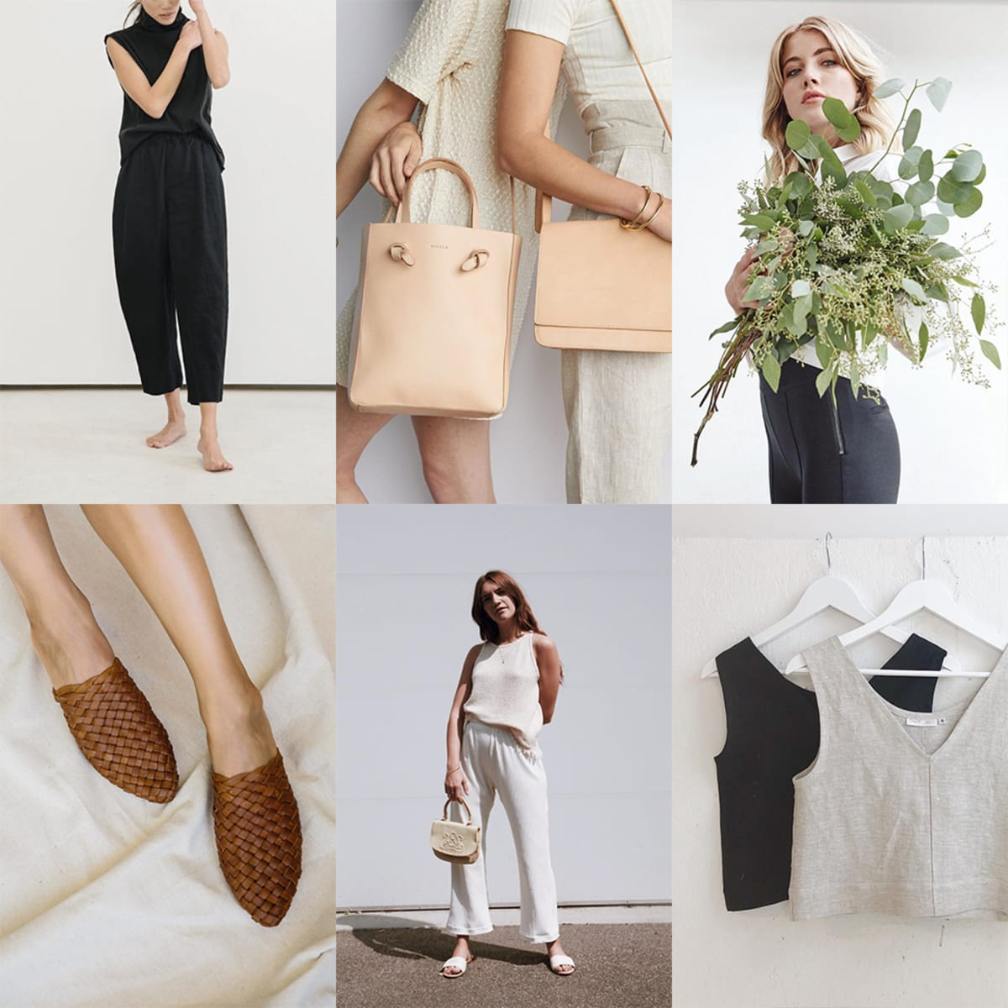
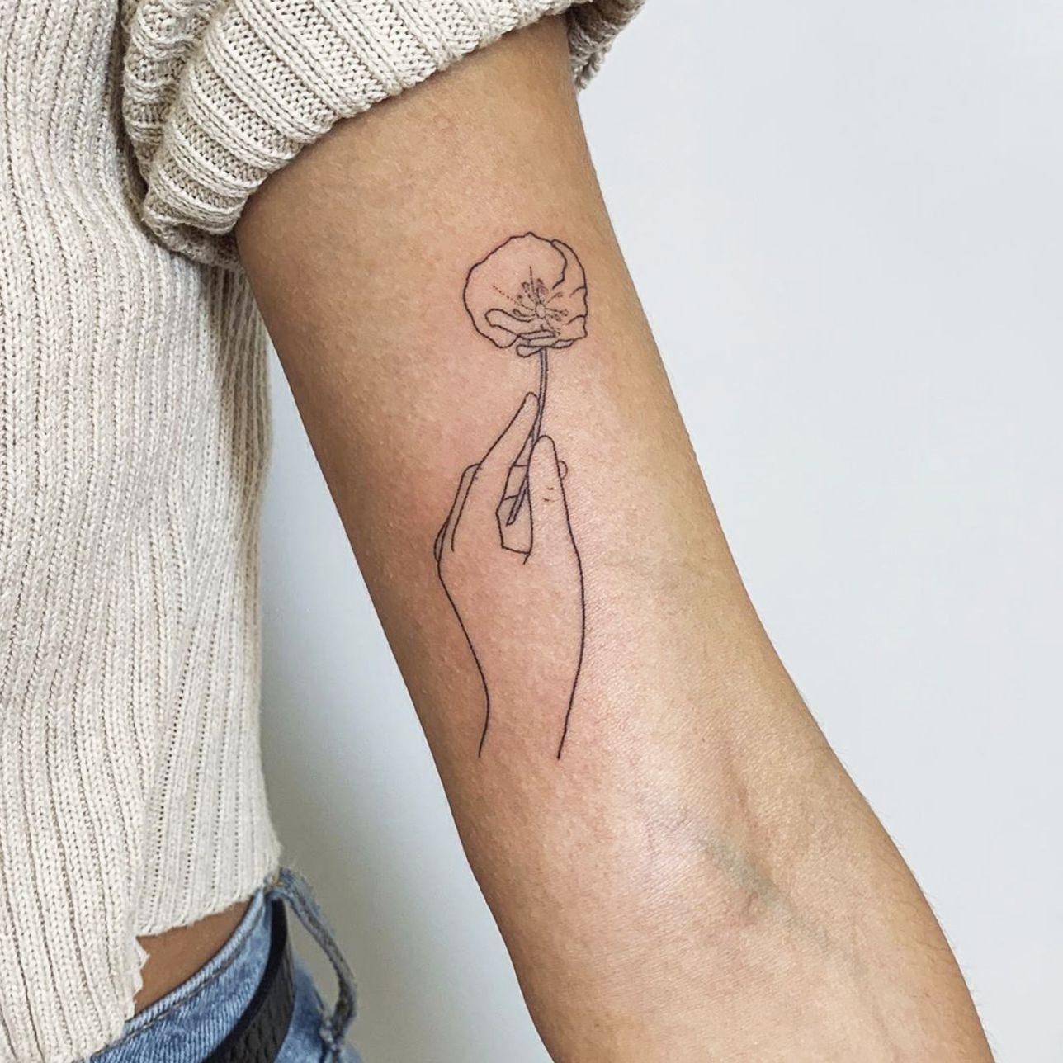
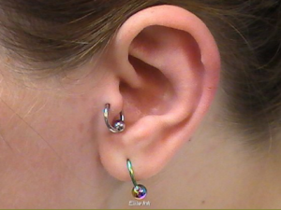
How dress affects Behaviour?
The social psychology of clothing is concerned with how an individual’s dress affects the behavior of self as well as the behavior of others toward the self.
Dress is defined as “an assemblage of modifications of the body and/or supplements to the body”
Body modifications include cosmetic use, suntanning, piercing, tattooing, dieting, exercising, and cosmetic surgery among others.
In studying the social psychology of clothing, researchers have often focused on dress as variable; for example,
The effect of dress on impression
And social perception
Behaviors

Slide 5
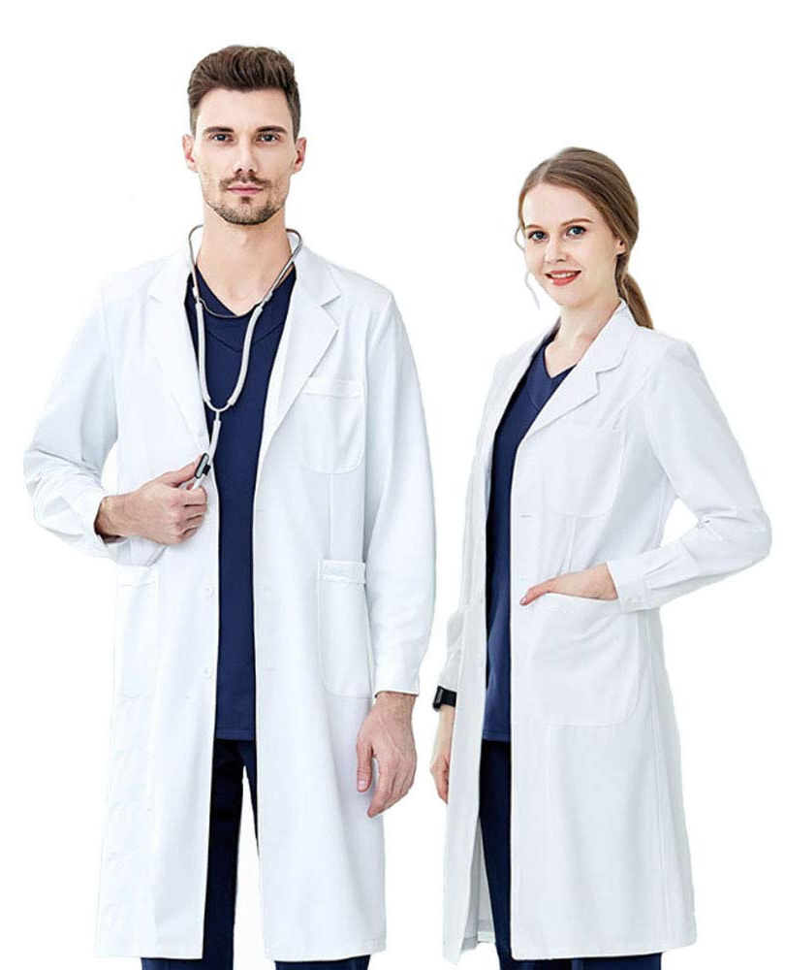
Et al, brothers trio, did experiments over the years to find out the behaviour changes as per various clothing for both men and women, they found as follows,
Women who wore revealing attire scored poor in a math test as opposed to the same woman
performing it in a sweat shirt
Different ethnicities, of both genders performed similarly in revealing to covered attires respectively.
The color black is associated with evil and death in many cultures; extent to which players wearing black uniforms were judged more evil and aggressive than players wearing uniforms of other colors.
Colours also affect the psychology of the wearer
The color red is associated with a cultural meaning that affects both the wearer and the perceiver of the red dress.
The researchers found that a white lab coat was associated with traits related to attentiveness
Uniforms bring about a sense of responsibility and attentiveness.
Some clothing items especially accessories enhances on power and status.
Dress affects wearers due to the symbolic meaning of the dress and the physical experience of wearing that dress item.

Slide 6
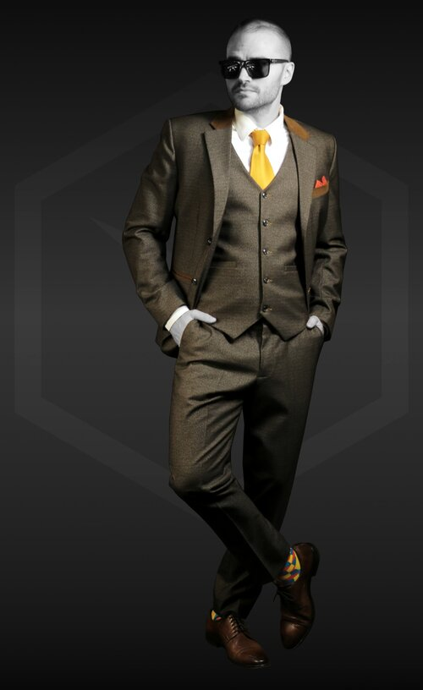
First Impression
Before an impression is made based on what you say or how you act, your value will be judged based on appearance alone.
Depending on multiple factors.
1.Colour Psychology
The color of your clothes can impact other’s first impressions of you very dramatically.
One can utilize this first look to your advantage by selecting the right color.
Confidence and authority can be conveyed best by wearing strong, vivid, and bold colors.
You wish to convey bold authority, leaning towards darker colors would do the trick.
On the contrary soft colors are often seen as more inviting and less in your face. Light greens, yellows, blues, and coral are some such colors with a friendlier appeal.
Cool colours will make you look more active and outgoing.
Blue outfit makes you seem more intelligent and competent.
You may choose to wear a solid yellow tie, for example, to demonstrate a confident and fun-loving demeanor.

Slide 7
2. Eye level- Placements
People will first notice the shirt, tie, or jacket you wear. They will eventually notice the rest of your ensemble.
You can be certain that the first thing they see will be the top pieces of clothing.
The emphasis in this outfit directly goes to the red hat as it brings a certain amount of attention, being vivid and also the placement is such.

Slide 8
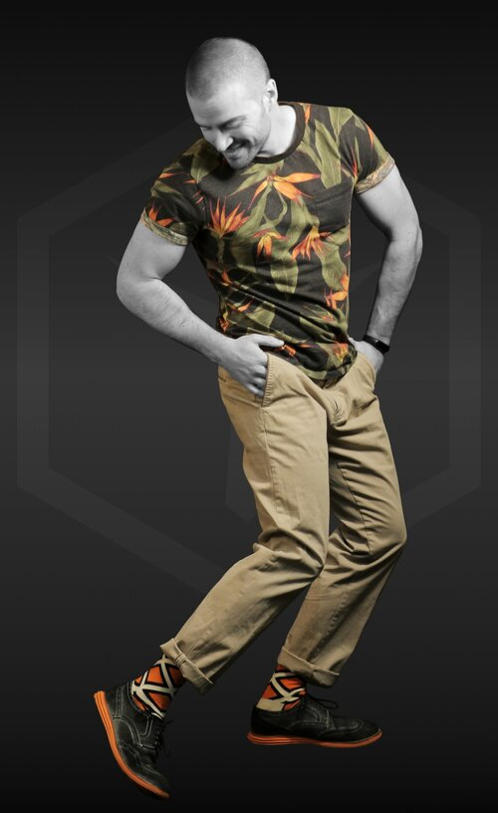
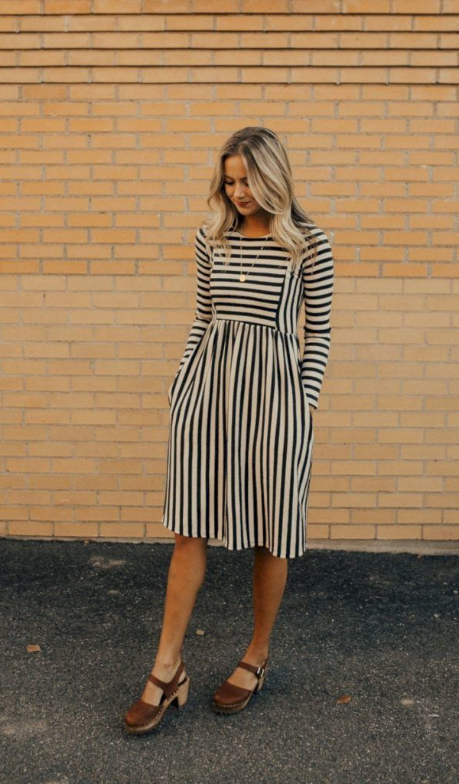
3)Right Patterns
In many instances, it will play to your advantage to make a lasting impression. This is especially true for first impressions in job interviews.
Try wearing a creative and imaginative pattern,
A few examples of such patterns include:
Paisley- Indicating traditionality, fertility and growth
Floral-Springs, warmth and summertime
Stripes- Professionalism and attitude, looking taller and thinner

Slide 9
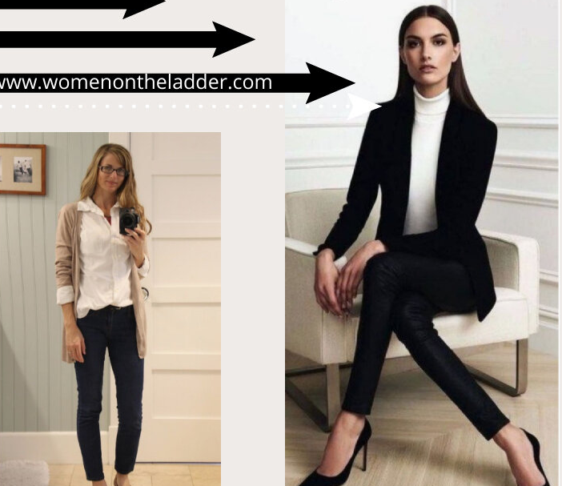
A halo effect is most visible in a professional setting.
You have to continuously build your skills, showcase your abilities and maintain relationships. In a high-competition environment.
You may not even realize your understanding of someone is solely based on how they speak or look.
Here are some common traits that form the halo bias and are examples of a halo effect:
Corporate etiquette comprises professional attire, maintaining decorum and respecting boundaries.
We assign a lot of weight to how people dress, behave and interact at the workplace.
Sharp dressing is associated with professionalism.
A firm handshake—rather than high-fives—is widely-accepted and formal greetings.
Whether intentionally or unintentionally, we’re inclined to believe that someone who’s sharply dressed exhibits better leadership qualities than someone wearing a Rolling Stones t-shirt.
2. Communication Skills
How someone communicates with their peers, juniors or senior management reflects how well they’re received at work.
If your coworker is eloquent—with excellent oration—they may even get more opportunities at work.
Many people believe that confidence can help you move past your flaws. The halo effect sheds light on how people tend to portray themselves in public.
Someone who’s a smooth talker may simply be diverting attention from their mistakes.
3. Interpersonal Skills
Maintaining good relationships at work is something everyone is encouraged to do.
Lasting relationships help you achieve collective goals with more dexterity.
So, if someone’s good at taking initiative, they may be the top choice for managerial roles.
Halo self concept and Image
1.Corporate etiquette

Slide 10
Unit II
Body Types

Slide 11
Different Body Types
1.Rectangle, straight, or “banana”
When the waist measurements are about the same as hip or bust, and shoulders and hips are about the same width, it is what’s called a “banana” or rectangle body type.
Stylists will probably point towardsoff-the-shoulder tops, tube dresses, and belted waists.
2.Triangle or “pear”
With this shape, shoulders and bust are narrower than the hips.
One probably have slim arms and a fairly defined waist.
Stylists often recommend clothing that shows off the waistline.

Slide 12
3.Spoon
The spoon body type is pretty similar to the triangle or “pear” shape.
hips are larger than the bust or the rest of the body and may have a “shelf”-like appearance.
One may be told to look for dresses that have classic “baby doll” cuts or other items with an empire waist.
.
4.Hourglass
If the hips and bust are nearly equal in size and one has a well-defined waist that’s narrower than both, they have an hourglass shape.
The legs and upper body are probably considered proportionate.
Shoulders may be slightly rounded, and most likely have a rounded buttocks.
Form-fitting or tailored clothing have traditionally been designed with this body type in mind.

Slide 13
5.Top hourglass
As a top hourglass, one has the general hourglass shape, but the bust measurements are slightly larger than your hips.
Boot cut or slightly flared pants probably fit them well, as do full or A-line skirts and tailored jackets.
6. Bottom hourglass
As a bottom hourglass, is the general hourglass shape, but hip measurements are slightly larger than the bust.
Stylists probably point toward form-fitting knits and dresses.

Slide 14
7.Inverted triangle or “apple”
If the shoulders and bust are larger than your relatively narrow hips, you have what’s known as an inverted triangle or “apple” shape.
Stylists may recommend tops that have some shaping around the waist and more open necklines, or clothing that shows off legs.
8.Round or oval
If the bust is larger than the rest of your body, hips are narrow, and midsection is fuller, it’s usually called a round or oval body type.
Stylists usually point people with this body type toward tops that flare at the top or that have vertical details.

Slide 15
9.Diamond
If you have broader hips than shoulders, a narrow bust, and a fuller waistline, it’s called a diamond body shape.
With this type, one may carry a little more weight in your upper legs. one may also have slender arms.
Flowy off-the-shoulder or boat-neck tops are usually recommended for this body type.
10. Athletic
If a body is muscular but isn’t particularly curvy, then they might have an athletic body type.
Shoulder and hip measurements are about the same.
Waist is narrower than shoulder and hips, but it isn’t overly-defined and looks more straight up and down.
Stylists often point to halter, strapless, and racerback styles.

Slide 16
Unit III
Recognizing Correct Fit

Slide 17
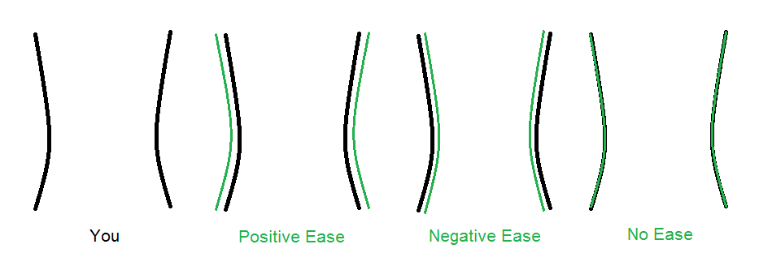
Five standards for good fit –
1. Ease
Ease is the difference between the circumference measurements of the figure and of the garment. The amount of ease should be sufficient for comfort and in keeping with fashion, the style and type of garment and fabric used.
Learning to Fit a Garment
2. Line
Line refers to many aspects of fitting, the silhouette of the garment, the proportion of garment to the figure and of various parts of the garment to each other, the shape of curved lines and the placing of the details of the design.
3. Set
Set refers to the way in which the fabric fits to the contours of the figure: the fabric should be perfectly smooth and free of creases in all areas. Incorrect set is indicated by creases in the fabric which are caused by a curve or hollow of the figure needing more or less width or length. Creases may be tight or loose, and vertical, horizontal or diagonal.

Slide 18
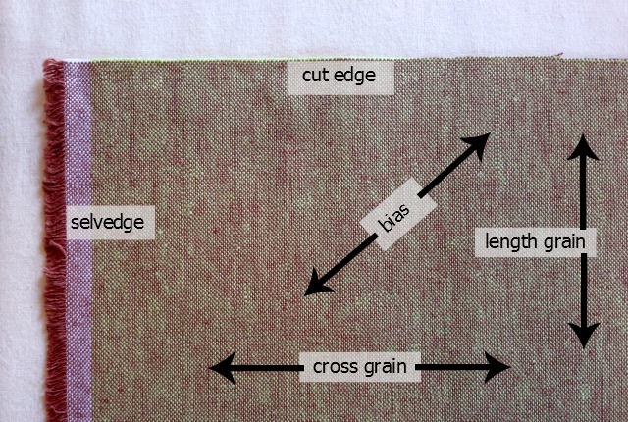
4.Balance
Balance is the relationship between the garment and the figure, and between various parts of the garment. The balance is correct when the garment hangs equally either side of the figure at all points when viewed from the front, back or side and with vertical seams perpendicular to the ground
5.Grain
Refers to the lengthwise and crosswise threads from which a woven fabric is constructed. Although straight grain refers to either set of threads, the straight grain line on a pattern is always placed parallel to warp threads. The warp threads which are thicker and stronger in most fabrics than the weft threads take most of the strain and also ensure that garment hangs attractively.

Slide 19
Basic Fitting Standards
What’s Garment Fit?
Garment fit is how well a garment’s measurements relate to those of the body. There are multiple factors to determine the same, as follows:
Trends and styles
Fabrics and their characteristics
Target consumer
1. Blazers
The shoulder seam should meet at the shoulder bone
Sleeves should cover the wrist bone
The blazer should not pull when buttoned (even when sitting down)
Armholes should fit close to the arms while still allowing movement
2.Outerwear
Lapels should sit close to the neck
All closures that extend to the neck should fasten comfortably and easily
Torso should fit slimly while accounting for layers of clothing under it
Coat front should lay flat and free of wrinkles when fastened (wrinkles indicate that the fit is too tight)
The shoulder seam should meet at the shoulder bone
Sleeve length should cover all under layers and can reach half palms length

Slide 20
3. Dresses
The torso should lay flat and should be free of draglines
Horizontal shoulder seams should sit across the shoulder (if it leans then the fit is not right)
Sleeveless dresses should not expose the bra
Draglines across the Bust.
4. Button-Up Blouses
All seams should lay flat
Shoulder seams should meet at the shoulder bone
Armholes should be high enough to allow movement
The fabric at the torso should not be able to expand more than 2-4” from the body
Sleeve length should reach past the wrists and the sleeve fit should be close to the body while still allowing room for movement
5. T-shirts
Sleeve length should reach to bicep following the arm downward
The hemline should reach the beltline or extend but below it
The collar should not be too restricting (head should fit through with ease)
The torso portion of the fabric should hang smoothly on the body
The shoulder seam should meet with the shoulder bone
Other

Slide 21
6.Other
There should be no pulls or gaps at button front
Arms should be able to move freely
Sleeveless tops: bras should not show
The shoulder seam should sit at the shoulder line
Collared blouses should fit closely to the neck while still allowing two fingers to fit when buttoned
When a blouse is tucked in it should not rise when arms are lifted or when sitting down
7.Trousers
The waistband should be able to fit 2 fingers inside of it to ensure proper fit
When standing, pants should be free of wrinkles/puckers/excess fabric
Trouser hems should hang 1” from the ground, touching your instep and covering half the heel, or hang ¼” form the ground if it’s a floor-skimming style
Side seams should hang perpendicular to the floor
8.Denim
Choose a pair that is snug to allow for denim to naturally stretch
9.Skirts
It should be possible to gather an inch of fabric at the waist when standing
Skirt with slits should remain shut when standing still
Bias cut skirts should hang smoothly
The hemline should fall evenly all-around being free from any rising

Slide 22
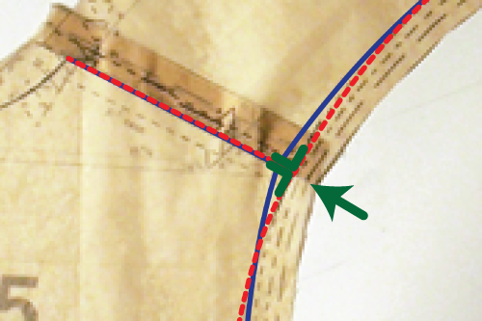
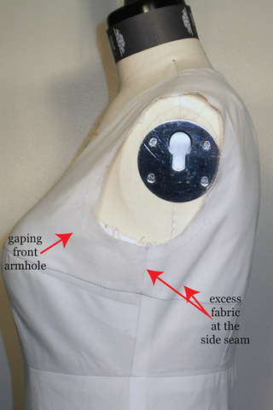
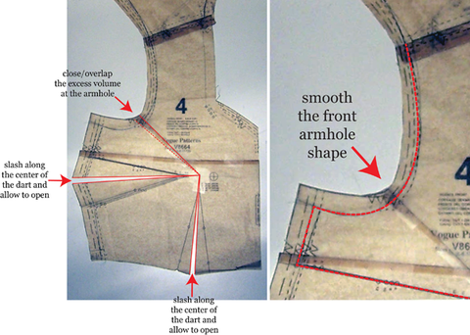
Armhole and Sleeve Correction
Small adjustments improve the shape of the armhole considerably, including
90 degree angle at the intersection of the shoulder seam and armhole seam. This 90 degree angle and adjustment to the shape of the armhole is directly connected to the fit and hang of the sleeve
Front Armhole Gaping, a very common problem, especially for those with larger busts. This gaping is caused by excess length in the front armhole which is magnified by the prominence of the bust. The correction is simple in this case, you just need to transfer this volume to one of the darts, or you can choose to share the volume between the two darts if you like.
Excess Fabric Under the Arm

Slide 23
Bust Correction
Follow this correction for styles:
identify the issue – The bust is loose, there is excess at the bust area.
b) Pinning the problem (when you’ve already sewn a muslin/toile): Pin the excess area you have at the front bust area and measure the amount you’ve pinned.
C) Correcting the problem: Cut/Slash the pattern as shown. 1. Stop cutting when you get 1/16” the armhole. 2. If you have no dart, then you’ll cut in the area where a dart would normally be. 3. Stop cutting when you get 1/16” from the bust cutting line.
For an easier reference, the pattern will look like the second image this after you’ve cut it

Slide 24
d)Close the pattern as shown by overlapping the bust the amount you’ve measured on your muslin. 1. The amount closed at the dart is automatically determined once you make the vertical bust line parallel. 2. The Vertical bust line – in pink (dashed line) – will be parallel all the way down. 3. The amount you close in the blue section is only to get this piece to fit into the other side.
e) You’ll mark where your Apex is. Then the dart point will be about 1” away for cup size C, 1 1/2” away for cup sizes D,E and 2” away for cup sizes bigger than E.
After you’ve marked the new dart legs, fold the dart shut. Use your tracing wheel over the dart to get the new dart side seam shaping. If your overlapped pieces show no dart, then you can skip the dart and eliminate it.
Smooth out the armhole for a nice curve.
Your dart depth will now be less deep. In styles where you have no dart, there will be no dart!

Slide 25
Hip Correction
To adjust a pattern for narrow hips, you will need to take in the pattern to reduce the amount of fabric that will be used. Instead of slashing and spreading, we’ll be pinning and tucking exactly where we need to, to get the desired look of a well fitted garment! So begin by adding dart legs by your armholes, and another extending to the bottom hem of your bodice. Additionally, mark another line going from the top of your skirt, to the hem as well. Pin and tuck, and sew with ample seam allowance.
If you happen to have wide set hips, you will need to slash and spread the pattern for more room. Simply follow the same lines as indicated above for the narrow hip section, and spread the pattern to pivot at the end of their points. Add your additional pattern drafting paper beneath it, and pin and tape the the additional sections where more room is needed in your garment.

Slide 26
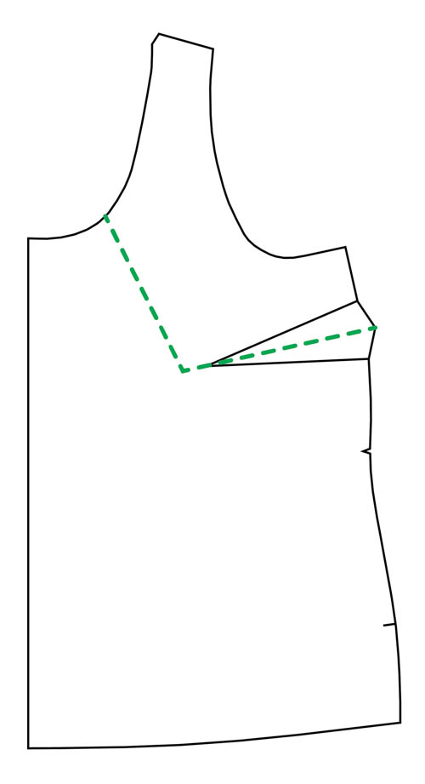
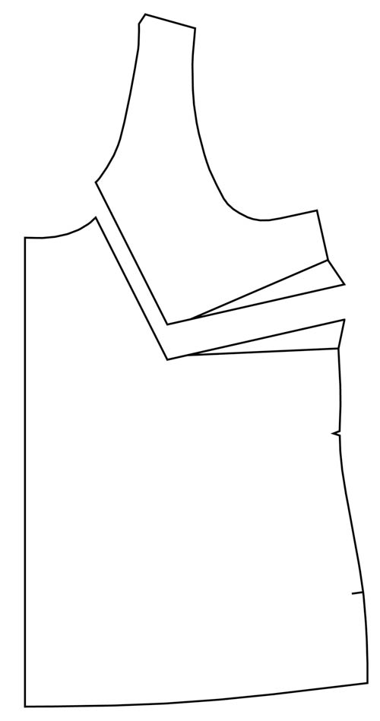
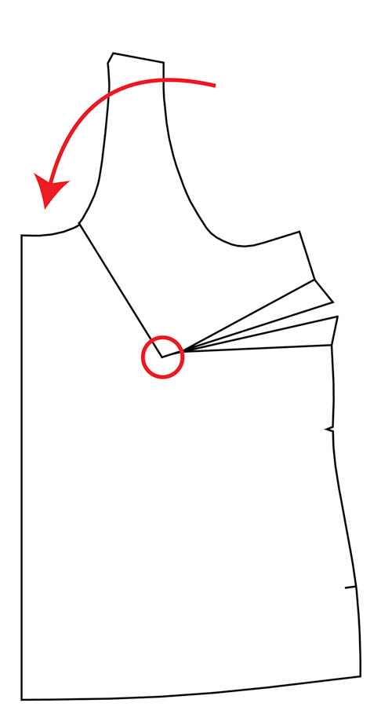
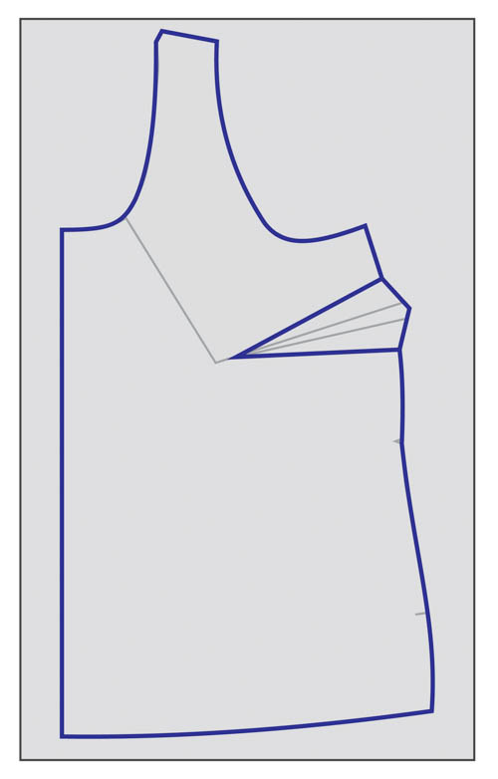
Neckline Correction
One of the most common pattern fitting issues is having to fix a gaping neckline. There are lots of reasons why one might have a gaping neckline, including having a hollow chest or narrow shoulders, but it’s a fairly easy fix.
To calculate how much you need to remove from the neckline, the best approach is to first make a muslin. Pinch out the excess at the neckline, and measure the length of the excess neckline. Divide this number by two, and you’ll be making that reduction to the pattern piece.
Draw a line through the center of your dart, to the bust apex (about 2 inches beyond the end of the dart in the case of the Springfield), and then continue the line up to the neckline, as shown. The exact angle doesn’t matter – just make it look roughly like this.
2. Cut along the line, separating the two pieces.
3. Keeping the inner corners of the two pieces together, pivot the top piece, overlapping the two pieces at the neckline by the amount that you need to remove. This will add additional space in the dart, too.
4. Place a fresh piece of tracing paper on top of the pattern piece. Trace the new piece, including the new, bigger dart. And you are done!

Slide 27
Unit IV
Clothing Suitability
Unit IV
Clothing Suitability

Slide 28
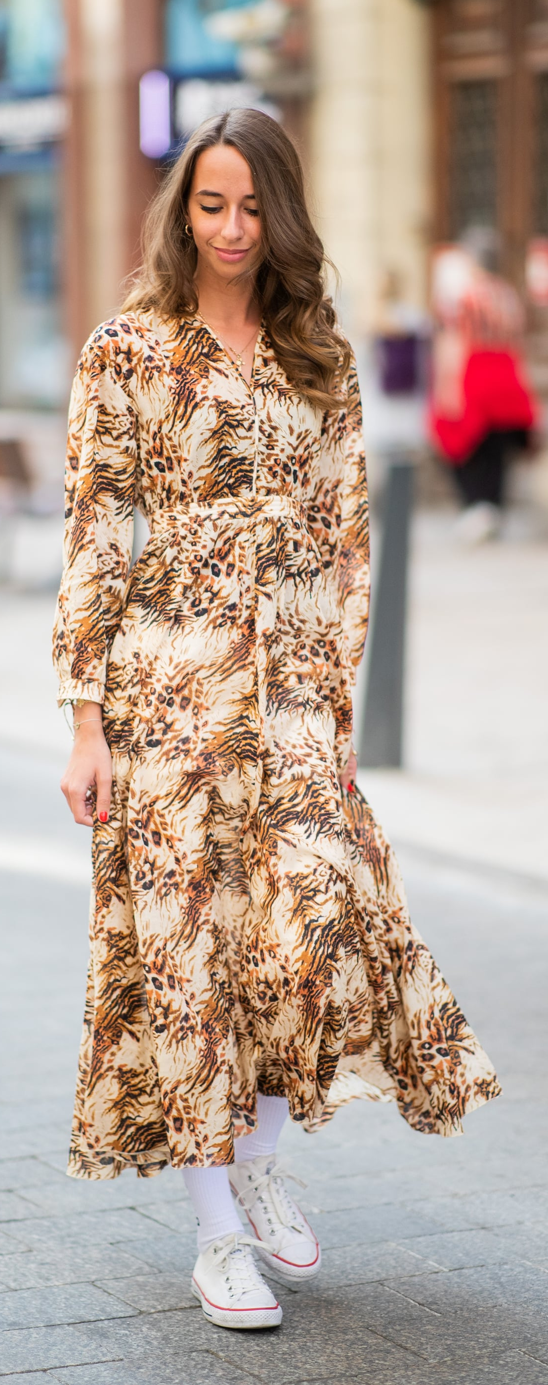
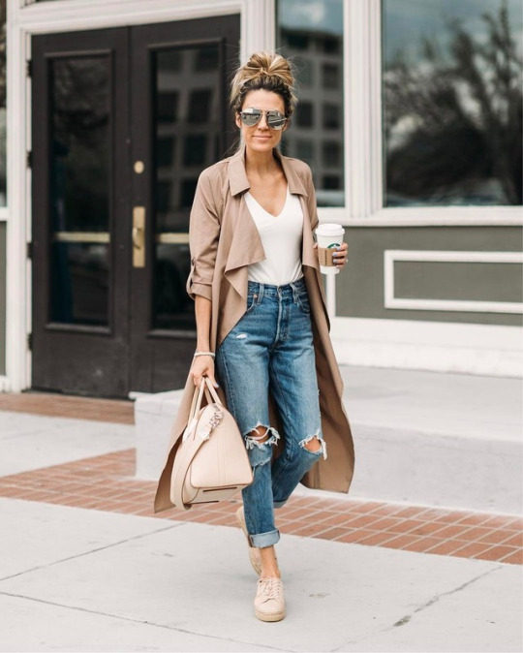
Clothing according to season
Picking the right supplies and materials is of the highest quality and must conform to the season. It is necessary to dress according to the weather or season as it not only protects you from the weather but also refreshes and enhances your wardrobe game.
Summer:
It’s the time to keep it fresh and light.
Finer linens to cottons and breezy fits.
Classic like whites to florals come into play at this time.
Spring:
Moving into the spring season, you can patronize the warmer clothes for more moderate coats and long-sleeved covers.
Wearing bright and energetic colors is supported.
It is the season of rebirth and meanwhile flowers blossom. Therefore, don’t be hesitant to reveal yourself with interesting colored trappings.

Slide 29
Winter:
Necessary to hold yourself covered up in heated clothes so that you do not get cold bites in the winter season.
Wear down coats, jackets, and comfortable sweaters to preserve yourself warm. Shawls, mitts, stockings, caps, and earmuffs can additionally be consumed to add more winter accomplices for further warmth.
Layer clothing because shield against the weather is important.
Warmer tones and darker palettes also become a part of winter wear.
Fall:
When it grows to dress for the fall term, layering is important.
Fall is the period of browns, oranges, as well as different mild and comfortable colors.
Jackets, ponchos, and coats are particularly in fashion in this period called fall.
Consolidate various forms and versatile layers for a contemporary look.
Rains:
During the rainy season, everyone prefers to wear clothes that are not too much but comfortable at the same time.
For this season, one can opt for clothes that are not lengthy but at the same time suits the occasion as well as the dress code.
Especially, when it comes to days where you have to head out during the rains, clothes that are of knee or ankle length are preferable and advised.

Slide 30
References
http://ecoursesonline.iasri.res.in/mod/page/view.php?id=29457#:~:text=Ease%20is%20the%20difference%20between,of%20garment%20and%20fabric%20used.
https://www.moodfabrics.com/blog/the-ultimate-guide-to-garment-fit/
https://inhousepatterns.com/blogs/news/5923079-pattern-correction-bust-waist-and-hip-position
https://www.idalia.in/blogs/articles/seasons-and-clothing-how-to-dress-for-every-season
https://www.ginareneedesigns.com/download/small-bust-adjustment-pattern-correction/
https://fashionandtextiles.springeropen.com/articles/10.1186/s40691-014-0020-7#Sec16
https://www.slideshare.net/raiuniversity/dress-for-success-dressing-skills

Slide 31
Thank You

