Slide 1
DEPARTMENT NAME: Department of Fashion Technology & Designing COURSE NAME: Master of Vocation ( M.Voc.) PAPER NAME: Fashion Merchandising PAPER CODE: mfd/2/cc/021 UNIT III : ViSUAL MERCHANDISING

Slide 2
Visual Merchandising
VISUAL MEANING
Relating to the sense of sight.
MERCHANDISING MEANING
Merchandising is a marketing practice in which the brand or image from one product or service is used to sell another

Slide 3
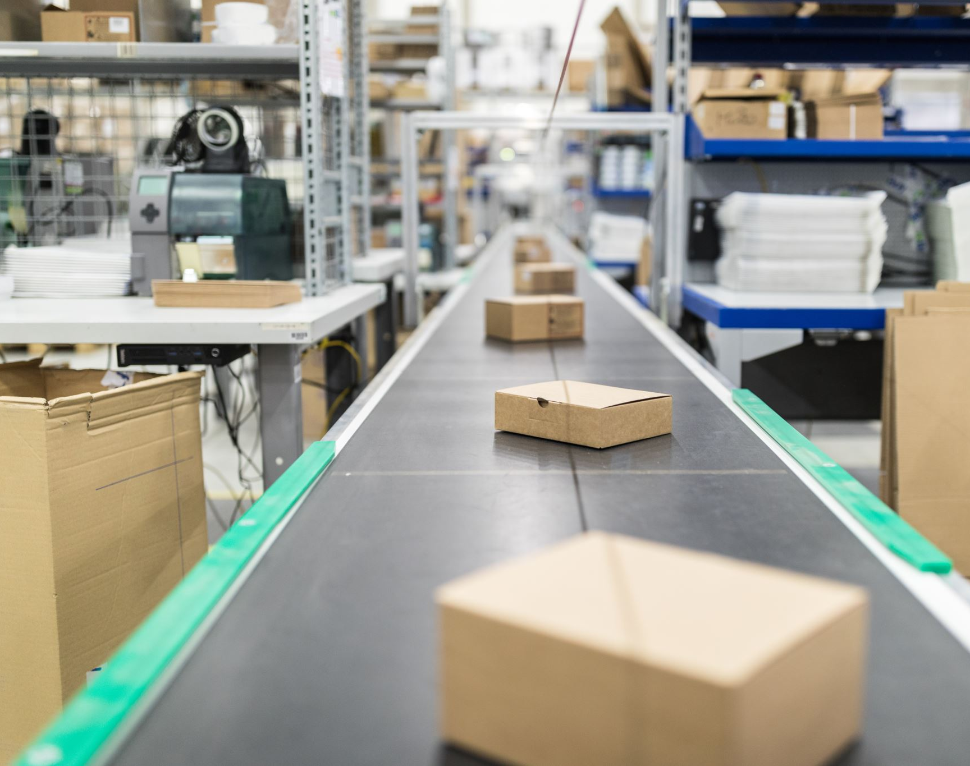
PURPOSE OF VISUAL MERCHANDISING
The purpose is to attract ,engage, motivate the customers towards making a purchase
Both goods and services can be displayed to highlight their features and benefits

Slide 5
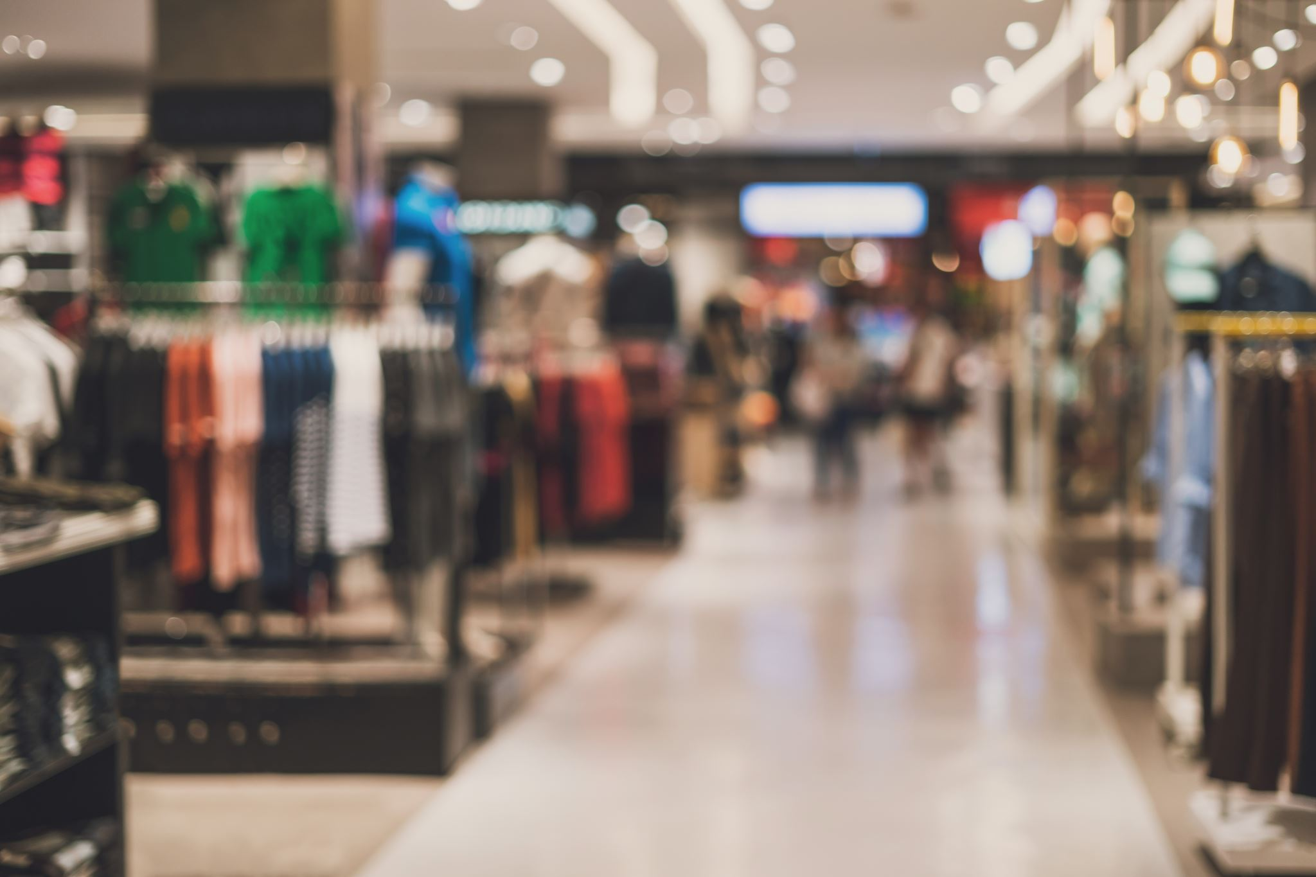
Elements OF VISUAL MERCHANDISING
A visual merchandiser has to work with various elements of VM to bring about the desired action (purchase) and reaction (satisfaction, to return for another purchase at a future date) from the customers.
These elements are as follow:
a) Store front
b) Store layout
c) Store interior
d) Interior display

Slide 6
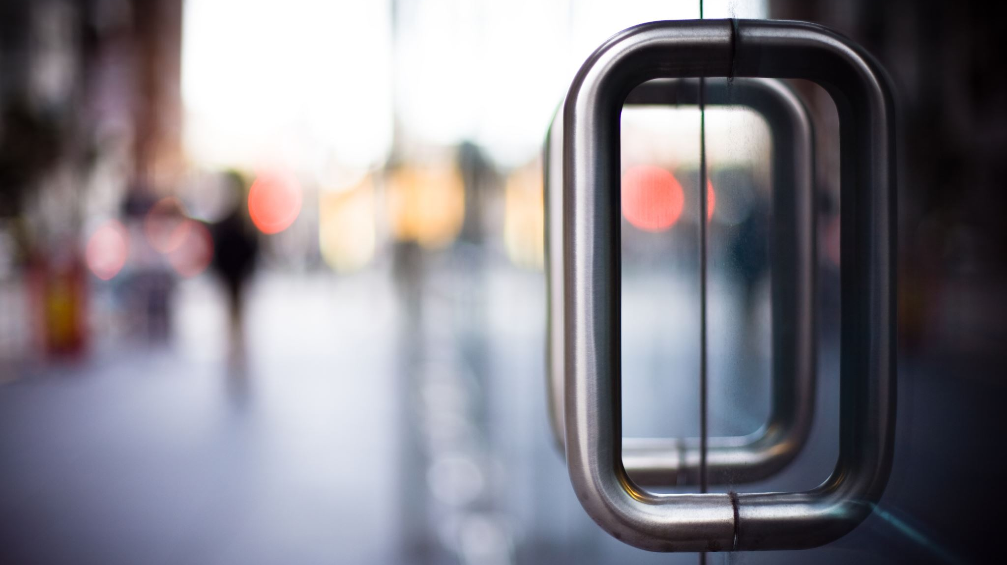
Store Front: The exterior of a business comprises the following:
i) Marquee: It is a sign that is used to display the store name
ii) Entrances: These are designed with customer convenience and store security
in mind. There are several types of entrances each portraying a certain image
Revolving – up scale stores
Push-Pull – full service stores often with fancy handles
Electronic – Self-serve stores, with carts such as Wal-Mart, Kroger etc.
Climate Controlled – shopping malls.
iii) Window Display: Window displays acts as an introduction of what will be
found inside the store. Given the fact that a pedestrian takes only a few seconds to consider a store window, a window display should be well planned to make the most impact.
Main intension should be to capture the attention of the passersby. It begins with the selling process even before the customer enters the store and suggests the type of merchandise carried in the store

Slide 7
b) Store Layout: Store layout describes the overall look and feel of the interior of a retail store, including the placement of fixtures and products within the store. It is an important part of implementing retail store strategy. Effective layouts are designed to expose customers to the most products possible given the amount of floor space available. It refers to the way the floor space is allocated. It is of four types.
● Selling Space: It includes: Interior displays, Sales demonstration areas, Sales transaction areas (wrap desk)
● Merchandise Space: It is allocated to items that are kept in inventory, Selling floor, and Stock room area.
● Personnel Space: It refers to space for employees, break rooms, lockers and restrooms.
● Customer Space: It refers the space meant for comfort and convenience of customers. It includes : Restaurants, Dressing rooms, Lounges, Restrooms, and Recreation area for children.

Slide 8
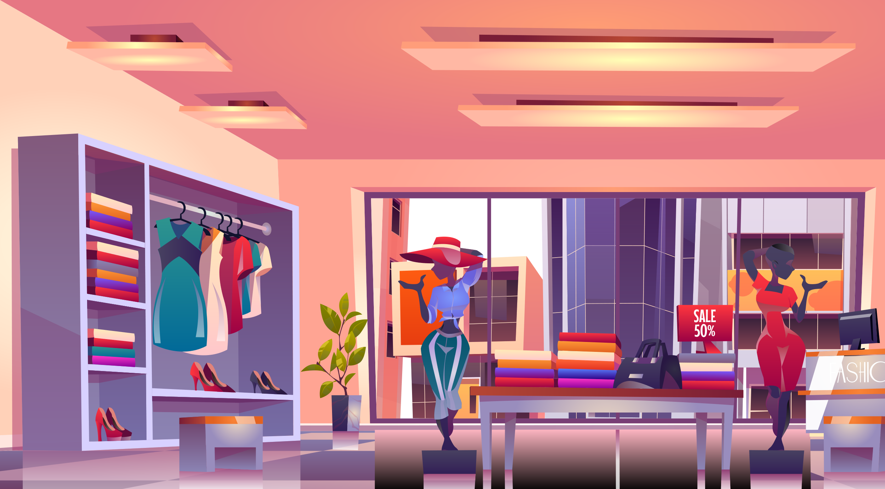
c) Store Interior: In-store displays should be in line with the window display in terms of theme and props. In-store displays can be further categorized into:
High points: When a display is placed above the eye level to be viewed from a distance is called a high point. They are used to demonstrate the use of this merchandise and inspire the fashion trends.
Focal points: Focal points are dedicated areas within the store for displays . They display the merchandise stacked around that area which may be from different departments. They are good source to encourage cross merchandising. It affects the store’s image and includes the items such as:
Floor & wall coverings , Lighting, Colors, and Fixtures. It is important to create a relaxing, comfortable place for customers to shop.

Slide 9
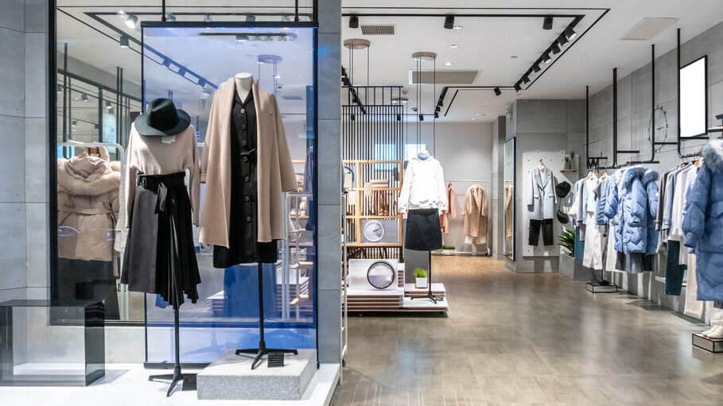
d) Interior Display: These are the part of general store interior. It helps the customer to make a selection without personal assistance. Interior displays use fixtures and props to showcase merchandise. Interior display may be of different types.
● Closed display: Examples are Look but don’t touch, require sales person assistance , Expensive or fragile merchandise, and Jewelry cases.
● Open Display: Examples are to handle merchandise without a salesperson, Selfservice , etc.
● Architectural Display: Examples are: Actual room setting and Furniture.
● Store Decorations: It refers to decorations for holidays such as Christmas,
Halloween and Valentine’s Day

Slide 10
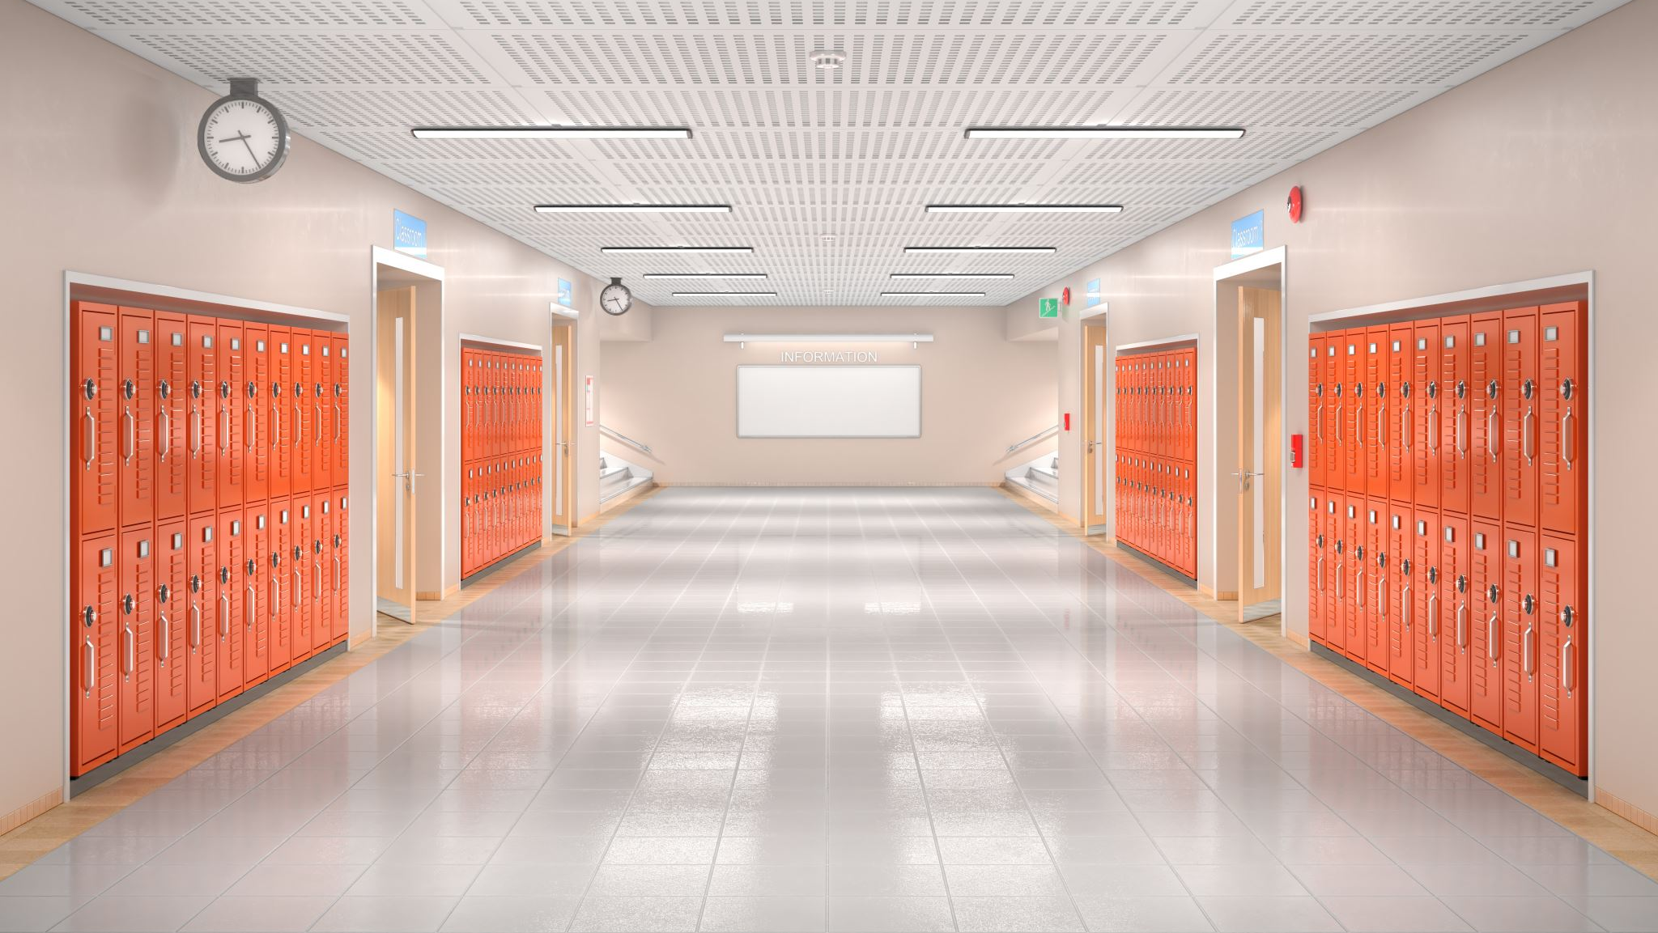
Store Layout interior arrangement of retail facilities
Selling areas
(75%-80%)
Where merchandise is displayed and customers interact with salespeople
aisles, counters, fitting rooms, merchandise fixtures, displays
Sales support areas
Customer services and all other operations
restrooms, cashiers, gift wrapping
Floor Plan – drawn to show selling floor vs sales support areas

Slide 11
Props Functional props physically support or hold merchandise
Mannequins, stands, pedestals, screens, panels, or forms
Decorative props
Used for mood or attractive setting
Artifical flowers, bicycles, seashells
Structural props support and change displays
Boxes, cylinders (usually hidden)
Decorative and functional prop

Slide 12
Exterior Store Design Exterior Store Design
Store design involves formulating and structuring all elements of the physical environment.
The storefront includes all aspects of the front/exterior of the store.
Elements include the marquee (or exterior sign), entrances, windows, banners, planters, awnings and lighting.
Three other important functional aspects of exterior design are customer visibility, store security, and potential for efficiency among staff and associates.

Slide 13
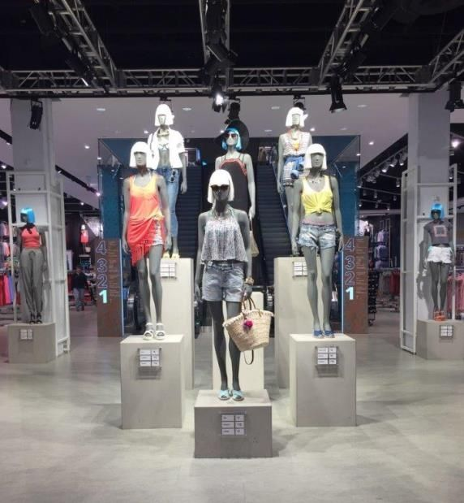
Signs and Entrances Signs and Entrances
A sign is a silent salesperson, and part of a shopper’s first impression of a store. In less than 10 seconds the sign must attract attention, tell who the business is and what it has to sell.
Retail entrances are designed to draw customers into the store through visual appeal and physical convenience.
The number, and type of entrances used depend on the location, the type and density or traffic, and security considerations.
Doors may be revolving, electric, or regular push pull.

Slide 14
Garments display according to theme

Slide 15
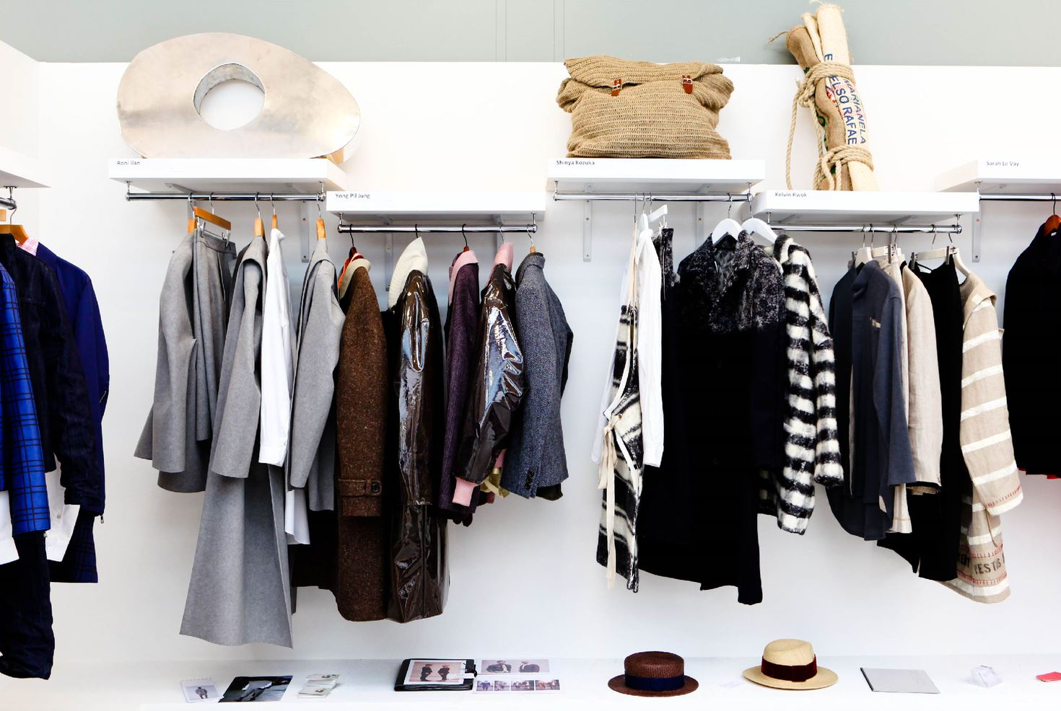
Categorise according to the products

Slide 16
Thank you

