Slide 1
THIRD YEAR T.D.C., SCIENCE
PAPER-III, Part D
Paper Code - 3163
SOLID STATE, NUCLEAR
AND PARTICLE PHYSICS

Slide 2
UNIT – 1 : CRYSTAL GEOMETRY
The seven crystal systems are characterized by three symmetry elements namely :
1. Centre of symmetry
2. Planes of symmetry
3. Axes of symmetry.
I. CENTRE OF SYMMETRY
Symmetry Elements:
CRYSTAL SYMMETRY
It is a point such that any line drawn through it will meet the surface of the crystal at equal distances on either side.
Since centre lies at equal distances from various symmetrical positions it is also known as `centre of inversions’.
It is equivalent to reflection through a point.

Slide 3
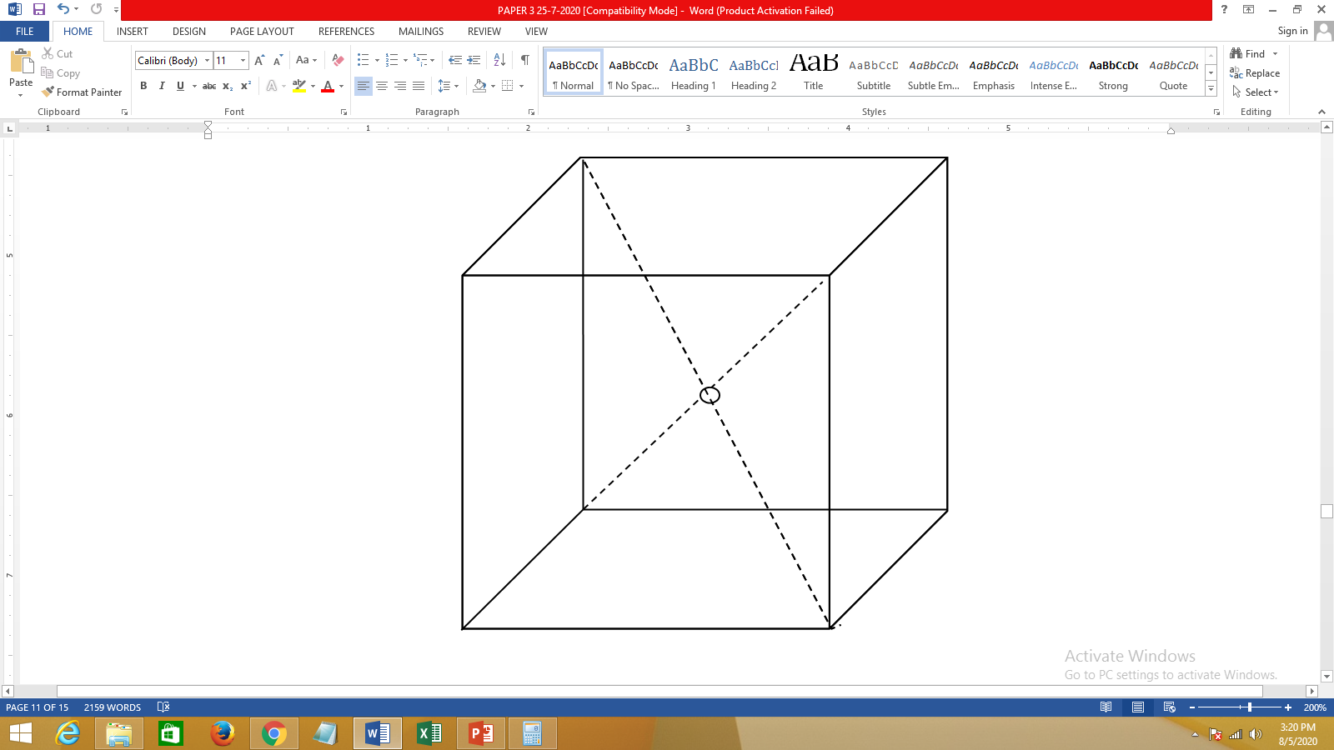
UNIT – 1 : CRYSTAL GEOMETRY
Symmetry Elements:
CRYSTAL SYMMETRY
The seven crystal systems are characterized by three symmetry elements namely :
I. CENTRE OF SYMMETRY
Some objects have special symmetry about an origin such that, for any point at position x, y, z, there is an exactly similar point at –x, –y, –z.
The origin is called a centre of symmetry or “inversion centre”. Such an object is said to be centrosymmetric
A Crystal may possess a number of planes or axes of symmetry but it can have only one centre of symmetry.
For example, for a unit cell of cubic lattice, the point at the body centre represents’ the `centre of symmetry’ as shown in the figure.

Slide 4
UNIT – 1 : CRYSTAL GEOMETRY
Symmetry Elements: CRYSTAL SYMMETRY
II. PLANE OF SYMMETRY
Planes of Symmetry Parallel to the Faces of a Cube
A crystal is said to have a plane of symmetry, when it is divided by an imaginary plane into two halves, such that one is the mirror image of the other.
For example, in the case of a cube, there are
Three planes of symmetry parallel to the faces of the cube and
Six diagonal planes of symmetry
Diagonal Planes of Symmetry

Slide 5
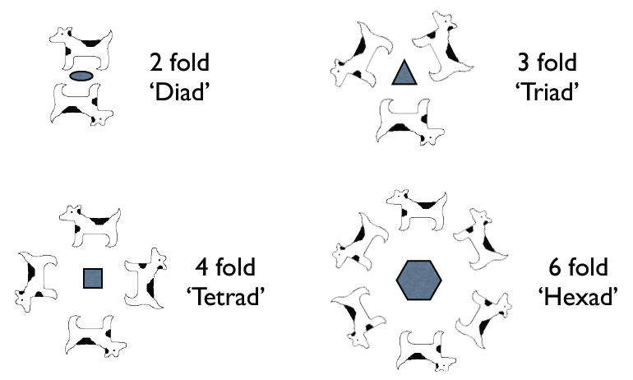
UNIT – 1 : CRYSTAL GEOMETRY
Symmetry Elements: CRYSTAL SYMMETRY
III. AXIS OF SYMMETRY
It is an axis passing through the crystal such that if the crystal is rotated around it through some angle, the crystal remains invariant.
The axis is called `n-fold, axis’ if the angle of rotation if the angle of rotation is 3600/n.
If equivalent configuration occurs after rotation of 180º, 120º and 90º, the axes of rotation are known as two-fold, three-fold and four-fold axes of symmetry respectively.
A pictorial depiction of ‘n’-fold axis of symmetry for 2 dimensions

Slide 6
UNIT – 1 : CRYSTAL GEOMETRY
Symmetry Elements: CRYSTAL SYMMETRY
III. AXIS OF SYMMETRY
If a cube is rotated through 90º, about an axis normal to one of its faces at its mid point, it brings the cube into the same position.
Hence during one complete rotation (360º) about this axisthe cube is coincident with its original position at four positions.
Thus this axis has four-fold axes of symmetry or is called a tetrad axis
If n=1, the crystal has to be rotated through an angle = 360º, about an axis to achieve self coincidence. Such an axis is called an `identity axis’.
Each crystal possesses an infinite number of identity axes.
A figure having only identity axes of rotation. For any axis that is chosen, the figure has to be rotated by 360⁰ for self coincidence (i.e., for the figure to look the same)

Slide 7
UNIT – 1 : CRYSTAL GEOMETRY
Symmetry Elements: CRYSTAL SYMMETRY
III. AXIS OF SYMMETRY
If n=2, the crystal has to be rotated through an angle = 180º about an axis to achieve self coincidence. Such an axis is called a `diad axis’.
Since there are 12 such edges in a cube, the number of diad axes is six.
If n=3, the crystal has to be rotated through an angle = 120º about an axis to achieve self coincidence. Such an axis is called is `triad axis’. In a cube, the axis passing through a solid diagonal acts as a triad axis.

Slide 8
UNIT – 1 : CRYSTAL GEOMETRY
Symmetry Elements: CRYSTAL SYMMETRY
III. AXIS OF SYMMETRY
Since there are 4 solid diagonals in a cube, the number of triad axis is four.
If n=6, the corresponding angle of rotation is 60º and the axis of rotation is called a hexad axis. A cubic crystal does not possess any hexad axis.
Crystalline solids do not show 5-fold axis of symmetry
No symmetry axis higher than `six’ is possible.
Identical repetition of an unit can take place only when we consider 1,2,3,4 and 6 fold axes.
In the above figures we can see that on trying to arrange shapes with 5 fold axis or 8 fold axis, gaps are created and so it is not possible

Slide 9
UNIT – 1 : CRYSTAL GEOMETRY
Symmetry Elements: CRYSTAL SYMMETRY
IV. ROTO INVERSION AXES
Rotation inversion axis is a symmetry element which has a compound operation of a proper rotation and an inversion [(x, y, z) → (-x, -y, -z)]
A crystal structure is said to possess a rotation – inversion axis if it is brought into self coincidence by rotation followed by an inversion about a lattice point through which the rotation axis passes.

Slide 10
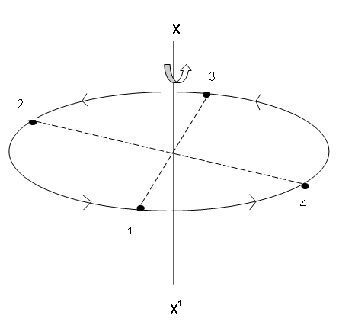
UNIT – 1 : CRYSTAL GEOMETRY
Symmetry Elements: CRYSTAL SYMMETRY
IV. ROTO INVERSION AXES
Consider an axis xx¹, normal to the circle passing through the centre as given in the figure.
Let a point (1) be rotated through 90º to come to the position (4).
Point (3) has come to point (2)
In the mean while, (2) to earlier (1) and (4) to earlier (3)
Now if we follow this by inversion to the position (2), (2) will go to where (4) now is and (4) to where (2) was.
This compound operation can then be repeated until the original position is again reached.

Slide 11
UNIT – 1 : CRYSTAL GEOMETRY
Symmetry Elements: CRYSTAL SYMMETRY
V. Combination of symmetry elements: Point groups and space groups
Apart from the different symmetry elements different combinations of the basic symmetry elements are also possible
They give rise to different symmetry points in the crystal.
The combination of symmetry elements at a point is called a `point group’.

Slide 12
UNIT – 1 : CRYSTAL GEOMETRY
Symmetry Elements: CRYSTAL SYMMETRY
V. Combination of symmetry elements: Point groups and space groups
In crystals, 32 point groups are possible.
The combination of 32 point groups with 14 Bravais lattices lead to 230 unique arrangements of points in space.
They are called as `space groups’.

