Slide 1
THIRD YEAR T.D.C., SCIENCE PAPER-III, Part F Paper Code - 3163
SOLID STATE, NUCLEAR
AND PARTICLE PHYSICS

Slide 2
UNIT – 1 : CRYSTALLOGRAPHY
Diffraction of X-rays by a Crystal Lattice
Since X-rays are electromagnetic radiations, they interact with the electron cloud of atoms
X-rays typically have wavelengths of the order of few Å.
The spacing between adjacent atoms in a crystal is also of the same order
Thus, X-rays are scattered by adjacent atoms in crystal
This gives rise to diffraction effects
The resulting diffraction pattern will give information of the internal arrangement of atoms in crystals
Original X-ray spectrometer made by William Bragg at Leeds University
Since each atom can act as a diffraction centre, the crystal as a whole acts like a three dimensional diffraction grating.

Slide 3
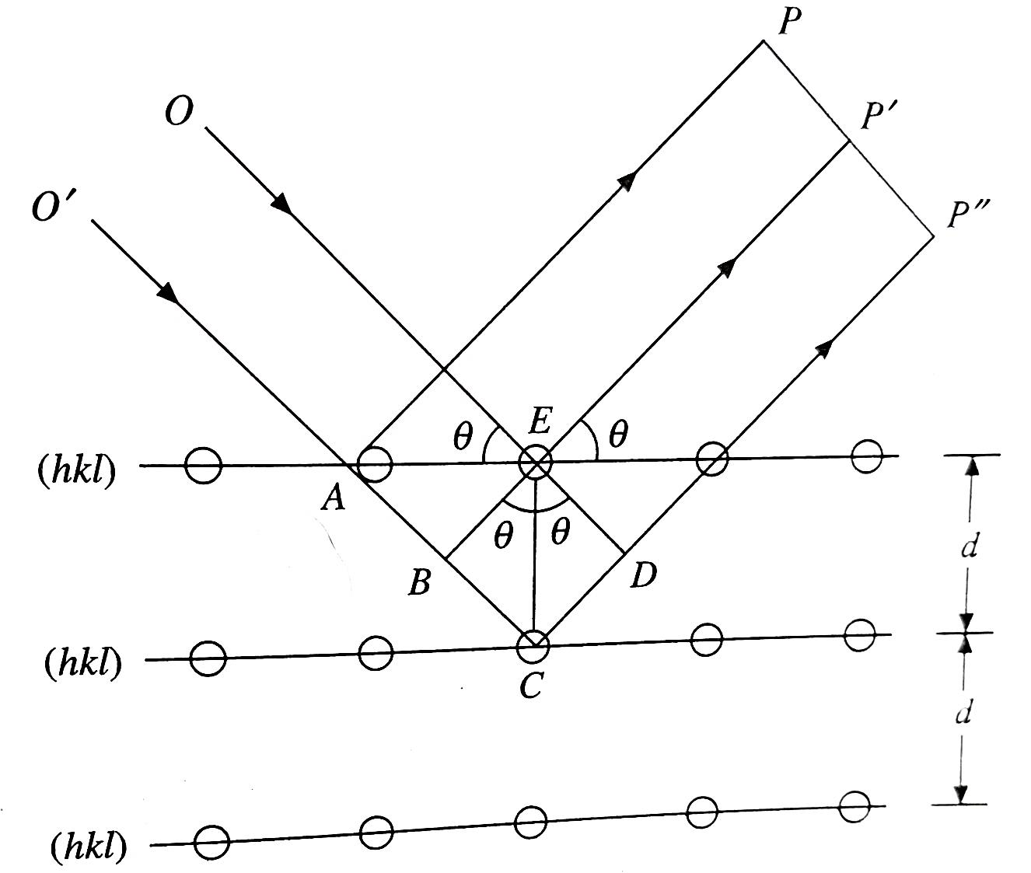
UNIT – 1 : CRYSTALLOGRAPHY
Diffraction of X-rays by a Crystal Lattice
Consider a crystal made up of equidistant parallel planes of atoms as shown in the figure
Let the distance between the planes be d
Let a monochromatic beam of X-rays with wavelength λ and having a common wavefront fall at an angle θ on these planes
The atoms scatter X-rays almost uniformly in all directions

Slide 4
UNIT – 1 : CRYSTALLOGRAPHY
Diffraction of X-rays by a Crystal Lattice
Let 2 of the incoming X-rays, OE (falling on atom at E) and O’A (falling on an atom at E) be inclined at an angle θ with the top most plane of the crystal
Let them be scattered in the directions AP and EP’
They also make an angle θ with the top most plane of the crystal
Since the path length of the rays OEP’ and O’AP are the same, they arrive at P and P’ in phase with each other and also forms a common wave front.

Slide 5
UNIT – 1 : CRYSTALLOGRAPHY
Diffraction of X-rays by a Crystal Lattice
Again consider the incoming beam O’C (falling on an atom at C) and the scattered ray CP’’
If EB and ED are parallel to the incident and scattered wave fronts respectively, then the total path O’CP’ is longer than OEP’ (or O’AP) by a quantity Δ=BCD=2BC
But from the figure, BC=EC Sinθ and EC=d
Or, Δ=2BC=2dSinθ

Slide 6
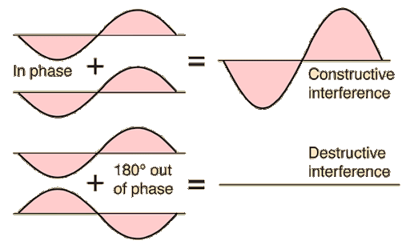
UNIT – 1 : CRYSTALLOGRAPHY
Diffraction of X-rays by a Crystal Lattice
If the scattering from two consecutive planes are in phase with each other, then, Δ=nλ (integral multiple of the wavelength)
Or, Δ=2dSinθ= nλ where, n=0, 1, 2 etc. gives the order of the reflection
Thus the condition for in-phase scattering by a set of equidistant parallel planes in a crystal is given by 2dSinθ= nλ
This expression is called the Bragg’s law after W. L. Bragg who first derived it.

Slide 7
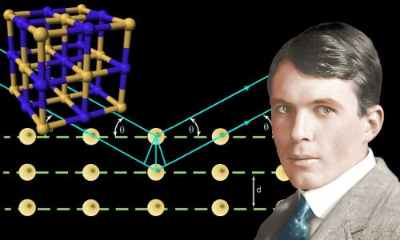
UNIT – 1 : CRYSTALLOGRAPHY
Diffraction of X-rays by a Crystal Lattice
The diffracted beams arise only for certain discrete values of θ for which the Bragg’s condition is fulfilled
However, the maximum value of Sinθ is 1
Using this in the Bragg condition we get that $\frac{nλ}{2d}$ $≤$1
Or, at best nλ=2d
This means that λ cannot be greater than twice the lattice spacing or diffraction cannot occur
William Lawrence Bragg was youngest Nobel Laureate in Physics upto now, who was 25 years old when he was awarded the Nobel Prize together with his father (William Henry Bragg) in 1915.
This means that λ cannot be greater than twice the lattice spacing or diffraction cannot occur

Slide 8
UNIT – 1 : CRYSTALLOGRAPHY
Diffraction of X-rays by a Crystal Lattice
The diffracted beams arise only for certain discrete values of θ for which the Bragg’s condition is fulfilled
Or, Δ=2dSinθ= nλ
Thus the condition for in-phase scattering by a set of equidistant parallel planes in a crystal is given by 2dSinθ= nλ
This expression is called the Bragg’s law after W. L. Bragg who first derived it.
The Bragg derivation is simple but is convincing only because it reproduces the correct result.

Slide 9
UNIT – 1 : CRYSTALLOGRAPHY
Diffraction of X-rays by a Crystal Lattice
Thus, reflections from all periodic parallel planes add up in phase to give a strong reflected beam for only certain values of θ.
If each plane were perfectly reflecting, all the radiation which falls on the first plane (i.e., any wavelength) would be completely reflected and thus there will not be any radiation which is transmitted. Thus, in such a case, only the first plane of a parallel set would see the radiation
But in reality, each plane reflects only10⁻³ to 10⁻⁵ of the incident radiation
This means that about 103 to 105 planes may contribute to the formation of the Bragg-reflected beam in a perfect crystal.
That is why there are only certain values of θ which add up

Slide 10
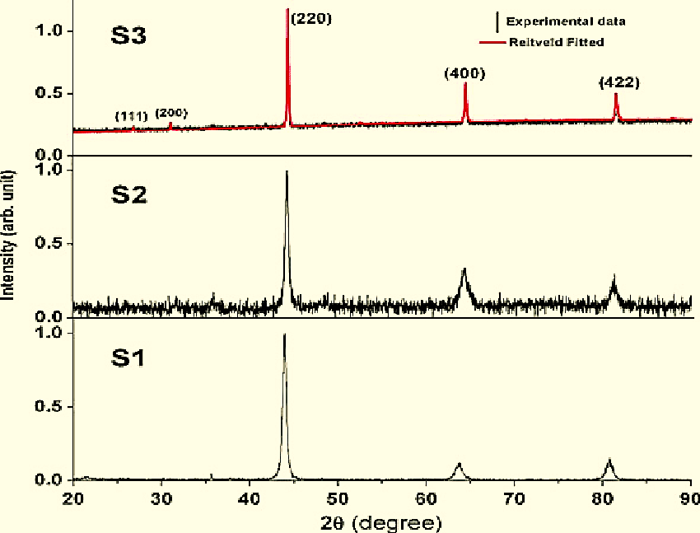
UNIT – 1 : CRYSTALLOGRAPHY
Diffraction of X-rays by a Crystal Lattice
The Bragg law is a consequence of the periodicity of the lattice
In deriving the law, the composition of the basis (i.e., the type of atoms) is not referred to
However, the composition of the basis determines the relative intensity of the various orders of diffraction (n) from a given set of parallel planes.
For example, in the figure given, you can see intensity of diffracted X rays plotted as a function of 2θ
Example of X-ray diffractogram (this is for Fe₃Al which has been milled for various periods)
However, the intensities of all peaks are not the same

Slide 11
UNIT – 1 : CRYSTALLOGRAPHY
Diffraction of X-rays by a Crystal Lattice : The Laue equations
Thus, reflections from all periodic parallel planes add up in phase to give a strong reflected beam for only certain values of θ.
If each plane were perfectly reflecting, all the radiation which falls on the first plane (i.e., any wavelength) would be completely reflected and thus there will not be any radiation which is transmitted. Thus, in such a case, only the first plane of a parallel set would see the radiation
But in reality, each plane reflects only10⁻³ to 10⁻⁵ of the incident radiation
This means that about 103 to 105 planes may contribute to the formation of the Bragg-reflected beam in a perfect crystal.
That is why there are only certain values of θ which add up

