Slide 1

GONDWANA SUPER GROUP
Dr. Maya Chaudhary
Department of Geology
Mohanlal Sukhadiya University
Udaipur-313001

Slide 2
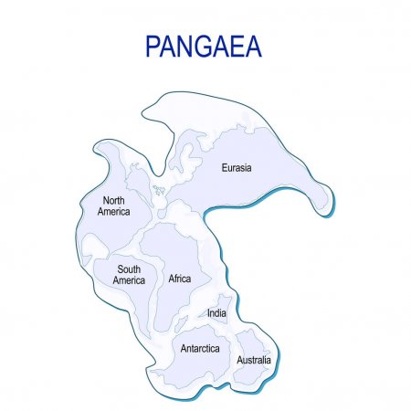

Slide 3
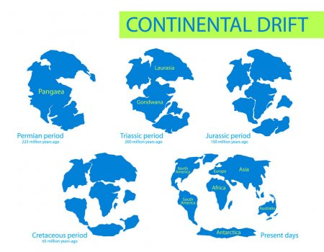

Slide 4
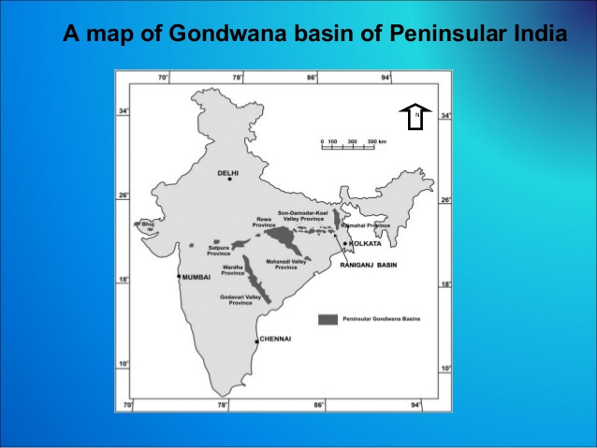

Slide 5
