Slide 1
DOWNSTREAM
PROCESSING

Slide 2
WHAT IS DOWNSTREAM
PROCESSING ???
The various process used for actual Recovery and
purification of biosynthetic products from a
fermentation or any other industrial process together
constitute a downstream processing.
4

Slide 3
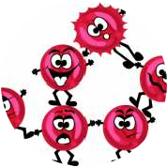
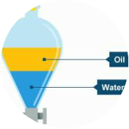
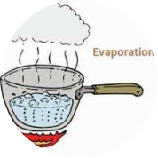
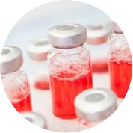
WHAT ARE THOSE PROCESSES ???
Removal of
insoluble
Isolation or
extraction of
product
concentration of
product
Packaging of
product

Slide 4
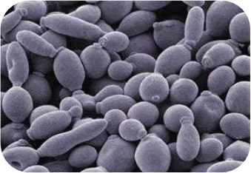
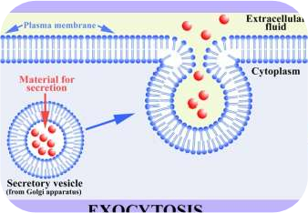
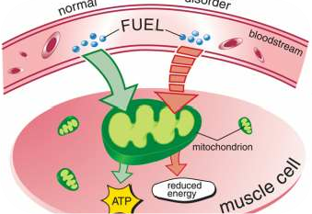
WHAT ARE THE CLASSES OF
PRODUCT OBTAINED???
Cell itself
Extracellular type
Intracellular type
• Bakers yeast
• Enzymes
• Antibiotics
• Bio-fertilizers
• Vitamins
• Alcohol

Slide 5
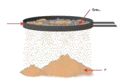
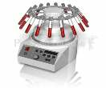
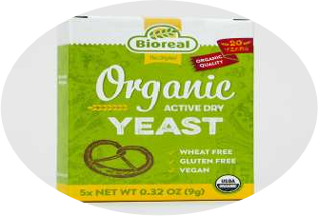
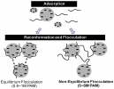
IF THE PRODUCT IS THE CELL ITSELF
???
Separation of particles
Cooling and
• Filtration
packaging
• Centrifugation
• Flocculation and floatation
-

Slide 6
IF THE PRODUCT IS EXCRETED OUTSIDE
THE CELL ??
• Centrifugation or filtration
Separation of
Particles
• Flocculation and floatation
• Liquid-liquid extraction
Extraction
• Whole broth extraction
• Aqueous Multiphase Extraction
• Chromatographic techniques
Concentration
• Evaporation process
• Crystallization
• Adsorption

Slide 7
IF THE PRODUCT IS INTRACELLULAR ???
• Filtration
Disintegration
of cells
Concentration
• Centrifugation
• Flocculation
and floatation
• Liquid-liquid
extraction
• Evaporation
• Mechanical
cell disruption
• Membrane
filtration
• Whole broth
extraction
Separation
of particles
• Chromatography
techniques
• Drying
• Aqueous
multiphase
extraction
• Lysis
• Adsorption
Extraction

Slide 8
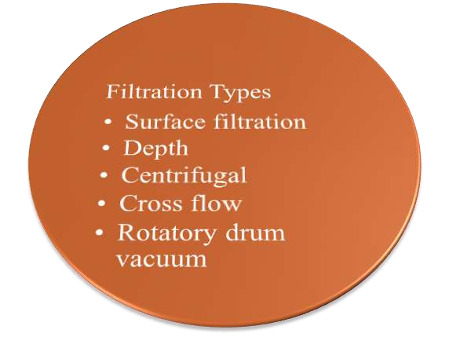
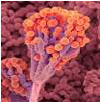
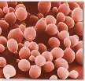
TECNIQUNIES INVOLVED IN DOWNSTREAM PROCESSING
1. Filtration
filamentous fungi
filamentous bacteria
Yeast

Slide 9
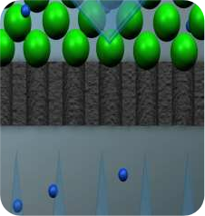
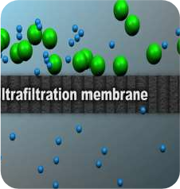
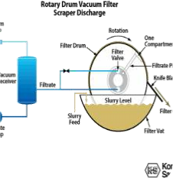
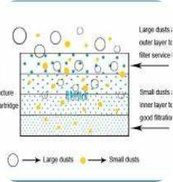
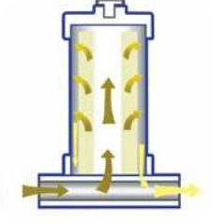
Surface
filters
Cross flow
filters
Rotatory
flow filters
Depth filters
Centrifugal
filters
Uses a porous
filtration
medium to
Retain particles
through out
the medium
rather than just on
Filtration on
the basis of
pore size but
pores are not
clogged due
to tangential
flow of
particles
Filtration due
to sucking of
liquid by
vacuum
when filter
drum is
rotated in the
slurry.
Filtration by
rapidly
rotating
slurry, so
solids are
retained on
porous screen
and liquid
filter out
Filtration on
the basis of
pore size of
the
membrane.
Basic Science H.O.T.
18-03-2017
13

Slide 10
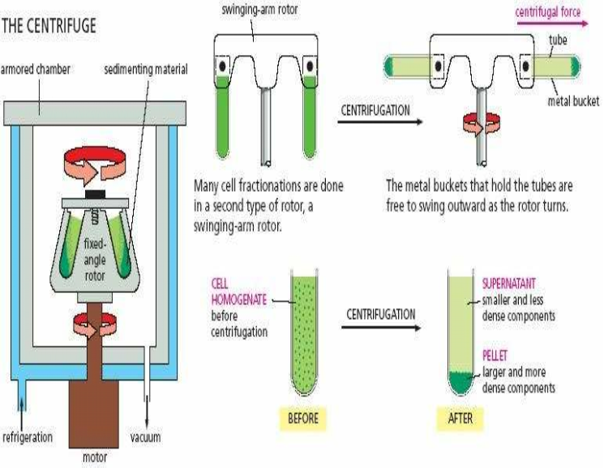
2. CENTRIFUGATION
The centripetal
acceleration
causes
denser
substances and
particles to
move outward
and less dense
are displaced
and move to
the centre
•Works on
sedimentation
principle
14

Slide 11
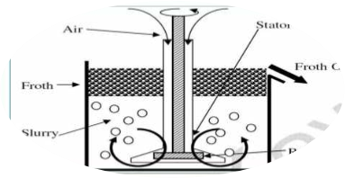
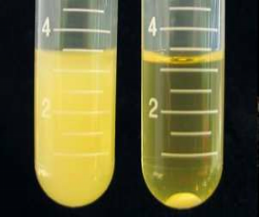
3. FLOCCULATION AND FLOATATION
Floatation is the process of
•Flocculation is the process by which
separation of particles based on
individual particles aggregate to form
relative buoyancy of particles
a clump
Froth flotation
•Due to addition of clarifying agent
Dissolve air flotation
Induced gas flotation
15

Slide 12
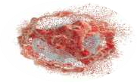
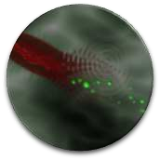
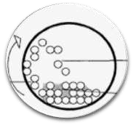
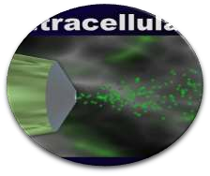
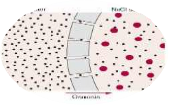
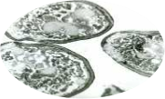
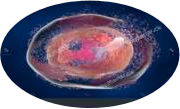
4. CELL DISRUPTION
Mechanical cell lysis
Non-mechanical cell lysis
•Drying
Lysis by osmotic
shock
Ultra
sound
Freezing
Bead mill
Homogenisers
Lytic enzymes

Slide 13
LIQUID SHEAR
ULTRA
SONICATION
SOLID SHEAR
FREEZE
THAWING
BLENDERS

Slide 14
1.HOMOGENIZERS:
❖
Pumps the slurry through a
restricted orifice valve.
Uses high pressure up to 1500 bar
followed by instant expansion
❖
through a special exiting nozzle.
Cell disruption is accomplished by High liquid shear in the orifice and
Sudden pressure drop upon discharge

Slide 15
2.Ball mill/Bead mill:
➢
Devices used to rapidly grind materials to colloidal fineness
(1 micron or below)
Grinding is carried out with steel or
ceramic balls within the cylinder.
➢
➢
Cells are agitated with small abrasive
particles
➢
Cells break due to shear forces
3.BLENDERS:
Simple method used to disrupt the cells in case of weak cell wall.
High speed mixing is employed.

Slide 16
4.FREEZE THAWING:
Freezing and thawing of microbial cell will cause formation of ice
crystals and repeated freeze thawing will lead to subsequent disruption
of cell.
Slow process with limited release of cell contents.
5.Ultrasonication:
➢High frequency vibration (20 kHz) transported through a metallic
tip to an concentrated cellular suspension
waves disrupt the cells.
➢Leads to creation of cavities, thereby shock
Disadvantages
➢Method is costly and effective in small scale.
Cells break completely leading to release of all cellular materials.

Slide 17
DETERGENTS
ENZYME
TREATMENT
CHAOTROPIC
AGENTS
ALKALI
TREATMENT
OSMOTIC
SHOCK

Slide 18
1.Detergents:
➢Cause damage to lipoproteins of cell wall of microorganisms.
➢Compounds used are sodium lauryl sulphate,sodium dodecyl sulphate,
triton X-100,phenyl ethyl alcohol, dimethyl sulphoxide, benzene,
methanol, chloroform etc.
➢Triton X-100 with guanidine-HCL is widely and effectively used for
release of cellular proteins.
2.Alkali treatment:
➢Used for hydrolysis of microbial cell wall.
➢Provided that the desired product will tolerate a pH of 11.5 to 12.5
for 20 to 30 minutes.

Slide 19
3.Osmotic shock:
➢Caused by sudden change in salt concentration.
➢Proved to be a successful tech’ for extraction of luciferase from
Photobacterium fisheri
➢High salt concentration causes cell lysis & low salt concentration causes
over accumulation of water inside the cell leading to bursting of cell.
4.Enzyme treatment:
.
➢Used to permeabilize cells to release the cell
contents.
➢Enzymes used include, glucanase, protease,
mannase, lysozyme etc.
➢Expensive method and presence of enzyme may further complicate
purification processes.

Slide 20
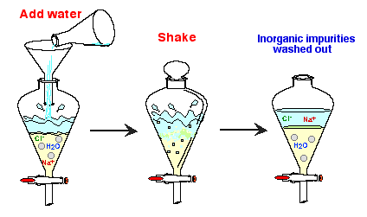
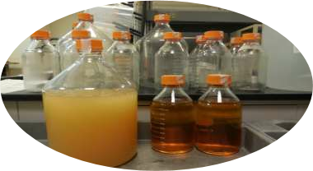
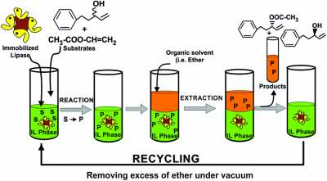
5. EXTRACTION OF PRODUCT
•Liquid-liquid extraction
Aqueous multiphase extraction
•Separation of compound
Whole broth
Enzymes are extracted in
based on there relative
Both cells and broth are
aqueous polyethylene glycol-
solubility's in two different
extracted together
dextran mixture, which form
immiscible liquids
separate phases

Slide 21
6. CONCENTRATION
Membrane
•Evaporation
filtration
Ion exchange
Adsorption
chromatography
resins

Slide 22
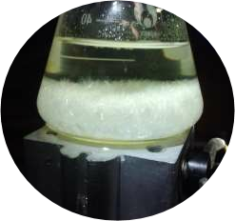
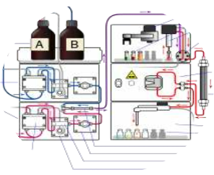
7. PURIFICATION
•Crystallization
Chromatographic
•Impure substances are
dissolved in solvent to reach
techniques
saturated stage at higher
temperature which is then
cooled to form pure crystals
•Antibiotics like penicillin G,

Slide 23
Paper chromatography
Thin layer chromatography
Column chromatography
Ion exchange chromatography
Types of
Affinity chromatography
High performance liquid
chromatography
chromatography
Reversed phase high
performance liquid
chromatography
Gas chromatography-mass
spectrometry
Gel filtration –
chromatography/ size exclusion
chromatography

Slide 24
PAPER CHROMATOGRAPHY
Stationary
phase
Advantage
Disadvantage
Mobile phase
Characteristics
Mechanism
1.Cheaper
1. Large
quantity of
sample
cannot be
applied
Based on
If molecule to
be separated
are more
attracted to
stationary
phase then it
will move
slowly and
2. Both
organic and
inorganic
compounds
can be
identified
Solid
Organic
polarity
(paper)
solvent
And Size
2.complex
mixture
cannot be
separated
Filter
Paper
Water,
Amino
Acids
3. Less
accurate
rubbing
vise versa.
Filter
Towel
alcohol
Basic Science H.O.T.
18-03-2017
22

Slide 25
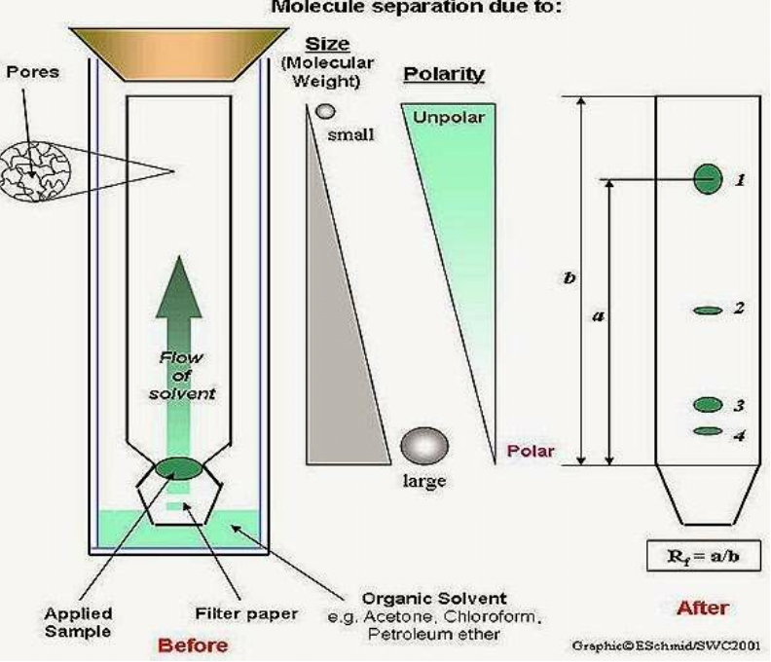
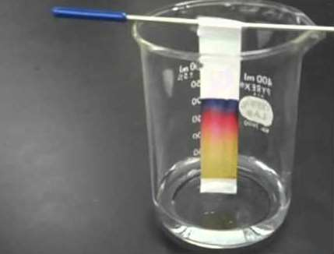
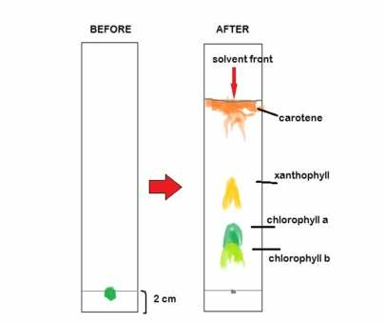
Basic Science H.O.T.
18-03-2017
23

Slide 26
THIN LAYER CHROMATOGRAPHY
Stationary
phase
Mobile
phase
Mechanism
Advantages
Characteristics
Disadvantages
- Based on
retention
factor Rf
- Simple
- Cheap
- Plate length
limited so
separation up
to limited
length
- Easy
recovery of
product
Organic
solvent
Attraction
of
compound
to solid or
liquid
phase
- Higher the
Rf higher the
rate with
which
product has
travelled
Solid
- Sample
affected by
Humidity and
Temperature
Glass slide
Ethanol,
water,
hexane,
pentane
with silica
gel,
Aluminum
oxide
Basic Science H.O.T.
18-03-2017
24

Slide 27
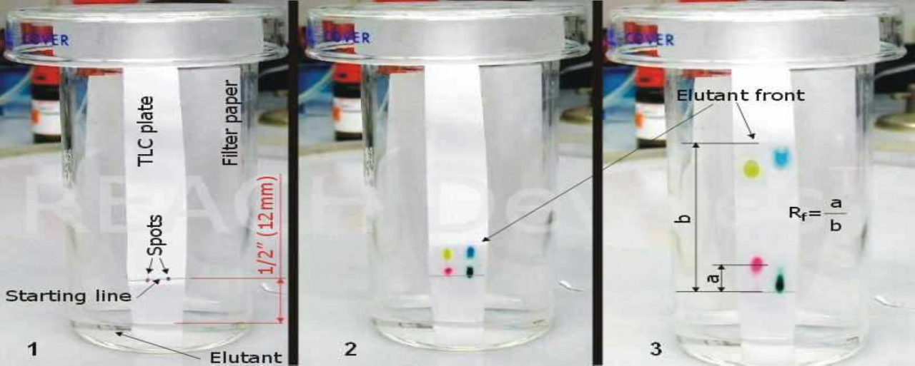
Basic Science H.O.T.
18-03-2017
25

Slide 28
COLUMN CHROMATOGRAPHY
Stationary
phase
Mobile
phase
Characteristics
Mechanism
Advantages
Based on
retention
factor Rf
Disadvantages
-Time
consuming
- Low cost
Solvent
according to
- Higher the
Rf higher the
rate with
which
product has
-Disposability
of stationary
phase so less
cross
contaminatio
n
- Low
separation
power
Silica gel
Differential
stationary
adsorption
phase
of substance
-Irreproducible
result
by
adsorbent or
Organic
relative
travelled
Alumina
affinity
solvents
Basic Science H.O.T.
18-03-2017
26

Slide 29
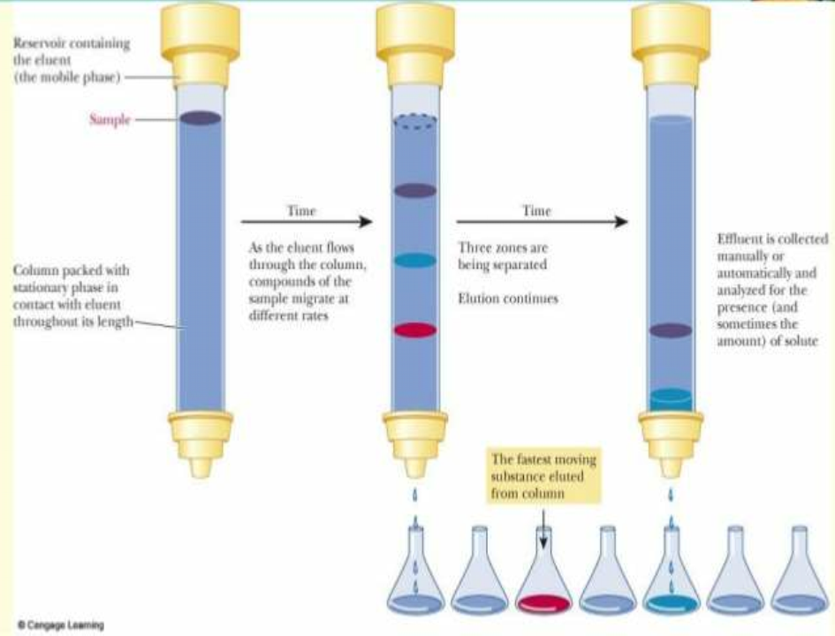
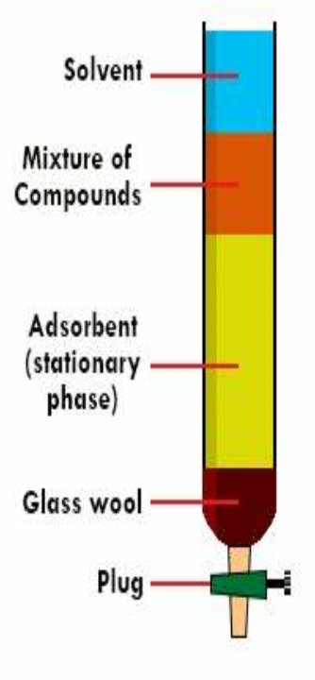
Basic Science H.O.T.
18-03-2017
27

Slide 30
GAS CHROMATOGRAPHY MS
-
Disadvantages
Stationary
phase
Mobile
phase
Advantages
Characteristics
Mechanism
Separation
due to
equilibrium
established
between the
solutes and
stationary
phase
-Fast
-Apply to only
volatile
compound
-Sensitive
-High quality
product
obtained
-Performed at
higher
temperature so
thermally liable
compounds
cannot be
analyzed
Gas(carrier)
volatility
Volatile
liquid
-More
resolution
Inert gas
(He, Ar,
Polarity
-Detectors used
are destructive
Ne)

Slide 31
Nature of stationary phase
Solubility of gas in solid phase
Retention time
Time taken by compound
to be detected
Length of column
Temperature of column
Flow rate of mobile phase
Basic Science H.O.T.
18-03-2017
29

Slide 32
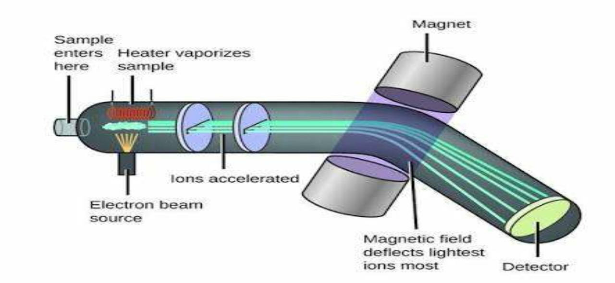
MASS SPECTROMETRY
Basic Science H.O.T.
18-03-2017
31

Slide 33
Basic Science H.O.T.
18-03-2017
33

Slide 34
Basic Science H.O.T.
18-03-2017
35

Slide 35
Basic Science H.O.T.
18-03-2017
36

Slide 36
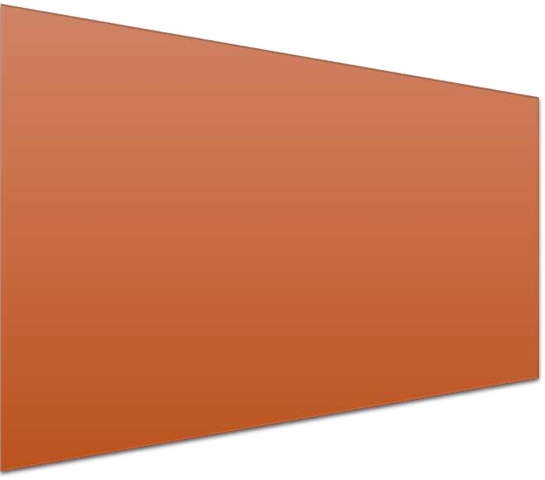
ADVANTAGES AND DISADVANTAGES OF
HPLC
ADVANTAGES
Disadvantages
• Slower technique than GC
•
Can be applied to any compound soluble in liquid
phase ex. AA, Lipids, Carbohydrates
•
Lower resolution when compared to GC.
•
Performed at room temperature so thermally
compounds can analyzed
•
More flexible
•
detectors can be reused i.e. they are non destructive
Basic Science H.O.T.
18-03-2017
38

Slide 37
ION-EXCHANGE CHROMATOGRAPHY
Stationary
Mobile phase
characteristics
Mechanism
Advantages
Disadvantages
phase
Charged molecules
attaches to the
oppositely charged
stationary phase as
a result the
molecules are
separated and the
molecule of interest
can be eluted by
adding another
compound which
has more affinity
for those charged
sites
More matrix
tolerance
Expensive
less
Reproducible
Sensitive
Solid
polarity
High quality
product
obtained
liquid
Cellulose,
Solubility
Agarose
Basic Science H.O.T.
18-03-2017
39

Slide 38
Basic Science H.O.T.
18-03-2017
40

Slide 39
Basic Science H.O.T.
18-03-2017
41

Slide 40
GEL- FILTERATION/ MOLECULAR
EXCLUSION CHROMATOGRAPHY
Stationary
Advantages
Mobile phase
characteristics
Mechanism
phase
Good
separation
Disadvantages
Based on size
proteins can
pass through
the holes in
beads as a
result pass the
column first
and vice versa
Molecules
with exact
same size and
weight cannot
be separated
Biological
activity of
particles
protected
Beads with
holes
Liquid
Organic
Size
Less and
defined time
solvent
hydrocarbon
No sample
loss
like dextran
Basic Science H.O.T.
18-03-2017
42

Slide 41
Basic Science H.O.T.
18-03-2017
43

Slide 42
SDS- PAGE
•Polyacramide
gel is
unreactive
It has many
pores to allow
proteins to pass
Forces
applied
Frictional
force and
Electric
force
(Gravitation
al force can
be
neglected)
Velocity
depends on
Electric
field,
Charge on
molecule
and
coefficient
of fricition
•Proteins
are purified
• setup
similar to
gel
electrophore
sis
Based
on size
SDS anions and
Beta
mercaptoethanol
denatures the
protein by
attaching to side
chains.
So net charge
becomes
negative on
protein
Basic Science H.O.T.
18-03-2017
44

Slide 43
Basic Science H.O.T.
18-03-2017
45

Slide 44
8. PACKING
Freeze
•Drying
Spray
Vaccum
drying

Slide 45
Basic Science H.O.T.
18-03-2017
59

