Slide 1
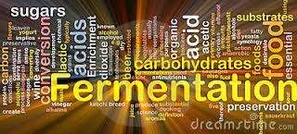
Solid state and Sub. Fermentation
Presented by:
Dr. Namita Ashish Singh
Assistant Professor
Department of Microbiology
MLSU, Udaipur

Slide 2
Fermentation
 Fermentation has been widely used for the production of a wide variety of substances that are highly beneficial to individuals and industry. Over the years, fermentation techniques have gained immense importance due to their economic and Environmental advantages.
 Ancient techniques have been further modified and refined to
maximize productivity. This has also involved the
development of new machinery and processes.
 Two broad fermentation techniques have emerged as a re s u lt
of this rapid development:
Solid State Fermentation (SSF). Submerged Fermentation (SmF).

Slide 3
 At the research level, both SSF and SmF have been used; however, some techniques yielded better results than others. Much work still needs to be done to identify the best fermentation technique for each bioactive compound.
 Solid State Fermentation
 Solid state (substrate) fermentation (SSF) has been defined as the fermentation process occurring in the absence or near-absence of free water.
 Solid state fermentation (SSF) is production of enzymes, which
another involves
method used for the the cultivation of
microorganisms on a solid substrate, such as grains, rice and wheat
bran.

Slide 4
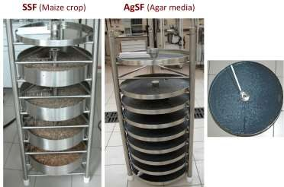
 SSF employs natural raw materials as carbon source such as cassava, barley, wheat bran, sugarcane bagasse, various oil cakes like palm kernel cake, soybean cake, ground nut oil cake, fruit pulps (e.g. apple pomace), saw dust, seeds (e.g. tamarind, jack fruit), coffee husk and coffee pulp, tea waste, spent brewing.

Slide 5
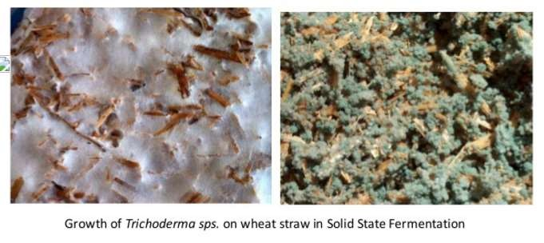
Solid-State Fermentation (SSF)
 SSF is used for the production of bioproducts from microorganisms under conditions of low moisture content for growth. The medium used for SSF is usually a solid substrate (e.g., rice bran, wheat bran, or grain), which requires no processing
 fewer problems due to contamination are observed.
 The power requirements are lower than submerged fermentation.
 Inadequate mixing, limitations of nutrient diffusion, metabolic heat accumulation, and ineffective process control renders SSF generally applicable for low value products with less monitoring and control

Slide 6
 This method is alternative to the production of enzyme in
liquid by subermerged fermentation.
 High volumetric productivity
 Relatively high concentration of product
 Less effluent generate
 Simple fermentation equipment.

Slide 7
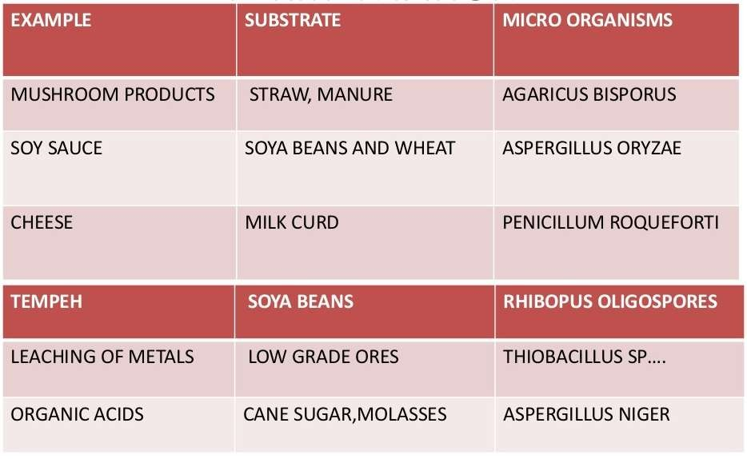
Examples for Solid State Fermentation

Slide 8
Why solid state fermentation ????
Simple and cost effective
Less effluent release, reduce pollution
Resembles the natural habitat of some fungi and bacteria
SSF utilizes solid substrate, thus nutrient rich waste
materials can be easily recycled as substrate
Substrate are used very slowly and steadily so the same substrate can be used for longer fermentation period
SSF is best suited for fermentation techniques involving fungi

Slide 9
Factors Involved in SSF Process
Selection of Micro-organisms
Substrate
Process Optimization
Product Isolation & Purification

Slide 10
 Selection of Micro-organism
 This is one of the key factor for improved yields of the product. Bacteria, Yeast and Filamentous Fungi can be used.
 Filamentous Fungi has shown be t t e r results growing in the solid substrate fermentation.
 Substrate
 Substrate also plays important role in determining the g r o w t h of micro-organisms, there by increasing the product yield.
Substrate is chosen such a way that it should provide physical
support as well as nutrients to the growing culture.
 Substrate : producing a specific product from a suitable substrate.

Slide 11
 Process Optimization
 Includes the optimization
of physico-chemical and
of biochemical Parameters
 Size, initial moisture, pH and pre-treatment of th e substrate •Relative humidity, temperature of incubation, agitation and aeration, age and size of the inoculum
 Nutrient Supplementation such as N, P and trace elements, supplementation of additional carbon source and inducers
•Extraction of product and its purification

Slide 12
 Problems in SSF
 •Heat Transfer: One of the main difficulty is to control the temperature during the fermentation process.
 Heat is generated during the metabolic activities of micro- organisms, since the substrate used has low thermal conductivity heat removal will be slow.
When the heat generated goes beyond certain level, which will result in product denaturation and will affect growth of microbe, ultimately ending up in reduction in yield and quality of the product.

Slide 13
Applications:
 Applications of SSF as described before, Solid State fermentation is being employed in various fields ranging from pharmacology to bioremediation, covering various aspects of biodiversity conservation. Each of the application will be dealt in brief in the following.
1.Production of Industrial Enzymes
 Ideally, almost all the known microbial enzymes can be produced under SSF systems. Enzymes of industrial importance, like proteases, cellulases, ligninases, xylanases, pectinases, amylases, glucoamylases, tannases, phenolic acid esterases, microbial rennets, aryl-alcohol oxidases, oligosaccharide oxidases, tannin acyl hydrolase, a -L-arabinofuranosidase, etc. using SSF systems

Slide 14
2.Production of Bio pesticides
 The infamous Bacillus thurengenesis (Bt)’s protein can be produced in large scale in order to address the issues of pest attacks-yield damage.
 This Biocide bacterium can be obtained by fermentation, either in liquid or semi-solid substrates found to act against Spodoptera frugiperda (fall armyworm) in corn.
4.Production of Renewable Energies
 Renewable energies referring to the Biogas production by utilizing the biomass from plant and animal sources when subjected to anaerobic fermentation by the microbial flora, results in generation of biogas which can be effectively utilized for running gas turbines, and fuel cells.

Slide 15
In Bioleaching:
The recovery of metals from low grade black shale ore was attempted by employing microbial samples using different organic wastes as substrates.
 Maximum recovery of metals such as copper , cobalt , zinc and other metals is possible by continuous SSF. Media components containing glucose (standard medium) and molasses etc., used as substrate.
In Bioremediation
 The discovery that certain microorganisms, living within our avid environment, can actually degrade various toxic components like hydrocarbons, oil spillage etc, has made possible the utilization of biological methods for the treatment of these toxicants.
 A biosurfactant accelerates the process of degradation of pollutant composites. A biosurfactant produced through fermentation subjected for bioremediation yields better results when compared to chemical remediation.

Slide 16
Submerged fermentation:
 In the submerged process, the substrate used for fermentation is always in liquid state which contains the nutrients needed for growth.
 The fermentor which contains the substrate is operated continuously and the product biomass is continuously harvested from the fermenter by using different techniques then the product is filtered or centrifuged and then dried.
 Submerged fermentation is a method of manufacturing biomolecules in which enzymes and other reactive compounds are submerged in a liquid such as alcohol, oil or a nutrient broth.

Slide 17
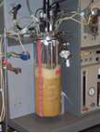
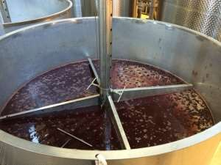
The process is used for a variety of purposes, mostly in
industrial manufacturing

Slide 18
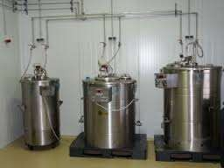
 Submerged liquid fermentations are traditionally used for the production of microbially derived enzymes. Submerged fermentation involves submersion of the microorganism in an aqueous solution containing all the nutrients needed for growth.
 Fermentation takes place in large vessels (fermenter) with volumes of up to 1,000 cubic metres. The fermentation media sterilises nutrients based on renewable raw materials like maize, sugars and soya.
 Most industrial enzymes are secreted by microorganisms into the fermentation medium in order to break down the carbon and nitrogen sources. Batch-fed and continuous fermentation processes are common. In the batch-fed process, sterilised nutrients are added to the fermenter during the growth of the biomass.

Slide 19
Cont..
 In the continuous process, sterilised liquid nutrients are fed into the fermenter at the same flow rate as the fermentation broth leaving the system. Parameters like temperature, pH, oxygen consumption and carbon dioxide formation are measured and controlled to optimize the fermentation process.
 Next in harvesting enzymes from the fermentation medium one must remove insoluble products, e.g. microbial cells. This is normally done by centrifugation. As most industrial enzymes are extracellular (secreted by cells into the external environment), they remain in the fermented broth after the biomass has been removed.
 The enzymes in the remaining broth are then concentrated by evaporation, membrane filtration or crystallization depending on their intended application. If pure enzyme preparations are required, they are usually isolated by gel or ion exchange chromatography.

Slide 20
Applications:
 Submerged Fermentation (SmF)/Liquid Fermentation (LF) SmF utilizes free flowing liquid substrates, such as molasses and broths. The bioactive compounds are secreted into the fermentation broth.
 The substrates are utilized quite rapidly; hence need to be constantly
replaced/supplemented with nutrients.
 This fermentation technique is best suited for microorganisms such as bacteria that require high moisture.
 An additional advantage of this technique is that purification of
products is easier.
 SmF is primarily used in the extraction of secondary metabolites that need to be used in liquid form

Slide 21
SOLID-STATE FERMENTATION | SUBMERGEDFERMENTATION
Utilizes solid substrates like bran, bagasse and paper pulp. | Utilizes free flowing liquid substrates, such as molasses and broths
Substrates are utilized very slowly, need not to be replaced. | Substrates are utilized quite rapidly, need to be replaced constantly
Best suited for fungi that require less moisture content. | Best suited for bacteria that require high moisture content.
Culture systems involves three phases, solid, liquid and gaseous | Involves two phases ,liquid and gaseous phase.
Inoculum ratio is always larger | Inoculum ratio is usually small.
System may or may not involve agitation | Agitation is often essential

Slide 22
SUBTRATES
Table.1
Submerged fermentation (SmF) | Solid state fermentation (SSF)
Soluble sugar Molasses Liquid media Fruit and vegetable juices Sewage / waste water | Wheat bran Rice and wheat straw Fruit and vegetable waste Paper pulp Bagasses Coconut coir Synthetic media

Slide 23



COMPARISION
Submerged fermentation | Solid state fermentation
Fermentation may be carried out as batch or continuous Medium is added in large vessel Surface area to volume height ratio is very less 5-10% of inoculums is added Inoculum is usually in liquid form Product used are usually high as compared to input cost | Fermentation may be carried out as batch Medium is added in flat vessel or trays Surface area to volume height ratio is very high Less inoculum is added Inoculum is usually sprayed on surface of medium Product yield is comparatively less

Slide 24
Submerged fermentation | Solid state fermentation
Lesser space is required Less contamination If a batch get contaminated there is a loss of entire batch Entire fermentation media is utilized by microorganism for growth and product fermentation Aeration and agitation of system is possible by use of sparger and impeller | More space is required More contamination If a tray gets contaminated then there is a loss of only tray but not the batch There is wastage of fermentation media Aeration is usually carried out by passing sterile air and no agitation
24

Slide 25
Submerged fermentation | Solid state fermentation
Power consumption is high Controlling parameters like temperature, pH is easy Foaming occurs Automation and use of computer is easy Less labor required eg penicillin, streptomycin production etc. | Power consumption is less Controlling parameters like temperature, pH is difficult Foaming doesn’t occurs Automation and use of computer is difficult More labor required eg Veniger, amylase production etc.
25

Slide 26
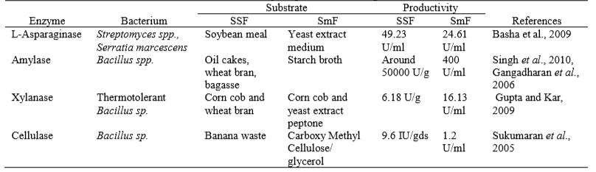
Bacterial enzyme production using fermentation

Slide 27
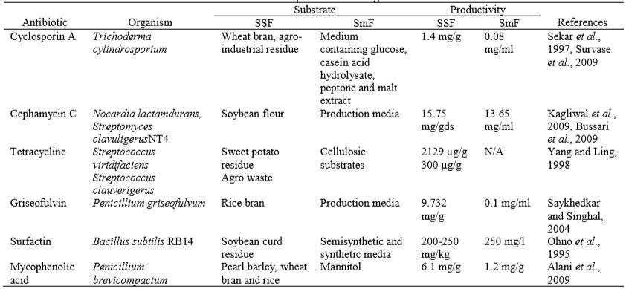
Antibiotics production using fermentation

Slide 28
Points to know
More that 75% of the industrial enzymes are produced using SmF, one of the major reasons being that SmF supports the utilization of genetically modified organisms to a greater extent than SSF.
Another reason why SmF is widely used is the lack of paraphernalia (materials) regarding the production of various enzymes using SSF.
In SmF, the accumulation of variety of intermediate metabolites results in lowered enzyme activity and production efficiency
based on research, certain bioactive compounds have found to be produced in higher quantities in SSF, whereas other compounds have been extracted using SmF
28

Slide 29



