Slide 1



Slide 2
Chromosome
Chromosome means: chroma - colour; some - body)
A chromosome is a thread-like self-replicating genetic structure containing organized DNA molecule package found in the nucleus of the cell.
Chromosomes are seen during metaphase stage of mitosis when the cells are stained with suitable basic dye and viewed under light microscope.
E. Strasburger in 1875 discovered thread-like structures which appeared during cell division.
In all types of higher organisms (eukaryote), the well organized nucleus contains definite number of chromosomes of definite size, and shape.

Slide 3
Waldeyer coined the term chromosome first time in 1888.
The somatic chromosome number is the number of chromosomes found in somatic cell and is represented by 2n (Diploid).
The gametic chromosome number is half of the somatic chromosome numbers and represented by n (Haploid).
The two copies of chromosome are ordinarily identical in morphology, gene content and gene order, they are known as homologus chromosomes.

Slide 4
Chromosomes are of two types
Autosomes: that control characters other than sex characters or carry genes for somatic characters.
Sex chromosomes (Gonosomes) – Chromosomes involved in sex determination.
Humans and most other mammals have two sex chromosomes X & Y, also called heterosome.
Females have two X chromosomes in diploid cells; males have an X and a Y chromosome.
In birds the female (ZW) is hetero-gametic and male (ZZ) is
homo-gametic.

Slide 5
Diploid and Haploid chromosome number
Diploid cells (2N where N- chromosome number) have two
homologous copies of each chromosome.
The body cells of animals are diploid.
Haploid cells (N) have only one copy of each chromosome.
In animals, gametes (sperm and eggs) are haploid.
Chromosome number varies from 2n = 4 (n = 2) to 2n = >
1200. (n = gametic or haploid chromosome number 2n = somatic or diploid chromosome number)
The number of chromosomes varies from species to species.
Normally all individual of a species have the same chromosome number.

Slide 6
The size of chromosome is normally measured at mitotic metaphase and may be as short as 0.25 µm in fungi and birds, or as long as 30 µm in some plants like Trillium.
Each chromosome has two arms - p (the shorter of the two) and q (the longer).
Chromosome shape is usually observed at anaphase,
when the position of primary constriction (centromere) determines chromosome shape.
This constriction or centromere can be terminal, sub-terminal or median in position.

Slide 7
Homologous Chromosomes
Diploid organisms have two copies of each chromosome (except the sex chromosomes).
Both the copies are ordinarily identical in morphology, gene content and gene order and hence known as homologous chromosomes.
Each pair of chromosomes made up of two homologs.
Homologous chromosome is inherited from separate parents; one homolog comes from the mother and the other comes from the father.

Slide 8
Species | 2n | Species | 2n | Species | 2n
Human | 46 | Hamster | 44 | Guinea pig | 64
Pea plant | 14 | Bison | 60 | Hare | 48
River buffalo | 50 | Chimpanzee | 48 | Lion | 38
Swamp buffalo | 48 | Deer | 68 | Mouse | 40
Cat | 38 | Elephant | 56 | Musk ox | 48
Cattle | 60 | Tiger | 38 | Rat | 42
Dog | 78 | Honey bee* | 32, 16 | Pigeon | 80
Donkey | 62 | House fly | 12 | pheasant | 82
Goat | 60 | Fruit fly | 8 | Turkey | 80
Horse | 64 | Reindeer | 70 | Domestic duck | 80
Pig | 38 | Alligator | 32 | Emu | 80
Camel | 74 | Chicken | 78 | Goose | 80
Rabbit | 44 | Guinea fowl | 74
Sheep | 54 | Japanese quail | 78
Mule | 63 | Muscovy duck | 80
Gorilla | 48 | Ostrich | 80

Slide 9
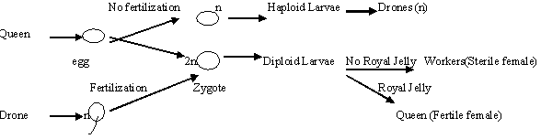
In honey bee female (queen and workers) have 32 chrmosomes and male (drone) have 16 chromosomes

Slide 10
Chromosome Morphology
Mitotic metaphase is the most suitable stage for studies on chromosome morphology.
The chromosome morphology changes during cell division.
Chromosomes are thin, coiled, elastic, thread-like structures
during the interphase.
As cells enter mitosis, their chromosomes become highly condensed so that they can be distributed to daughter cells.
In mitotic metaphase chromosomes, the following structural features can be seen under

Slide 11
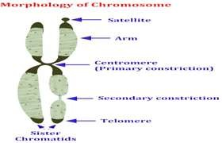

Slide 12
Chromatid
Each metaphase chromosome appears to be longitudinally divided into two identical parts each of which is called chromatid.
Both the chromatids of a chromosome appear to be joined together at a point known as centromere.
The two chromatids of chromosome separate from each other during mitotic anaphase (and during anaphase II of meiosis) and move towards opposite poles.
Since the two chromatids making up a chromosome are produced through replication of a single chromatid during synthesis (S) phase of interphase, they are referred to as sister chromatids.
In contrast, the chromatids of homologous chromosomes are known as non-sister chromatids.

Slide 13
Centromere (Primary constriction)
Centromere is the landmark for identification of chromosome.
Each chromosome has a constriction point called the centromere (Synonym: Kinetochore), which divides the chromosome into two sections or arms.
The short arm of the chromosome is labeled the "p" arm. The long arm of the chromosome is labeled the "q" arm.
Telomere
The two ends of a chromosome are known as telomeres, they play critical roles in chromosome replication and maintenance of chromosomal length.
The telomeres are highly stable and telomeres of different
chromosomes do not fuse.
The telomeric region of chromosome is made up of repeatative sequence of T and G bases

Slide 14
Secondary constriction
In some chromosome addition to centromere / primary constriction, one or more constrictions in the chromosome are present termed secondary constrictions.
Satellite
The chromosomal region between the secondary constriction and nearest telomere is called as satellite and chromosomes that possess this region called as satellite chromosome or sat chromosome.
A small chromosomal segment separated from the main body of the chromosome by a secondary constriction is called Satellite.

Slide 15
Size of the chromosome
The size of the chromosome varies from stage to stage of cell division.
The chromosomes are the longest and thinnest during interphase (resting stage) and hence not visible under light microscope.
Chromosomes are the smallest and thickest during mitotic metaphase.
Chromosome size is not proportional to the number of genes present on the chromosome.
The location of the centromere on each chromosome gives
the chromosome its characteristic shape.

Slide 16
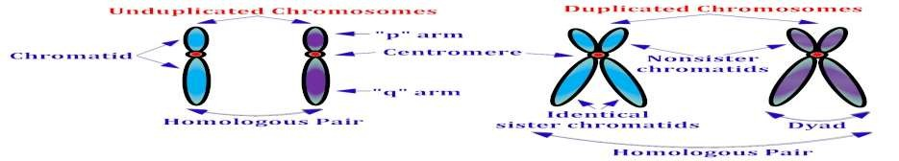
Chromosomes are classified according to the centromere
position :
At one end : Acrocentric
Closer to one end: Submetacentric
Middle: Metacentric
Each chromosome has two arms, labeled p (the shorter of the two) and q (the longer).
The p arm is named for "petite" meaning "small"; the q arm is named q simply because it follows p in the alphabet.

Slide 17
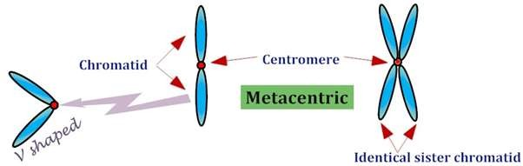
Metacentric chromosome
The centromere is located in the centre of chromosomes, i.e. the centromere is median. The centromere is localized approximately midway between each end and thereby two arms are roughly equal in length.
Metacentric chromosome take V shape during anaphase.

Slide 18

Submetacentric Chromosome
Centromere is located on one side of the central point of a chromosome. Centromere is submedian giving one longer and one shorter arms.
Submetacentric chromosome may be J or L shaped during
anaphase.

Slide 19

Acrocentric Chromosome
The centromere located close to one end of chromosomes. The centromere is more terminally placed and forms very unequal arm length (The "acro-" in acrocentric refers to the Greek word for "peak").
The p (short) arm is so short that is hard to observe, but still
present.
Acrocentric chromosome may be rod shape during anaphase.

Slide 20

Telocentric Chromosome
Centromere located at one end of chromosome (at terminal part of chromosome) lies at one end.
Telocentic chromosome may be rod shape during anaphase.

Slide 21
According to the number of the centromere the eukaryotic chromosomes may be
Acentric :without any centromere
Mono centric: with one centromere
Dicentric : with two centromeres
Polycentric: with more than two centromeres

Slide 22
How large size sequential DNA can fit in to small size chromosome ?

Slide 23
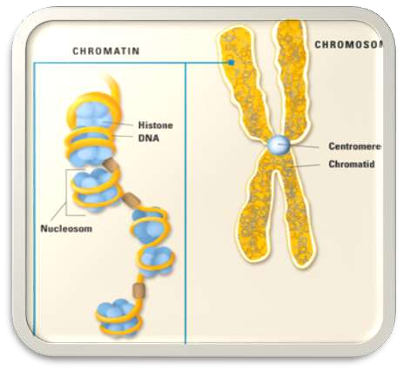
The DNA double helix in the cell nucleus is packaged by special proteins termed histones.
The formed protein/ DNA complex is called chromatin.
The structural entity of chromatin is the nucleosome.

Slide 24



CHROMATIN
NUCLEOSOMES
DNA binding proteins
DNA

Slide 25
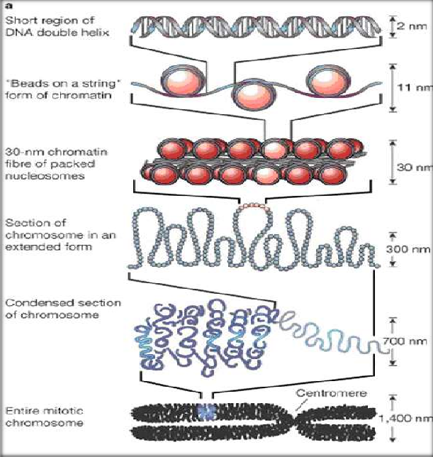
CHROMOSOME PACKAGING

Slide 26

Histone can be grouped into five major classes: H1/H5, H2A, H2B, H3, and H4
These are organised into two super-classes as follows:
  Core histones – H2A, H2B, H3 and H4
  Linker histones – H1 and H5

Slide 27
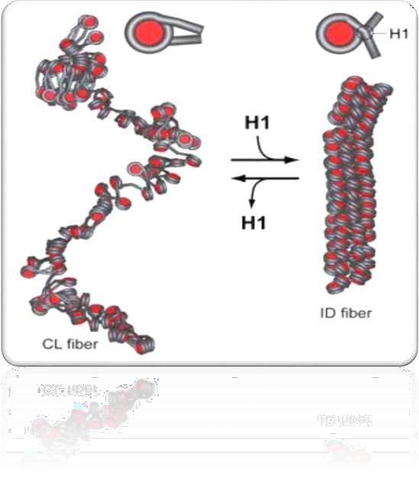
Linker DNA is double-stranded DNA in between
two nucleosome cores that, in association with histone H1, holds the cores together.

Slide 28

basic unit of DNA packaging in eukaryotes
consists of a segment of DNA wound around histone protein
core
fundamental repeating units of eukaryotic chromatin
The nucleosome core particle consists of approximately 147 base pairs of DNA wrapped in 1.67 left-handed superhelical turns around a histone octamer consisting of 2 copies each of the core histones H2A, H2B, H3, and H4
The nucleosome cores themselves coil into a solenoid shape which itself coils to further compact the DNA

Slide 29
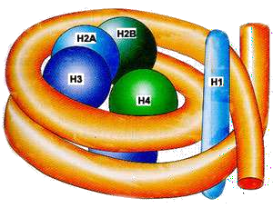
Core particles are connected by stretches of "linker DNA", which
can be up to about 80 bp long.
Technically, a nucleosome is defined as the core particle plus one of these linker regions; however the word is often synonymous with the core particle
Linker histones such as H1 and its isoforms are involved in chromatin compaction and sit at the base of the nucleosome near the DNA entry and exit binding to the linker region of the DNA
Non-condensed nucleosomes without the linker histone resemble "beads on a string of DNA" under an electron microscope.

Slide 30
The protein-DNA structure of chromatin is stabilized by attachment to a non-histone protein scaffold called the nuclear matrix.
In contrast to most eukaryotic cells, mature sperm cells largely use protamines to package their genomic DNA, most likely to achieve an even higher packaging ratio
Histone equivalents and a simplified chromatin structure have also been found in Archea, proving that eukaryotes are not the only organisms that use nucleosomes.

Slide 31

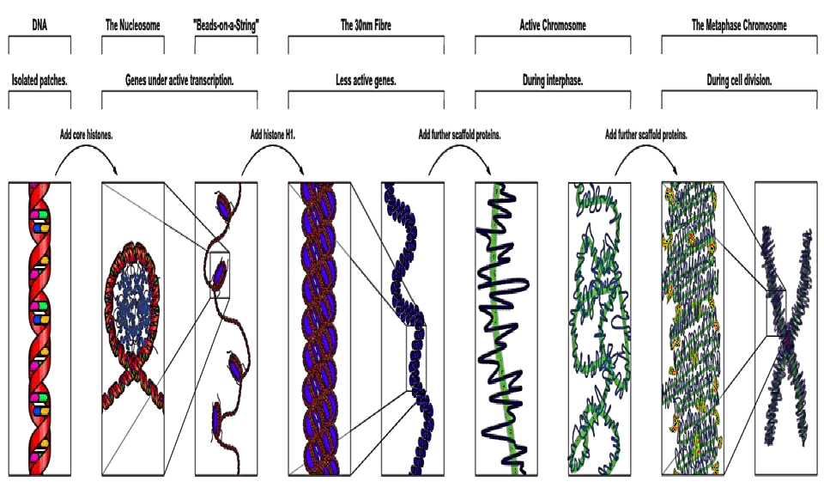

Slide 32
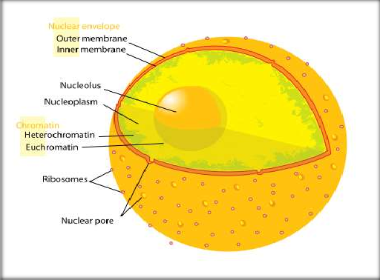
Tightly packed chromosome
Intensely stained
consists of genetically inactive satellite sequences
Both centromeres and telomeres are heterochromatic

Slide 33

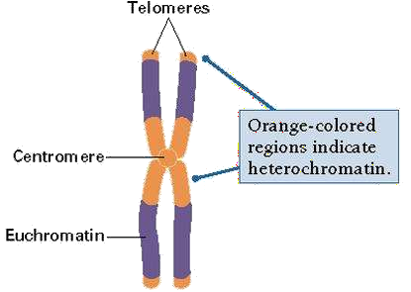
lightly packed form of chromatin (DNA, RNA and protein) that
is rich in gene concentration
often (but not always) under active transcription
Unlike heterochromatin, it is found in both cells with nuclei (eukaryotes) and cells without nuclei (prokaryotes) most active portion of the
genome within the cell nucleus

Slide 34

THANX

