Slide 1
When two waves superimpose the amplitude of the resultant wave is the vector sum of the individual amplitudes.
SUPERPOSITION PRINCIPLE:

Slide 2
When two waves of same frequency moving in the same direction superimpose interference takes place.
INTERFERENCE:

Slide 3
CONSTRUCTIVE INTERFERENCE:
Constructive interference occurs at a point where two overlapping or intersecting waves of the same frequency are in phase—that is, where the crests and troughs of the two waves coincide. In this case, the two waves reinforce each other and combine to form a wave that has an amplitude equal to the sum of the individual amplitudes of the original waves.

Slide 4
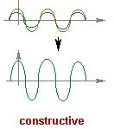

Slide 5
DESTRUCTIVE INTERFERENCE

Slide 6
Destructive interference occurs when two intersecting waves of the same frequency are completely out of phase
—that is, when the crest of one wave coincides with the trough of the other. In this case, the two waves cancel each other out.

Slide 7
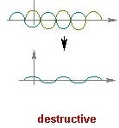

Slide 8
INTERFERENCE IN LIGHT WAVES

Slide 11
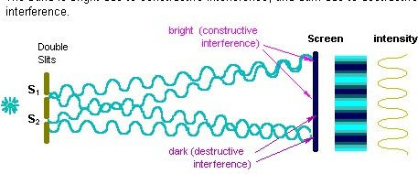

Slide 12
APPLICATIONS

Slide 13
1.Interfering light waves are responsible for the colours occasionally seen in soap bubbles. White light is made up of light waves of different wavelengths; the light waves reflected from the inner surface of the bubble interfere with light waves of the same wavelength reflected from the outer surface of the bubble. Some of the wavelengths interfere constructively, and other wavelengths interfere destructively. Since different wavelengths of light correspond to different colours, the light reflected from the soap bubble appears coloured.

Slide 14
2.The phenomenon of interference between visible light waves is exploited in holography ( method of obtaining three-dimensional photographic images).

Slide 15
3.The phenomenon of interference is used in interferometry (that utilizes the phenomenon of interference of light waves for the ultra-precise measurement of wavelengths of light itself, of small distances, and of certain optical phenomena).

Slide 16
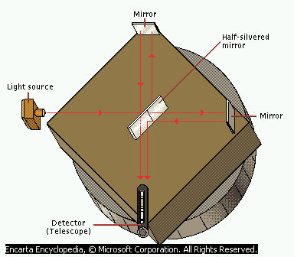

Slide 17
OTHER EXAMPLES

Slide 18
1.The interference of water waves can be observed by dropping objects in a still pool of water and noting how the overlapping waves interfere constructively at some points and destructively at others.

Slide 19
2. Radio waves interfere with each other when they bounce off buildings in cities, distorting the signal.

Slide 20
3.Sound-wave interference must be taken into account when constructing concert halls, so that destructive interference does not result in areas in the hall where the sounds produced on stage cannot be heard.

