Slide 1

Isolation, Screening and Strain Improvement of industrially
Important microorganisms
Presented by:
Dr. Namita Ashish Singh
Assistant Professor
Department of Microbiology

Slide 2
ISOLATION
In natural environments, microorganisms usually exist as mixed populations. If we want to study, characterize, and identify microorganisms then we must have the organisms in the form of a pure culture.
Mixed culture : more than one organism
A pure culture contains a single bacterial species
Pure culture Techniques:There are three techniques for isolation of pure cultures:
1) Streak plate method
2) Pour plate method
3) Spread plate method

Slide 3
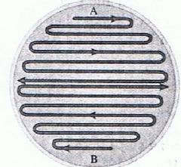
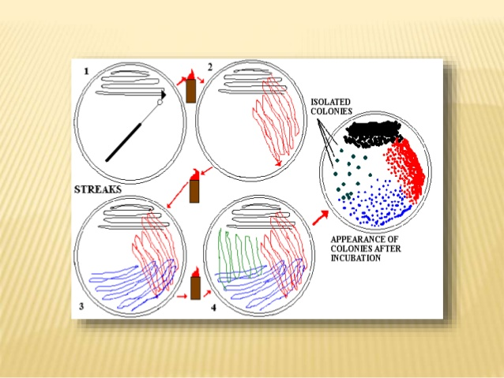
Streak plate method
The streak plating technique isolates individual bacterial cells (colony-forming units) on the surface of an agar plate using a wire loop.
Continuous Quadrant method

Slide 4
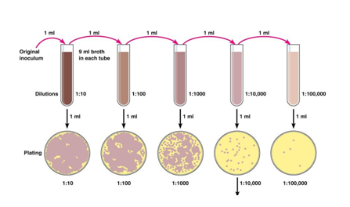
Pour plate method
Calculation:
Number of bacteria/ml =Number of colonies on plate x reciprocal of dilution of sample
(e.g. if 32 colonies are on the plate of 1/10000 dilution then the counts is 32X10,000 = 320,000 bacteria/ml in sample)
(Copyright © 2006 Pearson Education Inc. Publishing as Benjamin Cummings )

Slide 5
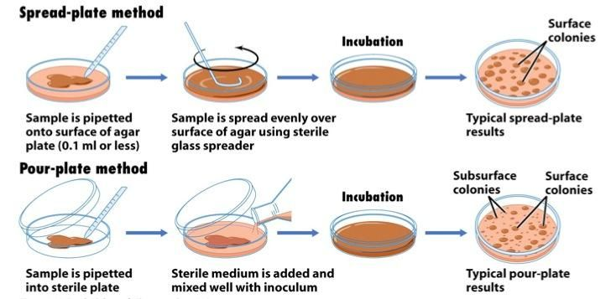
Spread plate method

Slide 6














MICROORGANISMS
SOURCE
COMPOST AND
OTHER
SOURCES
FOOD (MILK,
CHEESE etc. )
ENVIRONMENT
(AIR , WATER,
SOIL)
SCREENING
PRIMARY SCREENING
SECONDARY SCREEENING

Slide 7

TYPES OF SCREENING
SRCEENING
PRIMARY SCREENING
SECONDARY SCREENING
ORGANIC ACID
PRODUCING
MICROORGANISMS
ANTIBIOTIC
PRODUCING
MICROORGANISMS
EXTRACELLULAR
METABOLITES
PRODUCING
MICROORGANISMS
ENRICHMENT
CULTURE
TECHNIQUE
BY USING DYES
BY USING
CROWDED
PLATE
TECHNIQUE
BY
AUXANOGRAPHY
TECHNIQUE
BY
DEFINED
MEDIA

Slide 8

PRIMARY SCREENING
○ It’s a process for detection and isolation of microorganisms of our
interest.
○ Determines which microorganisms are able to produce a
compounds.
○ Does not provide much idea about the production or yield potential
of microorganisms.
○ It separate out only a few microorganisms, only few have
commercial value while discards the valueless microorganisms .

Slide 9

1) PRIMARY SCREENING OF ORGANIC
ACID PRODUCING MICROORGANISMS
The ph indicating dyes may be used for detecting
microorganism that are capable of producing organic
acids.
These dyes undergo color changes according to its ph.
Dyes such as Neutral red, Bromothymol blue are added to
the poorly buffered nutrient agar media .
Colonies are subcultured to make stock culture.
Further testing is needed since inorganic acids, bases are
also metabolic products of microbial growth.

Slide 10
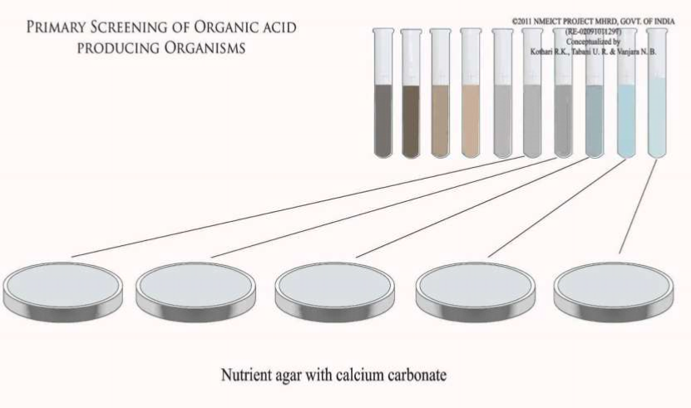
❖ Incorporation of CaCO3 in medium is also used to screen
organic acid producing microbes on basis of formation of
clear zone of dissolved CaCO3 around the colony.

Slide 11
2) PRIMARY SCREENING OF ANTIBIOTIC
PRODUCING MICROORGANISMS
❖ Crowded plate technique is used for screening of antibiotic
producing microorganisms.
❖ Does not give information about the sensitivity of antibiotics
towards other microorganisms.
❖ Dilutions are made and then pouring and spreading of soil
samples that give 300 to 400 or more colonies per plate.
❖ Colonies showing antibiotic activity are indicated by zone of
inhibition around the colony .
❖ Such colonies are sub cultured and purified by streak before
making stock cultures.

Slide 12
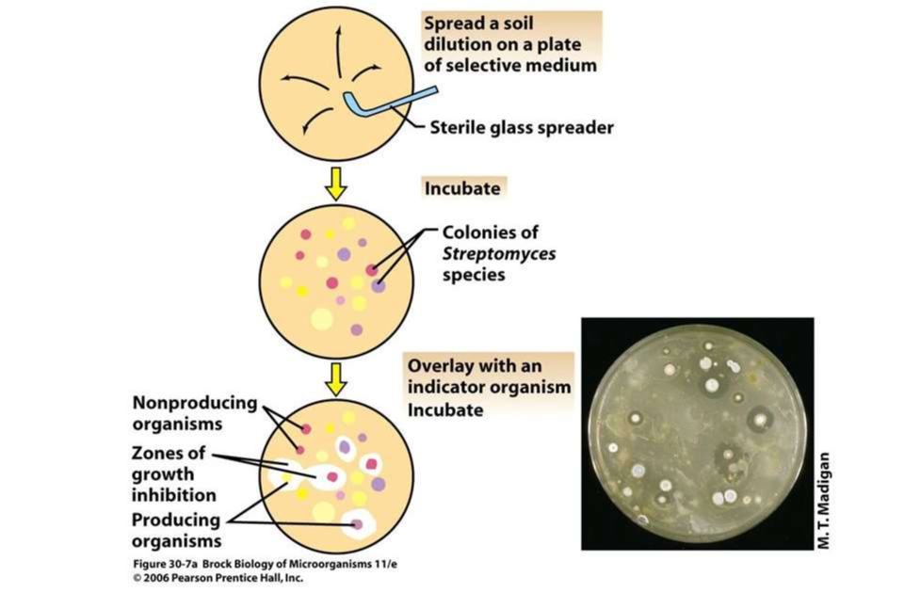
The purified cultures are then tested to find the Microbial
Inhibition Spectrum.

Slide 13












3) PRIMARY SCREENING EXTRACELLULAR
METABOLITE PRODUCING MICROORGANISM
Auxanography technique is employed for detecting microorganisms
able to produce growth factors , vitamins , amino acids etc.
extracellularly.
❖ The 2 major steps are:-
•
A filter paper strip is put across the bottom of petri dish.
• The nutrient agar is prepared and poured on the paper disc
• and allowed to solidify.
A.)Preparation
•
Soil sample is diluted and proper dilutions are inoculated.
of first plate
•
A minimal media lacking the growth factors is prepared and
seeded with the test organism.
• The seeded medium is poured onto fresh petri plate and the
plate is allowed to set.
B.) Preparation
of second plate

Slide 14
The agar in first plate is then lifted and placed on the second plate
without inverting.
The growth factors produced on agar can diffuse into the lower layer
containing test organism.
The zones of stimulated growth of test organism around colonies is an
indication that organism produce growth factor extracellularly.

Slide 15


4) ENRICHMENT CULTURE TECHNIQUE
This was designed by Beijerinck to isolate the desired
microorganism from heterogeneous microbial population.
❖ It consists of following steps :
a.) Nutrient broth is inoculated with microbial source material
and incubated.
b.) A small portion of all inoculums is plated onto the solid
medium and well isolated colonies are obtained.
c.) Suspected colonies from the plate are sub cultured on fresh
media and subjected for further testing.

Slide 16
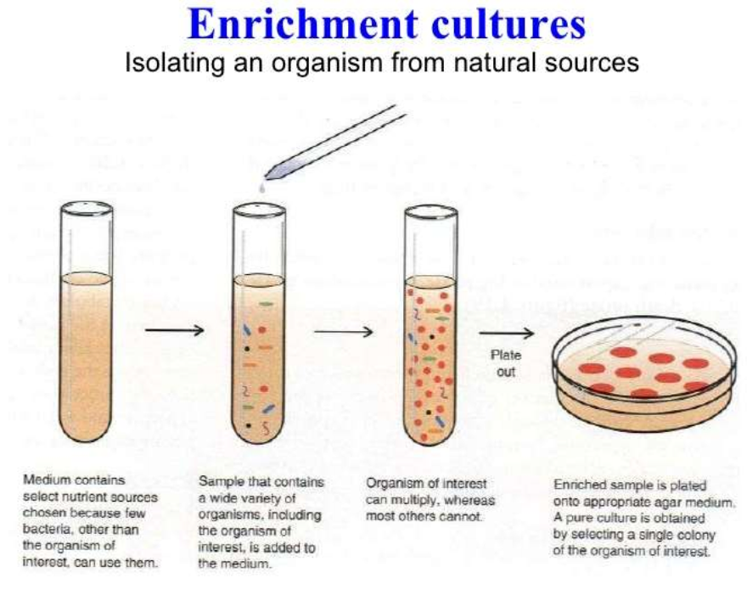

Slide 17
SECONDARY SCREENING
It’s a systematic screening programme intended to isolate
industrially important or useful microorganisms .
SOME IMPORTANT POINTS ASSOCIATED WITH
SECONDARY SCREENING ARE:-
•
It is useful in sorting of microorganisms that have real commercial
value. The microorganisms having poor applicability in fermentation
process are discarded.
•
Provides the information whether the product formed by
microorganisms is new or not. This may be accomplished by paper ,
thin layer, chromatographic technique.

Slide 18
•
It should show whether the product possess physical properties such as
UV light absorption or fluorescence or chemical properties that can be
employed to detect the compound during use of paper chromatography.
• It is conducted on agar plates, in flasks or in small fermentor containing
liquid media.
• It gives an idea about the economic position of the fermentation
process involving the use of a newly discovered culture.
• It helps in providing information regarding the product yield potentials
of different isolates.
• It determines the optimum conditions for growth or accumulation of a
product associated with a particular culture.

Slide 19
•Chemical, physical and biological properties of a product are also
determined during secondary screening. Moreover, it reveals whether
a product produced in the culture broth occurs in more than one
chemical form.
• It detects gross genetic instability in microbial cultures. This type
of information is very important, since microorganisms tending to
undergo mutation or alteration is some way may lose their capability
for maximum accumulation of the fermentation products.
•It tells about the chemical stability of the fermentation product.
•It can be qualitative or quantitative in its approach.

Slide 20







EXAMPLE OF SECONDARY SCREENING –
SPECIES
1. Streptomyces isolates are streaked as a narrow band on nutrient
agar plates are incubated .
2. Test organisms are then streaked from the edge of plates without
touching streptomyceal isolate and then the plates are then
incubated .
3. At the end of incubation, growth inhibitory zones for each organism
are measured in millimeters .
4. Such organisms are again subjected for further testing by growing
the culture in sterilized liquid media and incubated at constant
temperature in a mechanical shaker.

Slide 21







Strain Improvement
❖
Strain-
A Strain is a group of species with one/ more
characteristics that distinguish it from other sub groups of
the same species of the strain .
- each strain is indentified by a name, number or letter.
Example:- E.coli Strain K12
❖
Strain Improvement-
The Science and Technology of
manipulating and improving microbial strains in order to
enhance their metabolic capacities is known as Strain
Improvement

Slide 22


Ideal Characteristics of Strain
 Rapid growth
 Genetic stability
 Non-toxicity to humans
 Ability to use cheaper substrates
 Elimination of the production of compounds that may
interfere with downstream processing
 To improve the use of carbon and nitrogen sources.
 Reduction of cultivation cost
 Shorter fermentation time.

Slide 23


Purpose of Strain Improvement
 Increase the productivities
 Regulating the activity of the enzymes
 Increasing the permeability
 To change un used co-Metabolites
 Introducing new genetic properties into the
organism by Recombinant DNA technology /
Genetic engineering.

Slide 24


Approaches for Strain Improvement
➢ Mutant Selection
➢ Recombination
➢ Recombinant DNA Technology

Slide 25

MUTANT SELECTION
 A MUTATION
is a Sudden and Heritable change in the traits
of an organism.
 Application of Mutagens to Induce mutation is called
MUTAGENESIS.
 Agents capable of inducing mutations are called MUTGENS
Physical – Particulate and Non-Particulate
Chemical – Base analog, Deamine & Alkylating
agents, Acridine Dyes.
➢ Mutation occurring without any specific treatment are called
“ Spontaneous Mutation.
”
➢ Mutation are resulting due to a treatment with certain agents
are known as “Induced Mutation.”

Slide 26
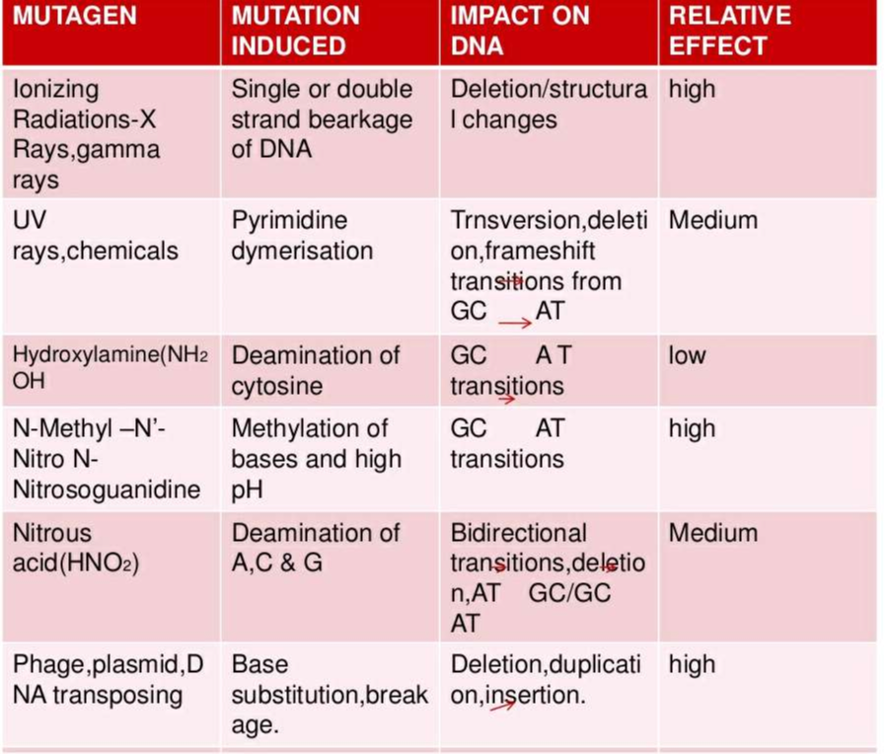

Slide 27
Contd…
❖ Many Mutations bring about marked changes in the
Biochemical Characters of practical interest these are called
Major Mutations
– these can be used in Strain Improvement
Ex: Streptomyces
griseus
-Streptomycin-Mannosidostreptomycin
Ex: Streptomyces
aurofaciens
(S-604) –
Produce 6-demethyl tetracycline in place of Tetracycline
❖ In contrast, most improvements in biochemical production
have been due to the Stepwise accumulation of so called
Minor genes.
Ex: Pencillium
chrysogenum – Strain E15-1 was obtained which
yield 55% more penicillin than original strain

Slide 28

Isolation of mutants
1.
Isolation of
Auxotrophic Mutants:- it has a defect in one of its
biosynthetic pathways, so it require a specific Bio-molecule for
normal growth & development.
Ex: Phe‾ mutant of C.glutamicus – require Phe for growth so, it
accumulates Tyrosine.
2
Analogue – Resistant Mutant:- it have feed back insensitive
enzymes of the biosynthetic pathway.
Feed - back inhibition- Tyr‾ mutant of C. glutamicus were
selected for resistance to 50mg/L of p-flurophenylalanine
( analogue of phenylalanine).
3
Revertants
from non producing mutants:- Of a Strain are high
producer . Mutant mutates back to its original phenotype is called
Reversion and mutant is called Revertant.
Ex: Reversion mutant of Streptomyces
viridifaciens showed over
6-fold increase in chlortetracycline production over the original
strain

Slide 29
Contd…
4.
Selection of Resistance to antibiotic:-
produced by the organism
itself may lead to increased yields.
Ex: Streptomyces
aurefaciens
mutants selected for resistance to
200-400mg/L chlortetracyclin showed for 4 fold increase in the
production of antibiotics.
5
Mutants with altered cell membrane permeability-
Show high
production of some metabolites
Ex: A mutant E.coli
strain has defective Lysine transport; it
actively excretes L-Lysine into the medium to 5 times as high
concentration as that with in it cells.
6
Mutants have been selected to produce altered metaboliteds,
especially in case of Aminoglycoside antibiotics.
Ex: Pseudomonas
aurofaciens
produces the antibiotic
Pyrrolnitrin:: a mutant of this organism yields 4’-fluropyrrolnitrin.

Slide 30


RECOMBINATION
 Defined as formation of new gene combinations among
those present in different strains.
 Recombination used for both genetic analysis as well as
strain improvement
 To generate new products
Recombination may be based on:-
- Cross over
- Transformation
- Conjugation
- Transduction
- protoplast fusion – The fusion between non producing
strains of two species (
Streptomyces griseus and
Streptomyces
tenjimariensis) has yielded a strain that
produces indolizomycin, a new Indolizine
antibiotic.

Slide 31


RECOMBINATION DNA TECHNOLOGY
 rDNA Technology or Genetic Engineering
involves the isolation and cloning of genes of
interest, production of the necessary gene
constructs using appropriate enzymes and then
transfer and expression of these genes into an
suitable host organism.
 This technique has been used to achieve 2 broad
objectives:
- Production of Recombinant proteins
- Metabolic Engineering

Slide 32
Contd…..
1.
Recombinant proteins:- These are the proteins
produced by the transferred gene / transgene ; they
themselves are of commercial value.
Ex: Insulin, Interferons
etc.. are produced in
Bacteria
2.
Metabolic Engineering :- When metabolic
activities of an organism are modified by
introducing into it transgenes, which affect
enzymatic, transport and /or regulatory function of
its cells its known as Metabolic Engineering.
Examples – Over production of the amino acid
Isoluecine in C. glutamicum
& Ethanol by E.coli .

Slide 33
Contd…
❑ Product Modification include the new enzymes which
modifies the product of existing biosynthetic pathway
e.g. Conversion of Cephalosporin C into 7- amino
cephalosporanic acid by D-amino acid oxidase
(in A. chrysogenum).
❑ Completely new metabolite formation include in which
all the genes of a new pathway are transferred
e.g. E.coli, transfer of 2 genes for polyhydroxybutyrate
synthesis from Alcaligenes eutrophus.
❑ Enhance growth include enhanced substrate utilization.
e.g. E.coli , glutamate dehydrogenase into
M.methylotrophus carbon conversion increased from 4% to
7%

Slide 34
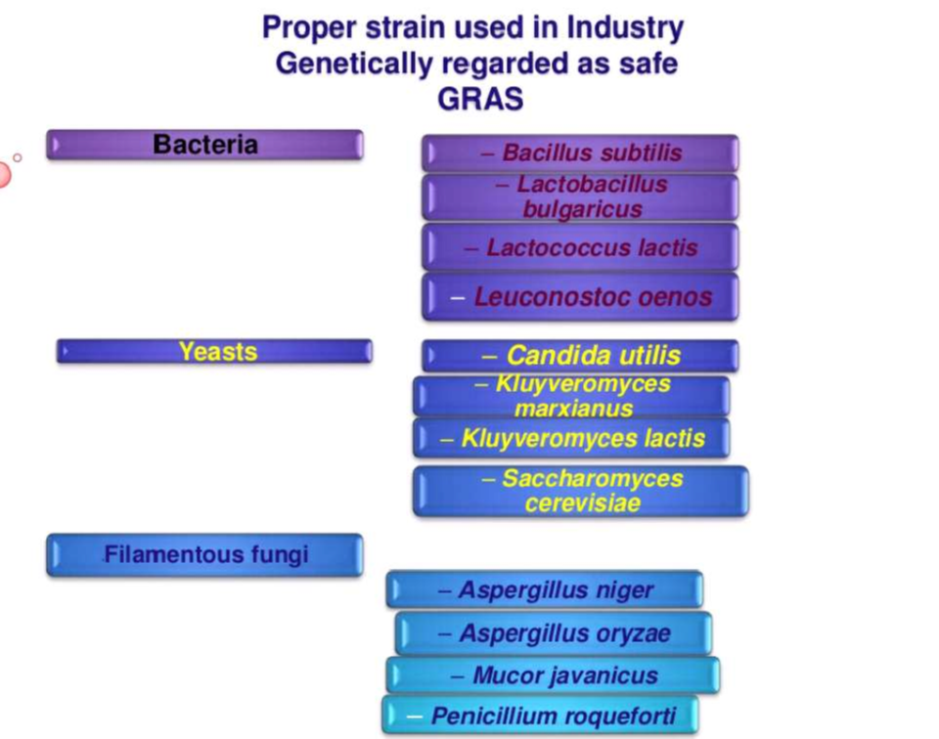

Slide 35


