Slide 1
Size separation
Dr. Garima Joshi
Assistant Professor
Department of Pharmaceutical Sciences, MLSU
B Pharm III sem-Unit operation

Slide 2
SIZE SEPARaTION
Size separation is a unit operation that involves the separation of a mixture of various size particles into two or more portions by means of screening surfaces.
It is a special technique used for separating the particles according to their sizes
Size separation is also known as sieving, sifting, screening. This technique is based on physical differences b/w the particles such as size, shape and density.

Slide 3
Need/ Application/ uses/ significance of size separation
Determination of particle size & size distribution is required for production of tablet and capsule.
It is a quality control tool for analysis of raw material.
To optimize the process condition such as method of agitation, time of screening, feed rate etc.
To measure the efficiency of size reduction equipments.

Slide 4
OFFICIAL STANDARDS FOR POWDERS
The Indian Pharmacopoeia has laid down the standards for powders for pharmaceutical purposes. The I.P. specifies five grades of powder which are as under:
1. Coarse powder : A powder of which al! the particles pass through a sieve with nominal mesh aperture of 1.70 mm (No. 10 sieve) and not more than 40.0 per cent through a sieve with nominal mesh aperture of 355 urn (No. 44 sieve) is called coarse powder.
2. Moderately coarse powder: A powder of which all the particles pass through a sieve with nominal mesh aperture of 710 micrometer (No. 22 sieve) and not more than 40.0 per cent through a sieve with nominal mesh aperture of 250 microm (No. 60 sieve) is called moderately coarse powder.2

Slide 5
OFFICIAL STANDARDS FOR POWDERS
3. Moderately fine powder : If all the particles of a powder pass through a sieve with nominal mesh aperture of 355 µm (No. 44 sieve) and not more than 40.0 per cent through a sieve with nominal mesh aperture of 180 µm(No. 85 sieve), it falls in this group.
4. Fine powder : In case all the particles pass through a sieve with a nominal mesh aperture of 180 µm (No. 85 sieve), it is called fine powder
5. Very fine powder : If all the particles of the powder pass through a sieve with a nominal mesh aperture of 125 µm (No. 120sieve), it is said to be very fine powder

Slide 6
Size separation techniques
SIEVING
Cyclone separator
Air separator
Elutriation

Slide 7
SIEVING- Through SIEVES
Sieves for pharmacopoeial testing are constructed from wire cloth with square meshes, woven from wires of brass,bronze, stainless steel or any other suitable material. The wires should be of uniform circular cross-section and should not be coated or plated.

Slide 8
SIEVes

Slide 9
Standards for sieves used for pharmacopoeial testing must
specify the following:
1. Number of sieve : Sieve number indicates the number of meshes in a length of 2.54 cm in each transverse direction parallel to the wires.
2. Nominal size of aperture : Nominal size of aperture indicates the distance between the wires. It represents the length of the side of the square aperture. The I.P. has given the nominal mesh aperture size for majority of sieves in mm or in cm.
3. Nominal diameter of the wire : Wire mesh sieves are made from the wire having the specified diameter in order to give a suitable aperture size and sufficient strength to avoid distortion of the sieve.
4. Approximate percentage sieving area : This standard expresses the area of the meshes a percentage of the total area of the sieve. It depends on the size of the wire used for any particular sieve number. Generally the sieving area is kept within the range of 35 to 40 per cent in order to give suitable strength to the sieve.

Slide 10
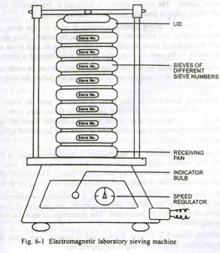
SIEVING METHOD
In this method, the fine powder is separated from the coarse
powder by using sieves of desired number. The degree of
fineness of a powder is known with the help of sieve through
which the powdered material is passed. Sieves are numbered
in order to distinguish from each other. Size separation of
powder is done by passing the powdered material through a
set of sieves. Sieves are arranged in descending order i.e.
sieve of larger size is at the top and the smallest one at the
bottom. The bottom sieve is attached to the receiving pan.

Slide 11
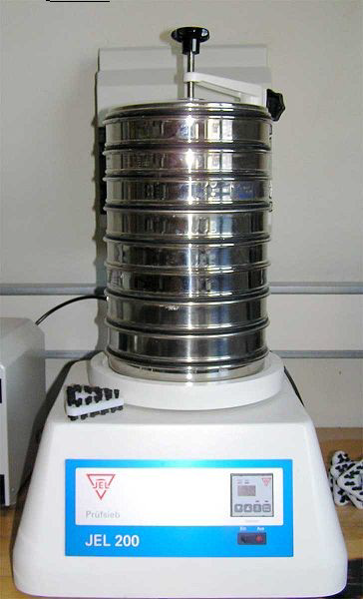

Slide 12
The material is placed in the uppermost sieve. The sieves are shaken with the help of mechanical sieve shaker or electromagnetic devices. It helps the particles to pass through the sieves.
The working of mechanical sieving devices are based on any of
the following methods.1. Agitation 2. Brushing 3. Centrifugal
Agitation methods Sieves may be agitated in a number of
different ways, such as:
1. Oscillation : This sieve is mounted in a frame that oscillates back and forth. It is a simple method but the material may roll on the surface of the sieve.
2. Vibration : The sieve is vibrated at high speed by means of an electric device. The rapid vibration is imparted to the particles on the sieve which helps to pass the powdered material through it.
Gyration : In this method, a system is made so that sieve is on rubber mounting and connected to an eccentric fly wheel. This gives a rotary movement of small amplitude to sieve which hi turn gives spinning
motion to the particles that helps to pass them through a sieve. Agitation methods are not continuous methods‘ but can be made so by inclination of the sieve and the provision of separate outlets for undersize and oversize particles.

Slide 13
Brushing methods In this case, a brush is used to move
the particles on the surface of the sieve and to keep the
meshes clear. The brush is rotated in the middle in the
case of a circular sieve but spiral brush is rotated on the
longitudinal axis in case Of a horizontal cylindrical
sieve.
Centrifugal methods In this method, a high speed rotor is
fixed inside the vertical cylindrical sieve, so that on
rotation of rotor the particles are thrown outwards by
centrifugal force. The current of air which is produced
due to high speed of rotor helps in sieving the powder.
On shaking the powdered material in a mechanical or
electromagnetic device using any of the above methods,
the weight of powder retained on each sieve is
determined. The percentage of each fraction is then
calculated.

Slide 14
SIZe separation-Cyclone separator, AIR SEPARATOR and Elutriation

Slide 15
Cyclone separator
Principle-In cyclone separator, the centrifugal force is used to separate solids from fluids. The separation depends not only on the particle size but also on density of particles. Hence depending on the fluid velocity, the cyclone separator can be used to separate all types of particles or to remove only coarse particles and allow fine particles to be carried through with the fluid.

Slide 16
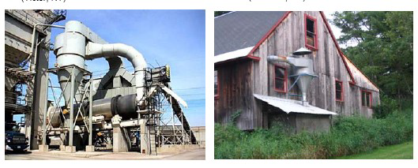
Cyclone separator
Construction It consists of a cylindrical vessel with a conical base. In the upper part of the vessel is fitted with a tangential inlet and a fluid outlet and at the base it is fitted with solid outlet.

Slide 17
Cyclone separator
Working -The suspension of a solid in gas (usually air) is introduced tangentially at a very high velocity, so that rotary movement takes place within the vessel. The fluid is removed from a central outlet at the top. The rotatory flow within the cyclone separator causes the particles to be acted on by centrifugal force. The solids are thrown out to the walls, thereafter it falls to the conical base and discharged out through solids outlet.
Uses-Cyclone separators are used to separate the suspension of a solid in a gas (air). It can be used with liquid suspensions of solids.

Slide 18
AIR SEPARATOR
Principle-
It works on the same principle as that of cyclone separator. But in this case the air movement is obtained by means of rotating disc and blades. To improve the separation, the stationary blades are used. By controlling these blades and the speed of rotation, it is possible to vary the size at which separation occurs.

Slide 19
AIR SEPARATOR
Construction-
It consists of a cylindrical vessel with a conical base. In the upper part of the separator the vessel is fitted
with feed inlet, and at the base there are two outlets, one for line particles and other for heavy particles. The rotating disc and rotating blades are attached to the central shaft, to produce air movement

Slide 20
AIR SEPARATOR
Working -As shown in the Figure, the sample powder is passed
through the feed inlet, which falls on the rotating disc. The
rotating blades are attached to the same shaft. These produce
a current of air as shown by the arrows. The fine particles are
picked up and are carried into space, where air velocity is
sufficiently reduced. The fine particles are dropped and
ultimately collected at an outlet meant for fine particles. The
heavy particles which fall downward are removed at an outlet
meant for heavy particles.
Uses- Air separator is often attached to the ball mill or hammer
mill to separate and return oversized particles for further size
reduction

Slide 21
Elutriation
In Elutriation method the size separation of powder is baseon the low density of fine particles and high density of the coarse particles. Elutriating tank is used to separate the coarse and fine particles of powder after levigation. The dry powder or paste made by levigation process is kept in an elutriating tank and mixed with a large quantity of water. The solid particles are uniformly distributed in the liquid by stirring and then it is allowed to settle down. Depending on the density of solid particles, it will either settle down or remain suspended in water.

Slide 22
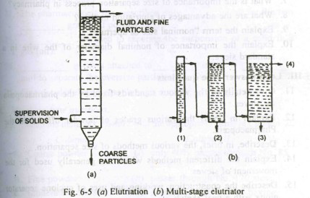
Diagrammatic representation

Slide 23
method
The sample is withdrawn at different heights through the
outlets. These are dried and thus the powder with various
size fractions are collected Nowadays in elutriation process,
the particles are suspended in a moving fluid, generally
water or air. The apparatus consists of a vertical column
with an inlet near the bottom for suspension, an outlet at the
base for coarse particles and an overflow near the top for
fluid and fine articles. One column will give single separation
into two fractions. If more than one fraction is required a
number of tubes of increasing area of cross section can be
connected in series. The velocity of the fluid decreases in
succeeding tubes as the area of cross section increases, thus
giving a number of fractions. These fractions are separated
and dried.

Slide 24
Advantages of Elutriation
(1) The process is continuous.
(2) Depending on the number of fractions required, the same
number of tubes of different area of cross section can be
connected.
(3) The separation is quick as compare to other methods of
separation.
(4) The apparatus is more compact than as that used in
sedimentation methods.
The main disadvantage of this method is that the suspension of
solid particles has to be diluted which may not be desired in
certain cases.

Slide 25
Thanks

