Slide 1
Hard & Soft
Acids and Bases
B.Sc. III year
Dr. Prabhat K. Baroliya
Department of Chemistry
MLSU, Udaipur
e-mail; prabhatkbaroliya@mlsu.ac.in

Slide 2
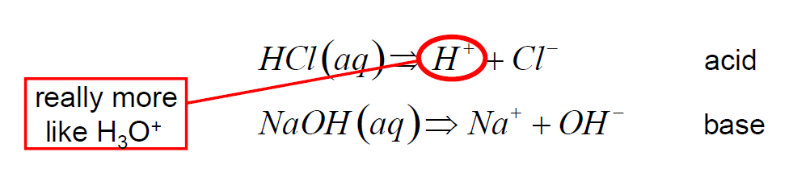
Acids and Bases
Arrhenius acids form hydronium ions (H₃O⁺),
and bases form hydroxide ions (OH⁻) in water.
Brønsted and Lowry expanded the Arrhenius definitions, and defined acids as proton donors and bases as proton acceptors.

Slide 3
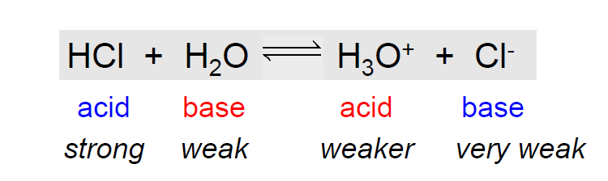
Acids and Bases
Brønsted and Lowry Model
They also introduced the concept of conjugate acid-base pairs.

Slide 4
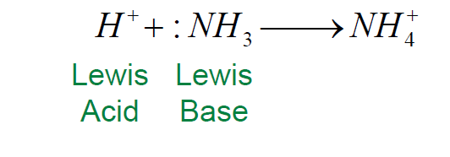
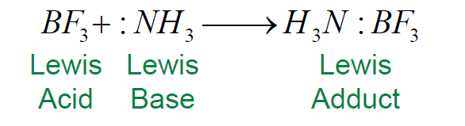
Acids and Bases
Lewis Model – acids are electron pair acceptors and bases are electron-pair donors.
It also works with molecules that neither give up nor accept a hydrogen ion

Slide 5
Acids and Bases
Solvent System Model– This model was developed for solvents that can dissociate into cations (acid) and anions (base).

Slide 6
Hard & Soft Acid-Base model
Observation
Oxide ores
Aluminium-Bauxite---Al₂O₃
Iron-Hematite---Fe₂O₃
Sulfide ores
Mercury-Cinnabar---HgS
Silver-Argentite---Ag₂S
Why?

Slide 7
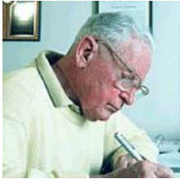
Hard & Soft Acid-Base model
R G Pearson introduced the hard
& soft-acid-base (HSAB) principle.
The polarizing power and polarizability of an acid or base play important role in its reactivity.
Hard acids and bases are small, compact, and non-polarizable.
Soft acids and bases are larger, with a more diffuse distribution of electrons.

Slide 8
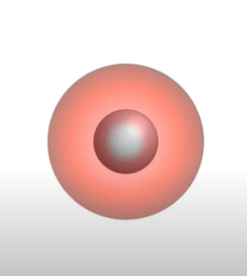
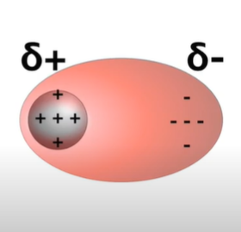
Polarizing power & Polarizability
The polarizing power can be defined as the ability of a cation to attract electron cloud towards itself. It is proportional to Charge/Size.
M⁺
M⁺

Slide 9
Polarizing power & Polarizability
The polarizability is the ability to form instantaneous dipoles. OR
It is measure of how easily an electron cloud is distorted by an electric field or nearby cation or anion.
Polarizability
M⁺
M⁺
Polarizing power

Slide 10
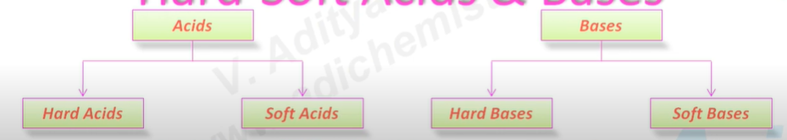
HSAB
According to HSAB principle, the Lewis acids and bases can be further divided into hard or soft or borderline types.
Hard Acids prefer to bond with Hard Bases, and Soft Acids prefer to bond with Soft Bases.

Slide 11
Hard Acids and Base
Hard acid:
High positive charge
Small size
High polarizing powder
Not easily polarizable
Hard base:
Small size
Low polarizability
High electronegativity

Slide 12
Soft Acids and Base
Soft acid:
Low positive charge
Large size
low polarizing powder
High polarizablity
Soft base:
Large size
High polarizability
Low electronegativity

Slide 13
Hard and Soft Acids-Base
Hard acids or bases are small and non-polarizable.
Soft acids and bases are larger and more polarizable
Halide ions increase in softness:
fluoride < chloride<bromide<iodide
Hard-hard or soft-soft interactions are stronger than hard-soft interactions.

Slide 14
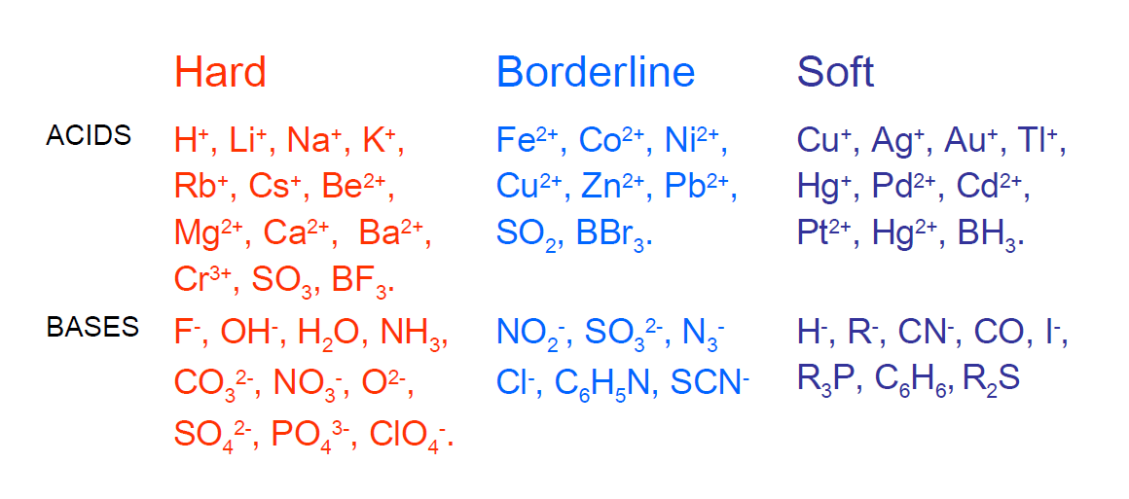
Hard and Soft Acids-Base
Classification

Slide 15
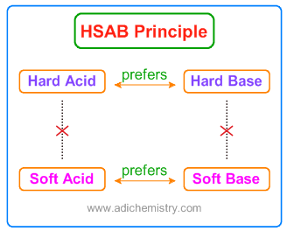
Hard and Soft Acids-Base
Ionic bond
Covalent bond
According to HSAB concept, hard acids prefer binding to the hard bases to give ionic complexes.
whereas the soft acids prefer binding to soft bases to give covalent complexes.

