Slide 1
Controlled drug delivery systems- General Introduction NDDS-VII semester
Dr. GarimaJoshi Assistant Professor, Pharmacy, MLSU

Slide 2
Drug Delivery
Drug delivery is the method of administering pharmaceutical compound to achieve a therapeutic effect in humans or animals.
drug delivery can be done through various routes-
the oral (through the mouth), topical (skin), trans-mucosal (nasal, buccal, sublingual, vaginal, ocular,rectal), parenteral(injection into systemic circulation) and inhalation routes.

Slide 3
The drug delivery system can further be divided into two main types: 1. Conventional drug delivery system. 2. Novel drug delivery system
The conventional dosage forms provide drug release immediately and it causes fluctuation of drug level in blood depending upon dosage form.
Therefore to maintain the drug concentration within therapeutically effective range need novel drug delivery system(NDDS).
NDDS is a combination of advanced techniques and newer dosage form with controlled/sustained drug release to target the at specific site.

Slide 4
Controlled drug delivery vs Conventional drug delivery
Conventional drug delivery
Controlled drug delivery
Periodic administration
High concentration can lead to undesirable effects
Low concentrations can be ineffective
Inconvenient
No targeting
Drug concentration rise quickly to effective level.
Effective concentration is maintained for longer duration

Slide 5
Sustained release drug delivery system
➢ sustained release are drug delivery system that achieve slow release of drug over an extended period of time after administration of single dose.
➢ In other words, the drug release is simply extended in time i.e. the rate and duration are not designed to achieve a particular profile. Sustained release- steadily over a long period of time
Controlled Release Drug Delivery System
➢ Controlled release are drug delivery system which maintain constant level of drug in blood and tissue for extended period of time. It implies A predictability and reproducibility in drug release kinetics
➢ In other words, the rate and duration are designed to achieve A desired concentration.
Controlled release drug delivery system is a way of designing and formulating a medicine so that the release of drug from it occur in a controlled manner, desirable manner.

Slide 6
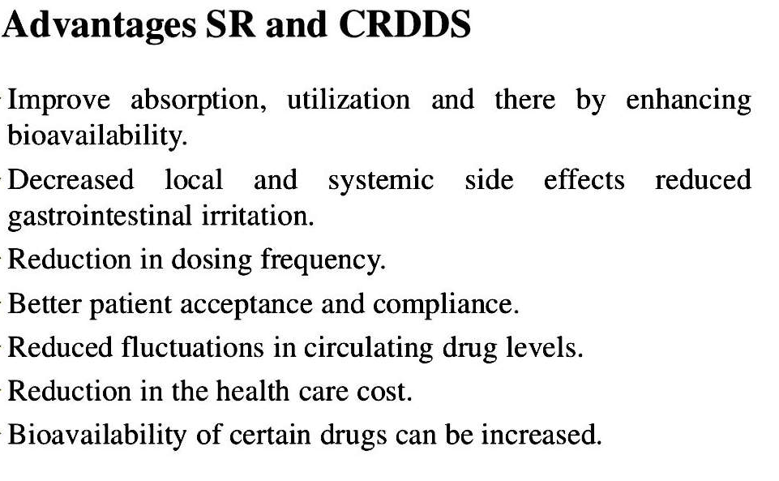

Slide 8
Pharmaceutical approaches for designing SR/CRDDS
It is further divided into matrix and reservoir type dissolution controlled release system

Slide 9
Dissolution controlled release system
• Control – Dissolution of the drug from the polymer matrix
or encapsulated forms.
• The dissolution process at a steady state is described by
Noyes Whitney equation:
dc / dt = k A/V (Cs – C)
dc / dt = (D/h) A (Cs – C)
where, dC/dt = dissolution rate
V = volume of the solution
k = dissolution rate constant
D = diffusion coefficient of drug through pores
h = thickness of the diffusion layer
A = surface area of the exposed solid
Cs = saturated solubility of the drug
C = conc. of drug in the bulk solution 42

Slide 11
MATRIX type
• First order drug release.
• There are 2 methods:
1. Congealing &
2. Aqueous dispersion method
• The drug release is determined by dissolution rate of the polymer.
• Examples: 1. Dimetane extencaps 2. Dimetapp extentabs.
ENCAPSULATION type (Reservoir Type)
• The drug particle are coated or encapsulated by microencapsulation technique
• The pellets are filled in hard gelatin capsule, popularly called as ‘spansules’.
• Once the coating material dissolves the entire drug inside the microcapsule is immediately
available for dissolution and absorption.
• Here the drug release is determined by dissolution rate and thickness of polymer membrane
which may range from 1 to 200μ
• it is also Called as Coating dissolution controlled system.
• Dissolution rate of coat depends upon stability & thickness of coating.
• One of the microencapsulation method is used.
• Examples: 1. Ornade spansules 2. Chlortrimeton Repetabs

Slide 12
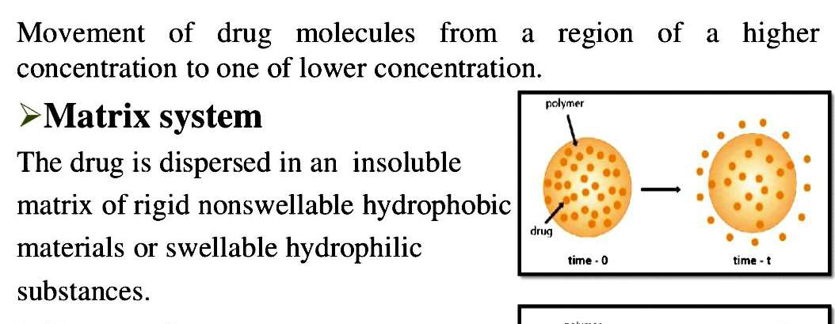
B)Diffusion controlled release system

Slide 13
INTRODUCTION
• This system is hollow containing an inner core of drug.
• The water insoluble polymeric material surrounds drug reservoir.
• The drug partitions into the membrane and exchanges with the surrounding
fluid by diffusion.
• The release drug from a reservoir device follows Fick’s first law of diffusion.
J = - D dc/dx
Where, J = flux, amount/area-time
D = diffusion coefficient of drug in the polymer, area/time
dc/dx = change in conc. with respect to polymer distance

Slide 14
MATRIX Devices
• A matrix or monolithic device consists of an inert polymeric matrix in
which a drug is uniformly distributed.
• Drugs can be dissolved in the matrix or the drugs can be present as a
dispersion.
NOTE : Matrix may be HOMOGENEOUS or POROUS with water filled
pores.
State of presentation of this form affects the various release patterns:
1. Dissolved drug (Fick’s Second law)
2. Dispersed drug (Fick’s First law)
3. Porous matrix (Higuchi’s theory for porous form)
4. Hydrophilic matrix (gelation & diffusion)
64

Slide 15
MATRIX Devices
• Rigid Matrix Diffusion
✓ Materials used are insoluble plastics such as PVP & fatty acids.
• Swellable Matrix Diffusion
1. Also called as Glassy hydrogels.Popular for sustaining the release of
highly water soluble drugs.
2. Materials used are hydrophilic gums.
Examples : Natural- Guar gum, Tragacanth. Semisynthetic -HPMC, CMC, Xanthum gum.
Synthetic -Polyacrilamides.
• Examples: Glucotrol XL, Procardia XL
RESERVOIR Devices
• The drug core is encased by a water-insoluble polymeric materials.
• The mesh (i.e., the space between macromolecular chains) of these polymers,
through which drug penetrates or diffuses after partitioning, is of
MOLECULAR LEVEL.
• The rate of drug release is dependent on the rate of drug diffusion but not on
the rate of dissolution.
• In short, mass transport phenomena at molecular level occurs.
• Examples: Nico-400, Nitro-Bid

Slide 16
Methods of Prep. (RESERVOIR Devices)
• Mostly it involves :
o Coated Beads/Pellets
o Microencapsulation
Coated Beads/Pellets (RESERVOIR Devices)
• BEADS/PELLETS
Coating of drug solution onto preformed cores.
Covering of core by an insoluble (but permeable coat).
NOTE: Pan coating or air-suspension technique is generally used for
coating.
NOTE: Pore forming additives may be added to the coating solution
Microencapsulation (RESERVOIR Devices)
• This technique used to encapsulate small particles of drug, solution of
drug, or even gases in a coat (usually a polymer coat).
• Generally, any method that can induce a polymer barrier to deposit on
the surface of a liquid droplet or a solid surface can be used to form
microcapsules.

Slide 17
Design considerations of controlled release
Route of drug delivery
Target site
Patient condition
Polymer consideration- Glass transition temperature, Diffusion characteristics, compatibility, ease of formulation, fabrication
Drug considerations-Physicochemical properties, stability, solubility, partitioning, charge protein binding

Slide 18
c) Ions Exchange Based SR/CR Formulations:
Ion-exchange systems generally use resins composed of water insoluble cross-linked polymers. These polymers contain salt-forming functional groups in repeating positions on the polymer chain.
The drug is bound to the resin and released by exchanging with appropriately charged ions in contact with the ion-exchange groups
d) Dissolution & Diffusion Controlled Release System:
Drug is encapsulated in partially soluble membrane, pores are
created due to soluble parts of coating film which permits entry
of aqueous medium into core and drug dissolution starts by
diffusion of dissolved drug out of system. Mixture of water
soluble PVP and water insoluble ethyl cellulose is used for this
purpose.

Slide 19
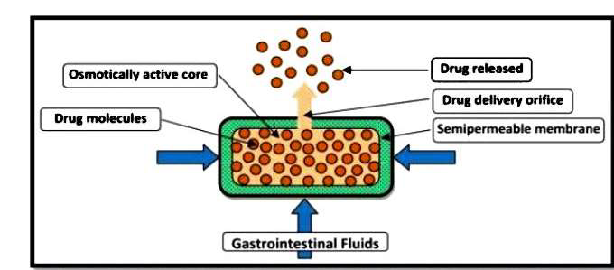
Osmotic Pressure Based SR/CR Formulations:
In this system, the flow of liquid into the release unit driven by a difference in osmotic pressure between the inside and the outside of the release unit is used as the release-controlling process.
Water penetration/Osmotic Pressure Controlled NDDS :
Drug may be osmotically active or drug may be combined with osmotically active salts like NaCl.

