Slide 1
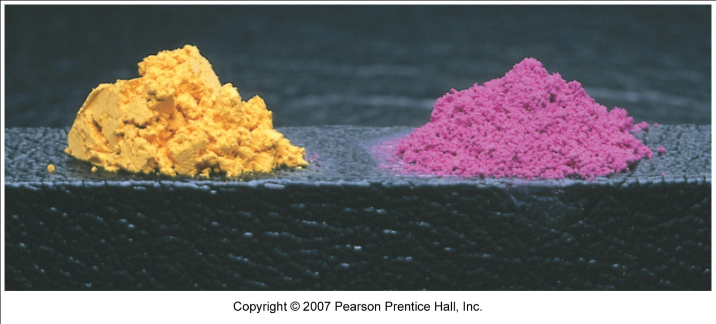
Coordination Compounds
CO-ORDINATION
CHEMISTRY
Introduction, Bonding, Crystal Field & Ligand Field Theory
Notes:
Iron rusts.
Natural gas burns.
Represent chemical reactions by chemical equations.
Relationship between reactants and products is STOICHIOMETRY.
Many reactions occur in solution-concentration uses the mole concept to describe solutions.

Slide 2
Bonding in Complex Ions:
Crystal Field Theory
Consider bonding in a complex to be an electrostatic attraction between a positively charged nucleus and the electrons of the ligands.
  Electrons on metal atom repel electrons on ligands.
  Focus particularly on the d-electrons on the metal ion.

Slide 3
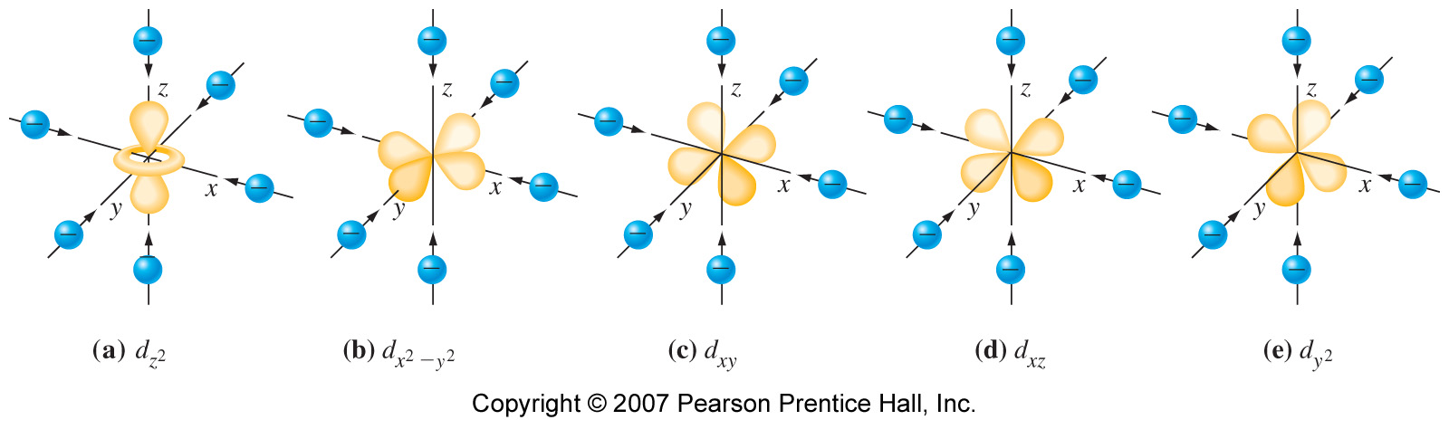
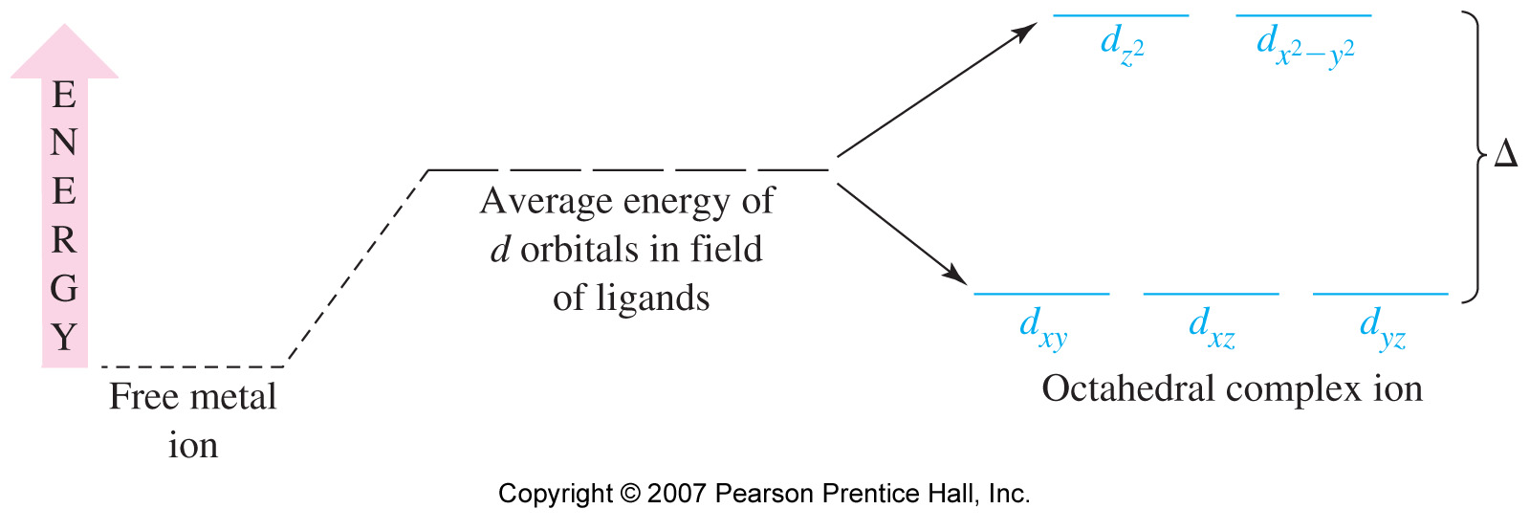
Octahedral Complex and d-Orbital Energies

Slide 4
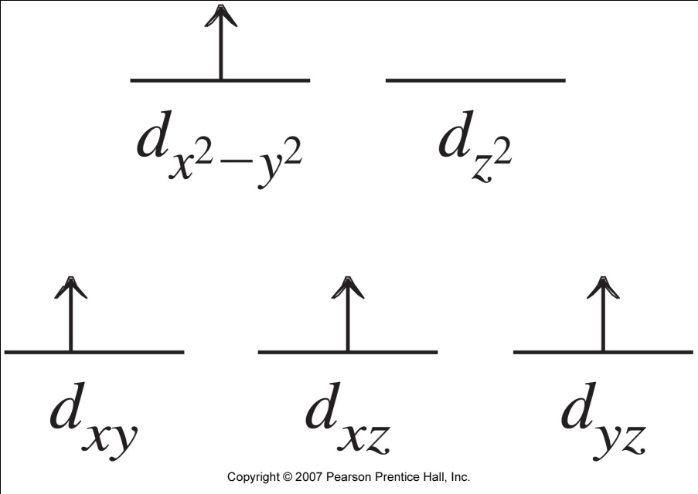
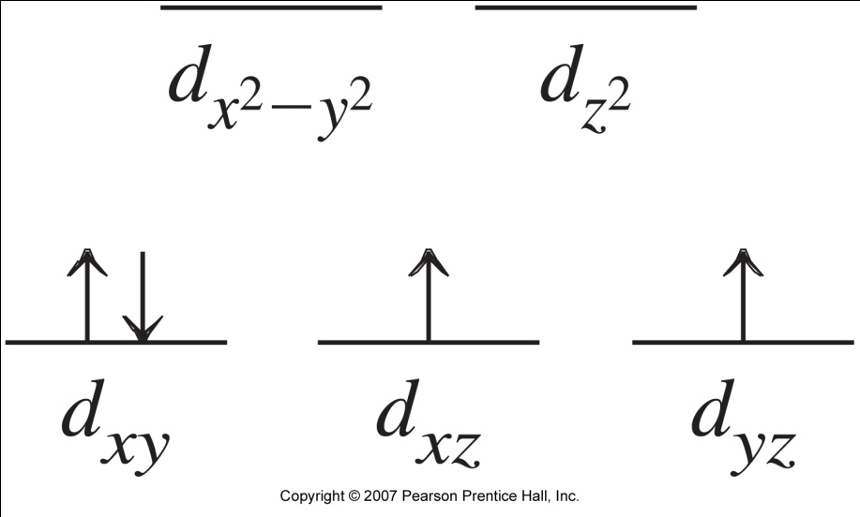
Electron Configuration in d-Orbitals
Δ
P
Hund’s Rule
Pairing Energy Considerations

Slide 5
Spectrochemical Series
Large Δ
Strong field ligands
CN⁻ > NO₂⁻ > en > py ≈ NH₃ > EDTA⁴⁻ > SCN⁻ > H₂O >
ONO⁻ > ox²⁻ > OH⁻ > F⁻ > SCN⁻ > Cl⁻ > Br⁻ > I⁻
Small Δ
Weak field ligands

Slide 6
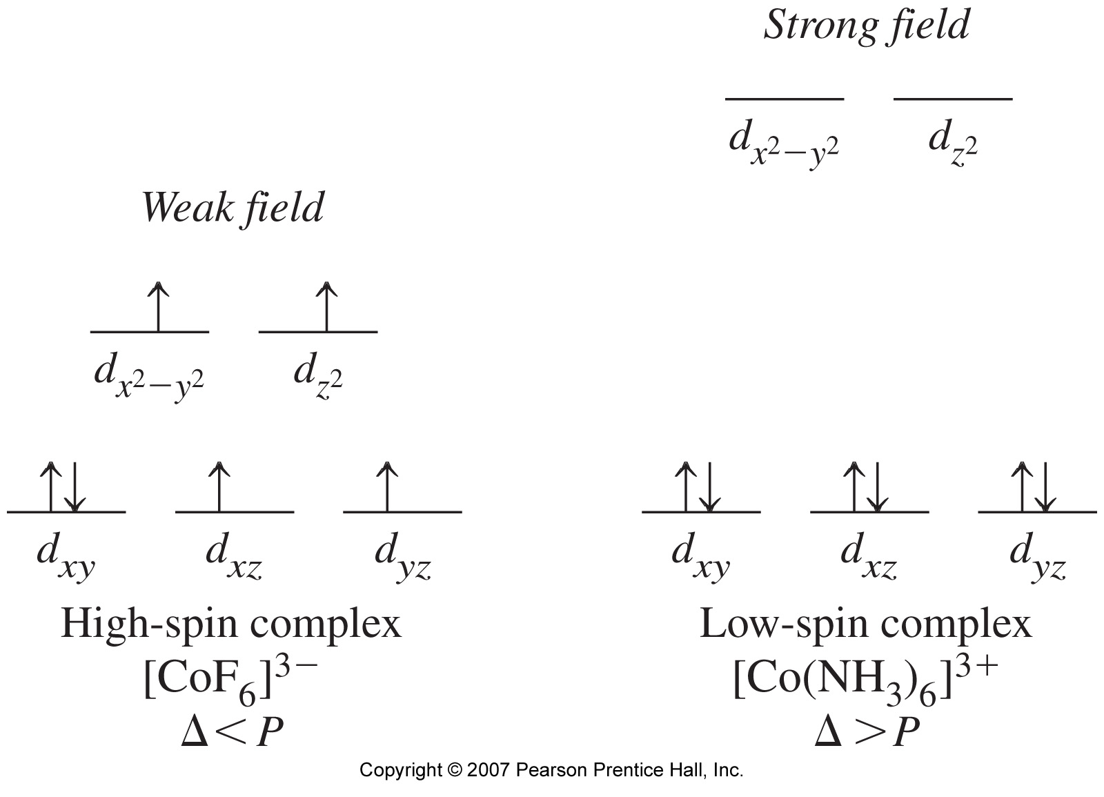
Electron Configuration in d-Orbitals

Slide 7
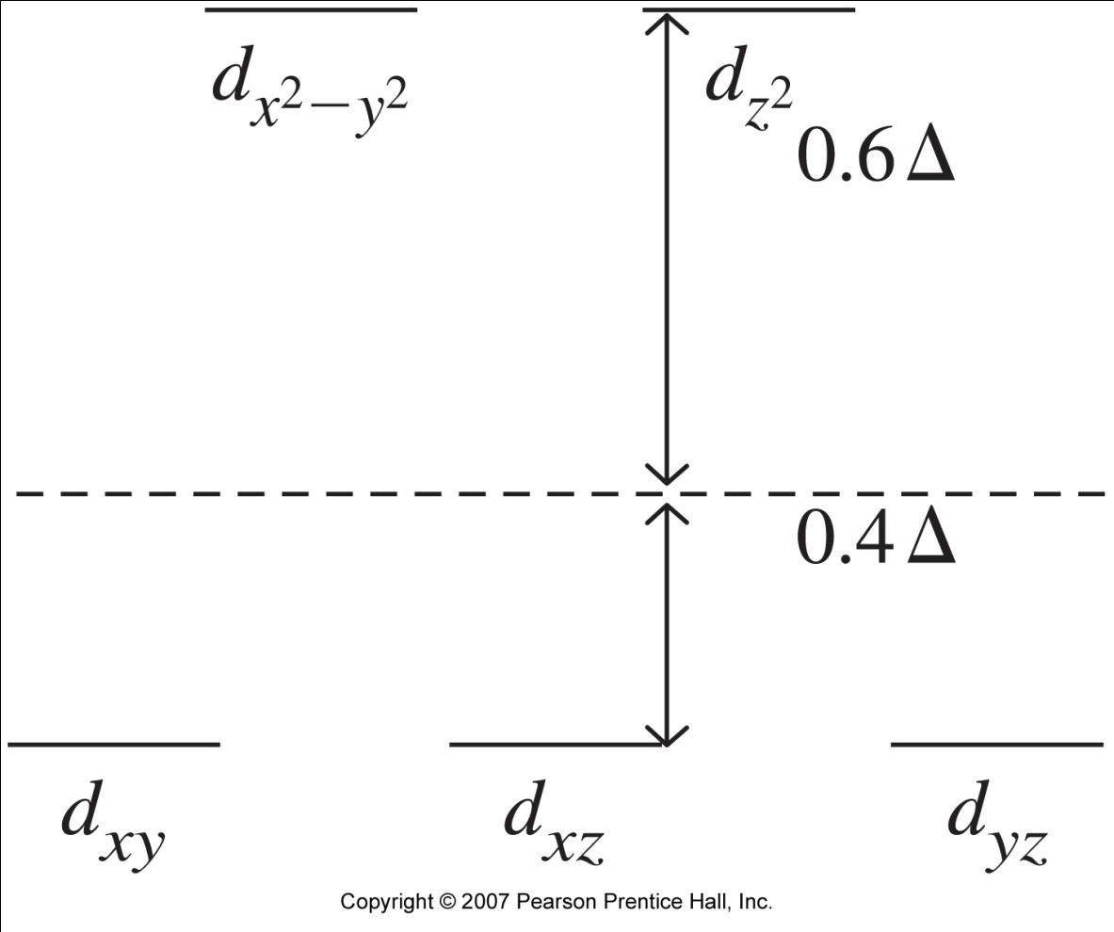
Energy Effects in a d¹⁰ System

Slide 8
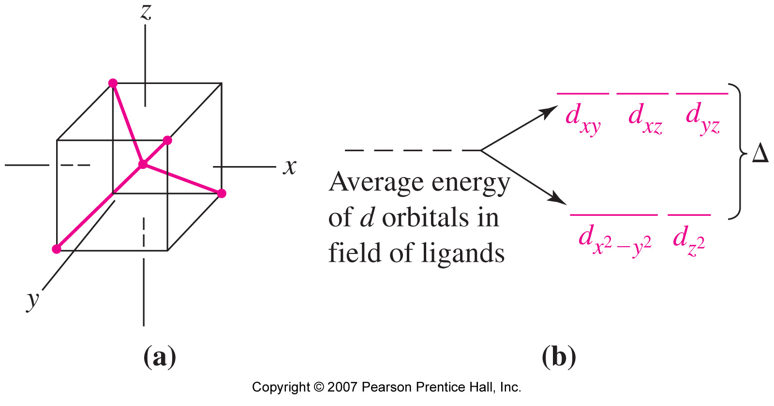
Tetrahedral Crystal Field Splitting

Slide 9
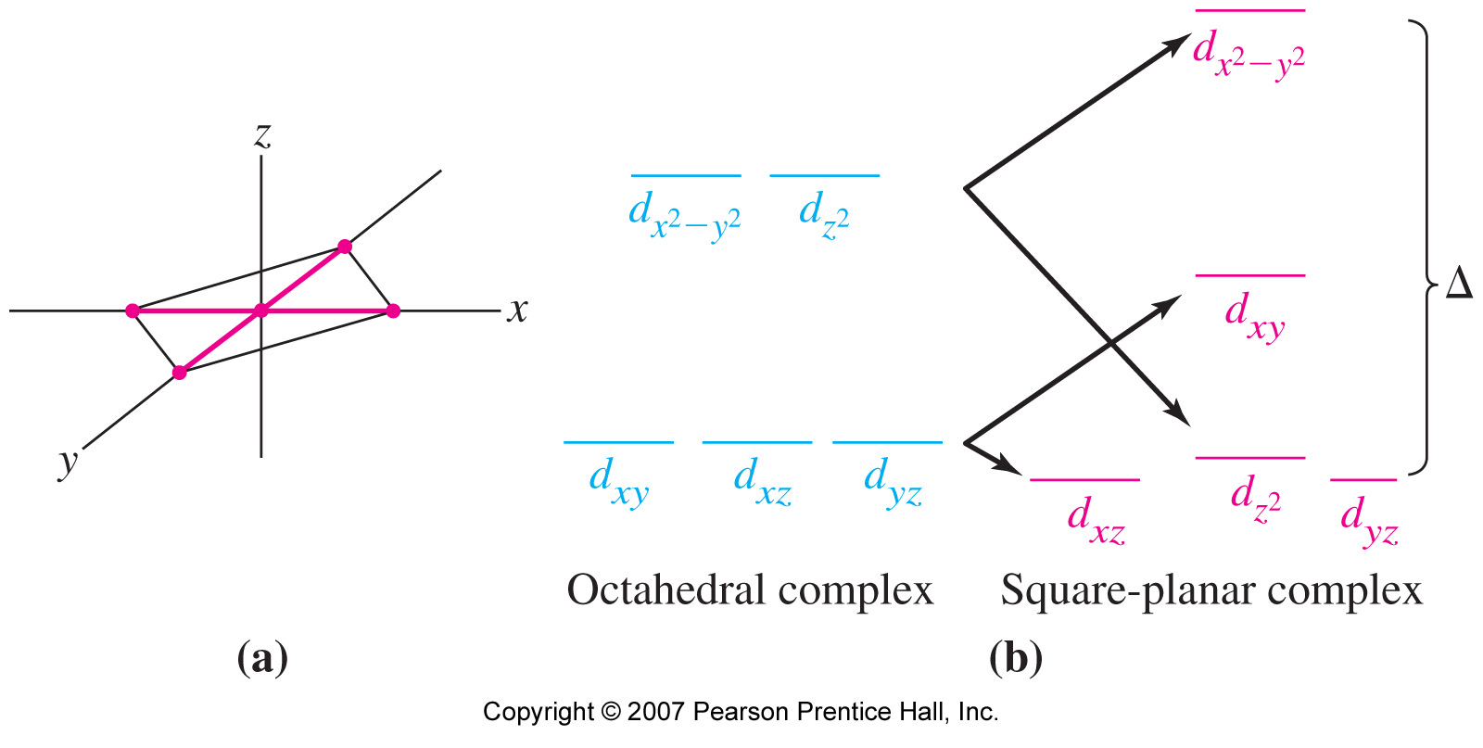
Square Planar Crystal Field Splitting

Slide 10
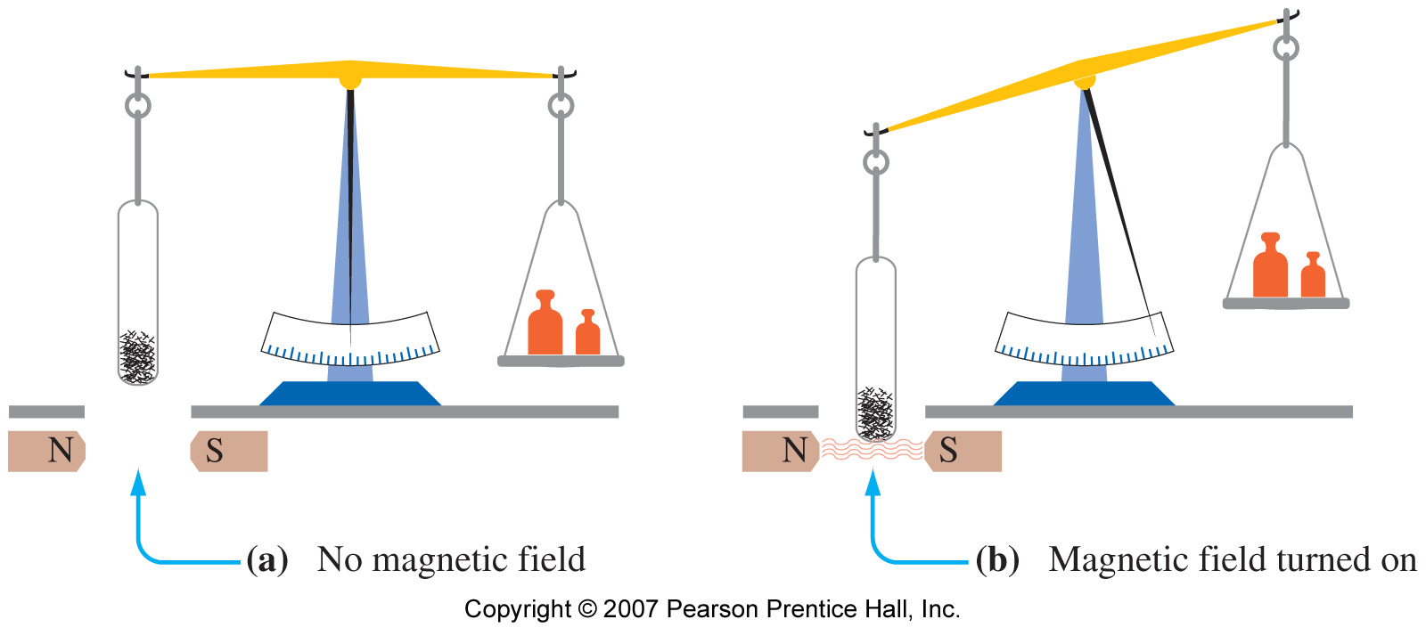
24-6 Magnetic Properties of Coordination Compounds and Crystal Field Theory
Paramagnetism illustrated:

Slide 11
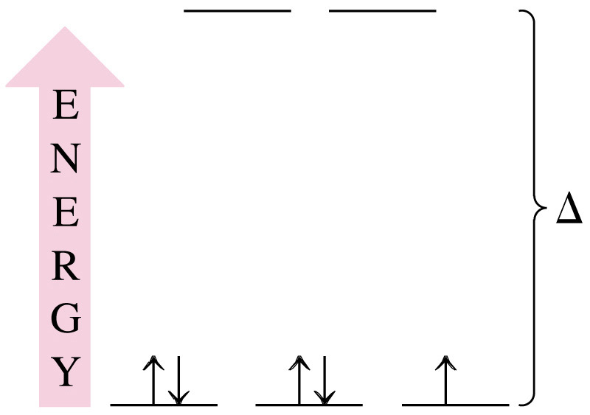
EXAMPLE 24-4
Using the Spectrochemical Series to Predict Magnetic Properties. How many unpaired electrons would you expect to find in the octahedral complex [Fe(CN)₆]³⁻?
Solution:
Fe [Ar]3d⁶4s²
Fe³⁺ [Ar]3d⁵

Slide 12
EXAMPLE 24-5
Using the Crystal Field theory to Predict the Structure of a Complex from Its Magnetic Properties. The complex ion [Ni(CN₄)]²⁻ is diamagnetic. Use ideas from the crystal field theory to speculate on its probably structure.
Solution:
Coordination is 4, so octahedral complex is not possible.
Complex must be tetrahedral or square planar.
Draw the energy level diagrams and fill the orbitals with e⁻.
Consider the magnetic properties.

Slide 13
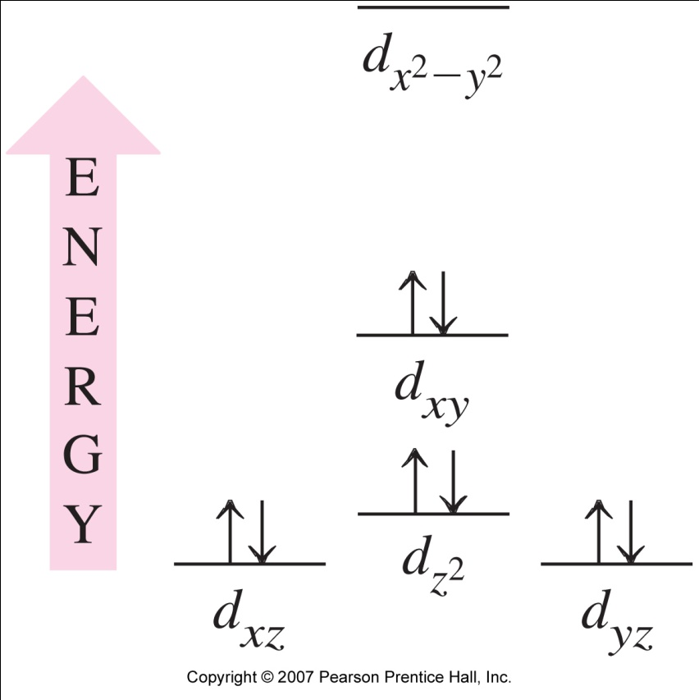
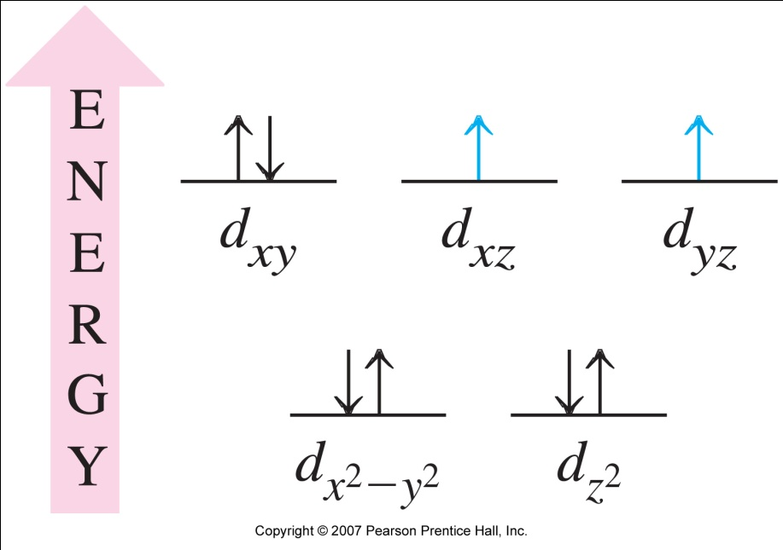
EXAMPLE 24-5
Tetrahedral:
Square planar:

Slide 14
24-7 Color and the Colors of Complexes
Primary colors:
  Red (R), green (G) and blue (B).
Secondary colors:
  Produced by mixing primary colors.
Complementary colors:
  Secondary colors are complementary to primary.
  Cyan (C), yellow (Y) and magenta (M)
  Adding a color and its complementary color produces white.

Slide 15
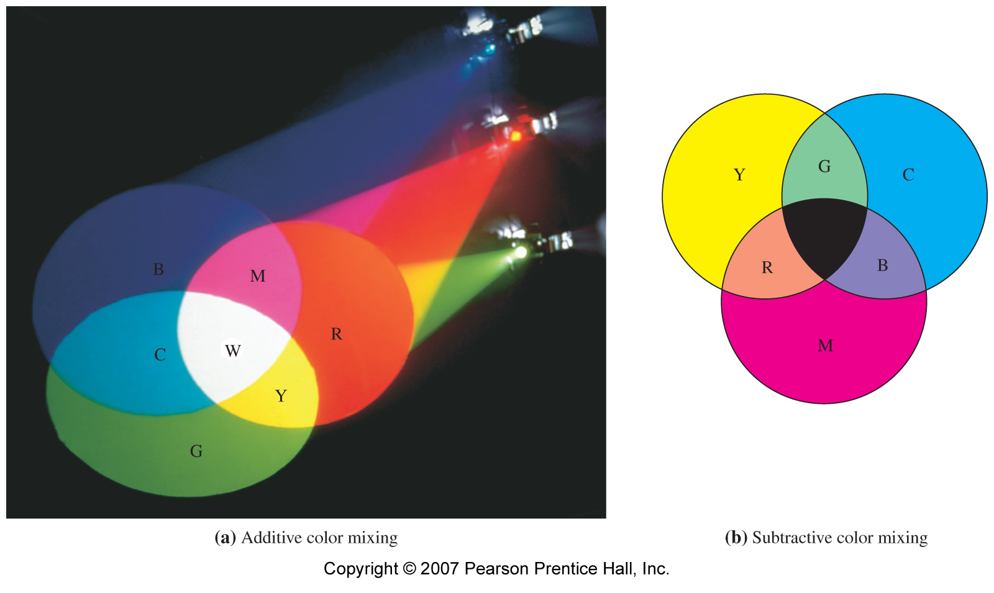
Color and the Colors of Complexes

Slide 16
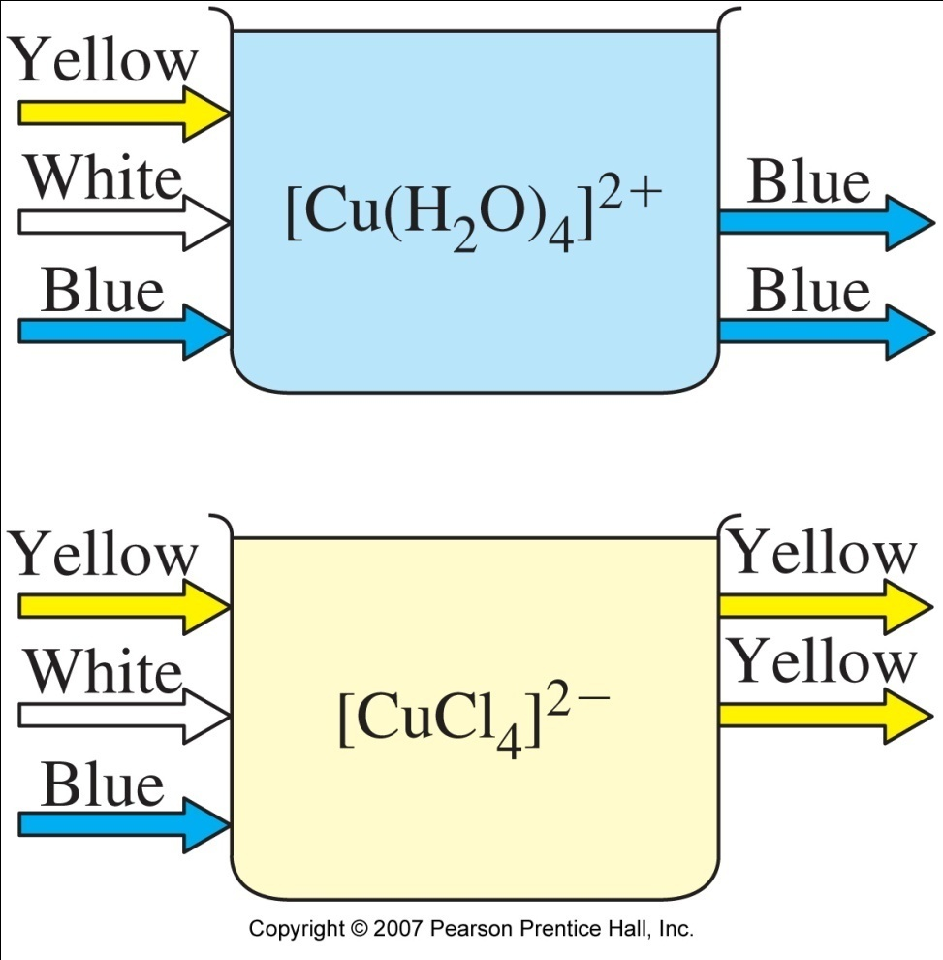
Light Absorption and Transmission

Slide 17
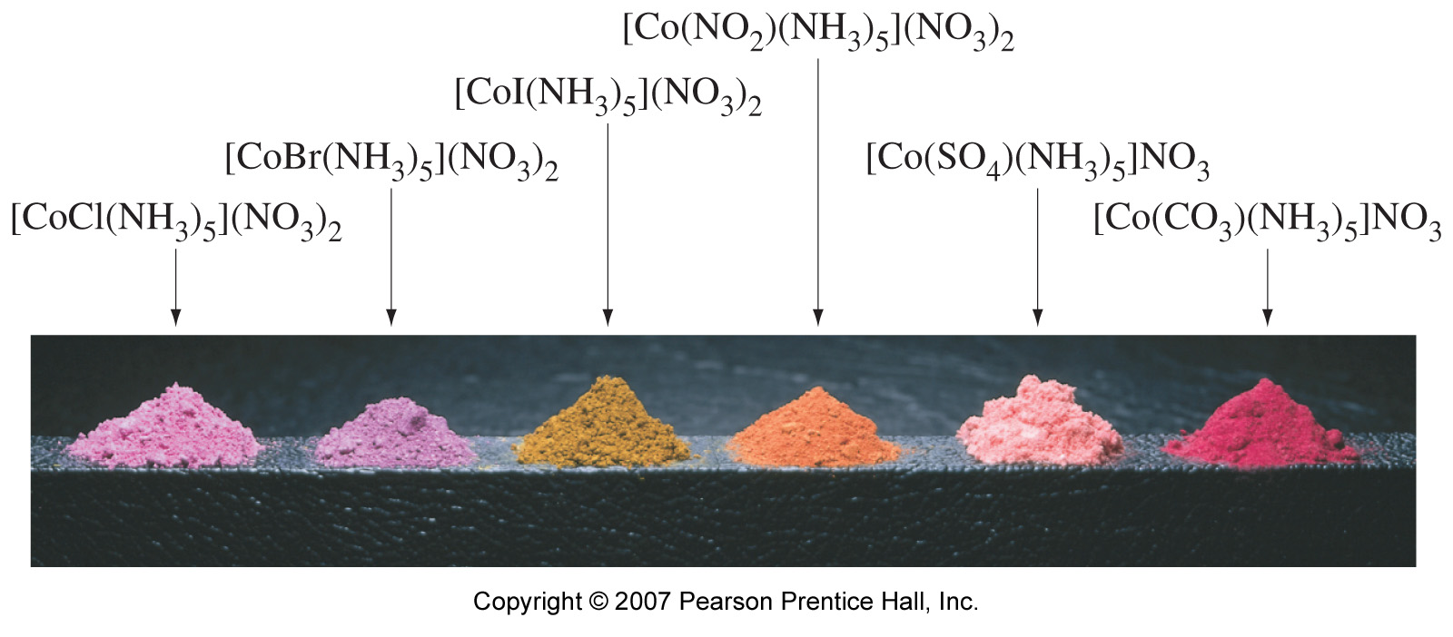
Effect of Ligands on the Colors of Coordination Compounds

Slide 18
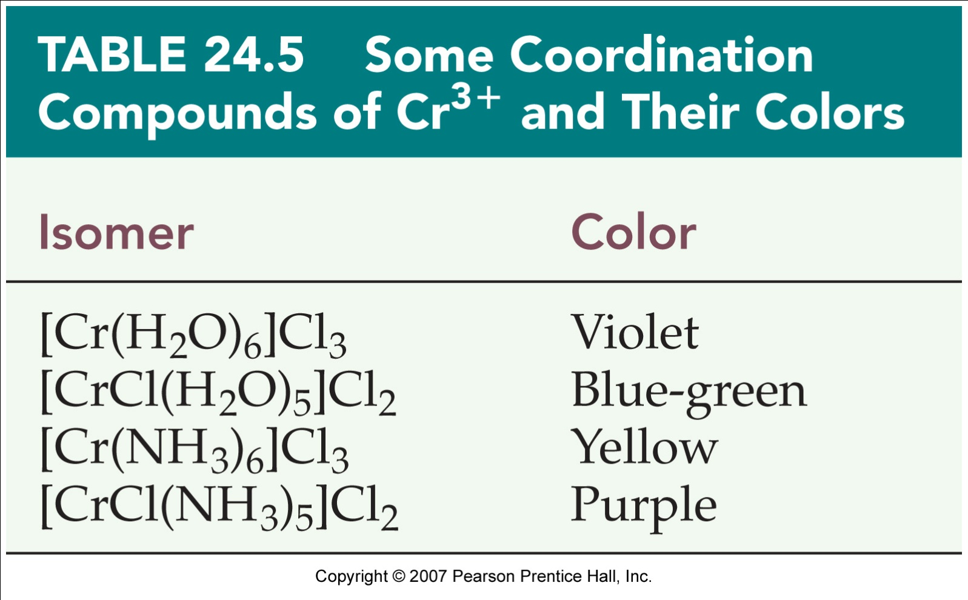
Table 24.5 Some Coordination Compounds of Cr³⁺ and Their Colors

