Slide 1
Introduction to NOVEL DRUG DELIVERY SYSTEMs- NDDS VII SEMESTER
Dr. Garima Joshi
Assistant Professor
Department of Pharmaceutical Sciences, MLSU
Udaipur

Slide 2
NDDS- Definition
Novel drug delivery system (NDDS) is newer system designed and developed for delivery of drugs by using advanced techniques and formulation strategies so as to achieve desirable effects better than the conventional dosage form.
NDDS is advanced drug delivery system which improves drug potency, control drug release to give a sustained therapeutic effect, provide greater safety, finally it is to target a drug specifically to a desired tissue.

Slide 3
Conventional dosage forms
Tablets, capsules, syrups are conventional dosage forms.
The conventional dosage forms provide drug release immediately and it causes fluctuation of drug level in blood.
Therefore, to maintain the drug concentration within therapeutically effective range need novel drug delivery system.

Slide 4
Advantages of NDDS
Optimum dose at the right time and right location. (TARGETED DELIVERY)
Efficient use of expensive drugs, excipients and reduction in production cost.
Beneficial to patients, better therapy, improved comfort and standard of living.
Minimise drug degradation and loss
Increase absorption and bioavailability of drug.
Reduce undesirable side effects.

Slide 5
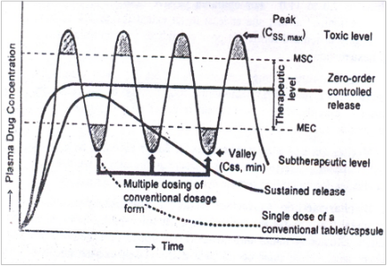
Plasma concentration VS time profile

Slide 6
Modes of NDDS
Targeted Drug Delivery System-The drug is delivered in such a way that drug is only active in the target area of the body (cancerous tissues) in which drug is released over a period of time in a controlled manner. e.g., Colon targeted drugs.
Controlled Drug Delivery System- Drug is released in controlled manner.
Modulated Drug Delivery System- Drug release is modulated by chemicals, physical

Slide 7
Sustained Release Vs Controlled Release
SR – Release of initial dose & further prolonged release of drug. Also called extended release, delayed release, prolonged release. SR means slow release of a drug substance from a dosage form to maintain therapeutic response for extended period (8-12hrs). Time depends on dosage form. e.g., Aspirin SR Tablet, Zuclopenthixol Depot Injection etc.
CR – Release of drug in controlled release for long periods. In this the rate or speed at which the drug is released is controlled. e.g., Adalat CR (Nifidipine).

Slide 8
List of drug carriers in NDDS
Nanosomes
Liposomes
Niosomes
Nanoparticle
Nanosphere
Microsphere
Microparticle
Microemulsion
Nanosuspension
Micelles

Slide 9
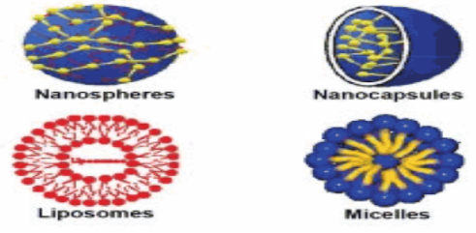
Novel Carriers for NDDS

Slide 10
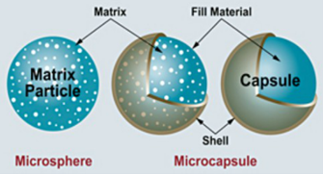
Microsphere & Microcapsule

