Slide 1
POLYMERS VII SEM. NDDS
Dr. Garima Joshi, Assistant Professor, PHARMACY, MLSU

Slide 2
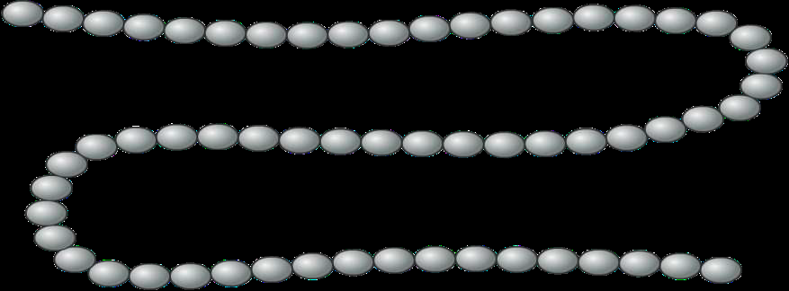
Polymer
Polymer is a long molecule made up from lots of small molecules called monomers.

Slide 3
polymers
A polymer with two different monomers is known as a copolymer or homopolymer
Most polymers are hydrocarbons– i.e. made up of H and C
A polymer ( Greek poly-, "many" + -mer, "part") is a large molecule, or macromolecule, composed of many repeated subunits.
Polymers range from familiar synthetic plastics such as polystyrene to natural biopolymers such as DNA and proteins that are fundamental to biological structure and function.
Their consequently large molecular mass, relative to small molecule compounds, produces unique physical properties including toughness, viscoelasticity, and a tendency to form glasses and semicrystalline structures rather than crystals

Slide 4
Common Examples of Polymers
Polymers are of two types: naturally occurring and synthetic or man made.
Natural polymeric materials such as hemp, shellac, amber, wool, silk, and natural rubber have been used for centuries. A variety of other natural polymers exist, such as cellulose, which is the main constituent of wood and paper.
The list of synthetic polymers, roughly in order of worldwide demand, includes polyethylene, polypropylene, polystyrene, polyvinyl chloride, synthetic rubber, phenol formaldehyde resin (or Bakelite), neoprene, nylon, polyacrylonitrile, PVB, silicone, and many more.

Slide 5
CHARACTERISTICS OF IDEAL POLYMER
Low Density.
2. Low coefficient of friction.
3. Good corrosion resistance.
4. Good mould ability.
5. Excellent surface finish can be obtained.
6. Can be produced with close dimensional tolerances.
7. Economical.
8. Poor tensile strength.
9. Low mechanical properties.
10. Poor temperature resistance.
11. Can be produced transparent or in different colours

Slide 6
Classification based on source
Natural polymers - The definition of a natural polymer is a polymer that results from only raw materials that are found in nature. Example - Proteins, Cellulose, Starch, Rubber.
Semi-synthesis polymers – The polymer can obtained both Natural as well as Synthetic origin is known as Semisynthetic polymer. Example - Cellulose derivatives - Cellulose acetate (Rayon).
Synthesis polymers - This are the polymer was prepared by Laboratory is known as Synthetic Polymer. Example - Buna-S, Buna-R, Nylon, Polythene, Polyester.

Slide 7
Natural Polymers
Protein-Albumin, collagen, gelatin
Polysaccharide-Chitosan, dextran, alginate, agarose, cyclodextrin
Synthetic polymers-
Biodegradable polymer
Polyesters- Polylactic acid, Polyglycolic acid, polycaprolactone, polyanhydride
Nonbiodegradable polymer- Carboxymethylcellulose (CMC), ethylcellulose, cellulose acetate, hydroxy propylmethyl cellulose,Colloidal Silica, Polymerhacrylate, polymethylmethacrylate, polyvinylpyrrolidone PVP, poloxamers,poloxamines.

Slide 8
Classification based on structure
Linear polymers - the smallest repeating unit arrange in straight line path is known as Linear polymer. Example - pvc.
Branched chain polymers - contain linear chains having some branches, Example - low density polymer.
Cross linked chain polymers - formed from bi-functional and tri-functional monomers and contain strong covalent bonds.Example - bakelite, melamine

Slide 9
Some common addition polymers

Slide 10
Some condensation polymer

Slide 11
Classification based on molecular force
Thermoplastic Polymers:
These are linear or slightly branched long chain polymers, which can be softened on heating & reversibly hardened on cooling repeatedly. Their hardness is a temporary property & varies with temperature.The polymer under heating it can convert one stare to anther state and after cooling it can again convert its original state. Example:- polyvinyl chloride
Thermosetting polymers:
Initial Mixture of Reactive, Low Molar Mass Compounds Reacts Upon Heating In The Mold To Form An Insoluble, Infusible Network.Example: Bakelite .Bakelite Is Formed of Phenol And Formaldehyde Polymerization.

Slide 12
Synthesis of Polymers
Initiation(birth)
Propagation(growth)
Termination(death)

Slide 13
Synthesis of polymer
INITIATION
The first step in chain polymerization- Initiation involves the formation of a free radical. Each initiating radical has the ability to attack the double bond of a monomer. In this way, the radical is transferred to the monomer and a monomer radical is produced. Addition can occur at either end of the monomer.
PROPAGATION:
The monomer radical is also able to attack another monomer and then another monomer, and so on and so forth. This step is called propagation by which a macro radical is formed. The entire propagation reaction usually takes place within a fraction of a second.
TERMINATION
Chain termination is the chemical reaction that ceases the formation of reactive intermediates in a chain propagation step in the course of polymerization, effectively bringing it to a halt.

Slide 14
GENERAL MECHANISM OF DRUG RELEASE FROM POLYMER
Three primary mechanism for drug release namely:
➢Diffusion
➢Degradation
➢Water penetration(Swelling)
Any of these mechanism can occur in a given
release system

Slide 15
Drug release from polymer by diffusion
Drug release from polymer by diffusion-Rate limiting step is diffusion of drug through inert water insoluble membrane barrier.There are two types,
a) Reservoir
b) Matrix

Slide 16
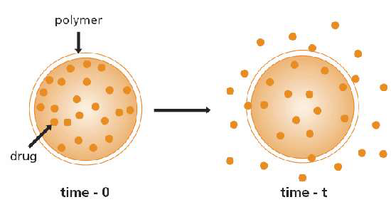
Reservoir diffusion system
In membrane-controlled reservoir devices, the drug is contained in a core, which is surrounded by a polymer membrane, and it is released by diffusion through thi ratecontrolling membrane e.g. Poly(N-vinyl pyrrolidone),Poly(ethylene-co-vinyl acetate).

Slide 17
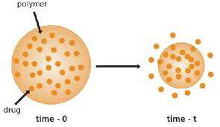
Matrix diffusion system
In these devices, the drug is released either by passing through the pores or between polymer chains, and these are the processes that control the release rate. Such as polyethylene , polyvinylacetate

Slide 18
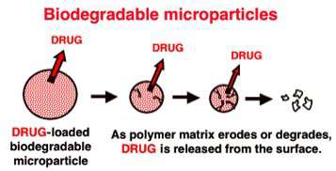
Degradation
The drug molecules, which are initially dispersed in the polymer, are released as the polymer starts eroding or degrading. The four most commonly used biodegradable polymers in drug delivery systems are poly(lactic acid), poly(lactic-co-glycolic acid), polyanhydrides, poly(ortho esters), and poly(phosphoesters).

Slide 19
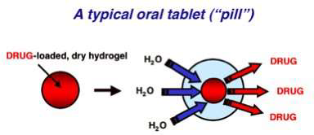
Water penetration (swelling) •
This type of systems are initially dry and when placed in body, absorb water or other fluid and it swells. Swelling increases aq. solvent content within the formulation as well as the polymer mesh size, enabling the drug to diffuse through the swollen network into external environment. E.g(N-isopro-pylacrylamide), Ethylene-vinyl alcohol

Slide 20
Bio degradation of polymers - •
Bio degradation is the chemical changes that alter the molecular weight or solubility of the polymers. Bio erosion may refer to as physical process that result in weight loss of a polymer device.The erosion of polymers basically takes place by two methods:-
1.Hydrolytic mechanism
2. Enzymatic mechanism

Slide 21
Hydrolytic degradation
Hydrolytic degradation of polymers may be defined as the breaking of chemical bonds in the polymer backbone by the attack of water to form oligomers and finally monomers.
This kind of hydrolysis could not require of specific biological compounds as proteases.
All biodegradable polymers contain hydrolysable bonds like
glycosides, esters, orthoesters, anhydrides, carbonates, amides
Rate of hydrolytic degradation is modulated by hydrophilic
characteristics of the polymers.

Slide 22
Enzymatic mechanism
Enzymes are biological catalysts. They accelerate reaction rates in living organisms without undergoing themselves any permanent change. Hydrolysis reactions may be catalyzed by enzymes known as hydrolases, which include proteases, esterases, glycosidases, and phos‐ phatases, among others. Enzymatic surface degradation occurs when enzymes cannot penetrate the interior of the polymer, due to high cross-link density or limited access to cleavage points, forcing the surface or exterior bonds to cleave first.

Slide 23
Properties and selection of polymers
A thorough understanding of properties of polymer is required to achieve mechanical and biological functions.
Solubility
Viscosity
Crystallinity
Polymer dissolution
Polymer erosion and biodegradation

Slide 24
Characterization of polymers
Differential scanning calorimetry- measures energies of phase transition
Gel permeation chromatography
Glass transition temperature- temperature at which amorphous polymer changes from solid to liquid state

Slide 25
APPLICATIONS OF POLYMERS IN SOLID DOSAGE FORMS
APPLICATIONS OF POLYMERS IN SOLID DOSAGE FORMS:
IN TABLETS
Polymers like methyl cellulose, hydroxyl ethyl cellulose, hydroxyl ethyl methyl cellulose are used as binders. Polymers like carboxyl methyl cellulose sodium is used as disintegrating agent. Polymers like all the cellulose derivative are used as film coating materials. Polymers like cellulose acetate phthalate, hydroxyl propyl methyl cellulose phthalate, polyvinyl acetate phthalate are used as enteric coating material.
INCAPSULES
Gelatin, a natural polymer which is the major ingredient in the manufacturing of capsules

Slide 26
APPLICATIONS OF POLYMERS IN FORMULATION OF CONTROLLED DRUG DELIVERY SYSTEM
ORAL DRUG DELIVERY SYSTEM
DRUG DELIVERY OF VARIOUS CONTRACEPTIVES & HORMONES:E.g. medroxyprogesterone acetate–vaginal contraceptive ring. It consists of a drug reservoir & polymer coating material. through this layer the drug releases slowly.
2)DRUG DELIVERY AND THE TREATMENT OF DIABETES Here the polymer will act as barrier between blood stream & insulin.Eg. polyacrylamide,N,Ndimethylaminoethylmethacrylate.

Slide 27
APPLICATIONS OF POLYMERS IN LIQUID DOSAGE FORMS:
IN SUSPENSIONS
Polymers like Acacia, Tragacanth, Cellulose derivative, Xanthum gum are used as suspending agents. They should be selected based on their characters like PH, solubility & concentration. They enhances the dispersion of solids in liquids.
IN EMULSIONS
Polymers like Tragacanth, Spans, Tweens are used as emulsifying agents

Slide 28
Applications in drug delivery
Film coatings
Matrices
Microcapsules and microspheres
Eroding systems
Osmotic pumps
Polymer implants
Membranes
Polymeric micelles

Slide 29
applications
Polymers can be used as film coatings to mask the unpleasant taste of a drug & to modify drug release characteristics.
Polyanhydrides are used in CDDS because of their unique property of surface erosion.
Hyaluronic acid is used in controlled release ophthalmic preparations.
Wide variety of polymers like natural gums are using as thickening agents. E.g. poly ethylene glycol, carbomer
Some of the polymers are using as protective colloids to stabilize suspensions & emulsions. E.g . Sodium alginate
Some polymers can be used as suppository bases E.g. poly ethylene glycol

Slide 30
applications
Some polymers are used in uterus therapeutic system E.g.silicone
Copolymers of lactide & glycolide, silicone are using in implantation therapeutic system.
Polyurethanes can be used for elasticity
Polymethyl methacrylate for physical strength & transparency.
Polyvinyl alcohol for hydrophilicity & strength
In addition to polymers being used as excipients, some drugs themselves are polymers including insulin, heparin & its antagonist, protamine sulfate, plasma expander like dextran, normal human serum albumin, bulk laxatives like methyl cellulose & sodium carboxy methyl cellulose.

Slide 31
applications
Chitosan is used for delivery of hydrophilic drugs as hydrogels, transdermal drug delivery, wound dressings.
Dextrans used for sustained and targeted delivery
Polysacchaarides used in colon specific drug delivery
PLGA-PEG block polymers for targeting

